Slide 1




for Scientific Computing
Benoît Richard
github.com/Kolaru
Cluster of Excellence
CUI: Advanced Imaging of matter

Slide 2
I am not a julian zealot
I believe julia has nice capabilities for scientific computing
The goal of the workshop is to showcase them so that you can determine if it worth using for you
2015 : start using julia (v0.4)
2017 : first contribution to a package (IntervalRootFinding.jl)
2021 : first invitation to a give a talk about my contributions

Slide 3
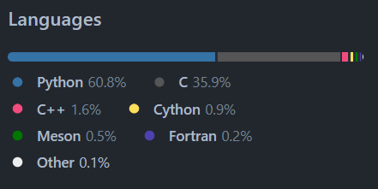
Julia is designed for (mad) scientists
Positive
Negative
No two languages problem
numpy

Slide 4
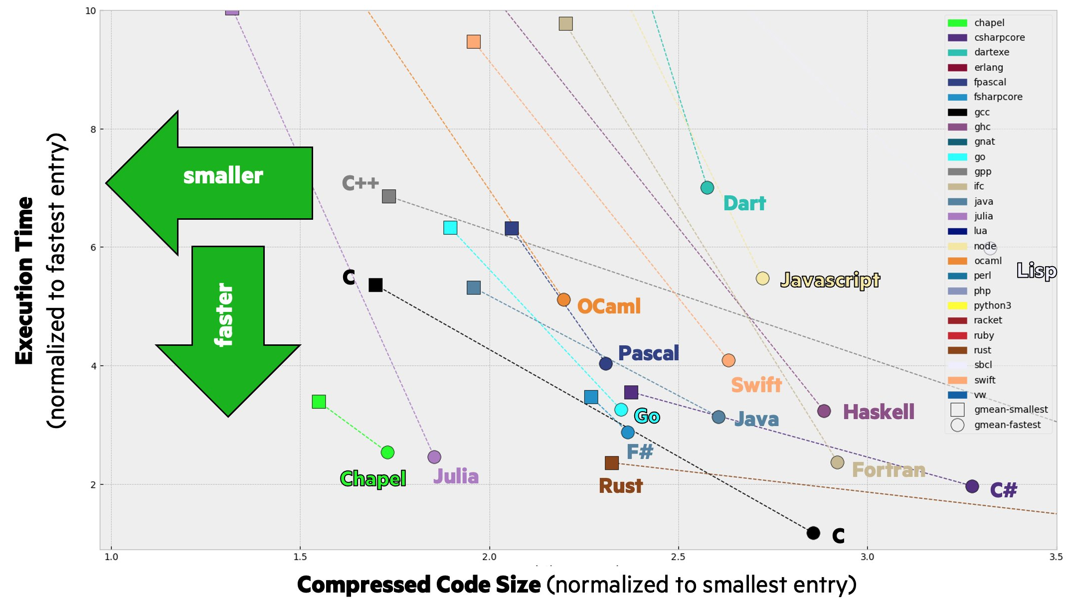
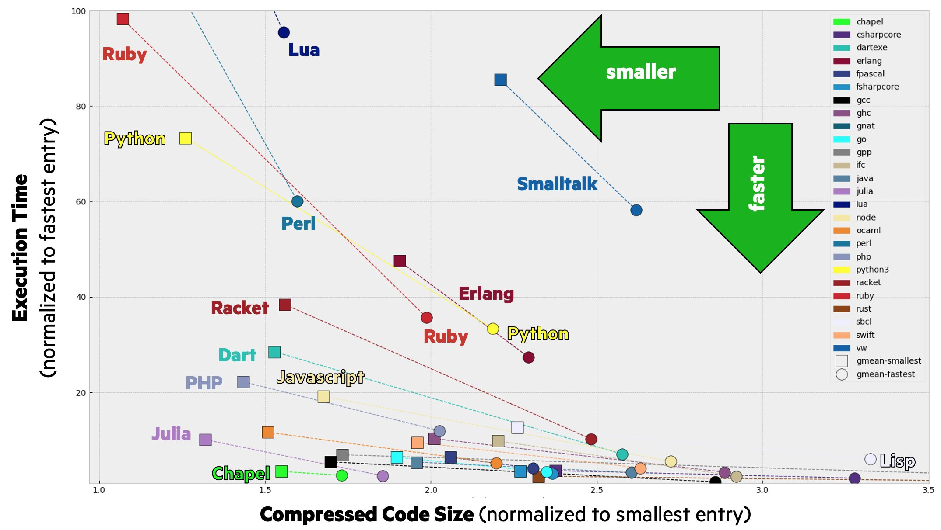
Julia in in a sweet spot in term of simplicity and execution speed
Zoomed in
Source: tweet from
@ChapelLanguage
February 8, 2023

Slide 5
Julia is designed for (mad) scientists
Positive
Negative
No two languages problem
State of the art in some fields
Differential equations
Automatic differentiation
Scientific machine learning
Great package manager
High composability
Tooling for experimentation
The code is the documentation
Weaker on very standard problems
No binary export
Time To First X (TTFX)
“Julia has been the future of machine learning for the past 10 years and I predict that julia will remain the future of machine learning for the next 10 years.”
Yann LeCun [reference needed]

Slide 6
What’s the plan?
Some tooling fun
VSCode julia extension
Packages
The Revise.jl workflow
Multiple dispatch
Per-function compilation
The need for compilation
Type inference
Code composability
StaticArrays.jl as an example
Let’s write a forward diff code
Broadcasting
The dot syntax
Next generation notebooks
Pluto.jl
Higher order functions
Function as type
The do syntax
Automatic differentiation

Slide 7
What are the additional possible plan for tomorrow?
Code efficiency
Type parameters as constants
Black magic einsum with Tullio.jl
Plotting and interactivity
Makie.jl and Observables
Calling python
PyCall.jl
Software engineering
Abstract types
Concrete structs
Parametric types
Reproducibility with environments
Project.toml, Manifest.toml
Parallelization
Multithreading
Package development
Testing and benchmarking
Think about it!
We will discuss it at the end of today’s session.

Slide 8
Tooling
Let’s have a great coding experience

Slide 9
VSCode is the standard way to run julia
Demo
Inline evaluation
Error highlighting
LaTeX for fancy symbols
Let’s set it up for everyone

Slide 10
Julia packages are straightforward
Their name end with .jl
Allows for mostly straightforward names
StaticArrays.jl
ForwardDiff.jl
IntervalArithmetic.jl
Each is a git repository on GitHub

Slide 11
The package manager is in the REPL
Open REPL
Type ] to enter Pkg mode
add – add a package
dev – add the dev version of a package, works with any URL
rm – remove a package
status – see the status of the current environment
Environments are managed through the Pkg mode of the REPL
Interested to see that tomorrow?

Slide 12
Revise automatize reloading packages on source code change
] add Revise
] dev – get the development version of a package
Load the package
Thanks to Revise.jl, any the package gets update on any change
@edit – Go directly to a function definition
It uses your default editor.
Change it by setting the EDITOR or JULIA_EDITOR environment variable.
The VSCode extension has a setting for it too.

Slide 13
Exercise – Revise the workshop package
] add Revise
] dev https://github.com/Kolaru/JuliaForScientists
Load Revise – Need to be loaded first !
Load the JuliaForScientists package
Check the output of wrong(), personalized() and fervent()
@edit personalized() – Change it to your liking.
Check that the function has changed accordingly.
Check that the change was also propagated to summarize_comments()

Slide 14
Multiple dispatch
How julia approaches compilation and composability

Slide 15
Functions are compiled just-in-time (JIT)
A compiler is never late, nor is it early, it compiles precisely when it needs to.

Slide 16
Programs need to determine what processor instruction to use
412 + 2023
What does this code do?
What about this one?
How do the computer know?
412
2023
2435
412.0 + 2023.0
.4120 E3
.2023 E4
>> .0412 E4
.2023 E4
.2435 E4

Slide 17
Compilation saves time
412 + 2023
412::Int + 2023::Int
add_int 412 2023
(instr) (blob) (blob)
(blob)
2435::Int
Find the types
Find the correct operation
Execute on processor
Read result
Interpret the result
Can be done ahead of time!

Slide 18
Julia compiles each function signature
function f(x, y)
if x < 0
z = x + y
else
z = x * y
end
return sin(z)
end
When calling f(412, 20.23) the first time, inference happens
function f(x::Int, y::Float64)
if (x < 0)::Bool
z::Float64 = x + y
else
z::Float64 = x * y
end
return sin(z)::Float64
end
This is a function
This is one method of the function f

Slide 19
Type instability silently kills performance
In julia, fast code is enforced by the community, not the compiler.
function f(x, y)
if x < 0
z = x + y
else
z = 4x
end
return x * z
end
When calling f(412, 20.23) inference happens
function f(x::Int, y::Float64)
if (x < 0)::Bool
z::Float64 = x + y
else
z::Int = 4x
end # z::Union{Float64, Int}
return (x * z)::Union{Float64, Int}
end
Can be diagnosed with @code_warntype

Slide 20
On more complicated example function compilation causes a delay
function eigendot(A, x)
evals, evecs = eigen(A)
return x ⋅ evals
end
function eigendot(A::Matrix{Float64}, x::Vector{Float64})
evals::Vector{Complex}, evecs::Matrix{Complex} = eigen(A)
return (x ⋅ evals)::Complex
end

Slide 21
Composability
Why julia is perfect if you want to build Frankenstein’s monster.
The fact that Frankenstein and his creation ended up being mortal enemies is irrelevant to the current story.

Slide 22
No check happen before a function is first used with a specific type signature
Example: Generic commutator function

Slide 23
Methods can be manually added to customize behavior of a function
The most specific method is always picked
Example: Commutator for real numbers should return 0 immediately

Slide 24
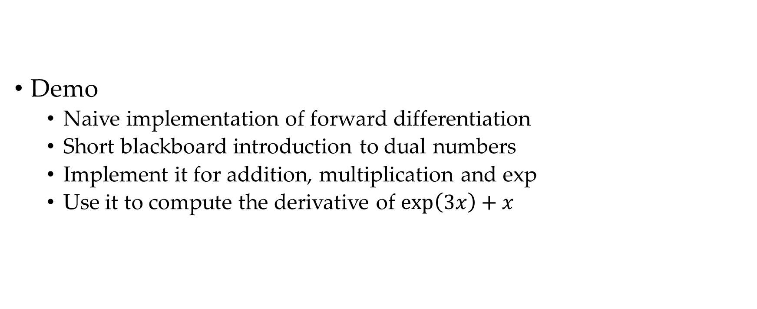
If you define your own type, you can extend any function from any package
Demo
Naive implementation of forward differentiation
Short blackboard introduction to dual numbers
Implement it for addition, multiplication and exp
Use it to compute the derivative of $\exp\left(3x\right)+x$

Slide 25
Exercise – Extend the example
An example file should be in
~/.julia/dev/JuliaForScientists/examples/dual.jl
Implement
Division of a dual by a real – Base.:/
Square root of dual – Base.sqrt
Load the Statistics package
Use your implementation to compute the derivative of
mean([(x, sqrt(x), exp(x)])

Slide 26
Broadcasting
Stronger together.

Slide 27
The dot syntax clarify vector operations
Is it a matrix multiplication or an elementwise multiplication?
A * B
In julia elementwise operations have a dot if they can be ambiguous
A .* B
A + B == A .+ B # If A and B have the same shape
A .+ 2023
Any function can be “dotted” to apply it elementwise
exp.(A)
Combined with other utilities make some operations much clearer
norm.(eachcol(A))

Slide 28
Pluto.jl
A modern successor for Jupyter designed for teaching and sharing.

