Slide 1




for Scientific Computing II
Benoît Richard
github.com/Kolaru
Cluster of Excellence
CUI: Advanced Imaging of matter

Slide 2
What’s the plan?
Iterating
Loops are fast
Broadcasting
The dot syntax
Plotting overview
Plots.jl
Makie.jl ecosystem
Next generation notebooks
Pluto.jl
Data management
DelimitedFiles.jl
CSV.jl
HDF5.jl
Code demo
Makie demo

Slide 3
Iterating
Let’s go through it.

Slide 4
for loops are fast
Loops are fast, no need to worry about it
for i in 1:10
# Do something
end
for x in vector
# Do something
end

Slide 5
There are many loop helpers
Enumerate
for (i, x) in enumerate(v)
# Do something
end
Zip
for (x1, x2) in zip(v1, v2)
# Do something
end
Each rows or columns
for col in eachcol(A)
# Do something
end
Dictionary
for (key, val) in dict
# Do something
end

Slide 6
The dot syntax clarify vector operations
Is it a matrix multiplication or an elementwise multiplication?
A * B
In julia elementwise operations have a dot if they can be ambiguous
A .* B
A + B == A .+ B # If A and B have the same shape
A .+ 2023
Any function can be “dotted” to apply it elementwise
exp.(A)
Combined with other utilities make some operations much clearer
norm.(eachcol(A))

Slide 7
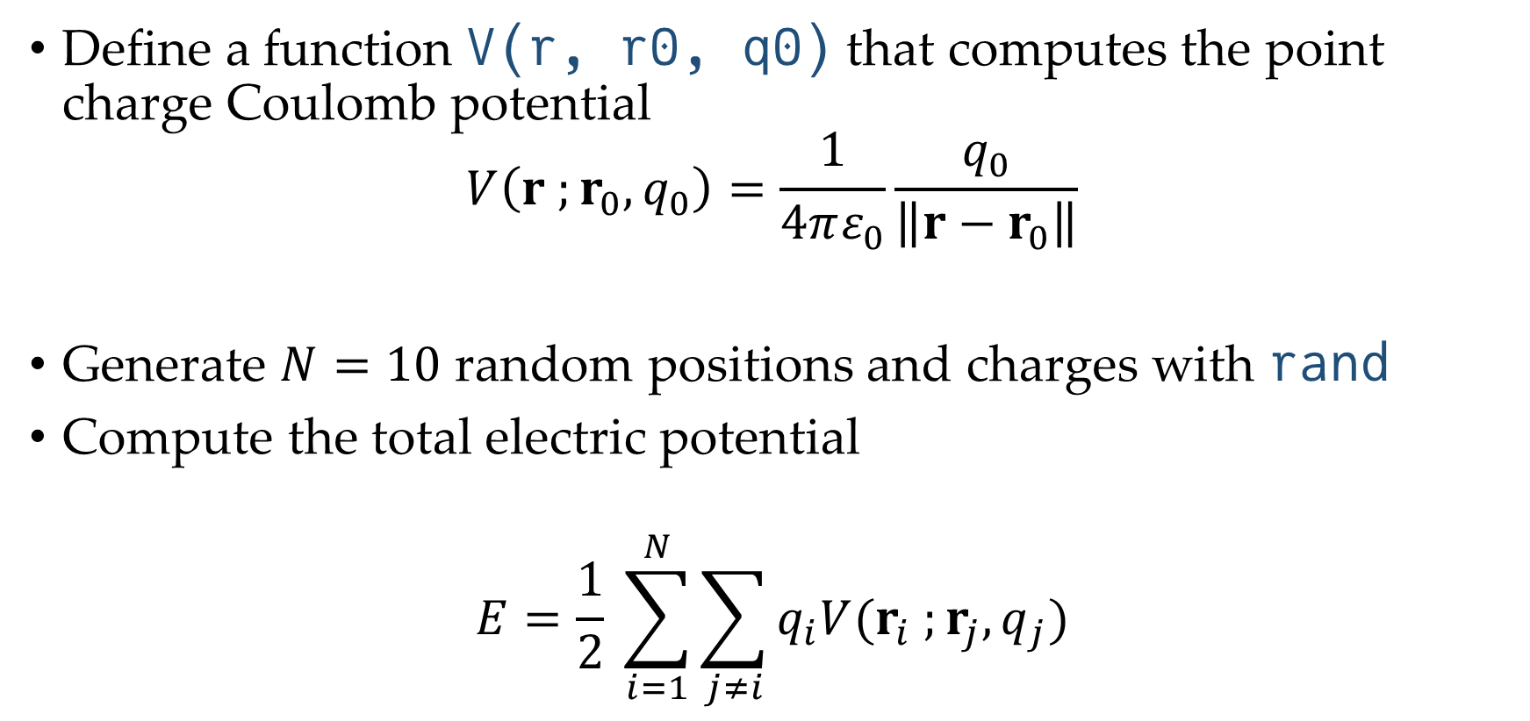
Exercise – Coulomb potential
Define a function V(r, r0, q0) that computes the point charge Coulomb potential
$$V\left(r ;r_{0}, q_{0}\right)=\frac{1}{4πε_{0}}\frac{q_{0}}{\left\|r−r_{0}\right\|}$$
Generate $N=10$ random positions and charges with rand
Compute the total electric potential
$$E=\frac{1}{2} \sum_{i=1}^{N}{\sum_{j≠i}{q_{i}V(r_{i} ;r_{j}, q_{j})}}$$

Slide 8
Plotting

Slide 9
There are two main competitors
Plots.jl
CairoMakie.jl / GLMakie.jl
Easiest for simple plots
Fast with the default
Lightweight
Can use Matplotlib as a backend
Better integration with Pluto.jl
I don’t know it well
Best layout system for complex plots
Incredible 3D
Very good interactivity
Massive and take ages to install
Poor LaTeX support

Slide 10
Pluto.jl
A modern successor for Jupyter designed for teaching and sharing.

Slide 11
Data management
The curse of choice.

Slide 12
Choosing a data format is hard
CSV
HDF5
Very simple
Very standard
Plain text
Can be read as DataFrames
Can only store tabular data
Can not store metadata
Infinitely powerful
Partial reading of the data
Multidimensional arrays
Any data organization
Compression
Metadata
Quite standard in science
Binary format

Slide 13
There are multiple way to read CSV
DelimitedFiles.jl
CSV.jl
Limited
Simple
More complex
Offer a lot of options

Slide 14
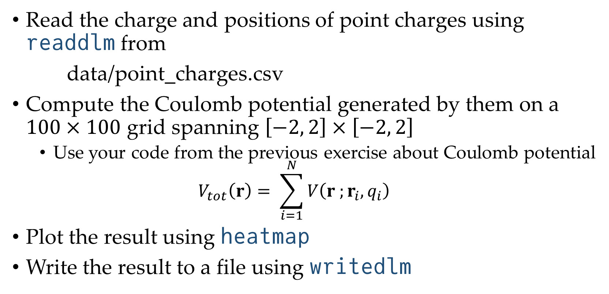
Exercise – Read and plot
Read the charge and positions of point charges using readdlm from
data/point_charges.csv
Compute the Coulomb potential generated by them on a $100×100$ grid spanning $\left[−2, 2\right]×\left[−2, 2\right]$
Use your code from the previous exercise about Coulomb potential
$$V_{tot}\left(r\right)= \sum_{i=1}^{N}{V\left(r ;r_{i}, q_{i}\right)}$$
Plot the result using heatmap
Write the result to a file using writedlm

