Slide 1
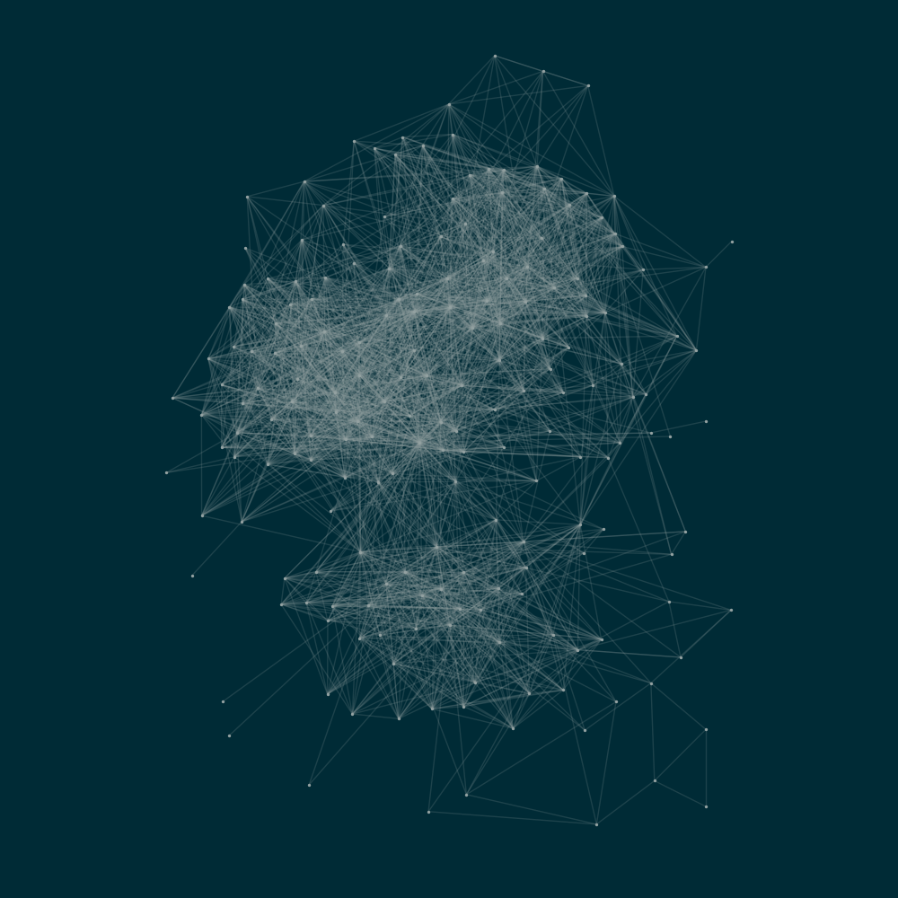
Connectivity in networks
Master thesis presentation
Benoît Richard
under the supervision of
Guyuan Shi
and Prof. Yi-Cheng Zhang

Slide 2
Network
Node
(or vertex)

Slide 3
Network

Slide 4
Network

Slide 5
Network
Edges

Slide 6
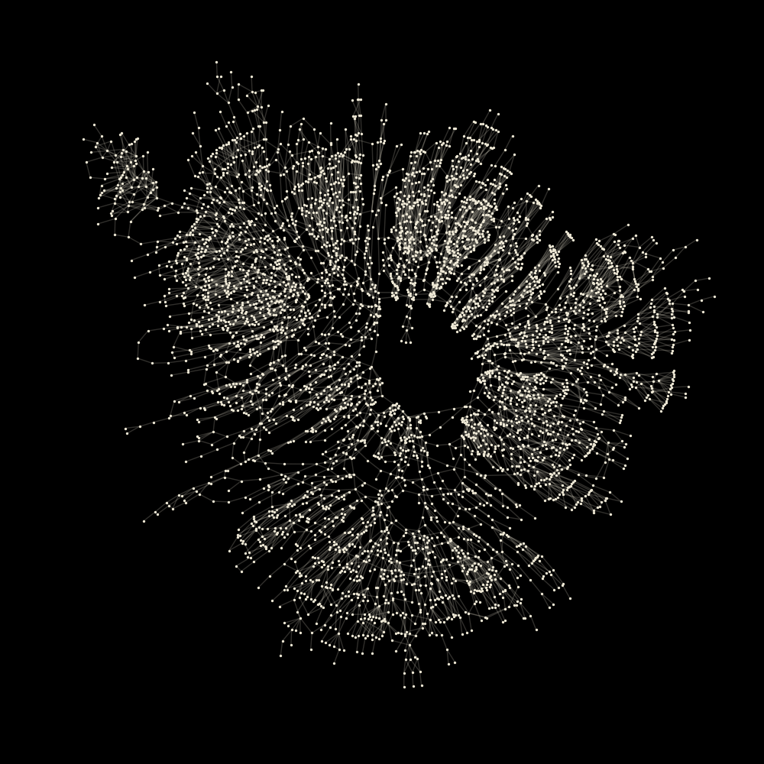
Western US power grid

Slide 7
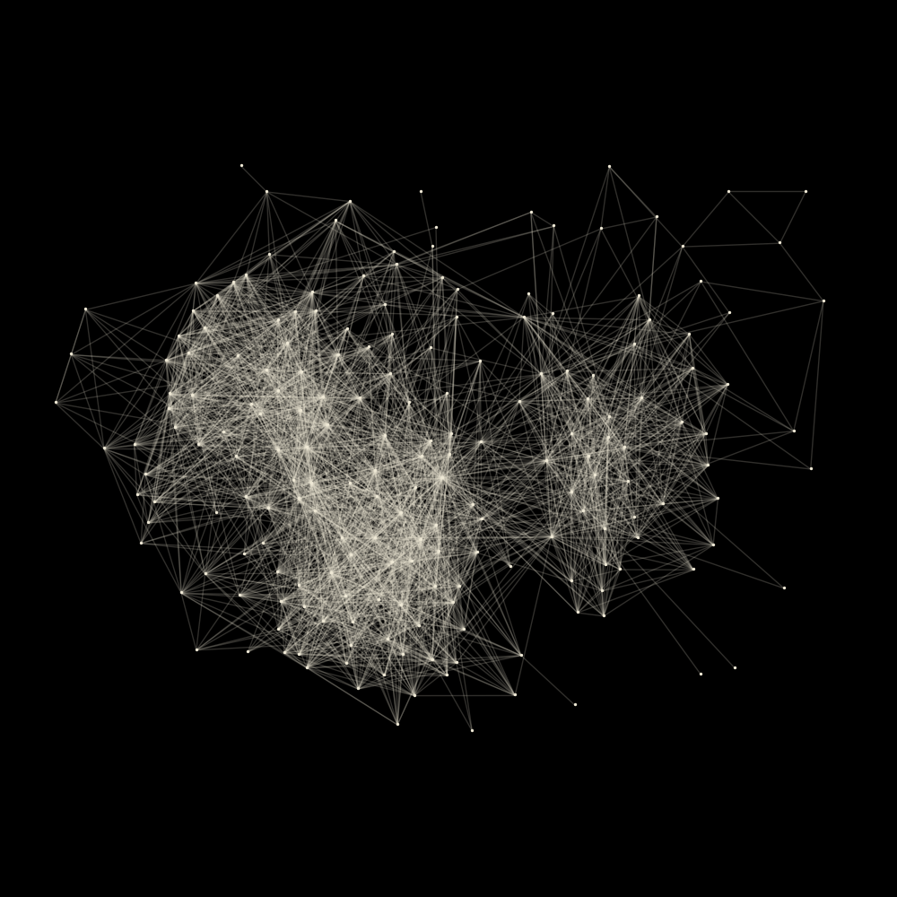
Jazz musicians

Slide 8

E-road
Connected component

Slide 9
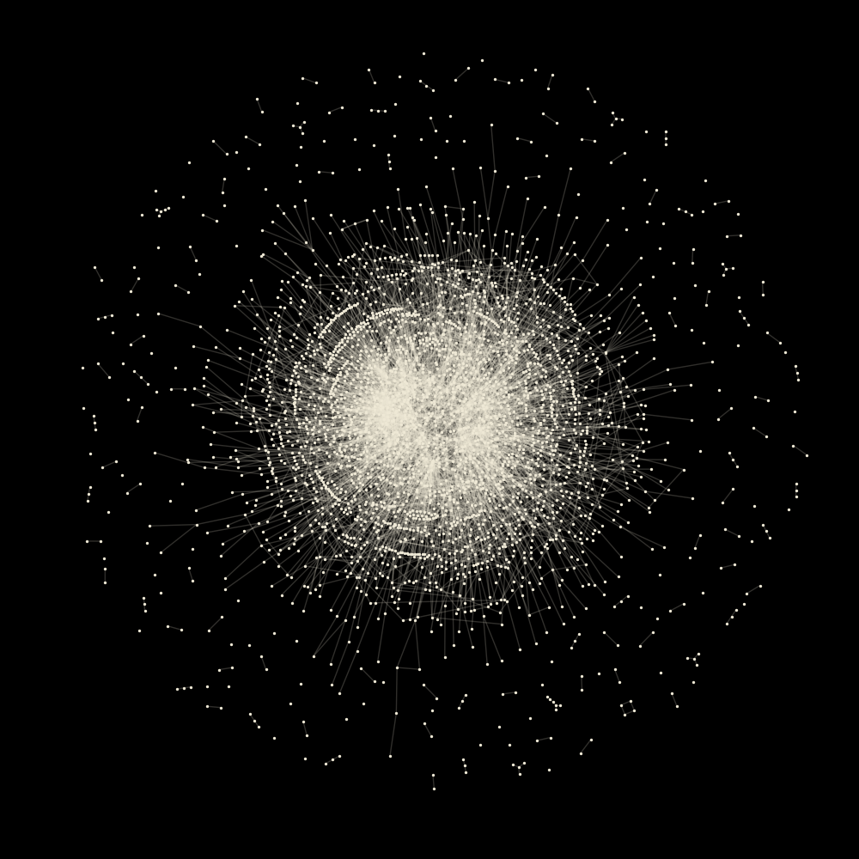
Protein interaction

Slide 10
Configuration model

Slide 11
Configuration model

Slide 12
Configuration model
3
3
1
3
1
1
2
Degree sequence

Slide 13
Configuration model
Degree sequence

Slide 14
Configuration model
Random matching

Slide 15
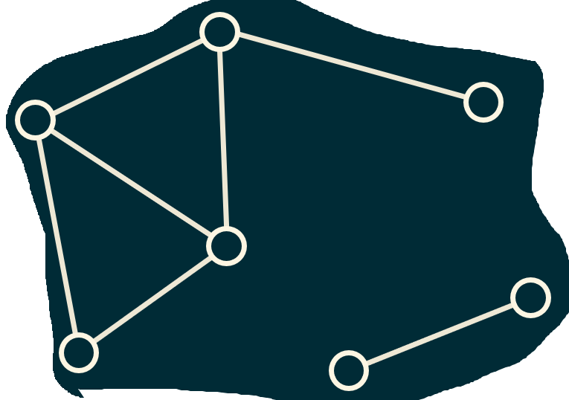
Configuration model
Random matching

Slide 16
Configuration model
Random matching

Slide 17
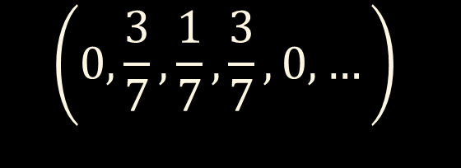
Configuration model
Degree sequence
3, 3, 3, 3, 3, 3, 2, 2, 1, 1, 1, 1, 1, 1
3, 3, 3, 2, 1, 1, 1
$$\left(0,\frac{3}{7},\frac{1}{7},\frac{3}{7}, 0, …\right)$$
Degree distribution

Slide 18


Degree distribution
$$p_{k}$$
Probability that a node has degree $k$
$$g_{0}\left(z\right)=\sum_{k}{p_{k} z^{k}}$$
Generating function of the degree distribution

