Slide 1

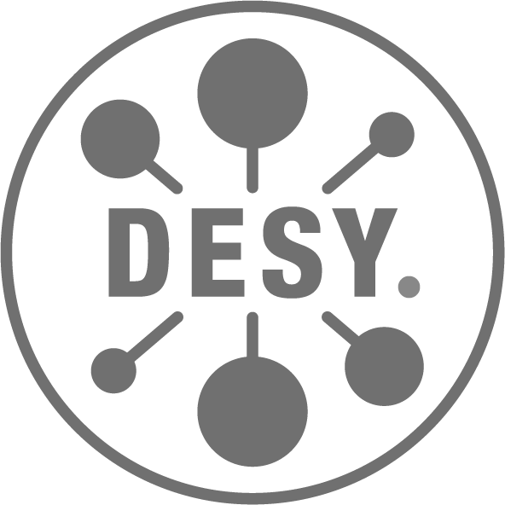

Interactivity and animations for scientific visualization
Cluster of Excellence
CUI: Advanced
Imaging of matter
AIM Summer School
June 2, 2022
Benoît Richard
Notes:
Goal: structure of protein
It determines how they function
E.g. determines what antibodies stick to
There is no one-fit-for-all imaging method
Making molecules explode goes toward that direction
This is Coulomb Explosion Imaging
We are far from a full reconstruction from now

Slide 2
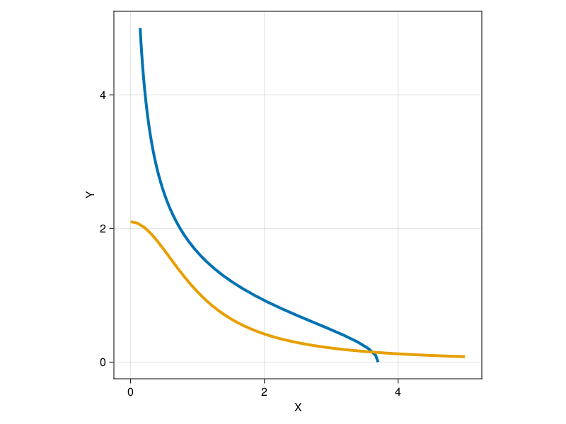
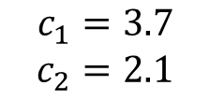
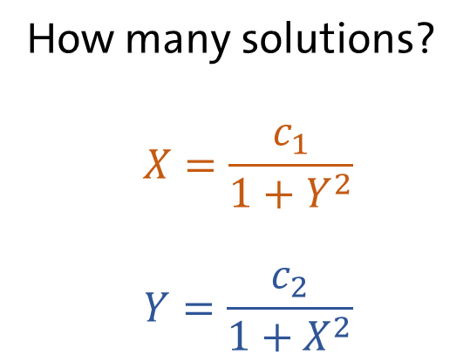
Representing data can be tricky
How many solutions?
$$X=\frac{c_{1}}{1+Y^{2}}$$
$$Y=\frac{c_{2}}{1+X^{2}}$$
$$c_{1}=3.7$$
$$c_{2}=2.1$$

Slide 3
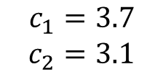
All Libraries use the observer pattern
Callback
Call
Modify
Observer
Notify
$$c_{1}=3.7$$
$$c_{2}=3.1$$
Observable

Slide 4
There is a jungle of terminology
Callback
On top of that sometimes:
Observer = Observable
Observer is implicit
Possible observers have arcane names (e.g. artist, scene)
Events/Signals are separate objects
Callback signature changes
Call
Modify
Observer
aka Listener
Register
Connect
Bind
Notify
aka Emit a signal
Event
Observable
aka Node
Widget*

Slide 5
There is a simplified version
Callback
Plot
Generate new
Call
Generate
Plot holder
Callback
Plot
Call on change
Notify
Observable
Observable

Slide 6
Animation work by observing time
Plot
Frame
Save
Generate
Callback
Increment
Call on change
Observable
Time

Slide 7
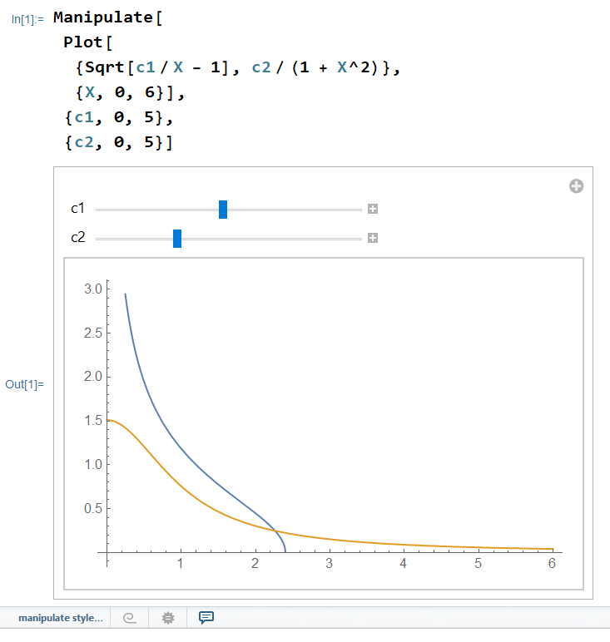
Mathematica Manipulate
Mathematica function
Simple
Automatic widgets

Slide 8
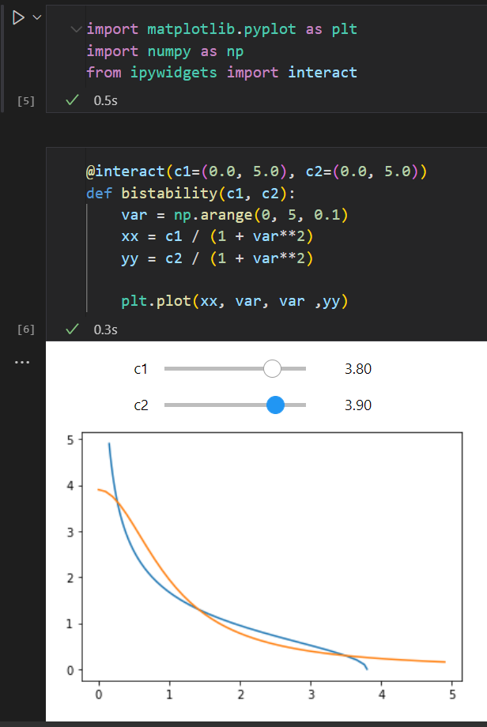
Jupyter + Ipywidgets + Matplotlib
Python
interact function similar to Mathematica manipulate
Full fledge widget system

Slide 9
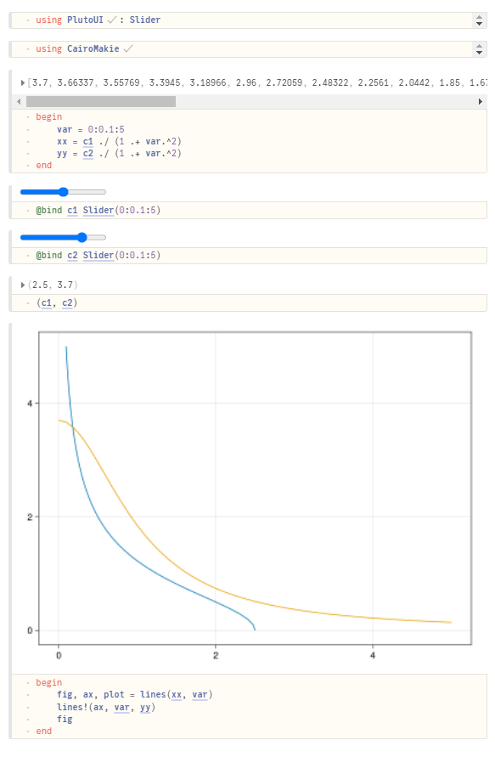
Pluto.jl
Notebook system for Julia
Each cell is an observable
All dependent cells get updated on change (including plots)
Very intuitive
Nice support for widgets

Slide 10
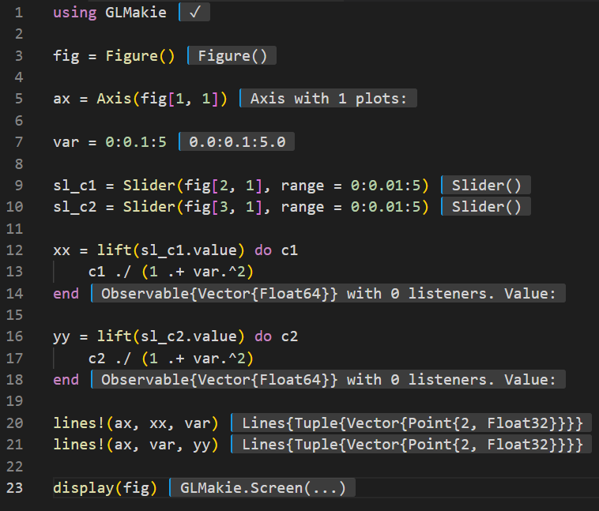
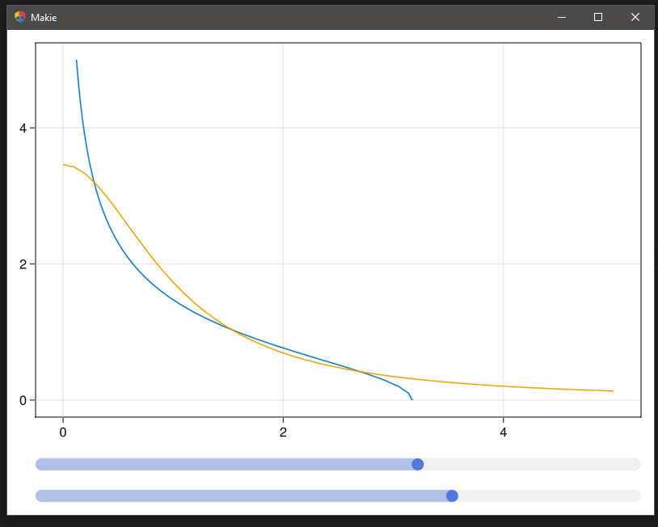
Plotting library with window support
Matplotlib, Makie.jl
Full fledge widget system
Extensive event handling (e.g. selection of plot elements)

Slide 11
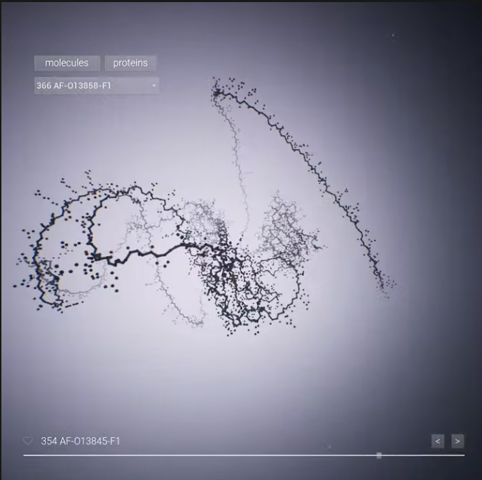
Game engines
Godot Engine, Unreal Engine, Unity
Visual editor
Extremely good support for 3D
Standalone exports
Poor support for scientific libraries
https://www.youtube.com/watch?v=WcXLszc_cno

Slide 12
Conclusion
Callback
Interactivity is cool
The observer pattern is the skeleton of all framework/libraries
Some (e.g. the next speaker) may say it is not science, don’t listen to them
Call
Modify
Observer
Notify
Observable
Code examples available at github.com/Kolaru/SimpleInteractiveExamples

