Slide 1


Hadoop File System Management
Hadoop Distributed File System (HDFS) allows efficient storage and retrieval of large datasets. Proper management of the HDFS is critical for ensuring optimal performance and reliability of the Hadoop ecosystem. This guide provides essential commands for managing the directory structure and files within HDFS.
Ma
by Madhu Koleti

Slide 2

Creating a Directory Structure in HDFS
1
Command to Create Directory
Use the following command to create a directory structure in HDFS:
hadoop fs -mkdir -p /path/to/directory
Replace /path/to/directory with the desired directory structure.
2
Moving a File to HDFS
Use the command below to move a file from the local Unix/Linux machine to HDFS:
hadoop fs -put /path/to/local/file /path/in/hdfs
Replace /path/to/local/file with the file's path on your local machine and /path/in/hdfs with the destination directory in HDFS.

Slide 3
Viewing and Managing Files in HDFS
Viewing File Contents
Listing Directory Contents
To see the contents of files in HDFS, use the command:
To list the contents of directories in HDFS, use the command:
hadoop fs -cat /path/to/file
hadoop fs -ls /path/to/directory
Replace /path/to/file with the file path in HDFS.
This command lists the contents of the specified directory in HDFS.

Slide 4
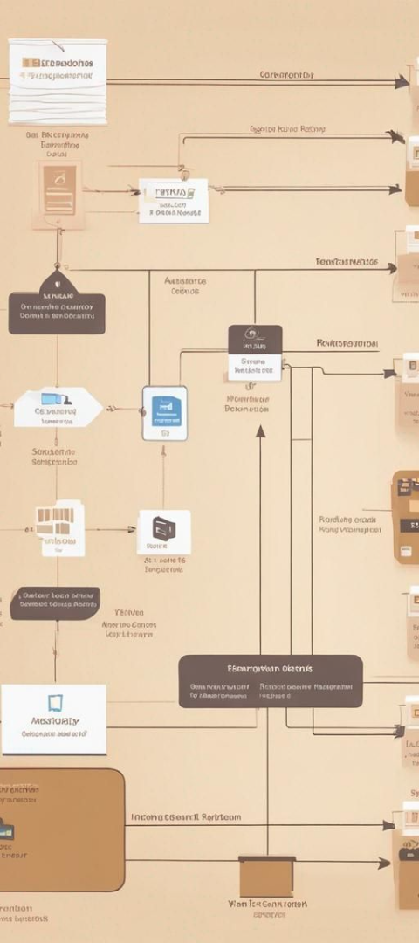
Copying Files between HDFS and Local File System
1
Copying from HDFS to Local
Use the following command to copy a file from HDFS to the local file system:
hadoop fs -copyToLocal /path/in/hdfs /path/in/local
Replace /path/in/hdfs with the file's path in HDFS and /path/in/local with the destination directory on your local machine.

Slide 5

Security Considerations in HDFS Management
Authentication
Authorization
HDFS supports various authentication mechanisms to ensure secure access to files and directories. Setting up proper authentication protocols is crucial for preventing unauthorized access.
Implementing robust authorization policies helps in controlling user permissions and access privileges within the Hadoop ecosystem, enhancing overall data security.

Slide 6
HDFS Maintenance and Monitoring
1
Health Checks
2
Backup Strategies
Regular health checks and monitoring of HDFS ensure early detection of potential issues, allowing for proactive maintenance and data integrity.
Establishing backup and recovery mechanisms is essential for maintaining data reliability and mitigating the impact of potential failures within HDFS.

Slide 7


Optimizing HDFS for Performance
Efficiency
Scalability
Implementing efficient data storage and retrieval practices enhances overall performance and reduces latency in HDFS operations.
Scalable architecture and optimized data distribution strategies contribute to the seamless expansion of HDFS to accommodate growing datasets.

Slide 8




Troubleshooting and Debugging in HDFS
Log Analysis
Thorough analysis of system logs and error messages aids in identifying and resolving underlying issues impacting HDFS performance.
Network Diagnostics
Conducting network diagnostics helps in detecting connectivity issues and optimizing data transfer processes within the Hadoop environment.
Cluster Monitoring
Regular monitoring of cluster activities and resource utilization assists in troubleshooting potential bottlenecks and inefficiencies in HDFS.

