Slide 1
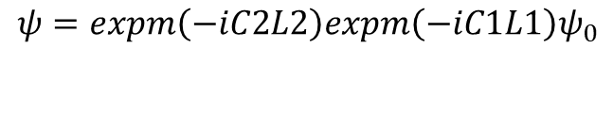
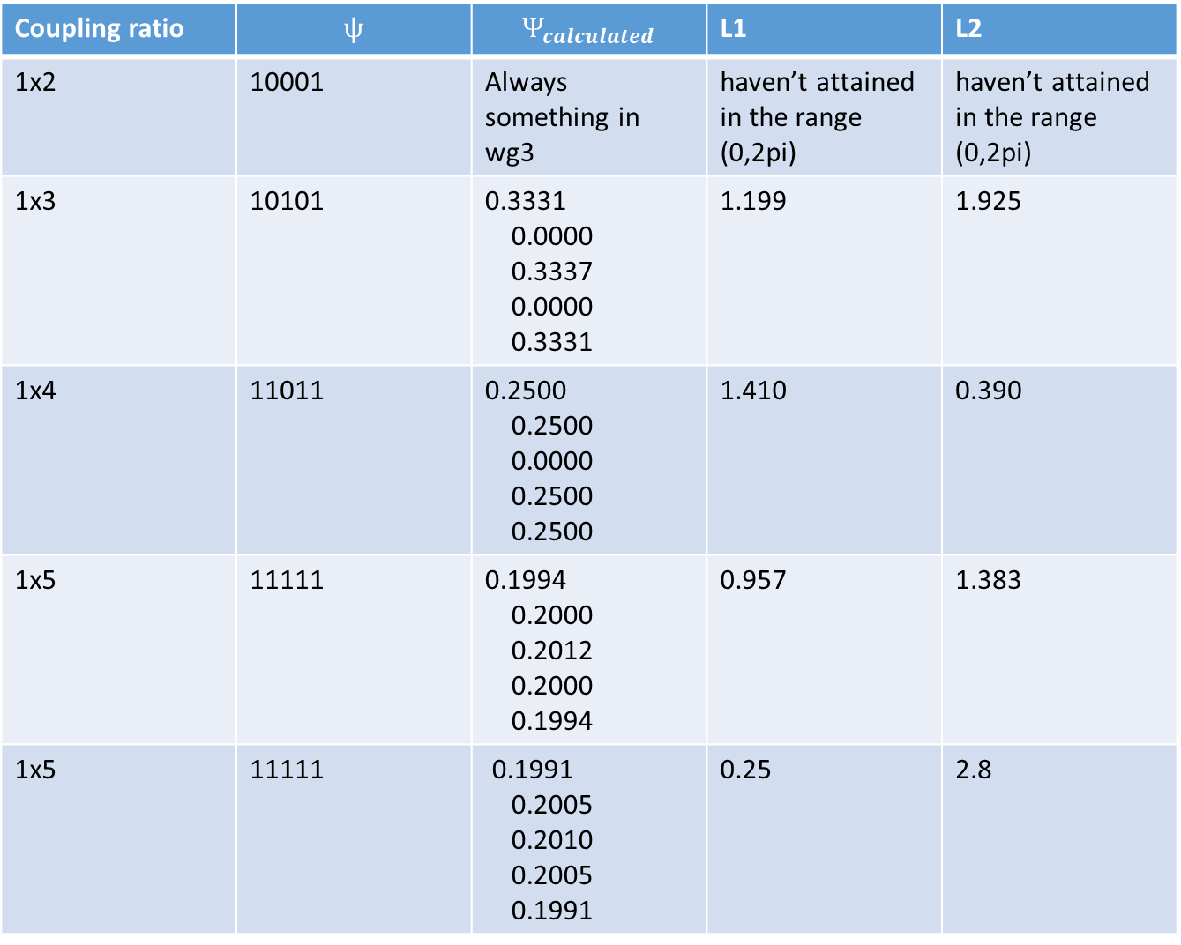

d
d
d
d
Coupling ratio | $$ψ$$ | $$Ψ_{calculated}$$ | L1 | L2
1x2 | 10001 | Always something in wg3 | haven’t attained in the range (0,2pi) | haven’t attained in the range (0,2pi)
1x3 | 10101 | 0.3331 0.0000 0.3337 0.0000 0.3331 | 1.199 | 1.925
1x4 | 11011 | 0.2500 0.2500 0.0000 0.2500 0.2500 | 1.410 | 0.390
1x5 | 11111 | 0.1994 0.2000 0.2012 0.2000 0.1994 | 0.957 | 1.383
1x5 | 11111 | 0.1991 0.2005 0.2010 0.2005 0.1991 | 0.25 | 2.8
L2
L1
$$ψ=expm\left(−iC2L2\right)expm\left(−iC1L1\right)ψ_{0}$$
$$ψ_{0}={\left(0 0 1 0 0\right)}^{T}$$
Coupling coefficients = 1, detunings = 0
I searched the space (L1, L2) and optimized the output to match the wanted coupling ratio.

Slide 2
I think this is great because the couplers consist of concatenated uniform photonic lattices.
We can most probably find solutions for lattices with even number of wgs, too. They will not be symmetric in terms of light propagation as the light always enters a port closer to one side.
The work can be extended to asymmetric lattices or as a matter of fact any lattice composed of uniform WGAs.
Using only wg pairs (similar to the first picture in your report) resembles nesting of directional couplers and many designs can be taken from there. However, using lattices gives even more possibilities, at the expense of more involved calculation.
The fact that all lattices are uniform makes a strong case for rapid prototyping.

