Slide 1
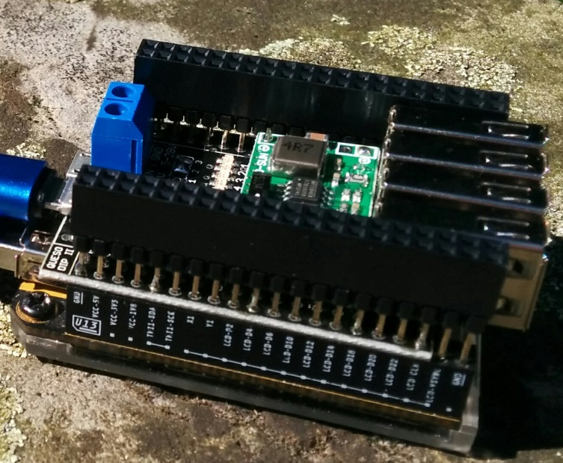
Approximate assembly height
14mm
10,8 mm
7,4mm
12,2 mm
Assembly help:
Just stack a header through the PCB and into another header, push it all the way in, fix the board in this position
4x USB facing out, on top layer,
USB are flush with header
Four solder joints per header on top layer, before assembly of USB jacks
Last 2x2 pins must overlap, only 2x18 holes on pcb

