Slide 1
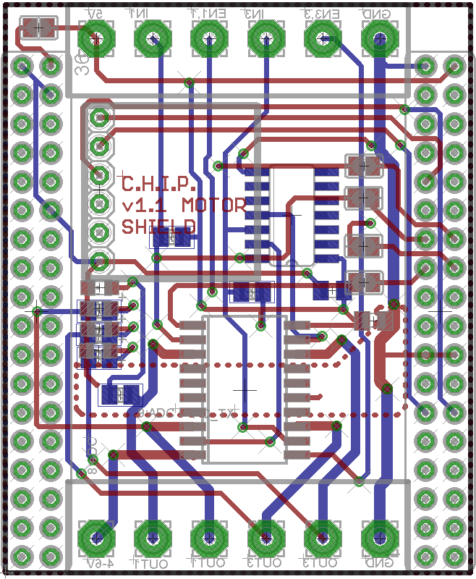
Pin OUT v1.1 Motor DIP
P3
P1
Vin
P0
P2
GND
# | Function
Vin | Logic voltage, 5V
P0 | Channel 1 direction
P1 | Channel 1 enable
P2 | Channel 3 direction
P3 | Channel 3 enable
GND | Ground for logic voltage
VHin | “High” voltage for Motor (5-36 Volt), can be connected to Vin
P4 | Channel 1 output
P5 | Channel 2 output (inverse of channel 1)
P6 | Channel 3 output
P7 | Channel 4 output (inverse of channel 3)
GND | Ground for “high” voltage
Inverter
Accel
Header for
Sparkfun:
MMA8452Q Connected to CHIP I2C bus
P9
CHIP GPIO P0, P1, P2, P3 can be used instead of screw header
Status LED
Motor
Driver IC
L293DD
VHin
GND
P4
P6
P5
P7

Slide 2
Jumper Config v1.1 Motor DIP
P3
P1
Vin
P0
P2
GND
SJ5
SJ | Function
1-4 | Use CHIP GPIO as input Close them, if you use the CHIP GPIO to generate the control signals. Leave them open if you want to use the screw header
5 | Vin to Charge in Close it if you Vin is 5V from a power supply or external battery to power this CHIP over this pin as well Leave it open, if you feed the CHIP 5V to the Vin
SJ1-4
Accel
Header for
Sparkfun:
MMA8452Q Connected to CHIP I2C bus
P9
CHIP GPIO P0, P1, P2, P3 can be used instead of screw header
Status LED
(resistors on bot,
LED and resistor aren’t populated)
Motor
Driver IC
L293DD
VHin
GND
P4
P6
P5
P7

