Slide 1
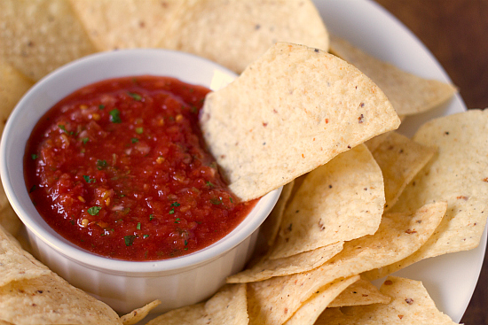
APPETIZERS
Bare Boards ………………………………………….... $2 PCB only, SALSA / QUESO / ONION, no components
SALSA PWM Component Kit …….……………. $9
Atmega + Mosfet + other small components
SALSA Motor Component Kit …...…..…….. $11
Atmega + Mosfet + other small components
QUESO hub components ……………………… $10 IC, USB Jacks, ESD, Fuses, Caps, LEDs, etc.
ONION tinker components …………….….….. $3 LEDs, MOS-FET, Relay
MAINS
Salsa II PWM…………………………………...…… $14 SMD soldered board, with non-stack headers
Salsa II Motor …....……...………….……………. $16
SMD soldered board, with non-stack headers
QUESO …………….……………………………...…… $17 SMD soldered board, without DC-DC regulator (highly recommended), with non-stack headers
ONION …....……...…………………….……..………. $7
SMD soldered board, with non-stack headers
DESERT
Stackable Header ……………………………..….. $3
Replacement for both headers, soldered on request
Salsa II Screw Terminals ……..…….………… $2
6 top + 6 bottom pins, soldered to Board on request
3A 5V DC-DC regulator ……….………………… $3
Powers CHIP and the DIP from any 7V to 28V DC power supply , SALSA can carry one, QUESO up to two
Pick up ……….…………………………………...…. $0
Houston, TX until 1st May 2016
Hannover, Germany, from 1st June 2016
Shipping (2 day from US) ………..…………. $7
Until 1st May 2016
Shipping (2 wks. from Germany) ………... $5
From 1st June 2016

