Slide 1
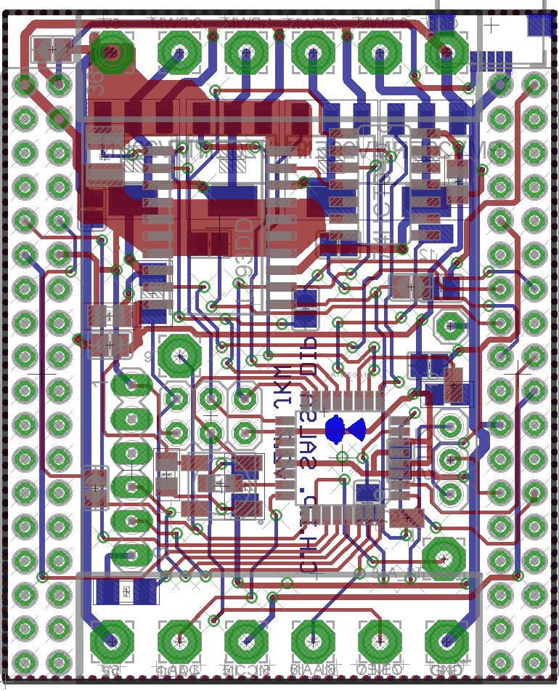
Pin OUT v2.7 Salsa DIP
Low side PWM, 6A, 30V
Or Motor Driver, 600mA
Channel P0,P1,P2,P3
Vin
GND
Micro USB
Atmega pin | DIP pin | Arduino Pin | Digital IN/OUT | Analog IN | PWM out | WS2812 support | C.H.I.P. connection
PD7 | P12 | 7 | X | - | - | X | -
PB0 | P11 | 8 | X | - | - | X | -
PC3 | P10 | 17 | X | X | - | - | -
PD3 | P9 | 3 | X | - | X | X | -
PC2 | P8 | 16 | X | X | - | - | -
PB3 | P7 | 11 | X | - | X | X | -
PD2 | P6 | 2 | X | - | - | X | -
- | P5 | - | - | - | - | - | X
PC1 | P4 | 15 | X | X | - | - | -
PD5 | P3 | 5 | */X | - | X | * | -
PD6 | P2 | 6 | */X | - | X | * | -
PB1 | P1 | 9 | */X | - | X | * | -
PB2 | P0 | 10 | */X | - | X | * | -
P11
P12
4x Transistor
on Bottom or Motor driver + Inverter on the top layer!
Accel header connected to
CHIP I2C_2
P8
ICSP header
UART header
GND
-
-
PC TX
PC RX
Reset
P9
P10
Vout
GND
P4
P6
Direct connected to CHIP GPIO 7
P7
* Only without transistor
And a little solder bridge

Slide 2
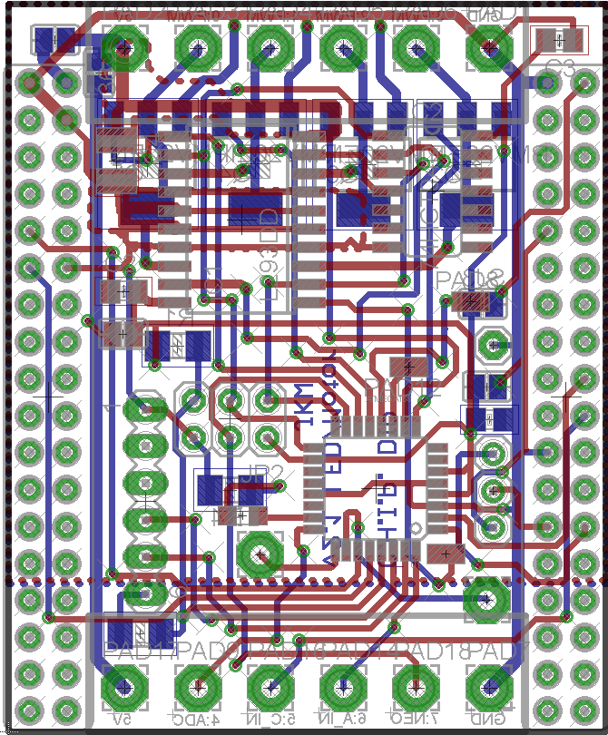
Jumper Config v2.5! Salsa DIP
Vin
Low side PWM, 6A, 30V
Channel T0,T1,T2,T3
GND
SJ | Function
1 | Vin to Charge in If your input voltage is 5V close this jumper. Your Vin will charge your Battery
2 | Vout to Vcc If your Vin is not 5V close it, to get CHIPs 5V on the output If your Vin is 5V and you close SJ5, close this one to power the DIP from the VIN, in this case you must leave SJ3 and SJ4 open!
3 | CHIP 5V to Vcc (bot) If you won’t power the DIP via VIN, close this jumper to supply 5V power via the CHIP If you’ve destroyed your CHIP onboard 5V, close it to supply power to the USB ☺
4 | CHIP 3.3V to Vcc (bot) If you want to work the DIP on the (limited) 3.3V of the CHIP
5 | Vin to Vout To forward your input to the output
SJ1
SJ5
SJ3
SJ2
SJ4
Combine: SJ1 + SJ5 + SJ2 if your Vin is 5V or
SJ2 + SJ3 if you only draw a few mA to use the CHIPs 5V
Vout
GND
Never combine: SJ3 and SJ4 or
SJ4 + SJ2 + SJ5 and supply power via Vin/Vout or
SJ3 + SJ2 + SJ5 and supply power via Vin/Vout or
SJ1 if your Vin is NOT ~5V or SJ2 + SJ5 if your Vin > 5V
PC1
PD2
Direct connected to CHIP GPIO 7
PB3

