Slide 1
JKW boards – Confusion avoidance chart LEDv1.1 / Motor v1.1 / preSalsa / Salsa / Salsa II DIP
Function X = possible - = not possible * = ‘Or’ .. E.g. Motor OR Mosfet / Optional | Motor v1.1 | LEDv1.1 | PreSalsa | Salsa | Salsa II | Queso
Screw terminals that connects an external power supply to CHIP CHR-IN | X | X | X | X | X | X
Controller connected via I2C | - | X | X | X | X | -
Pins for driving ws2812 LEDs | - | X | X | X | X | -
Pins for analog reading | - | X | X | X | X | -
“Real-time” GPIOs | - | X | X | X | X | -
Mosfets to dim a lot of LEDs | - | 4 | 4* | 4* | 4*/2X | -
Motor driver Channels | 2 | - | 2* | 2* | 2*/1X | -
Input for “High voltage” (~7V for the Motor) | X | - | - | - | X | -
Internal connection to CHIP power button pin, e.g. to start the CHIP from power off, or to shut the CHIP down | - | - | - | X | X | -
“Seamless power” (run on CHIP battery, with CHIP powered down) | - | - | - | - | X | -
Option for onboard power supply (DC in 7-28V) | - | - | - | - | X | X
CHIP pins used by board (besides I2C bus which is not exclusively used) | *4 | *1 | *5 | *6 | *6 | -
On board Ws2812 LED option | - | - | - | * | * | -
On board general purpose button (e.g. shutdown) | - | - | - | - | * | -
On board general purpose LED | - | - | X | * | X | -
4x USB Hub | - | - | - | - | - | X

Slide 2
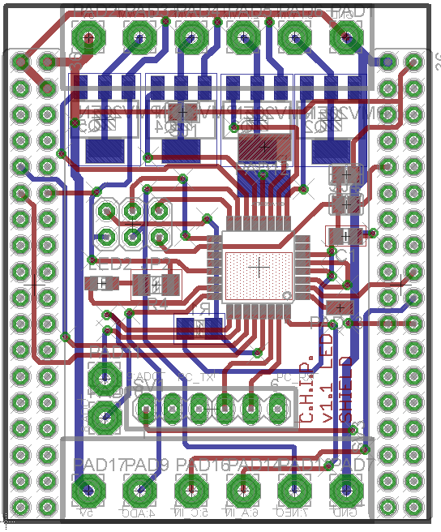
LED DIP v1.1 PinOut
Low side PWM, 6A, 30V
Or Motor Driver, 600mA
Channel P0,P1,P2,P3
Vin
GND
Atmega pin | DIP pin | Arduino Pin | Digital IN/OUT | Analog IN | PWM out | WS2812 support | C.H.I.P. connection
PD7 | P12 | 7 | X | - | - | X | -
PB0 | P11 | 8 | X | - | - | X | -
PC3 | P10 | 17 | X | X | - | - | -
PD3 | P9 | 3 | X | - | X | X | -
PC2 | P8 | 16 | X | X | - | - | -
PB3 | P7 | 11 | X | - | X | X | -
PD2 | P6 | 2 | X | - | - | X | -
- | P5 | - | - | - | - | - | X
PC1 | P4 | 15 | X | X | - | - | -
PD5 | P3 | 5 | */X | - | X | * | -
PD6 | P2 | 6 | */X | - | X | * | -
PB1 | P1 | 9 | */X | - | X | * | -
PB2 | P0 | 10 | */X | - | X | * | -
P12
4x Transistor
on Bottom or Motor driver + Inverter on the top layer!
P11
ICSP header
P9
P10
P8
UART header
GND
-
-
PC TX
PC RX
Reset
Vout
GND
P4
P6
Direct connected to CHIP GPIO 7
P7
* Only without transistor
And a little solder bridge

Slide 3
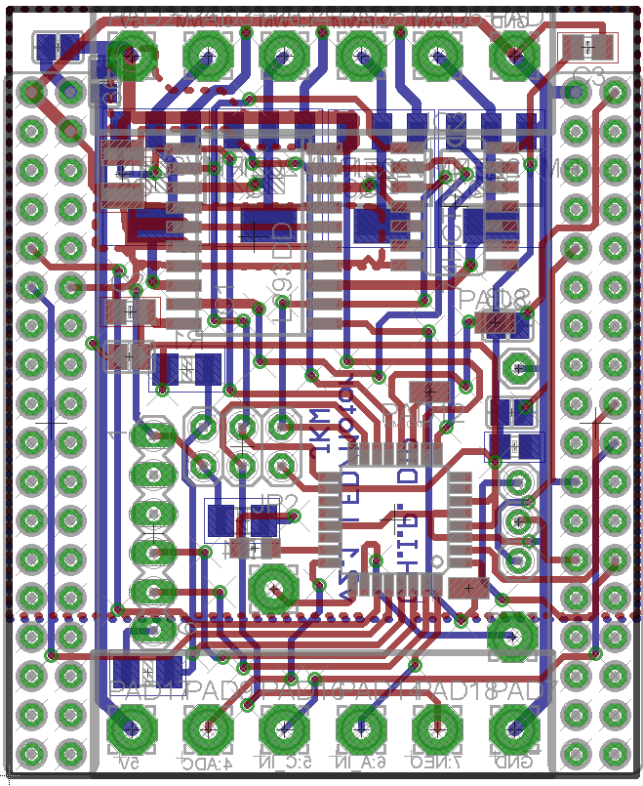
preSalsa DIP PinOut
Low side PWM, 6A, 30V
Or Motor Driver, 600mA
Channel P0,P1,P2,P3
Vin
GND
Atmega pin | DIP pin | Arduino Pin | Digital IN/OUT | Analog IN | PWM out | WS2812 support | C.H.I.P. connection
PD7 | P12 | 7 | X | - | - | X | -
PB0 | P11 | 8 | X | - | - | X | -
PC3 | P10 | 17 | X | X | - | - | -
PD3 | P9 | 3 | X | - | X | X | -
PC2 | P8 | 16 | X | X | - | - | -
PB3 | P7 | 11 | X | - | X | X | -
PD2 | P6 | 2 | X | - | - | X | -
- | P5 | - | - | - | - | - | X
PC1 | P4 | 15 | X | X | - | - | -
PD5 | P3 | 5 | */X | - | X | * | -
PD6 | P2 | 6 | */X | - | X | * | -
PB1 | P1 | 9 | */X | - | X | * | -
PB2 | P0 | 10 | */X | - | X | * | -
P11
P12
4x Transistor
on Bottom or Motor driver + Inverter on the top layer!
Accel header connected to
CHIP I2C_2
ICSP header
P8
UART header
GND
-
-
PC TX
PC RX
Reset
P9
P10
Vout
GND
P4
P6
Direct connected to CHIP GPIO 7
P7
* Only without transistor
And a little solder bridge

Slide 4
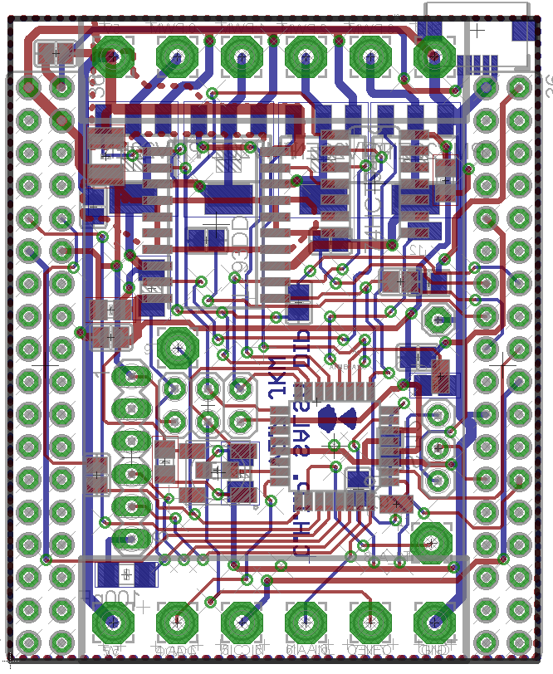
Salsa DIP PinOut
Low side PWM, 6A, 30V
Or Motor Driver, 600mA
Channel P0,P1,P2,P3
Vin
GND
Micro USB
Atmega pin | DIP pin | Arduino Pin | Digital IN/OUT | Analog IN | PWM out | WS2812 support | C.H.I.P. connection
PD7 | P12 | 7 | X | - | - | X | -
PB0 | P11 | 8 | X | - | - | X | -
PC3 | P10 | 17 | X | X | - | - | -
PD3 | P9 | 3 | X | - | X | X | -
PC2 | P8 | 16 | X | X | - | - | -
PB3 | P7 | 11 | X | - | X | X | -
PD2 | P6 | 2 | X | - | - | X | -
- | P5 | - | - | - | - | - | X
PC1 | P4 | 15 | X | X | - | - | -
PD5 | P3 | 5 | */X | - | X | * | -
PD6 | P2 | 6 | */X | - | X | * | -
PB1 | P1 | 9 | */X | - | X | * | -
PB2 | P0 | 10 | */X | - | X | * | -
P11
P12
4x Transistor
on Bottom or Motor driver + Inverter on the top layer!
Accel header connected to
CHIP I2C_2
P8
ICSP header
UART header
GND
-
-
PC TX
PC RX
Reset
P9
P10
Ws2812 or LED
Vout
GND
P4
P6
Direct connected to CHIP GPIO 7
P7
* Only without transistor
And a little solder bridge

Slide 5
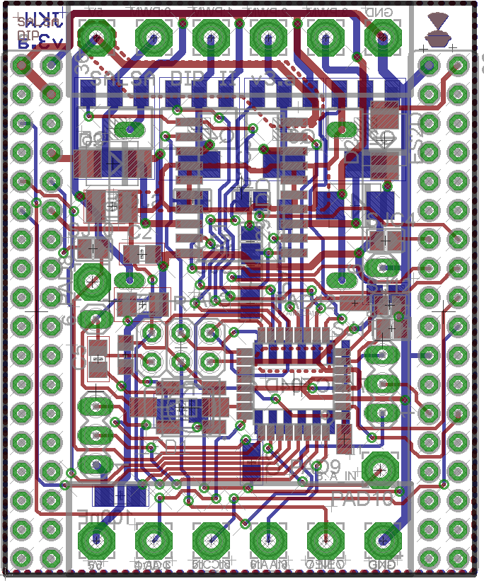
Salsa II DIP PinOut
Low side PWM, 6A, 30V
Or Motor Driver, 600mA
Channel P0,P1,P2,P3
Vin
GND
Atmega pin | DIP pin | Arduino Pin | Digital IN/OUT | Analog IN | PWM out | WS2812 support | C.H.I.P. connection
PD7 | P12 | 7 | X | - | - | X | -
PB0 | P11 | 8 | X | - | - | X | -
PC3 | P10 | 17 | X | X | - | - | -
PD3 | P9 | 3 | X | - | X | X | -
PC2 | P8 | 16 | X | X | - | - | -
PB3 | P7 | 11 | X | - | X | X | -
PD2 | P6 | 2 | X | - | - | X | -
- | P5 | - | - | - | - | - | X
PC1 | P4 | 15 | X | X | - | - | -
PD5 | P3 | 5 | */X | - | X | * | -
PD6 | P2 | 6 | */X | - | X | * | -
PB1 | P1 | 9 | */X | - | X | * | -
PB2 | P0 | 10 | */X | - | X | * | -
P11
4x Transistor
+ Inverter on Bottom and Motor driver + power supply on the top layer!
P12
Accel header connected to
CHIP I2C_2
P8
ICSP header
UART header
GND
-
-
PC TX
PC RX
Reset
P9
P10
LED +
(Ws2812 or button)
Vout
GND
P4
P6
* Only without transistor
And a little solder bridge
Direct connected to CHIP GPIO 7
P7

Slide 6
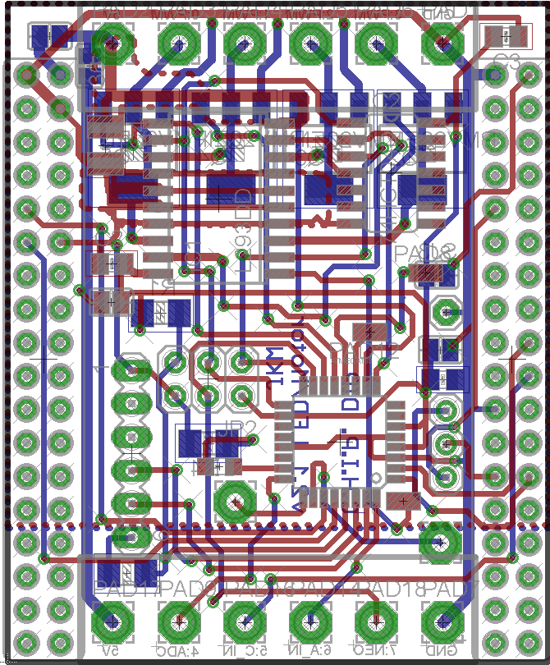
PreSalsa Jumper Config
Vin
Low side PWM, 6A, 30V
Channel T0,T1,T2,T3
GND
SJ | Function
1 | Vin to Charge in If your input voltage is 5V close this jumper. Your Vin will charge your Battery
2 | Vout to Vcc If your Vin is not 5V close it, to get CHIPs 5V on the output If your Vin is 5V and you close SJ5, close this one to power the DIP from the VIN, in this case you must leave SJ3 and SJ4 open!
3 | CHIP 5V to Vcc (bot) If you won’t power the DIP via VIN, close this jumper to supply 5V power via the CHIP If you’ve destroyed your CHIP onboard 5V, close it to supply power to the USB ☺
4 | CHIP 3.3V to Vcc (bot) If you want to work the DIP on the (limited) 3.3V of the CHIP
5 | Vin to Vout To forward your input to the output
SJ1
SJ5
SJ3
SJ2
SJ4
Combine: SJ1 + SJ5 + SJ2 if your Vin is 5V or
SJ2 + SJ3 if you only draw a few mA to use the CHIPs 5V
Vout
GND
Never combine: SJ3 and SJ4 or
SJ4 + SJ2 + SJ5 and supply power via Vin/Vout or
SJ3 + SJ2 + SJ5 and supply power via Vin/Vout or
SJ1 if your Vin is NOT ~5V or SJ2 + SJ5 if your Vin > 5V
PC1
PD2
Direct connected to CHIP GPIO 7
PB3

Slide 7
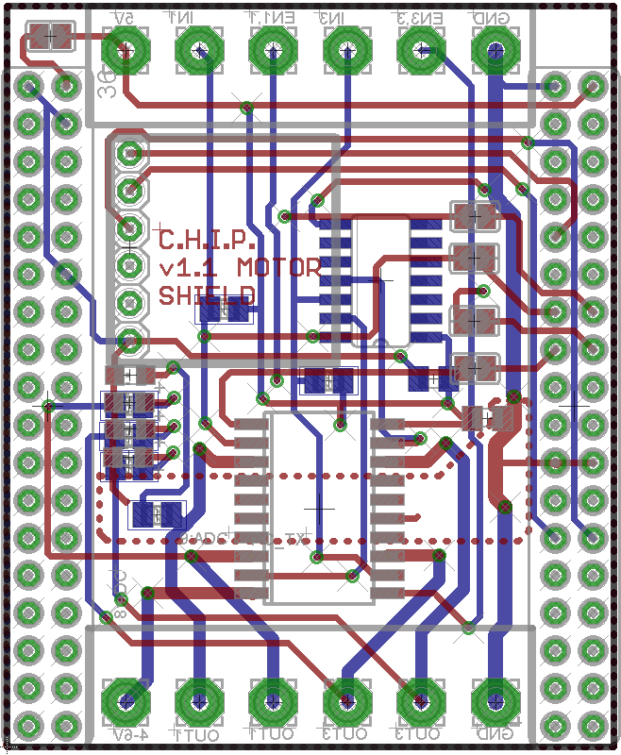
Motor DIP v1.1 Pin Out
P3
P1
Vin
P0
P2
GND
# | Function
Vin | Logic voltage, 5V
P0 | Channel 1 direction
P1 | Channel 1 enable
P2 | Channel 3 direction
P3 | Channel 3 enable
GND | Ground for logic voltage
VHin | “High” voltage for Motor (5-36 Volt), can be connected to Vin
P4 | Channel 1 output
P5 | Channel 2 output (inverse of channel 1)
P6 | Channel 3 output
P7 | Channel 4 output (inverse of channel 3)
GND | Ground for “high” voltage
Inverter
Accel
Header for
Sparkfun:
MMA8452Q Connected to CHIP I2C bus
P9
CHIP GPIO P0, P1, P2, P3 can be used instead of screw header
Status LED
Motor
Driver IC
L293DD
VHin
GND
P4
P6
P5
P7

Slide 8
P3
Motor DIP v1.1 Jumper Config
P1
Vin
P0
P2
GND
SJ5
SJ | Function
1-4 | Use CHIP GPIO as input Close them, if you use the CHIP GPIO to generate the control signals. Leave them open if you want to use the screw header
5 | Vin to Charge in Close it if you Vin is 5V from a power supply or external battery to power this CHIP over this pin as well Leave it open, if you feed the CHIP 5V to the Vin
SJ1-4
Accel
Header for
Sparkfun:
MMA8452Q Connected to CHIP I2C bus
P9
CHIP GPIO P0, P1, P2, P3 can be used instead of screw header
Status LED
(resistors on bot,
LED and resistor aren’t populated)
Motor
Driver IC
L293DD
VHin
GND
P4
P6
P5
P7

