Slide 1
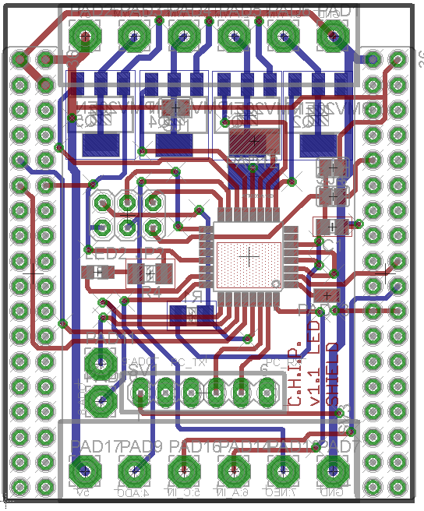
Pin OUT v1.1 LED/Arduino/PWM DIP
Low side PWM, 6A, 30V
Or Motor Driver, 600mA
Channel P0,P1,P2,P3
Vin
GND
Atmega pin | DIP pin | Arduino Pin | Digital IN/OUT | Analog IN | PWM out | WS2812 support | C.H.I.P. connection
PD7 | P12 | 7 | X | - | - | X | -
PB0 | P11 | 8 | X | - | - | X | -
PC3 | P10 | 17 | X | X | - | - | -
PD3 | P9 | 3 | X | - | X | X | -
PC2 | P8 | 16 | X | X | - | - | -
PB3 | P7 | 11 | X | - | X | X | -
PD2 | P6 | 2 | X | - | - | X | -
- | P5 | - | - | - | - | - | X
PC1 | P4 | 15 | X | X | - | - | -
PD5 | P3 | 5 | */X | - | X | * | -
PD6 | P2 | 6 | */X | - | X | * | -
PB1 | P1 | 9 | */X | - | X | * | -
PB2 | P0 | 10 | */X | - | X | * | -
P12
4x Transistor
on Bottom or Motor driver + Inverter on the top layer!
P11
ICSP header
P9
P10
P8
UART header
GND
-
-
PC TX
PC RX
Reset
Vout
GND
P4
P6
Direct connected to CHIP GPIO 7
P7
* Only without transistor
And a little solder bridge

