Slide 1
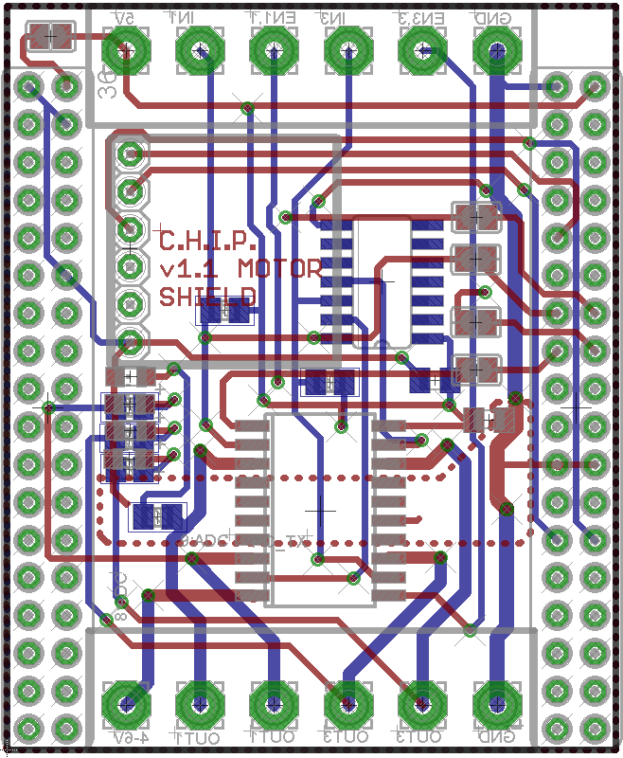
Pin OUT v1.1 Motor DIP
P3
P1
Vin
P0
P2
GND
# | Function
Vin | Logic voltage, 5V
P0 | Channel 1 direction
P1 | Channel 1 enable
P2 | Channel 3 direction
P3 | Channel 3 enable
GND | Ground for logic voltage
VHin | “High” voltage for Motor (5-36 Volt), can be connected to Vin
P4 | Channel 1 output
P5 | Channel 2 output (inverse of channel 1)
P6 | Channel 3 output
P7 | Channel 4 output (inverse of channel 3)
GND | Ground for “high” voltage
Inverter
Accel
Header for
Sparkfun:
MMA8452Q Connected to CHIP I2C bus
P9
CHIP GPIO P0, P1, P2, P3 can be used instead of screw header
Status LED
Motor
Driver IC
L293DD
VHin
GND
P4
P6
P5
P7

