Slide 1
Operation week 6 presentation

Slide 2
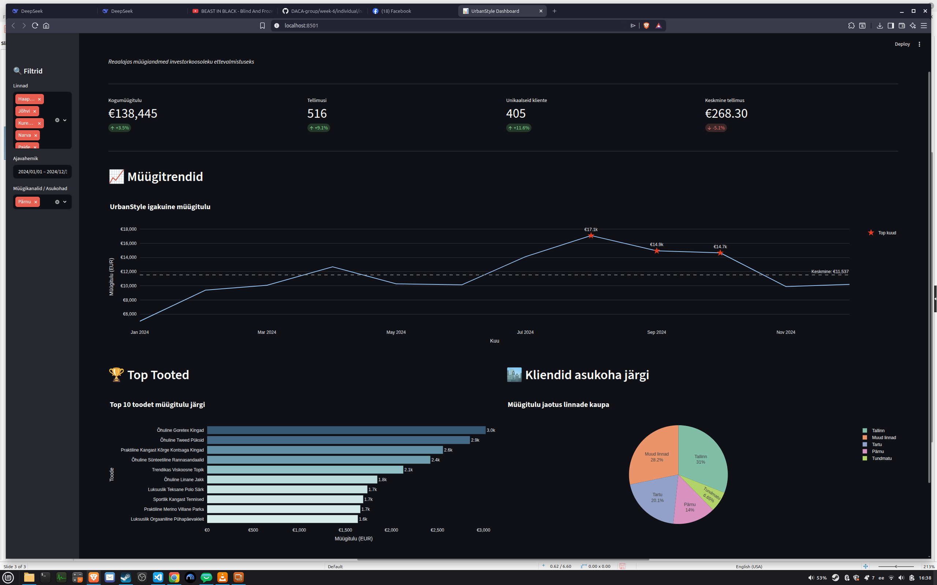

Slide 3
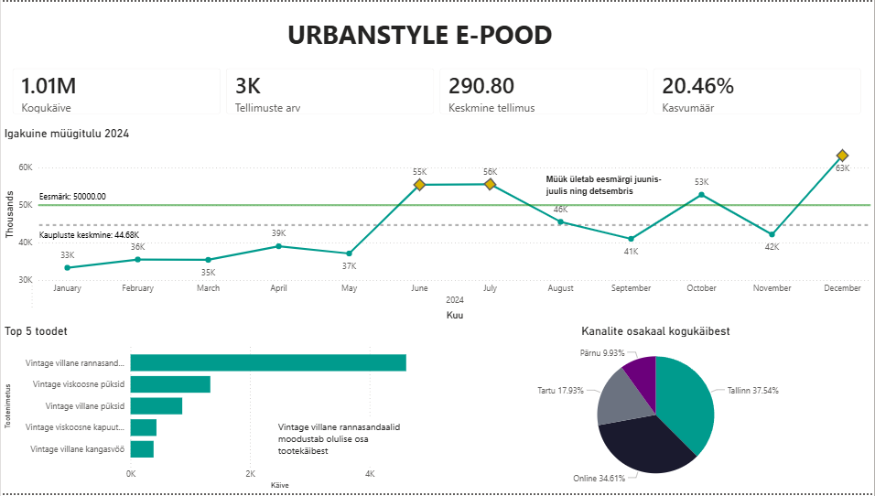

Slide 4
