Slide 1


Six Things to Know About Wisconsin Small-Business Finance
August 2026
Notes:
[Sources]
Content: 2026 Small Business Finance Report (final report supplied by the author).
Editorial wording: Wisc_smallbiz_finance_soundbites.pptx.
Visual template: extension_example.pptx, source slide 1.

Slide 2
1. Wisconsin has nearly half as many banking institutions as it did in 2000.
Notes:
[Sources]
2026 Small Business Finance Report, p. 6: institutions fell from 365 in 2000 to 193 in 2024 (−47.1%).
Editorial wording: Wisc_smallbiz_finance_soundbites.pptx, Fact 1.
Visual template: extension_example.pptx, source slide 2.

Slide 3
Nearly
HALF
as many banking institutions operate in Wisconsin as in 2000
Notes:
[Sources]
2026 Small Business Finance Report, p. 6: 365 institutions in 2000 versus 193 in 2024; branches fell from 2,116 to 1,661.
Visual template: extension_example.pptx, source slide 16.

Slide 4
2. A branch count can hide a long drive.
Notes:
[Sources]
2026 Small Business Finance Report, p. 10: five- and ten-mile lending deserts persist, especially in northern Wisconsin.
Visual template: extension_example.pptx, source slide 2.

Slide 5
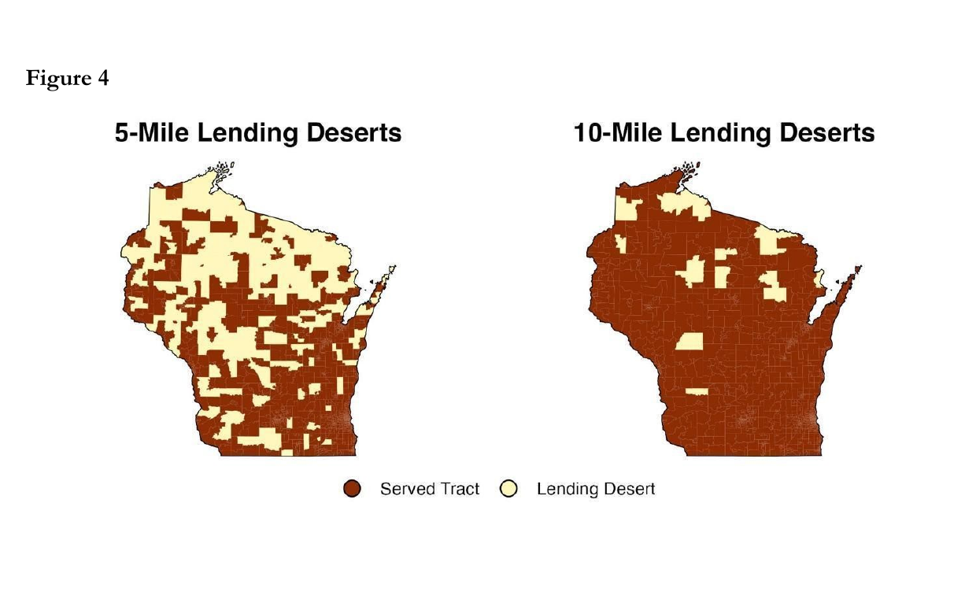
5
AND
10
MILE LENDING DESERTS span northern Wisconsin
Notes:
[Sources]
Map and metric: 2026 Small Business Finance Report, p. 10, Figure 4. The report notes that some residents may travel more than 20 miles round trip to reach a branch.
Visual template: extension_example.pptx, source slide 11; UW Extension logo inherited from the reference deck.

Slide 6
3. Small-business lending contracted—and small loans dominate what remains.
Notes:
[Sources]
2026 Small Business Finance Report, p. 12: Wisconsin small-business lending remained below pre-crisis levels in 2023.
Editorial wording: Wisc_smallbiz_finance_soundbites.pptx, Fact 2, limited to the CRA loan-size range supported by the final report.
Visual template: extension_example.pptx, source slide 2.

Slide 7
Loans under $100,000 dominate by count—not by dollars.
91.5%
of loans
30.6%
of dollars
Notes:
[Sources]
2026 Small Business Finance Report, p. 12: in 2023, loans under $100,000 were 91.5% of CRA loan count but 30.6% of dollar volume.
Visual template: extension_example.pptx, source slide 15.

Slide 8
4. Credit unions consolidated while expanding their branch networks.
Notes:
[Sources]
2026 Small Business Finance Report, pp. 15–16: Wisconsin credit unions declined from 191 institutions in 2010 to 140 in 2024, while branches rose from 546 to 696.
Editorial wording: Wisc_smallbiz_finance_soundbites.pptx, Fact 3.
Visual template: extension_example.pptx, source slide 2.

Slide 9
6.5:1
branches per credit union in 2024 up from 2.8:1 in 2010
Notes:
[Sources]
2026 Small Business Finance Report, p. 16, Figure CU-2: 696 branches and 140 institutions in 2024; approximately 6.5 branches per institution, versus 2.8 in 2010.
Visual template: extension_example.pptx, source slide 18.

Slide 10
5. Credit unions are lending more—but not more often.
Notes:
[Sources]
2026 Small Business Finance Report, p. 18: per-capita credit-union commercial lending rose while originations stayed near 9–11 per 10,000 residents.
Editorial wording: Wisc_smallbiz_finance_soundbites.pptx, Fact 4.
Visual template: extension_example.pptx, source slide 2.

Slide 11
Larger loans—not more loans—drove growth.
2017
2024
$185K average commercial loan
$485K average commercial loan
Notes:
[Sources]
2026 Small Business Finance Report, p. 18: average commercial loan size increased from approximately $185,000 in 2017 to $485,000 in 2024; origination frequency remained relatively flat.
Visual template: extension_example.pptx, source slide 14.

Slide 12
6. Wisconsin attracts venture capital—but remains in the lower third nationally.
Notes:
[Sources]
2026 Small Business Finance Report, pp. 22 and 24: Wisconsin firms raised approximately $3.8 billion from 2015–2024; Wisconsin ranked 35th among 45 contiguous states shown on a per-capita basis.
Editorial wording: Wisc_smallbiz_finance_soundbites.pptx, Fact 5, with the final-report total of $3.8 billion.
Visual template: extension_example.pptx, source slide 2.

Slide 13
35th of 45 states in per-capita VC. ≈$3.8B raised 2015–2024.
Notes:
[Sources]
2026 Small Business Finance Report, p. 24: Wisconsin ranked 35th among the 45 contiguous states shown in per-capita venture-capital investment.
2026 Small Business Finance Report, p. 22: Wisconsin firms raised approximately $3.8 billion from 2015–2024.
Visual template: extension_example.pptx, source slide 3.

Slide 14
The takeaway: Wisconsin has capital—but access, scale, and local control remain uneven.
Notes:
[Sources]
Synthesis of the six findings presented in the 2026 Small Business Finance Report.
Visual template: extension_example.pptx, source slide 2.

