Slide 1
CAPSTONE PROJECT
CROP PRODUCTION DATASET

Slide 2
DATASET DESCRIPTION
The "Crop Production" dataset provides valuable insights into the agricultural landscape of India. It includes detailed information on crop production across various states, regions, and seasons over multiple years. The dataset offers comprehensive data for analysis and modeling of crop yield trends, crop diversity, and regional agricultural practices in India.

Slide 3
FEATURES
State_Name: The state or union territory in India where the crop was produced.
District_Name: The specific district within the state where the crop production data was collected.
Season: The agricultural season during which the crop was grown. This could include seasons like Kharif, Rabi, Summer, Autumn and Winter, as well as a whole year overview.
Crop_Year: The year of crop production data, spanning from 1997 to 2015.
Crop: The name of the crop grown in the respective state/district during the specific year and season. There are 124 distinct crops.
Area: The area (in hectares) where the crop was cultivated.
7. Production: The total quantity of the crop harvested, typically measured in tons or kilograms.

Slide 4
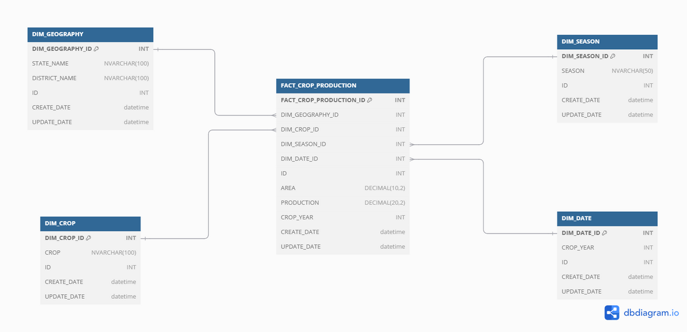
DB MODEL

Slide 5
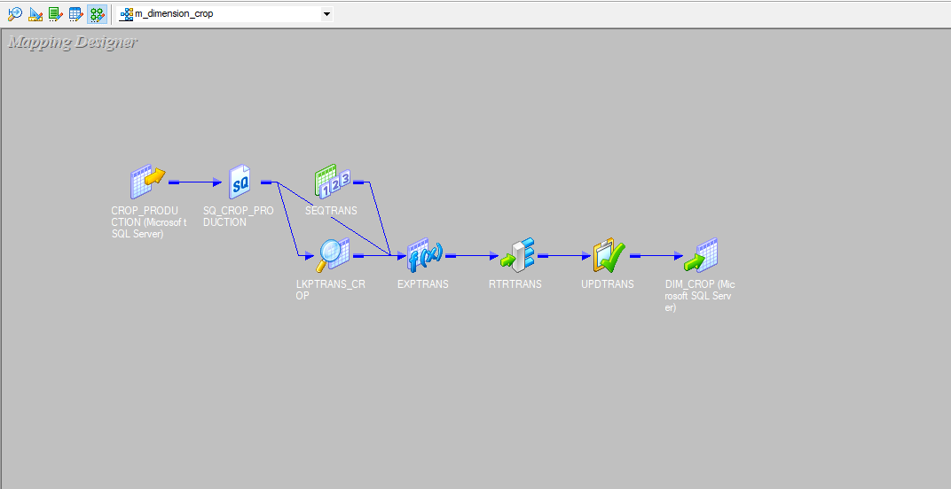
DIM_CROP

Slide 6
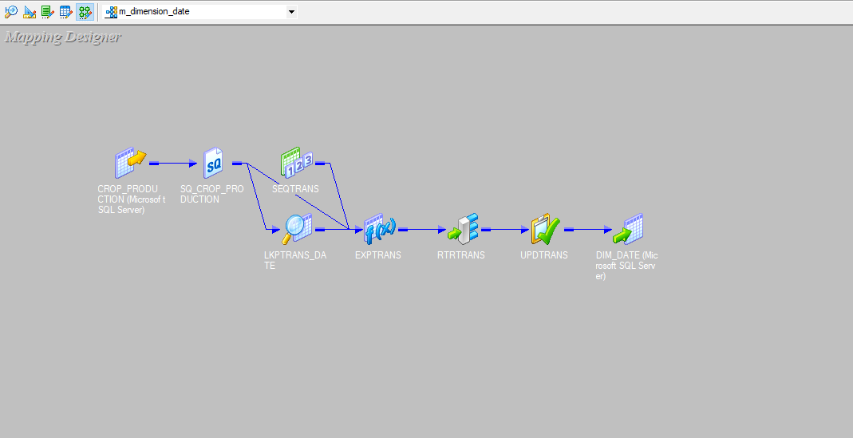
DIM_DATE

Slide 7

DIM_SEASON

Slide 8
DIM_GEOGRAPHY

Slide 9
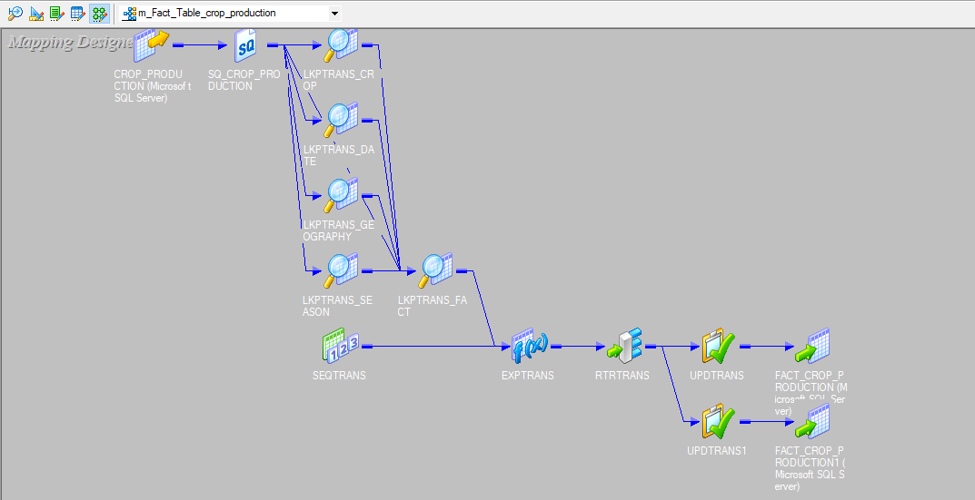
FACT TABLE

Slide 10
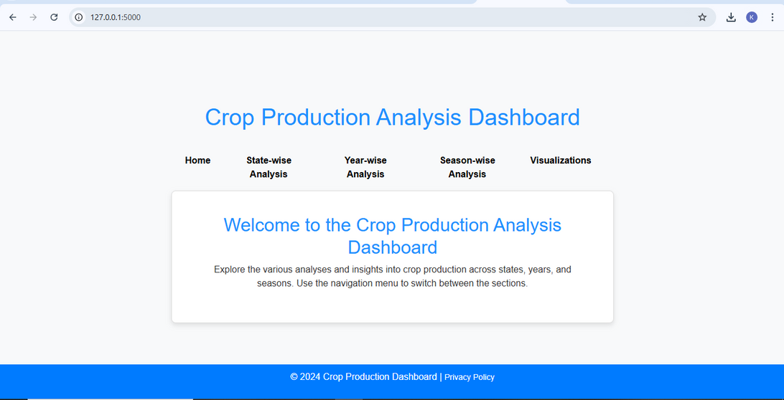
FRONT END SCREENS

Slide 11
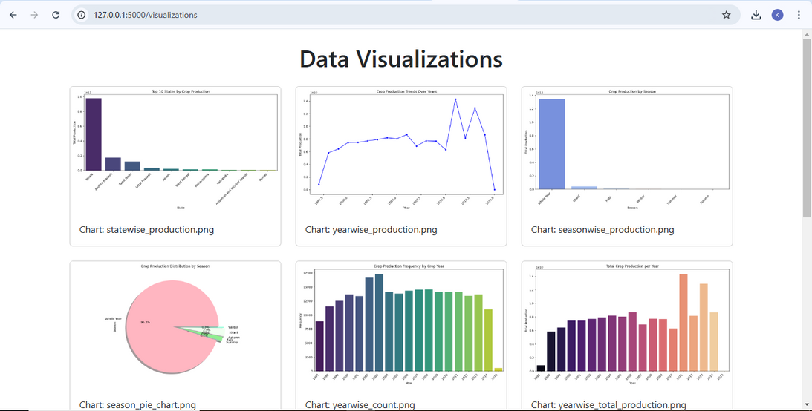
FRONT END SCREENS

Slide 12
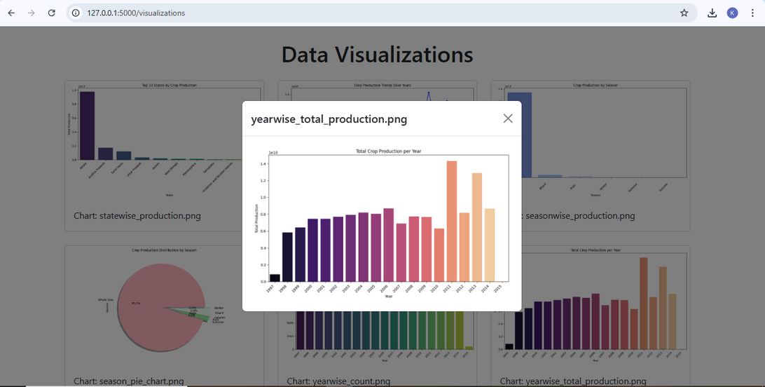
FRONT END SCREENS

Slide 13
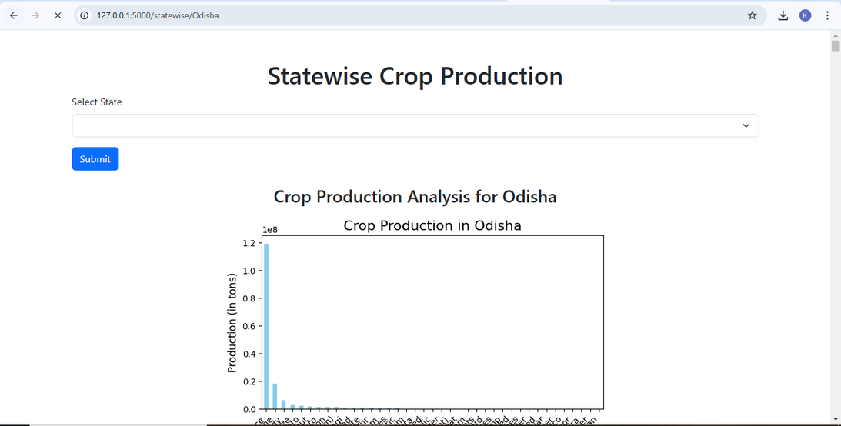
FRONT END SCREENS

Slide 14
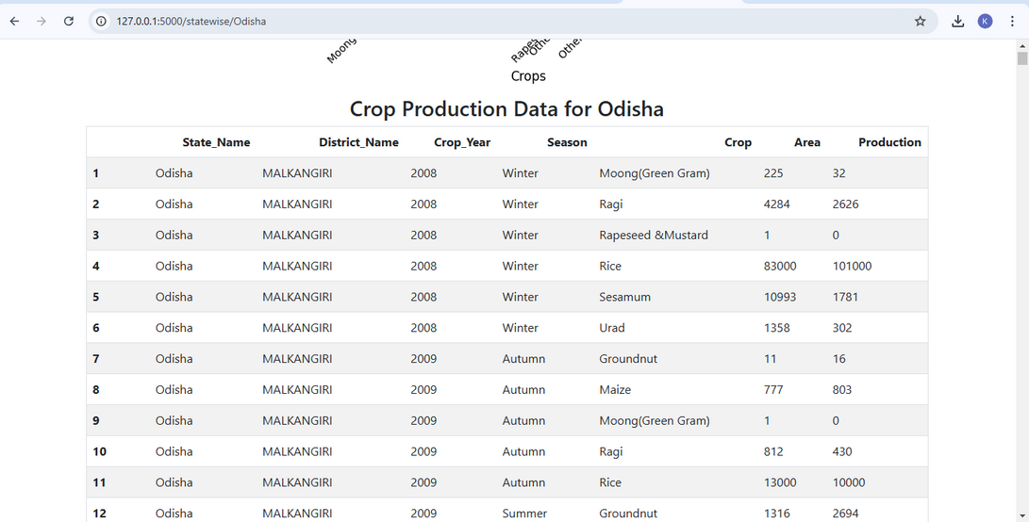
FRONT END SCREENS

Slide 15
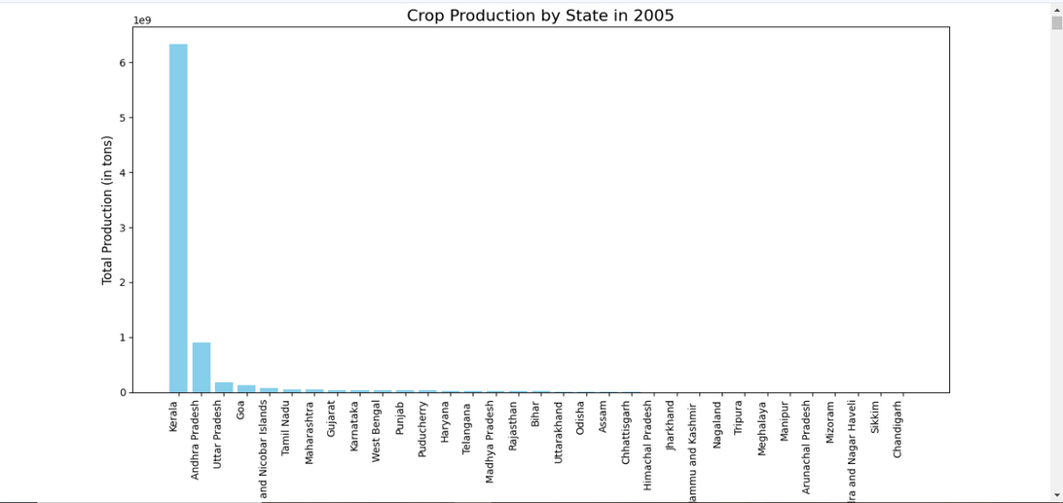
FRONT END SCREENS

Slide 16
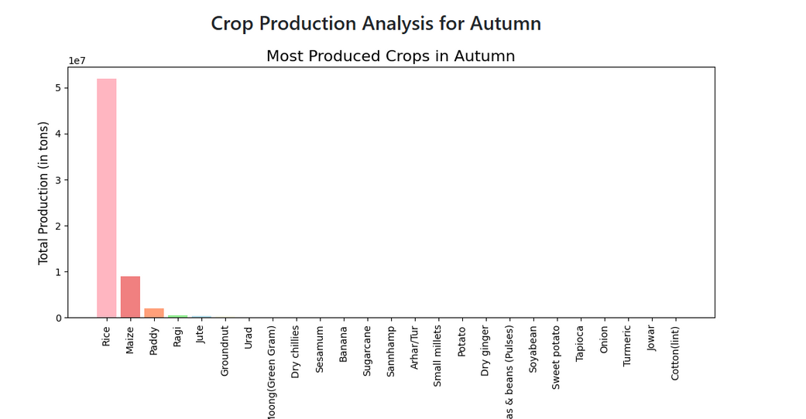
FRONT END SCREENS

Slide 17
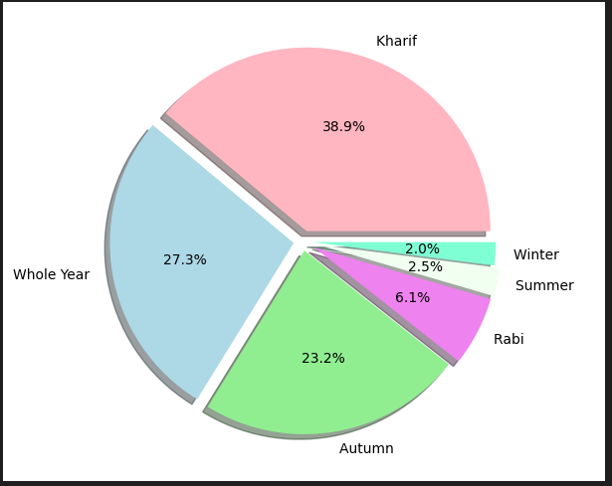
FRONT END SCREENS

Slide 18
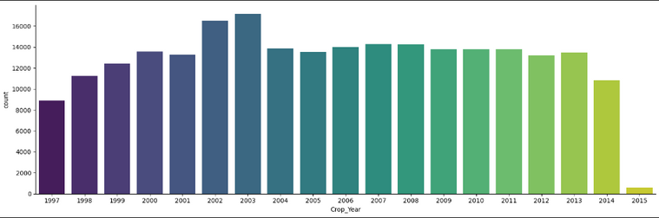
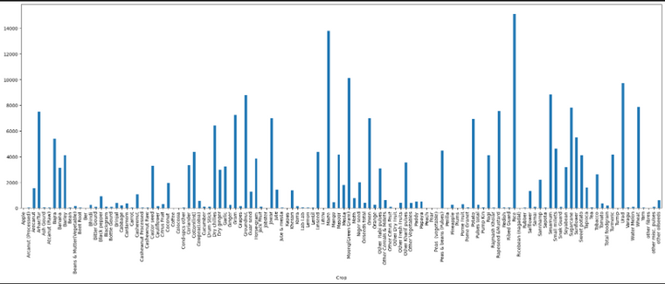
FRONT END SCREENS

Slide 19
THANK YOU

