Slide 1
Image Plagiarism
Here is where your presentation begins

Slide 2
Kollapudi Jeevan Kumar 2010030305 Indla Harshitha 2010030300 P. Arun Tej Reddy 2010030262 P. Venkata Sai Adithya 2010030434
Team Members
Under the Guidance of
Dr. Figlu Mohanty
Assistant Professor
Computer Science and Engineering Department
KL Hyderabad Off Campus, Aziz Nagar ,Hyderabad

Slide 3

OVERVIEW
Introduction
Literature Review
Problem Statement
Objectives of the Project
Proposed Methodology/Architecture/Algorithm/Technique/etc
References

Slide 4
Introduction
Image similarity can be thought of as a numerical representation of how alike two images are in terms of their visual content.
There are several dimensions along which images can be similar, such as color, shape, texture, and composition.
Various mathematical and computational methods are employed to quantify these similarities, enabling us to compare and categorize images efficiently.

Slide 5
LITERATURE REVIEW
S. No | Author | Title | Publish Year
1. | Shanmukh Thummala | Understanding Keypoints and ORB algorithm | 2020
2. | Vasista Reddy | Exploring Image Similarity Approaches in Python | 2023
3. | Param Raval | Measuring similarity in two images using Python | 2021
4. | Rendyk | Beginner’s Guide to Image and Text Similarity | 2022
5. | Mike Bijon | Measuring image similarity with opencv | 2021

Slide 6
PROBLEM STATEMENT
In a world inundated with images, the ability to measure and quantify the similarity between images has become a critical task.
Whether it’s for image retrieval, content recommendation, or visual search, image similarity approaches play a pivotal role in modern applications.
Fortunately, Python offers a plethora of tools and libraries that make exploring and implementing these approaches accessible to developers and researchers alike.
In this project, we’ll delve into various image similarity techniques and demonstrate how to implement them using Python.

Slide 7
Objectives of the Project
The objective of the Measuring Image Similarity project is to develop a robust algorithm capable of accurately quantifying the similarity between images.
Leveraging advanced computer vision techniques, the project aims to overcome challenges such as variations in lighting, orientation, and scale to provide precise similarity metrics.
Ultimately, the goal is to empower applications in various domains, including content-based image retrieval, recommendation systems, and image classification, enhancing user experiences and facilitating more effective data analysis and decision-making processes.

Slide 8
Proposed Methodology/Architecture/Algorithm/Technique/etc
SSIM is a widely used metric that assesses the structural similarity between two images. It considers luminance, contrast, and structure, giving a score between -1 (dissimilar) and 1 (identical). The scikit-image library in Python offers an SSIM implementation.
ORB (Oriented Fast Rotated Brief) algorithm is used to measure the similarity and other types of similarity measures.
We can use the ORB class in the OpenCV library to detect the keypoints and compute the feature descriptors. First keypoints are identified and then it computes binary feature vectors and groups them all in ORB descriptor.
We have also used Brute force algorithm. Brute-Force matchers are easy to use. It uses a distance computation to match the descriptor of one feature from the first set to every other feature in the second set and they return the nearest one.

Slide 9
Implementation Details
Import cv2
import numpy as np
from skimage.metrics import structural_similarity
img1 cv2.imread("1st.jpg")
img2= cv2.imread("2nd.jpg")
img2 cv2.resize(img2, (img1.shape[1], img1.shape[0]))
g1 = cv2.cvtColor(img1, cv2.COLOR_BGR2GRAY)
g2 = cv2.cvtColor(img2, cv2.COLOR_BGR2GRAY)
(score, diff) = structural_similarity(g1, g2, full=True)
diff (diff*255).astype("uint8")
_, thresh = cv2.threshold(diff, 40, 255, cv2.THRESH BINARY_INV)
contors = cv2.findContours(thresh, cv2.RETR_EXTERNAL, cv2.CHAIN_APPROX_SIMPLE) [0]
contors = [c for c in contors if cv2.contourArea(c) > 80]
if len(contors):
for c in contors:
x,y,w,h = cv2.boundingRect(c)
cv2.rectangle(img1, (x,y), (x+w, y+h), (0,0,255), 4)
while True:
cv2.imshow("window1", img1)
cv2.imshow("window2", img2)
cv2.imshow("window3", thresh)
if cv2.waitKey(0) == 27:
cv2.destroyAllWindows()
break
print(diff)

Slide 10
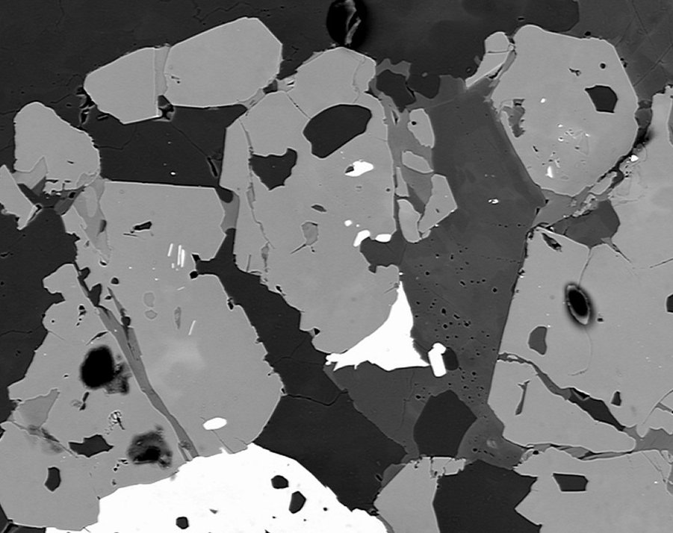
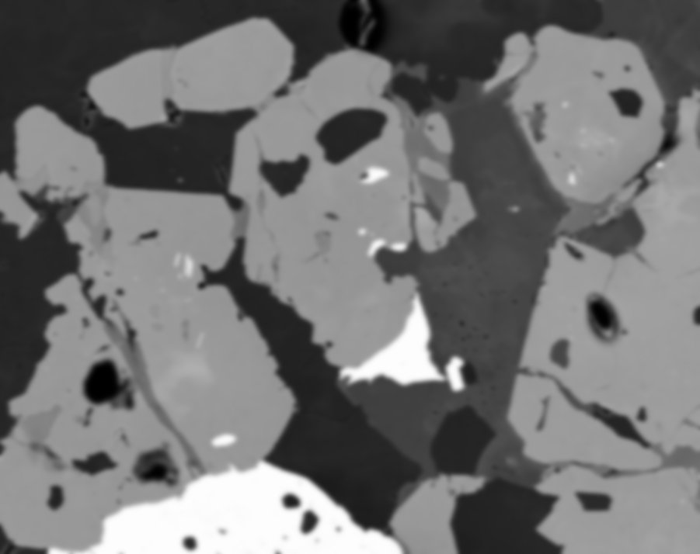
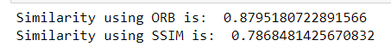
Results

Slide 11
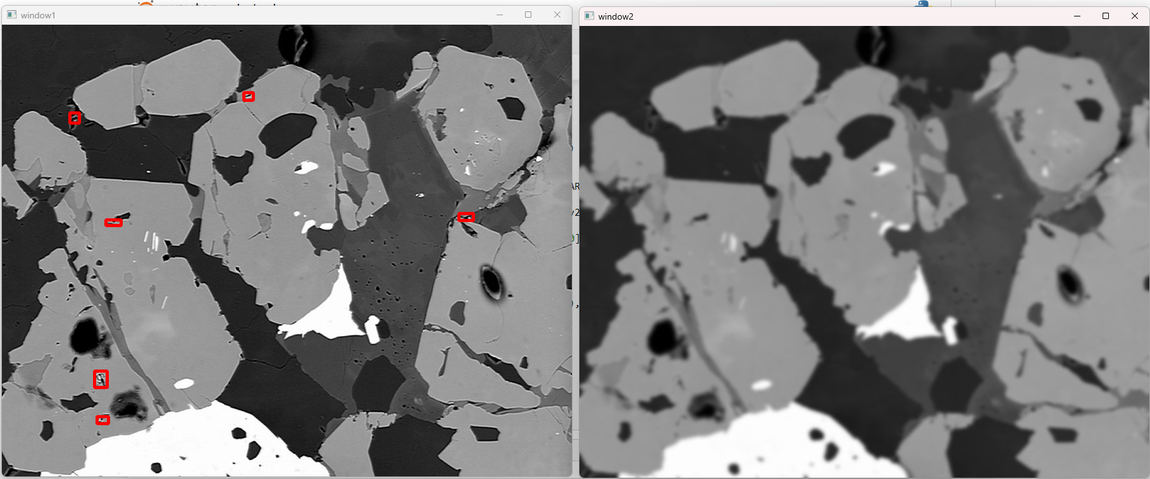

Slide 12
Thanks!

Slide 13
References
https://medium.com/analytics-vidhya/understanding-keypoints-and-orb-algorithm-f260e6fb640c
https://medium.com/scrapehero/exploring-image-similarity-approaches-in-python-b8ca0a3ed5a3
https://pypi.org/project/image-similarity-measures/

