Slide 1
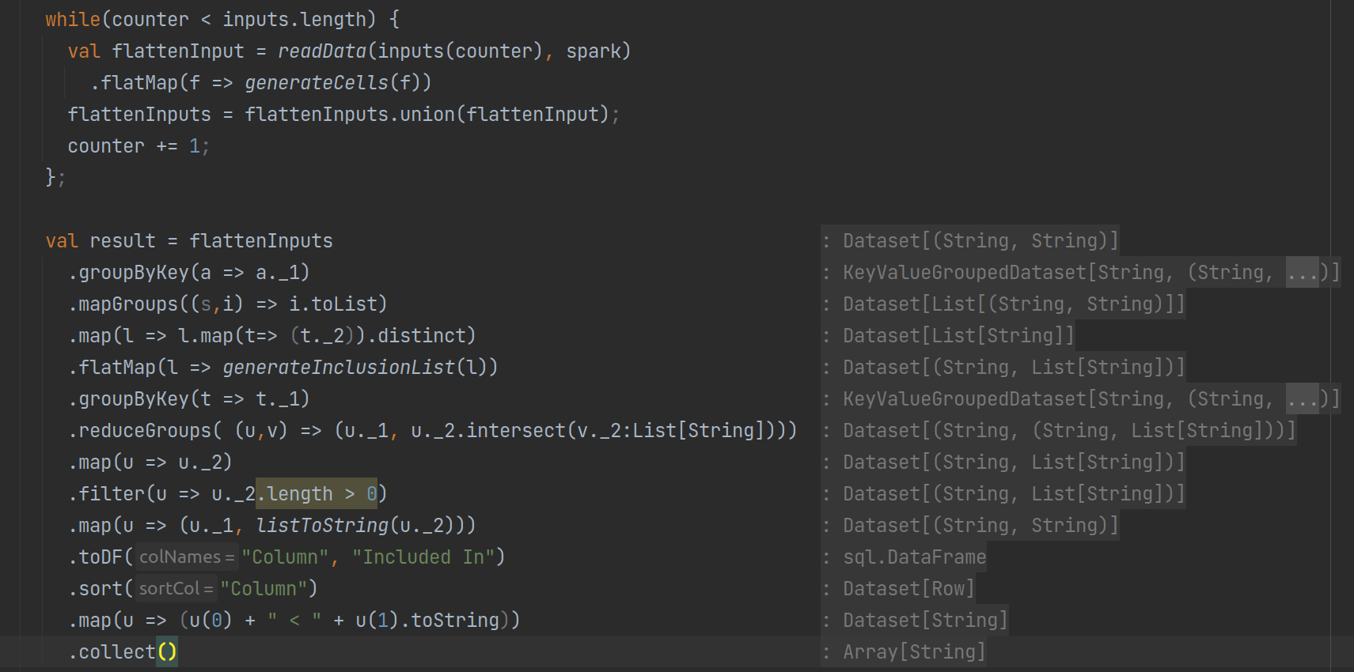
DDMSpark – Central Procrastinating Units (Florian, Yannik) 31.01.2023
C1 | D2 | C3
VW | VW | Audi
Audi
VW | C1
Audi | C1
VW | D2
Audi | C3
VW | VW | C1
 | VW | D2
Audi | Audi | C1
 | Audi | C3
[(VW, C1),(VW, D2)]
[(Audi, C1), (Audi, C3)]
[C1,D2]
[C1,C3]
C1 | (D2)
D2 | (C1)
C1 | (C3)
C3 | (C1)
C1 | C1 | (D2)
 | C1 | (C3)
D2 | D2 | (C1)
C3 | C3 | (C1)
Sindy algorithm implementation
C1 | [C1, ()]
D2 | [D2, (C1)]
C3 | [C3, (C1)]
C1 | ()
D2 | (C1)
C3 | (C1)
„C3 < C1“
„D2 < C1“
C3 | „C1“
D2 | „C1“
D2 | „C1“
C3 | „C1“
D2 | (C1)
C3 | (C1)

Slide 2
Csv files
Read Data
FlatMap:Generate Cells
Union
FlatMap:Generate Cells
Read Data
FlatMap:Generate Cells
Read Data
FlatMap:Generate Cells
UDF: Splits up row into pairs of column names and entries
Map
GroupMap
GroupBy: Entry
UDF: Forgets about the original table entries in the list of cells.
UDF: Maps a group (consisting a key and an interator of cells) to a list of cells.
Groups cells by their 2nd element (original table entry).
FlatMap: Generate Inclusion List
GroupBy: column
UDF: Receives one list of columns which share (at least one) element. Generates a list of all possible INDs for all known columns in its point of view as pair (column, List of possible INDs)
Groups pairs by their 1nd element (column).
Map
toDF/sort
Map
Reduce Group
Collect
Generates Output Strings
Sorts Dataframe/-set as wanted
Forgets about all columns with no INDs
Intersects lists of all possible INDs in a group

