Slide 1
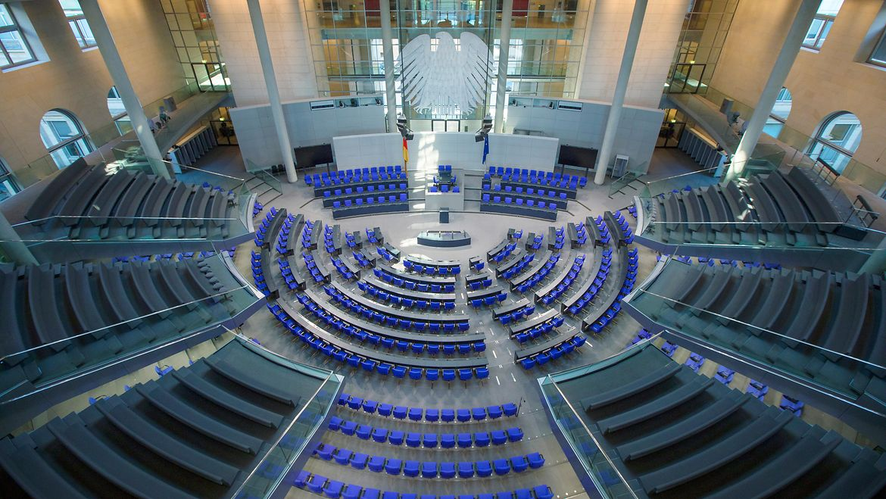
WHO claps
THE MOST?

Slide 2
Parliament sessions
OpenData from Dokumentations- und Informationssystem für Parlamentsmaterialien (DIP)
Parliament sessions available in .xml format (at least election period #19)
All events, e.g. applauses, interruptions,… are logged, but not in a clear, machine-readable format
Participating members are logged
Can be automatically downloaded by using an API: https://dip.bundestag.de/über-dip/hilfe/api#contenthttps://dip.bundestag.de/über-dip/hilfe/api#content

Slide 3
Parliament members
Open Data from Bundestag
.xml format
Curriculum vita (parties, birthday, jobs,…) of all (former) Bundestag members

Slide 4
Showcase
Extract information from the parliament session xml files and compare them to the other dataset
Example: Which job groups clap the most during parliament sessions?
Which party members skip the most parliament sessions? e.g. when celebrating their birthday?

Slide 5
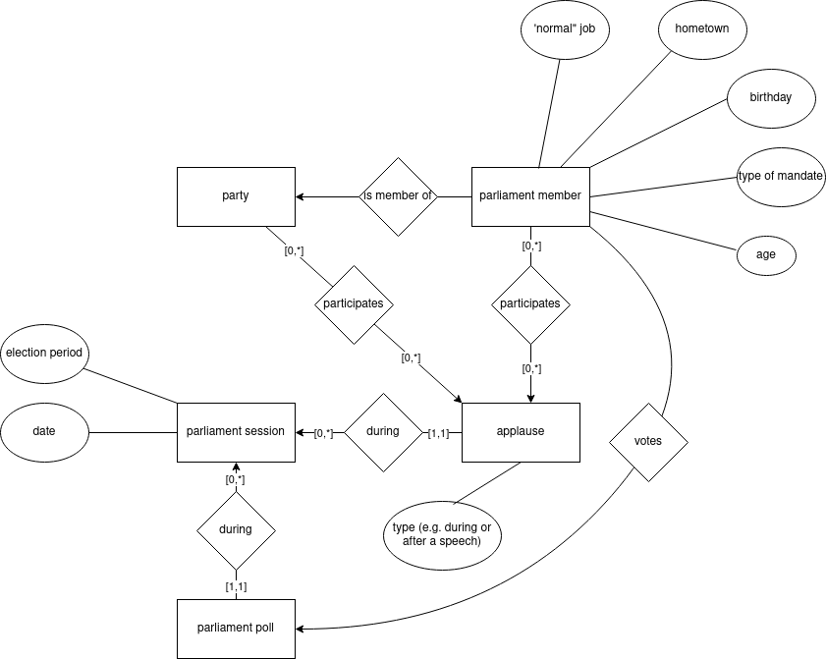
Entity relationship

