Slide 1

Industry Specific Solutions Hackathon
Team name : Dwaj Tech
Team Member : K. Bharadwaj – Innovator/Product Developer
Sponsored By

Slide 2
Problem Statements
Target Industry : Healthcare
> Personalized medicine & healthcare services > Innovative Solutions for Virtual patient care
In the current busy world, it is becoming difficult for patients to follow the timelines, quantity, type of medications as per the doctor's prescriptions. Taking medicine as prescribed is very important for the patient's recovery.
Patients may not take the right medicine in the right quantity at right time in absence of doctor or care giver. Also, chance of human errors are obvious.
On various circumstances, the patient may take multiple pills, in absence of doctor or the caretaker such as taking medicines in home etc.
Patients may even forget to take the medicine, due to their busy schedule or other health issues, old age issues etc.
Free access of the medicines of patients to others in uncontrolled situations like in homes, hostels etc may lead to dangerous consequences.

Slide 3
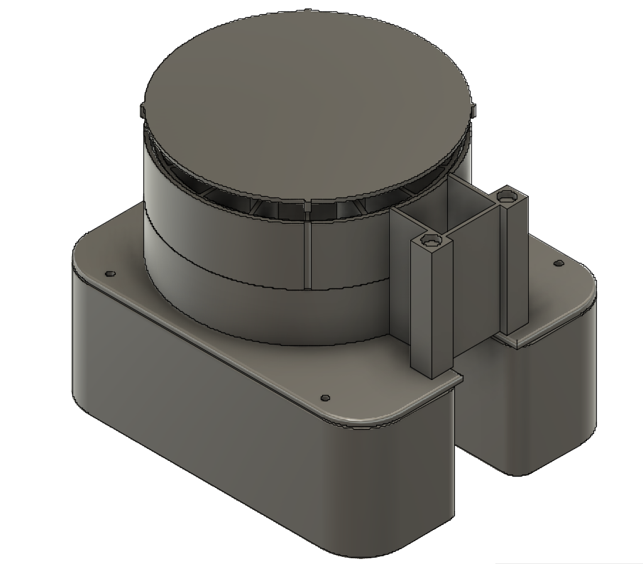


Abstract
The proposed project is an automated system which can deliver/dispense pills to patients based on the programme set as per the prescription given by a doctor or any other programme as per the individual requirement. The system also logs the intake of the different drugs taken by the patient and hopefully reduces drug abuse and monitors drug usage by the patient.

Slide 4
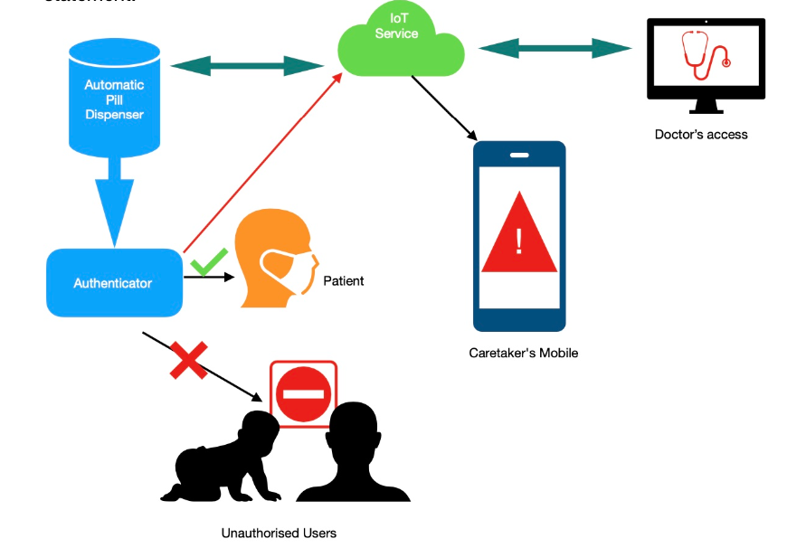
Architecture
The proposed system will be using some of the advanced available technologies like IoT and embedded system with respective software's to solve the problem statement.
Sends a virtual/physical remainder to the patients/caretaker. The virtual remainder can be in the form of a smartphone notification along with a loud broadcast in the form of a siren or a voice assistant.
Once the patient/caretaker acknowledges the remainder, then the pill/medicine needs to be dispensed.
If for any reason the patient/caretaker misses the medicine, an alert will be sent to doctor/caretaker to take further action.
Provides access to monitor patients daily intake of the prescription using IoT and collect the data for various research purposes.
Can adjust the pill dosage based on patient response to the treatment .
The proposed project prevent the patient from taking the wrong medication at wrong time in wrong quantity.

Slide 5
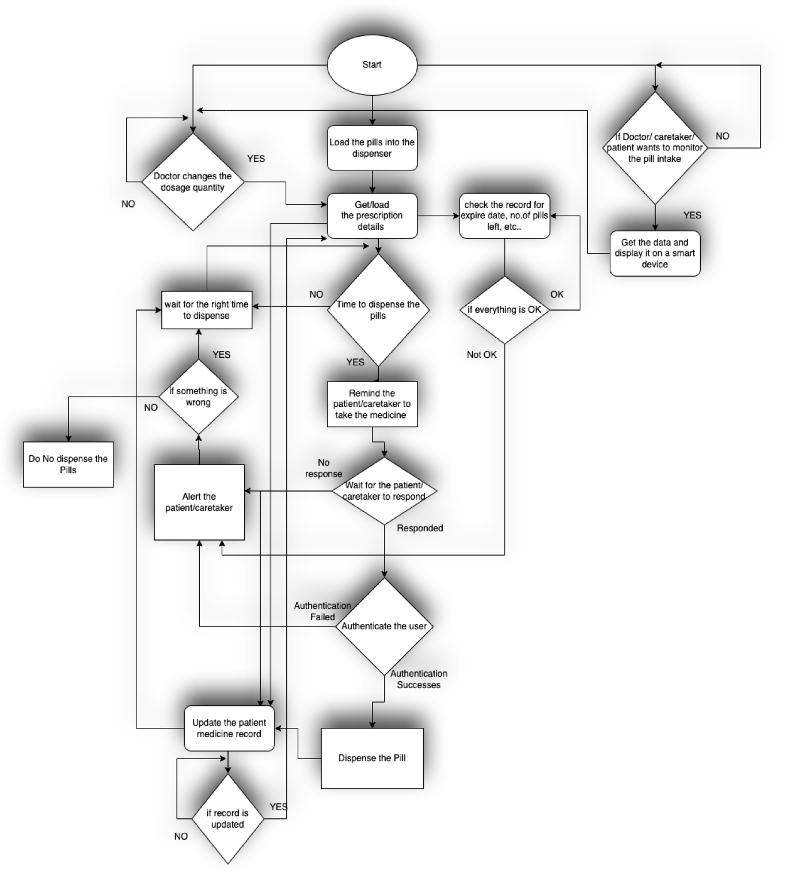
High Level Flow Chart
Note: For better visibility view in full screen mode

Slide 6
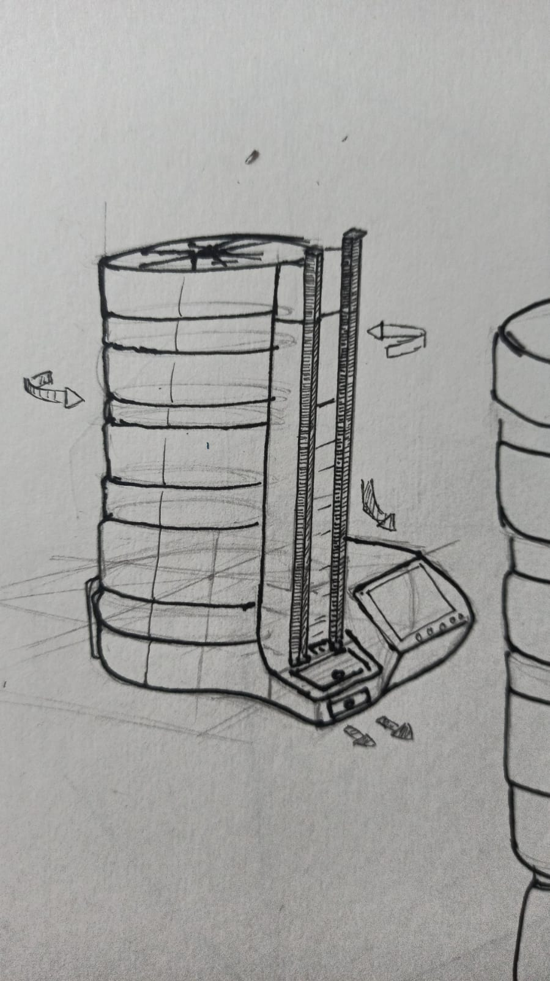
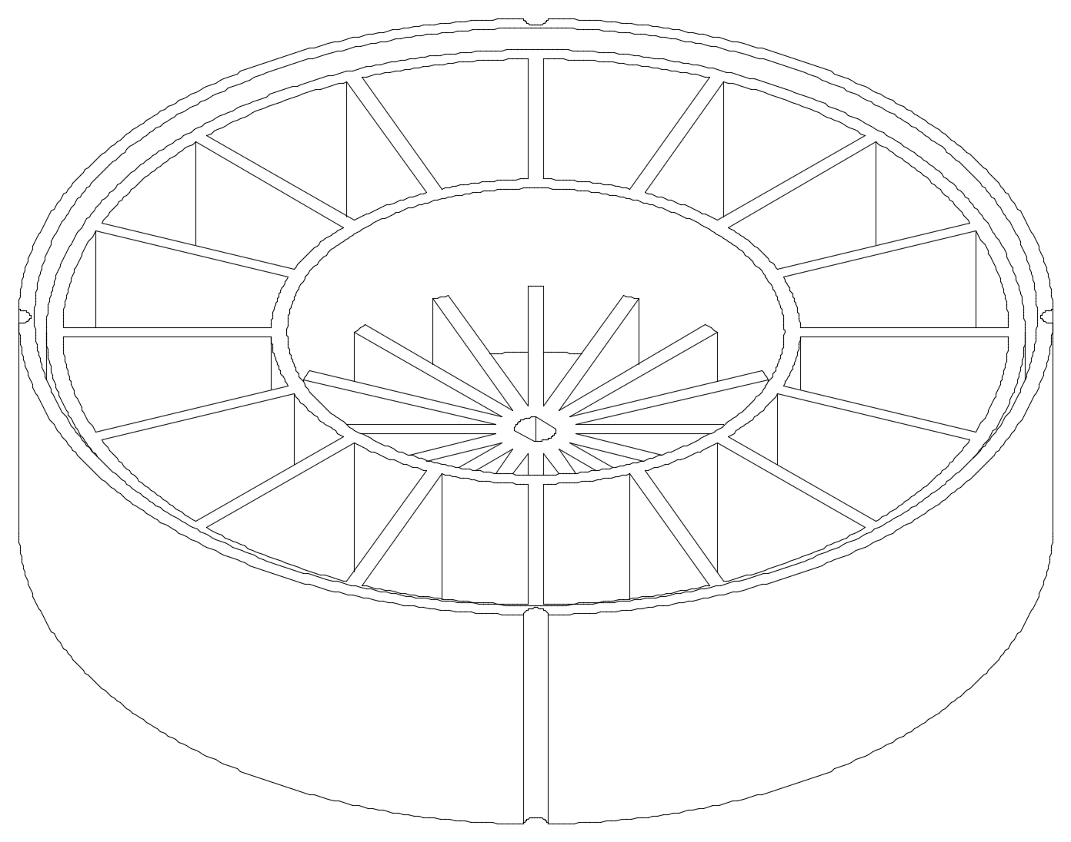
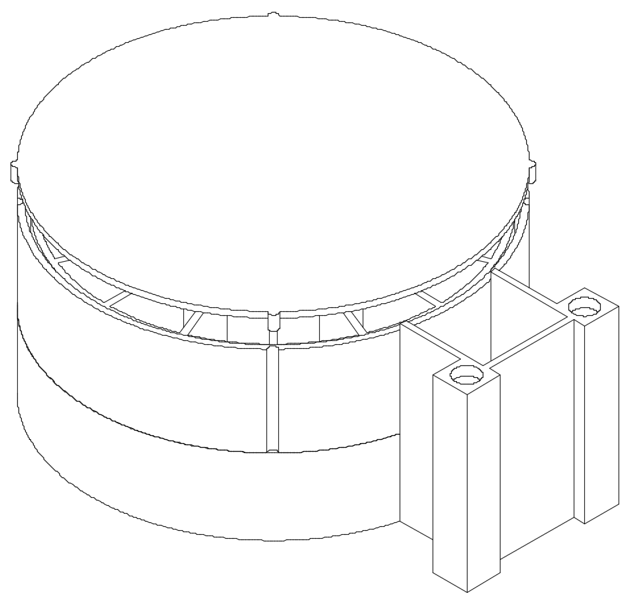
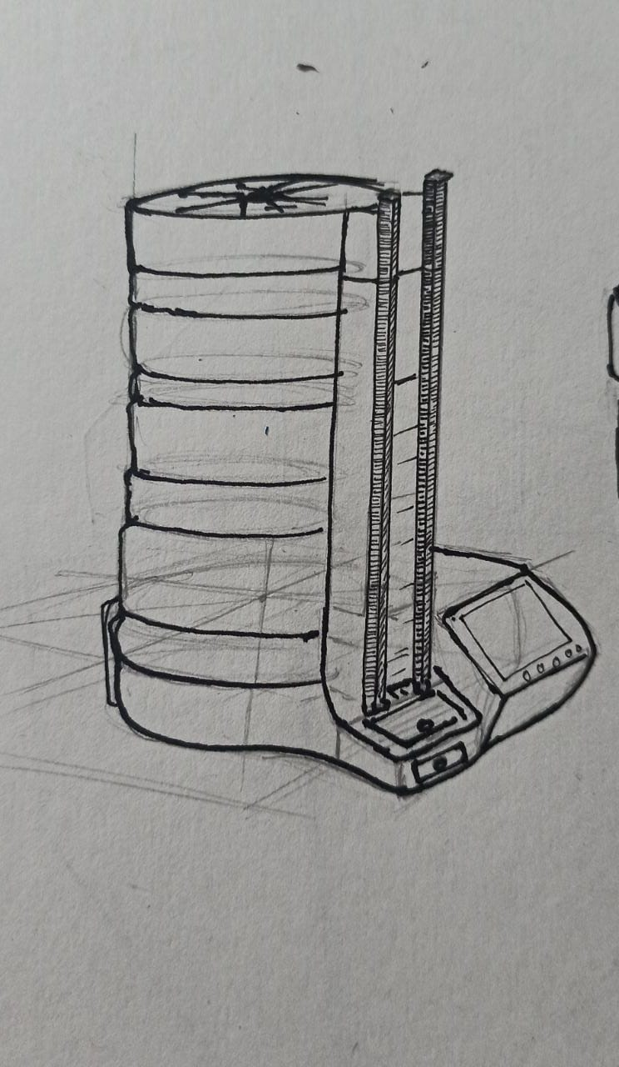
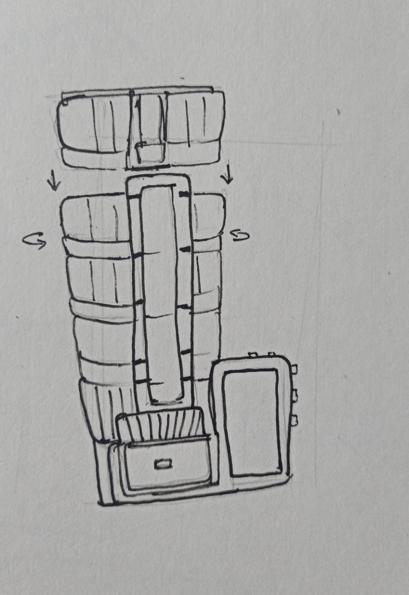
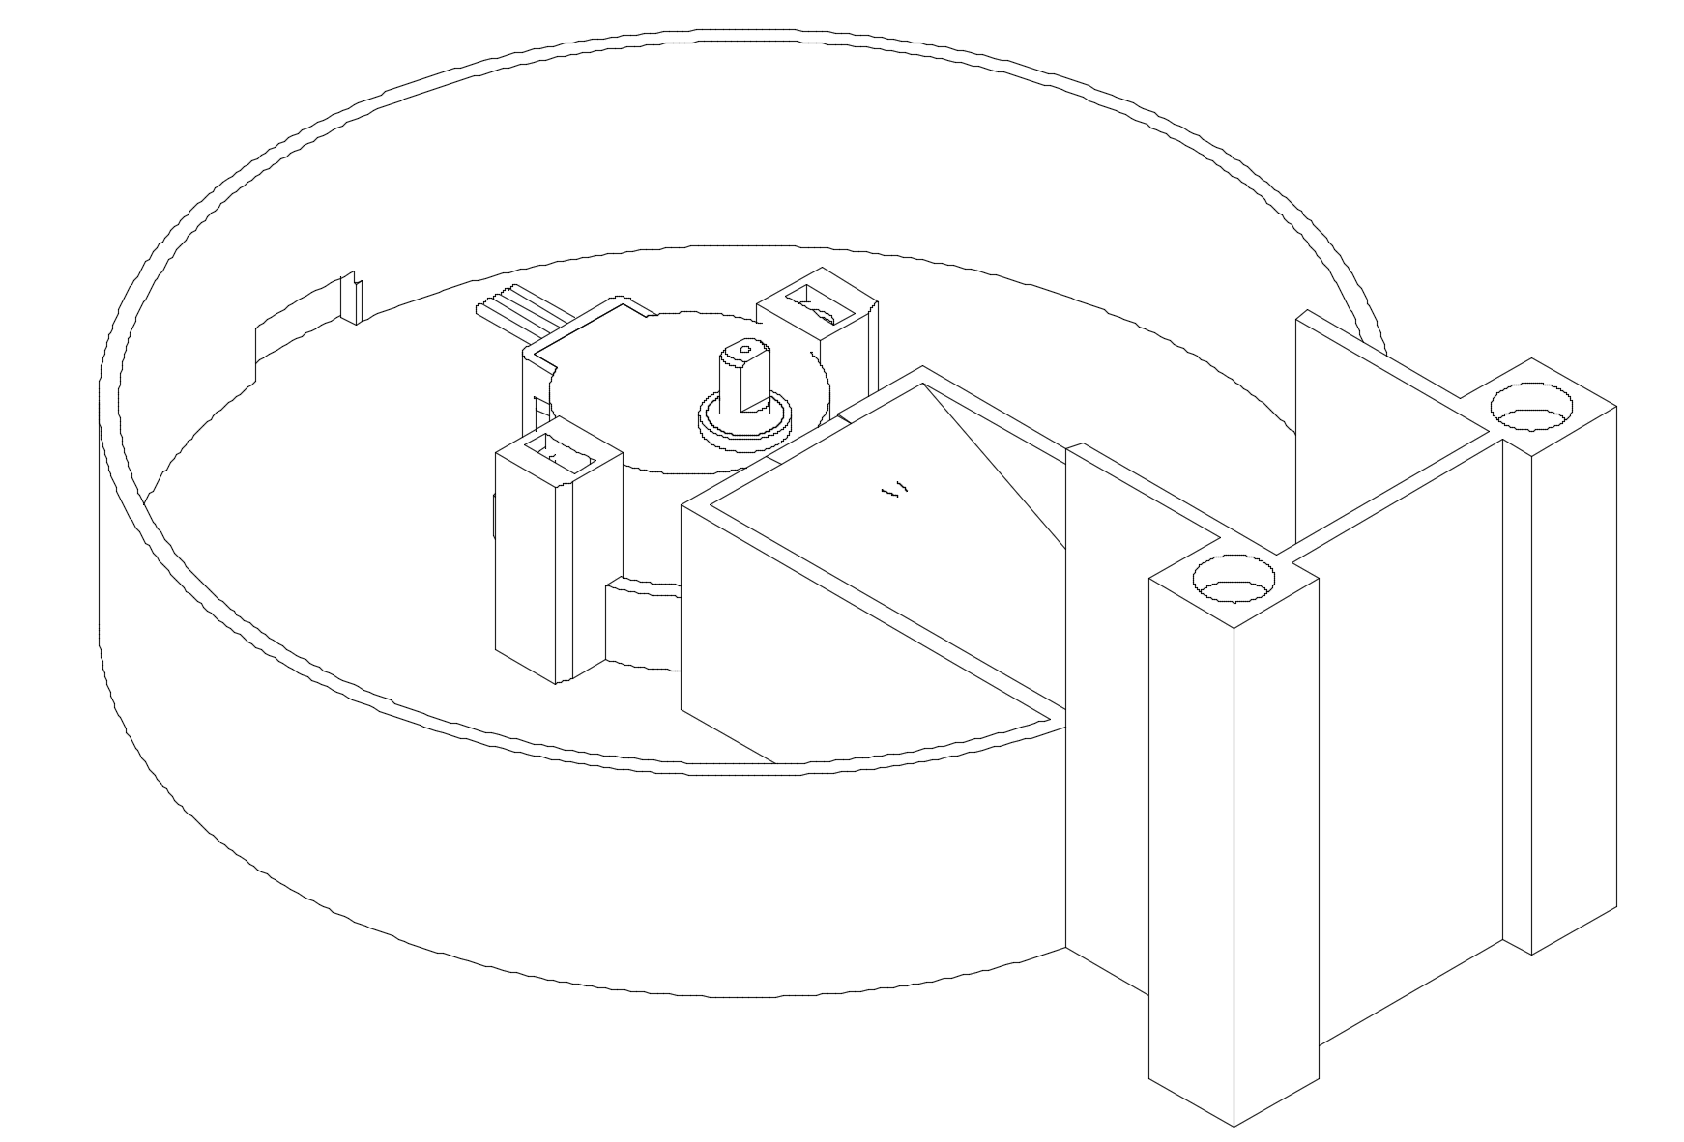
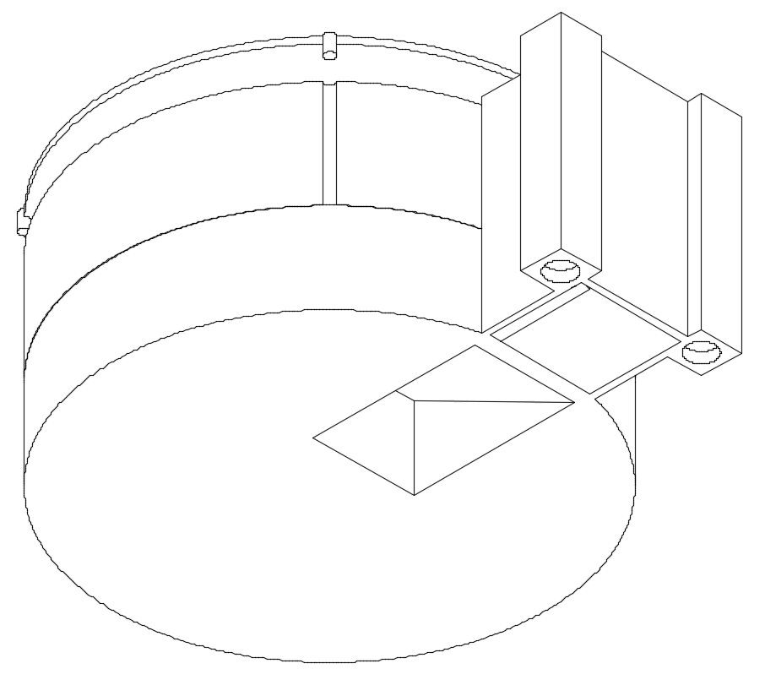
Ideation
Currently we are working on a 3D printed prototype of the same, which is evolved from the hand drawings presented here.

Slide 7

Inventive step / innovation
Modular design, which can be easily customised according to the needs of the patient.
If a patient need only 2 types of pills, then the customer can buy just 2 modules of our product, if the patient needs, say 5 types of pills in a later time, then the customer can buy 3 more modules and add to the existing 2 modules, so that the customer upgrades the system without any hustle.
Creates an ecosystem for the Doctor and patient to monitor their drug usage.
Also provides the doctor an option to adjust the medication based on the patient's response to the treatment
Alerts the doctor or caretaker or a family member, if the patient misses his or her medication, so that corresponding action can be taken.

Slide 8
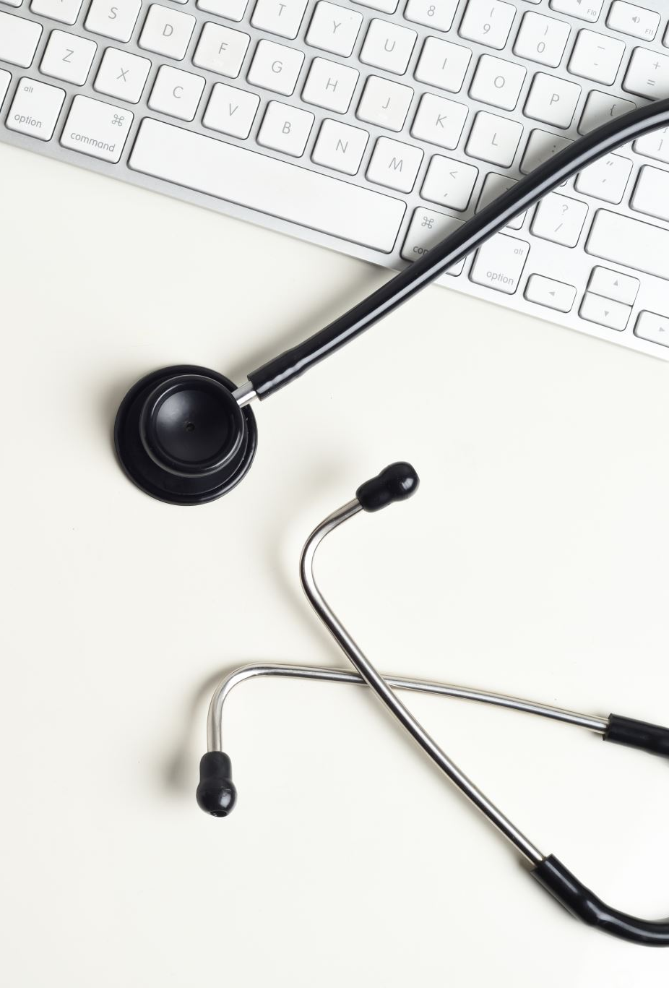
TARGET User Segment
The proposed product will introduce a new segment in the current market either in India or elsewhere for pill dispensers. The proposed product can be sold / given on rent / deployed at different
Retail pharmacy outlets
Hospitals
Nursing Homes
Retainment Homes

Slide 9
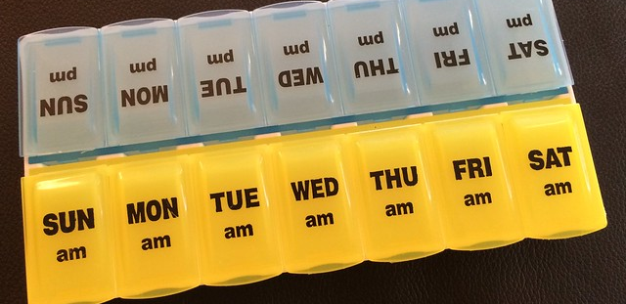
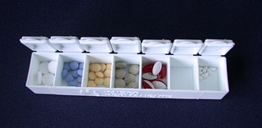
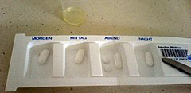
Market analysis
The products displayed on the left side are some of the compotator's products, which can justify some of the needs, but they do not address all the issues mentioned in the problem statement.
The proposed product will introduce a new segment in the current market either in India or elsewhere for pill dispensers. The proposed product can be sold/given on rent at different retail pharmacy outlets, where most of the Indian customers buy regular medicine. The retail outlets also can help the patients in filling the dispenser at their end.
Hospitals also require the product very much as it reduces the work pressure for the caretaker/nurse in reminding/administering the patients. It not only ensures dispensing the medicine but also for maintaining the inventory and to give automatic alters for refilling the dispenser. The doctors also can go through the data of medicine intake without taking the inputs from the caretaker/nurse.

Slide 10
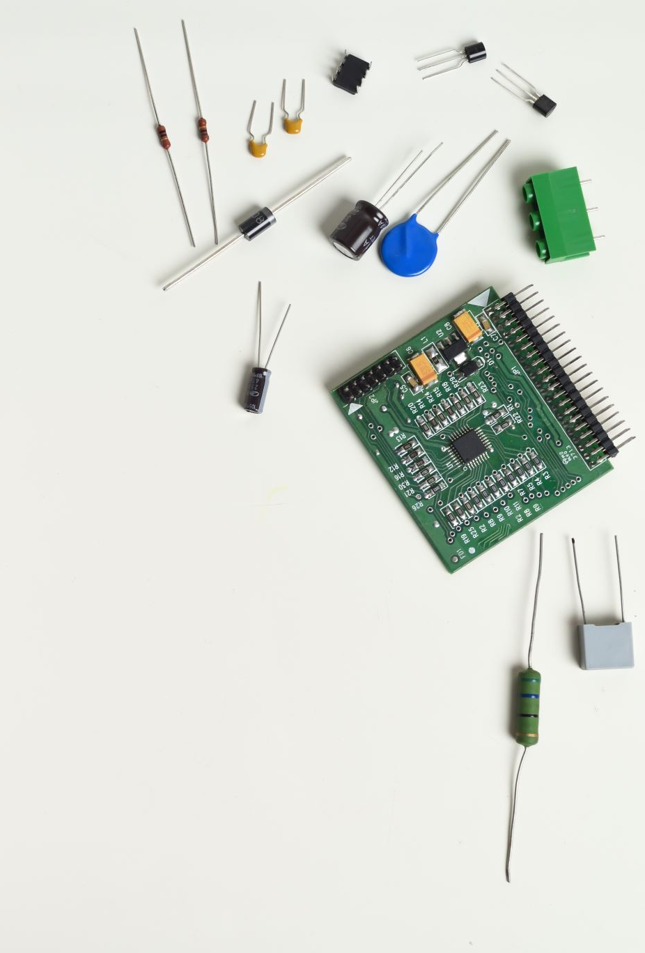
Tools or resources can be used
If my proposal gets selected, I am planning to use the following Azure services for further product development
Azure IoT HUB
Azure IoT Central
Azure IoT Edge
Azure Cloud database
Azure FREERTOS

Slide 11

Thanks for your time
Regards
Kollepara Bharadwaj (Dwaj Tech)
Ph. No: +91-7013145530
E-mail: bharadwaj18k@gmail.com

