Slide 1

ADITYA INSTITUTE OF TECHNOLOGY AND MANAGEMENT
DEPARTMENT OF
COMPUTER SCIENCE AND ENGINEERING
(Approved by AICTE, Permanently Affiliated to JNTUGV, Vizianagaram,
Accredited by NBA & NAAC with A+)
(AUTONOMOUS)
K.KOTTURU, TEKKALI - 532201

Slide 2
Smart Farming through Multi Temporal Climate based AI for Agricultural Decision Support
Under the guidance of: Dr. Y. Ramesh HOD, Dept of CSE
PRESENTED BY:
B.REVATHI KUSUMA 22A51A0572
K.AKHIL LOKESH 22A51A0596
K.TARUN SAI 23A51A0514
V.UDAY CHANDRA NAIDU 22A51A05D0
K.CHAITHRA JYOTSHNA 22A51A0594

Slide 3
Table of contents
Abstract
Introduction
Problem statement
Objective
Literature survey
Identified Research Gaps
Proposed Solution to Address the Gaps
Methodology
Dataset Overview
Models Used
Results

Slide 4
Abstract
Agricultural production is largely dependent upon the climate, but the fact is many farmers cannot afford the cost of soil analysis equipment, which is necessary to check the nutrient level. However, as a solution to the above problem, this paper would outline the procedure of determining the level of agricultural land by employing climate variables as opposed to the chemical composition of the soil. Here, data regarding the level of moisture present in the root zone of the soil, the wetness of the soil, rainfall, and the temperature of the land are calculated to obtain a value referred to as the Agriculture Condition Level Index (ACLI). Rather than depending on the actual production of crops, the agricultural land is classified into three categories, namely poor, moderately, and good, depending upon the pre-defined ACLI value. Decision Tree is used as the baseline model for capturing the interaction between the environment variables and crop growth, while Gradient Boosting is used for better predictions through the use of ensemble learning. It can be seen that, in general, the land condition during the monsoon season is quite good due to sufficient rainfall, while land conditions in the summer season reveal higher climate stress. This approach is relatively cost-effective and practical since it does not require chemical soil nutrient data such as NPK, hence appropriately applicable to resource-constrained farmers. Future works include the incorporation of aerial images and market information into the system for a multimodal precision farming system.
Keywords: weed detection, smart farming, deep learning, image processing , Segmentation, Classification

Slide 5
Introduction
Agriculture is very important for food security and the economy, but climate changes are making farming difficult.
Factors like temperature, rainfall, humidity, and wind affect crop growth, stress, and irrigation needs.
Traditional farming depends on experience, manual checks, or costly sensor systems, which are not affordable everywhere.
AI and machine learning can use freely available climate data to support better farming decisions.
This project proposes a low-cost, multi-temporal climate-based AI model to predict crop stress and irrigation needs without using sensors.

Slide 6
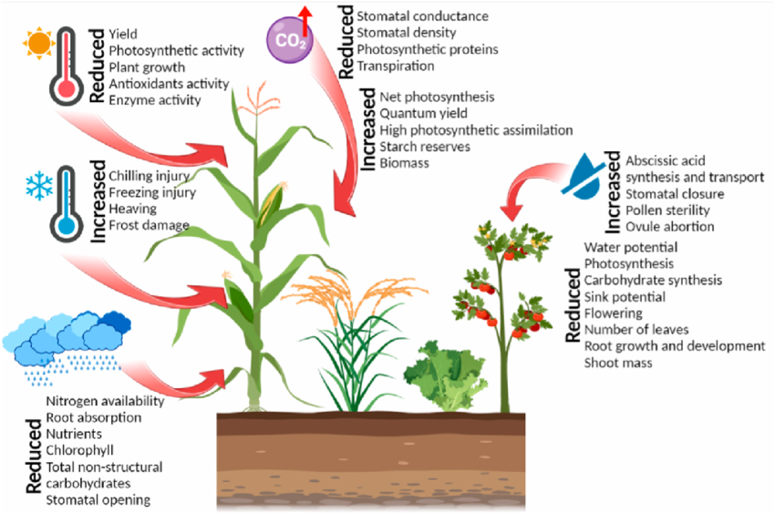
Problem Statement

Slide 7
Climate changes such as high/low temperature, irregular rainfall, and water stress cause hidden crop stress that reduces yield and plant growth.
These climate stresses affect photosynthesis, root growth, flowering, and biomass, but the damage is often noticed only after yield loss.
Traditional farming depends on manual field inspection and farmer experience, which is slow and cannot detect long-term climate effects.
Sensor-based smart farming systems are costly, require maintenance, and are not affordable in rural and developing regions.
There is a lack of low-cost systems that use long-term climate data to support timely and adaptive agricultural decision-making.

Slide 8
Objective
To develop a climate-based method to assess agricultural land condition without using soil nutrient tests.
To use climate variables such as rainfall, temperature, soil moisture, and wetness to calculate the Agriculture Condition Level Index (ACLI).
To classify agricultural land into poor, moderate, and good categories based on ACLI values.
To apply Decision Tree and Gradient Boosting models for analyzing climate effects on land condition and improving prediction accuracy.
To design a low-cost and practical solution suitable for farmers in resource-constrained regions.

Slide 9
Literature survey
Authors & Date | Methodology | Results | Remarks
Y. Mahale et al. [1] June 2024 | Machine learning–based crop recommendation and forecasting using LSTM and expectation–maximization technique. | Improved crop recommendation and yield forecasting accuracy. | Focused on prediction only; depends on historical and field-level data.
P. Raeva et al. [2] March 2025 | Random Forest model using multitemporal Sentinel-2 satellite data and public datasets. | Achieved moderate yield prediction performance (R² ≈ 0.78). | Limited to yield prediction; does not provide comprehensive decision support.

Slide 10
P. Gupta et al.[3] July 2025 | ML models (SVM, RF, KNN) with IoT sensors and web-based agricultural platform. | Improved prediction accuracy compared to traditional methods. | Requires sensor infrastructure and continuous data availability.
T. Ali et al. [4] December 2024 | Machine learning and deep learning models for drought stress identification in crops. | Successfully detected drought stress conditions in crops. | Focused on stress detection only; not extended to decision-making support.
R. K. Dhanaraj et al. [5] – 2025 | Lightweight on-device AI models for climate-resilient crop yield prediction. | Enabled local yield prediction with reduced computational cost. | Limited model complexity and focused mainly on yield estimation.

Slide 11
Identified Research Gaps
Most existing smart agriculture systems depend on sensors, drones, or field devices, which are expensive and hard to deploy everywhere.
Many studies focus on only a single task such as irrigation or yield prediction, instead of providing complete decision support.
Several approaches ignore long-term climate effects and rely mainly on short-term or field-level data.
Field-level data required by many models is often unavailable in rural or data-scarce regions.
Due to high cost and data dependency, advanced models are not suitable for small or resource-limited farmers.

Slide 12
Proposed Solution to Address the Gaps
Uses only publicly available climate data, so no sensors or drones are required.
Analyzes daily, weekly, and monthly weather data to capture both short-term stress and long-term climate effects.
Uses a single multi-task machine learning model to predict crop condition, crop stress, and irrigation needs together.
Provides complete decision support, instead of focusing on only one task.
Applies rule-based climate indices when real field data is not available.
The system is simple, interpretable, low-cost, and scalable, making it suitable for resource-limited regions.

Slide 13
Methodology
In this project, publicly available climate data such as temperature, rainfall, and soil moisture is used to support agricultural decision-making. The data is analyzed in daily, weekly, and monthly formats to capture both short-term and long-term climate effects. A rule-based Agriculture Condition Level Index (ACLI) is calculated to classify land into poor, moderate, and good conditions. Decision Tree and Gradient Boosting models are then used to predict crop condition, climate stress, and irrigation needs without relying on sensors or soil testing, making the system low-cost and suitable for resource-limited regions.

Slide 14
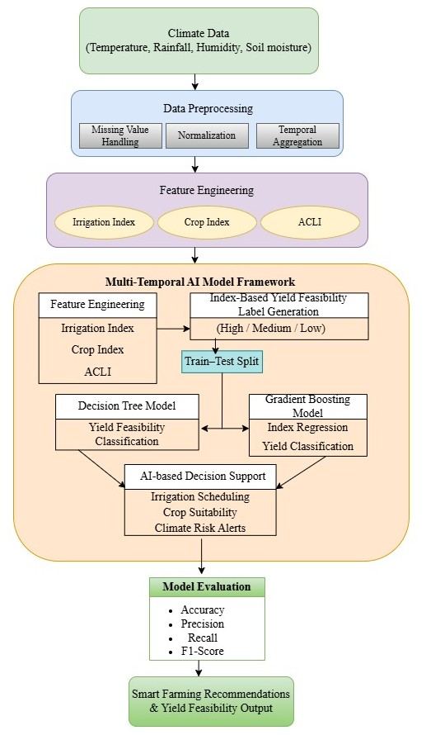

Slide 15
Dataset Overview
Daily weather data collected from the NASA POWER database.
Data period covers 2015 to 2024.
Data is location-specific, based on latitude and longitude of the agricultural region.
Includes key climate parameters such as rainfall, land surface temperature, root zone soil moisture, and surface soil wetness.
Derived indices like Irrigation Index, Crop Index, and Agricultural Climate Load Index (ACLI) are calculated.
These indices are used to assess climate stress and land suitability for agriculture.

Slide 16
Decision Tree – Overview
A Decision Tree is a machine learning model based on if–else conditions.
It splits data into branches using input feature values.
Easy to understand and visualize.
Works well with structured climate data.
Helps identify important features influencing the output.
Suitable as a baseline model for comparison.

Slide 17
Decision Tree – Role in Our Project
Used as the baseline model in our system.
Learns relationships between climate variables and land condition.
Helps analyze the effect of individual climate factors.
Generates transparent decision rules.
Useful for explaining model decisions in simple terms.
Supports initial agricultural decision analysis.

Slide 18
Gradient Boosting – Overview
Gradient Boosting is an ensemble learning technique.
Combines multiple weak models to form a strong model.
Learns from errors made by previous models.
Handles complex and non-linear data patterns.
Provides higher accuracy than single models.
Performs well with large and multi-temporal datasets.

Slide 19
Gradient Boosting – Role in Our Project
Used to improve prediction accuracy and reliability.
Handles daily, weekly, and monthly climate data effectively.
Captures complex interactions among climate variables.
Provides stable predictions across different seasons.
Supports accurate assessment of crop condition and stress.
Enables reliable agricultural decision support.

Slide 20
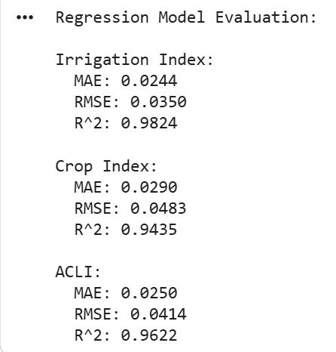
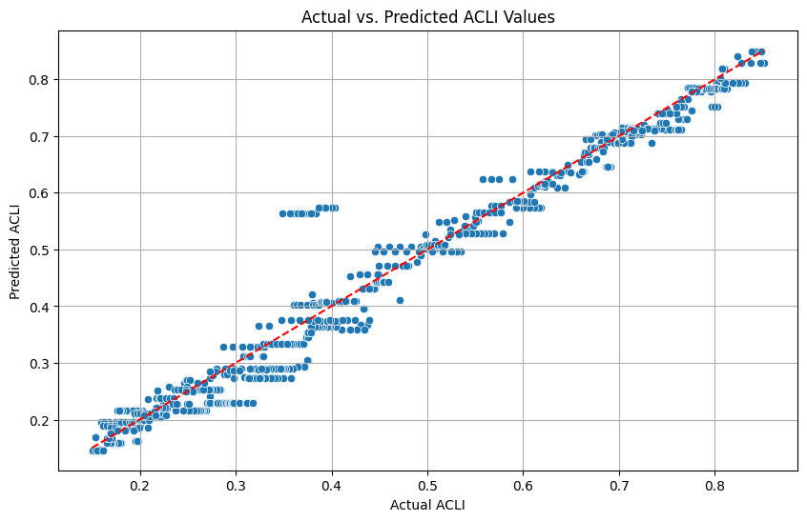
Results
Decision Tree Model Regression Analysis

Slide 21
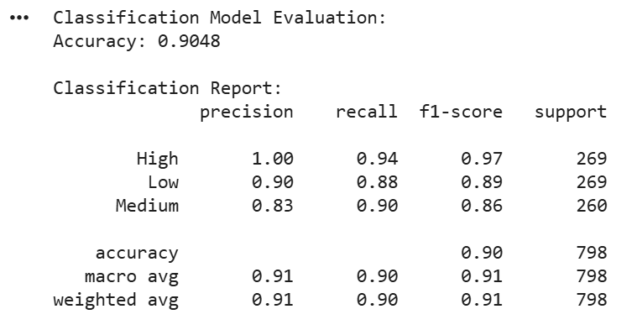
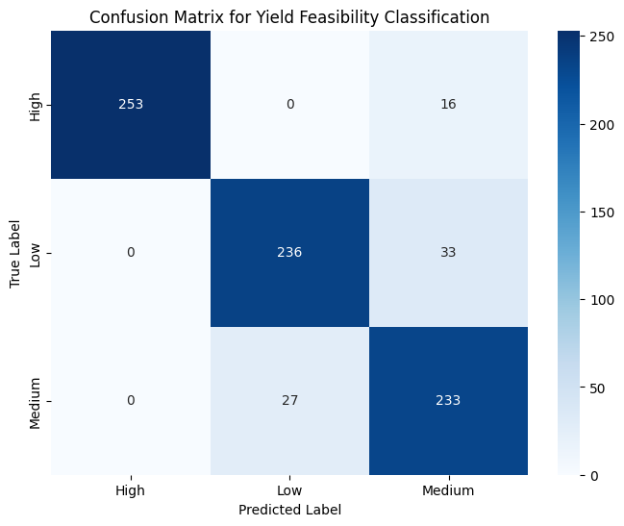
Decision Tree Model Classification Analysis

Slide 22
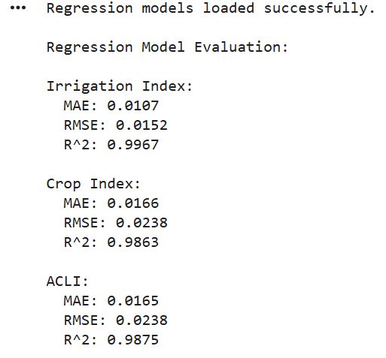
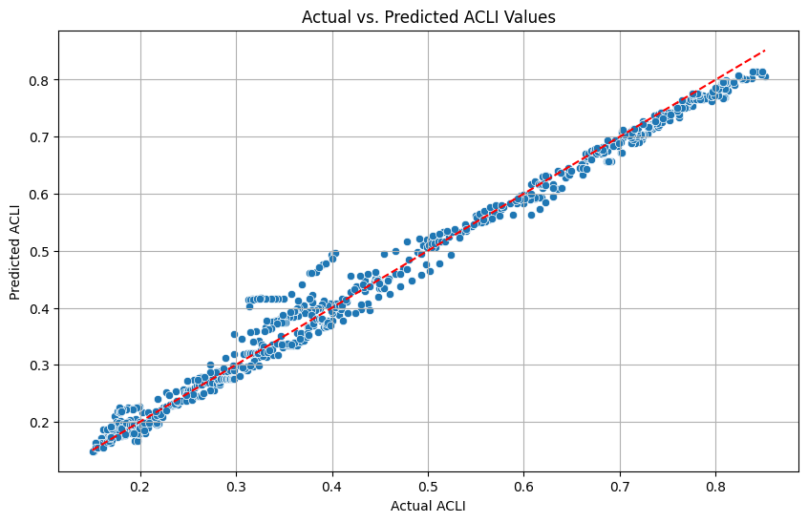
Gradient Boosting Model Regression Analysis

Slide 23
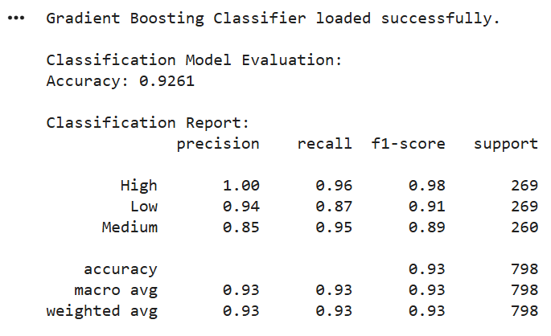
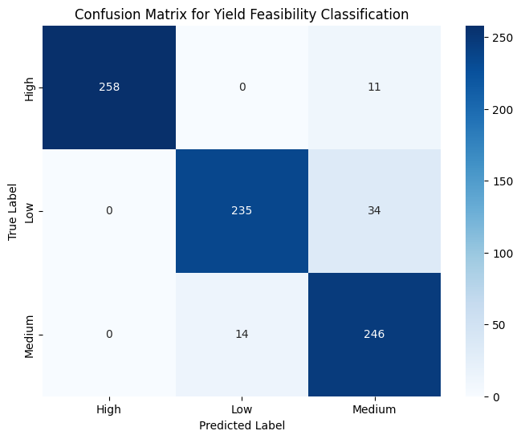
Gradient Boosting Model Classification Analysis

Slide 24
References
[1] Y. Mahale et al., “Crop recommendation and forecasting system for Maharashtra using machine learning with LSTM: a novel expectation-maximization technique,” ResearchGate, 2024.
[2] P. Raeva et al., “Yield Prediction Model Based on Multitemporal Satellite Data and Open Public Data: Case Study for Bulgaria,” MDPI, 2025.
[3] P. Gupta et al., “Optimizing Agricultural Production Using
ML and AI,” International Journal of Innovative Science and Research Technology, 2025.
[4] T. Ali et al., “Smart agriculture: utilizing machine learning and deep learning for drought stress identification in crops,” Scientific reports, 2024.
[5] R. K. Dhanaraj et al., “On-device AI for climate-resilient farming with intelligent crop yield prediction using lightweight models on smart agricultural devices,” Scientific reports, 2025.

Slide 25
Thank You!

