Slide 1
Data Analysis Portfolio
By: Kollin Trujillo

Slide 2
Meat Data

Slide 3
Data Source
Taken from OECD dataset:
Link: https://data.oecd.org/agroutput/meat-consumption.htm?platform=hootsuite
Columns:
ID (added for selection purposes)
Location (country)
Indicator (only MEATCONSUMP)
Subject (type of meat)
Measure (kg per capita or THND_TONNE)
Frequency (only A for annual)
Time (year)
Value

Slide 4
How I will structure the analysis
Focus understanding which countries eat which type of meat and how much.
While a thousand tonnes is interesting data, it isn’t appropriately scaled and makes it unfeasible to compare betweens countries of different sizes.

Slide 5
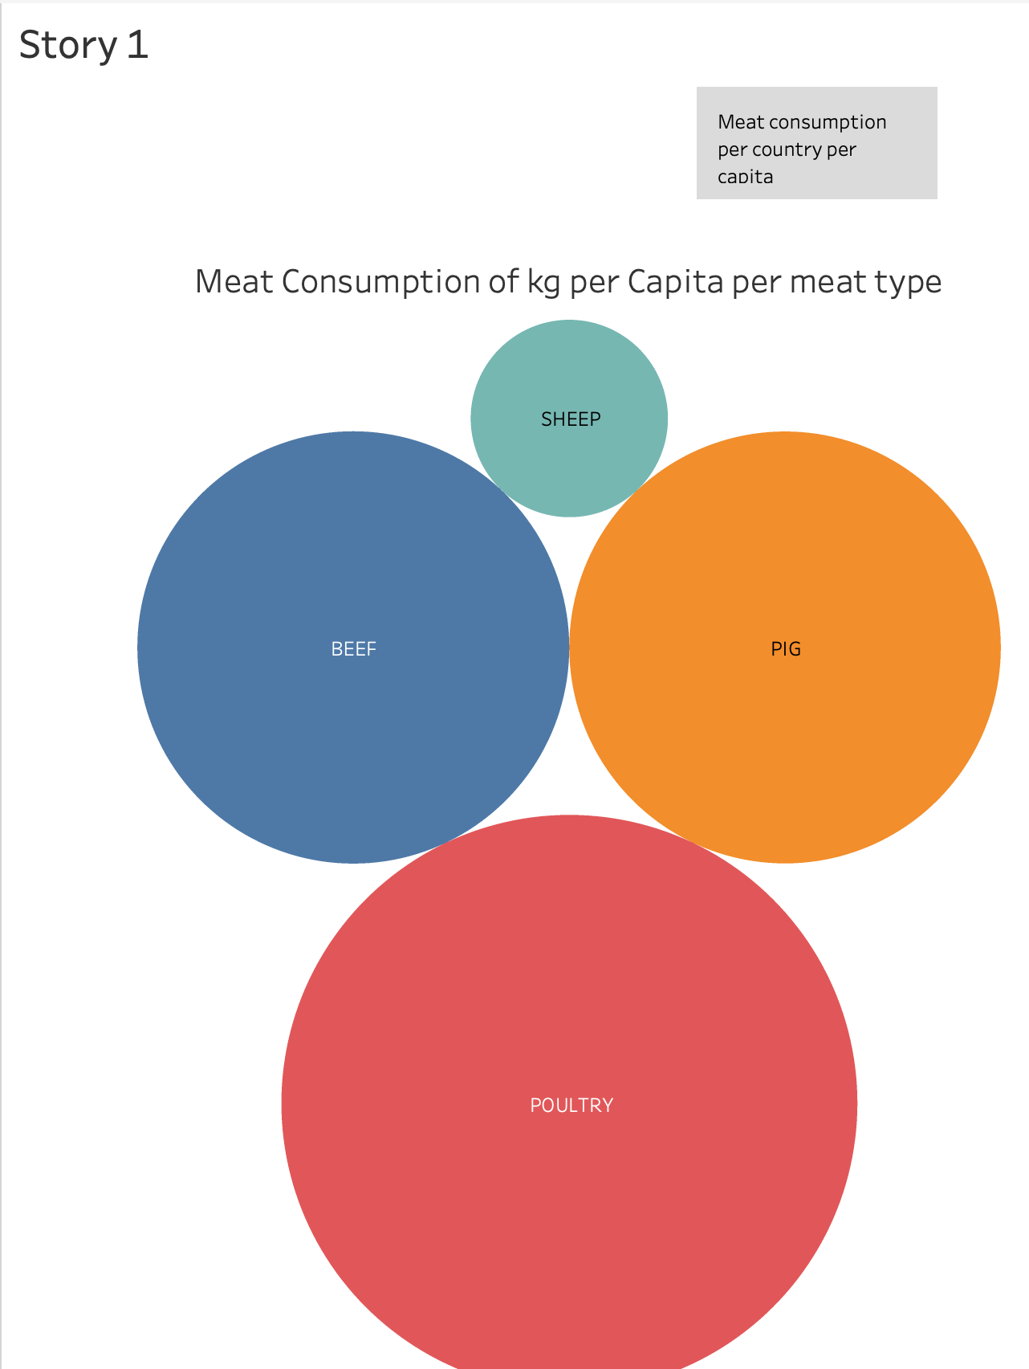
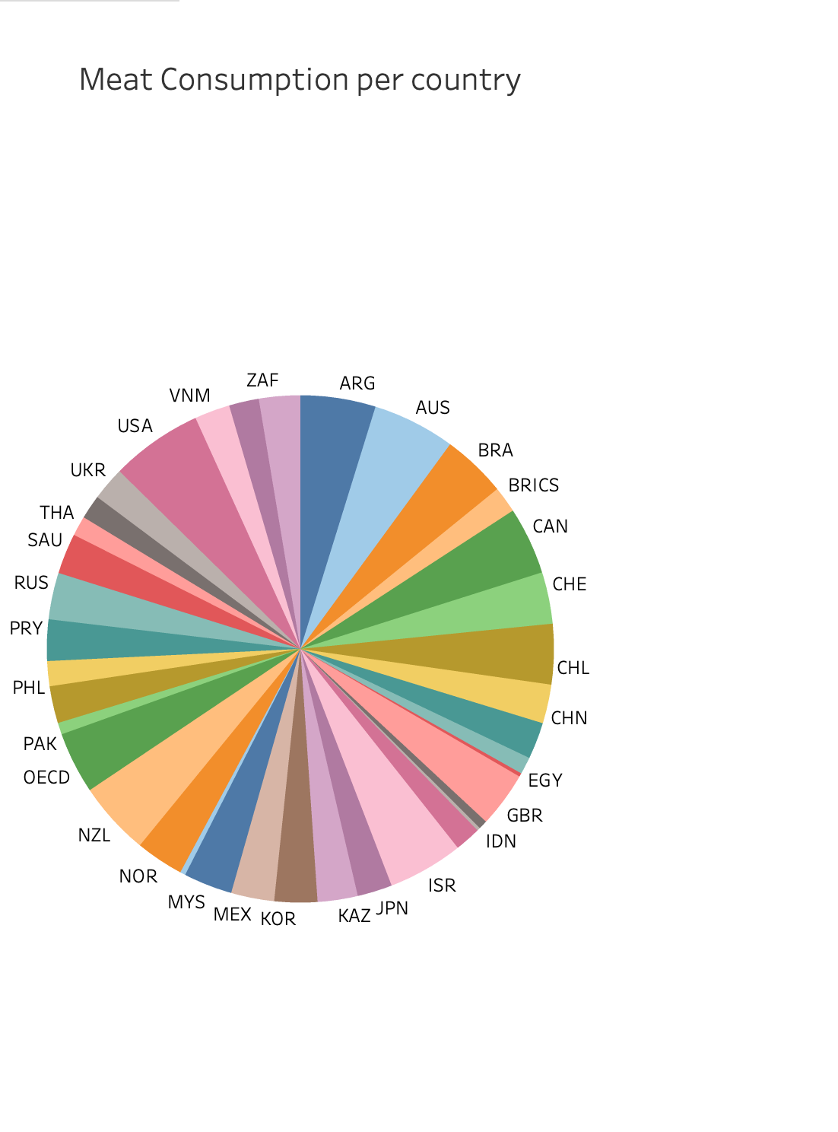
Analysis
With this visualization I can quickly at a glance see the meat consumption of kg per Capita per meat type. With the country filter on the right side highlighting which countries consume more meat. This quickly shows us the breakdown per country and per type of meat.
see:
https://public.tableau.com/shared/54P7KR2KY?:display_count=n&:origin=viz_share_link

Slide 6
Analysis
We can see that overall, with all countries selected that poultry is the most eaten meat.
We could add additional charts with Tableau to ascertain particular questions such as:
Is X type of meat correlated in consumption with Y type of meat? Is there a negative correlation?

Slide 7
Shopping Data

Slide 8
Data Source
Taken from another user on Kaggle:
Link: https://www.kaggle.com/datasets/shedai/retail-data-set
Columns:
DocumentID
Date
SKU
Price
Discount
Customer
Quantity

Slide 9
How I will structure the analysis
I think a two-pronged approach might be the best.
I want to learn which customers are high-price purchasers
Which SKUs are popular and selling

Slide 10
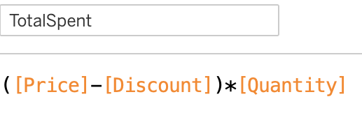
Simple Custom Function
Utilized a simple function in tableau to get the net amount spent rather than the gross amount which would’ve been summed before any discounts were factored in.

Slide 11
Customers Focus
This one is fairly straightforward.

Slide 12
Customers Focus (slide 2)
We can see that there are a few high spenders. These are customerID numbers 414 & 418 for the top 2 then ID 359 for the third.
These comprise of the top three each spending:
Which altogether sums up to around 1.16 billion dollars worth of sales, post-discount
Being conscientious of your high-value clients and attentive to their needs and desires is what is key to keeping them!
Customer | Total Spent
414 | 513,773,037.09
418 | 438,245,796.70
359 | 209,593,181.37

Slide 13
SKUs Focus
Through this we can see that SKUs 611, 614, 978, 1408, and 1648 are the highest 5 peaks in the visualization

Slide 14
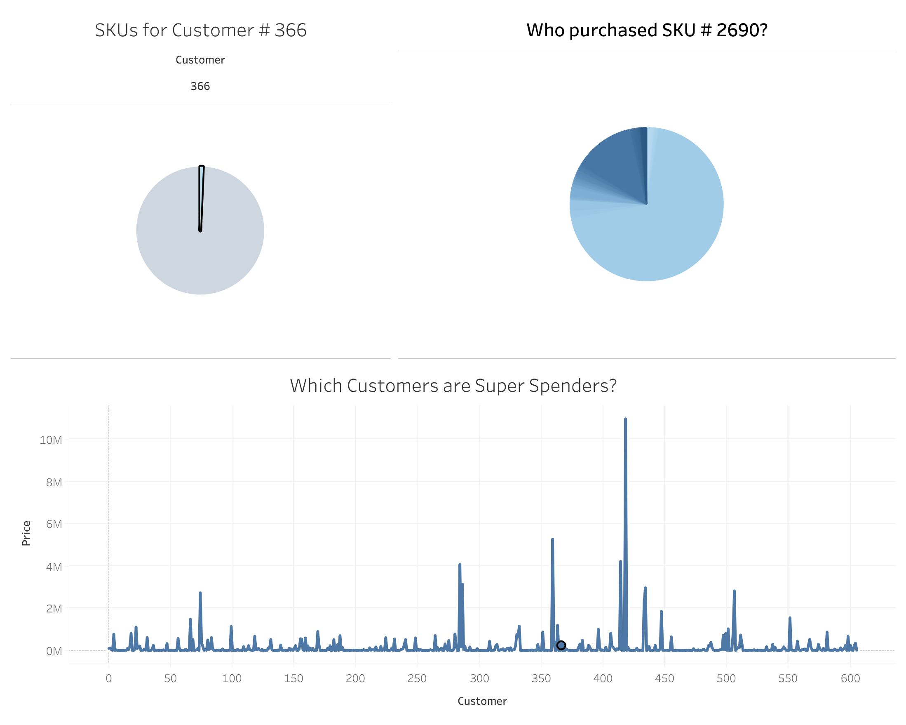
SKUs Focus (slide 2)
In this overall visualization, we can see the total spenders and then the breakdown of SKUs per customer along with all the customers that purchased that SKU.
see: https://public.tableau.com/views/VisualizingSpendingHabits/SpendersAndWhat?:language=en-US&:display_count=n&:origin=viz_share_link

Slide 15
Analysis
While the last visualization shows all the data, there could be nicer ways to show the data. If I spaced out the data into boxes, it might be easier to view or added a 2-D X&Y component, that the visualization could be a little more spatially resolved than just the pie chart.

