Slide 1
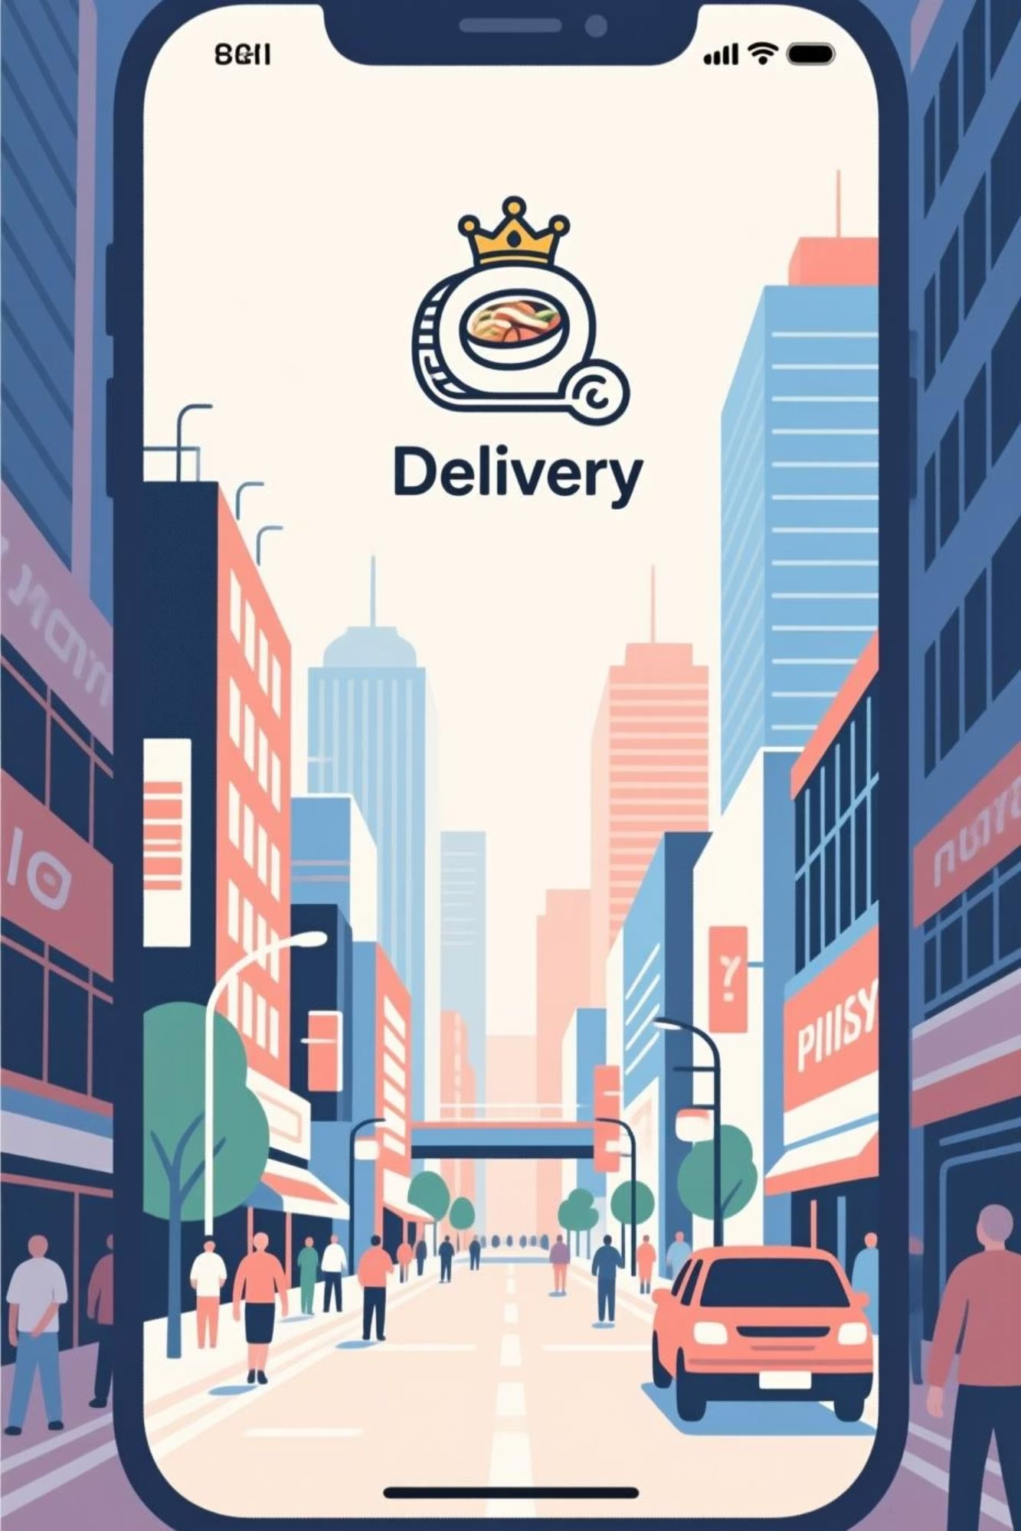
Scalable System Design for a Food Delivery Aggregator
Functional, Technical, and Architectural Overview
Presented by: AI Design Team | October 2023

Slide 2


Introduction: Revolutionising Food Delivery
Our mission is to build a robust and scalable food delivery aggregator platform that seamlessly connects customers, restaurants, and couriers. This system addresses the complexities of real-time ordering, dispatch, and tracking, ensuring efficiency and reliability.
This presentation delves into the core architectural decisions and technical components that underpin our platform's performance and scalability.

Slide 3

Stakeholders & Core Requirements
Customer Focus
Restaurant Integration
Intuitive ordering, real-time tracking, secure payments, and personalised experiences.
Efficient order management, menu updates, and timely payment processing.
Courier Operations
Operational Efficiency
Optimised dispatch, navigation assistance, and transparent earnings tracking.
Robust administration tools, analytics, and customer support interfaces.
Functional Requirements
Order Placement & Management
Real-time Tracking
Payment Processing
Search & Discovery
Non-Functional Requirements
High Availability (99.99%)
Low Latency (Sub-second)
Scalability (Millions of users)
Data Consistency

Slide 4
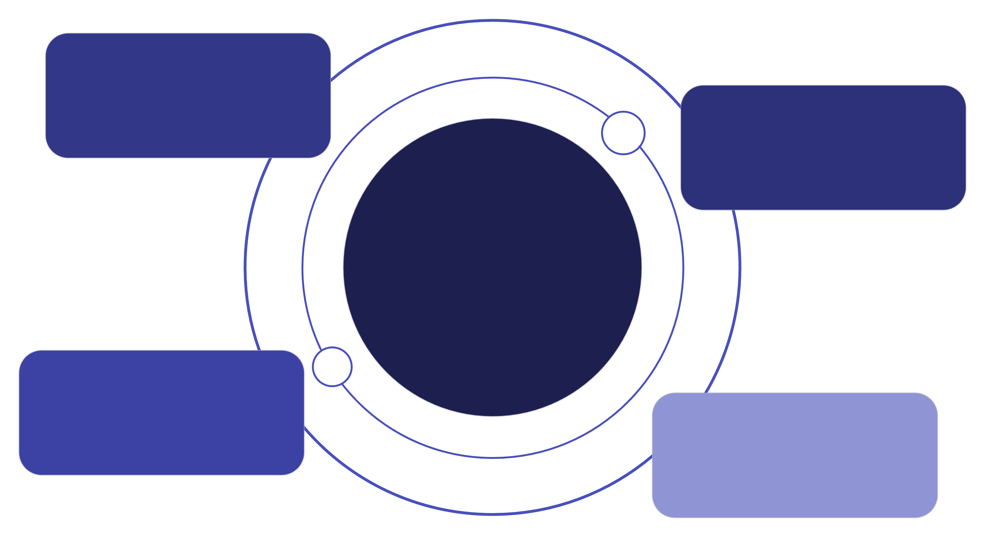
System Context Diagram
Understanding the high-level interactions between our core system and external entities is crucial for defining boundaries and integrations.
Customer App
Place orders and track deliveries
Restaurant App
Receive orders and update status
Food Delivery Aggregator
Core system coordinating orders and integrations
Courier App
Accept jobs and report location
Payment Gateway
Process payments securely
This diagram illustrates the primary interfaces and external dependencies required for our platform to function.

Slide 5
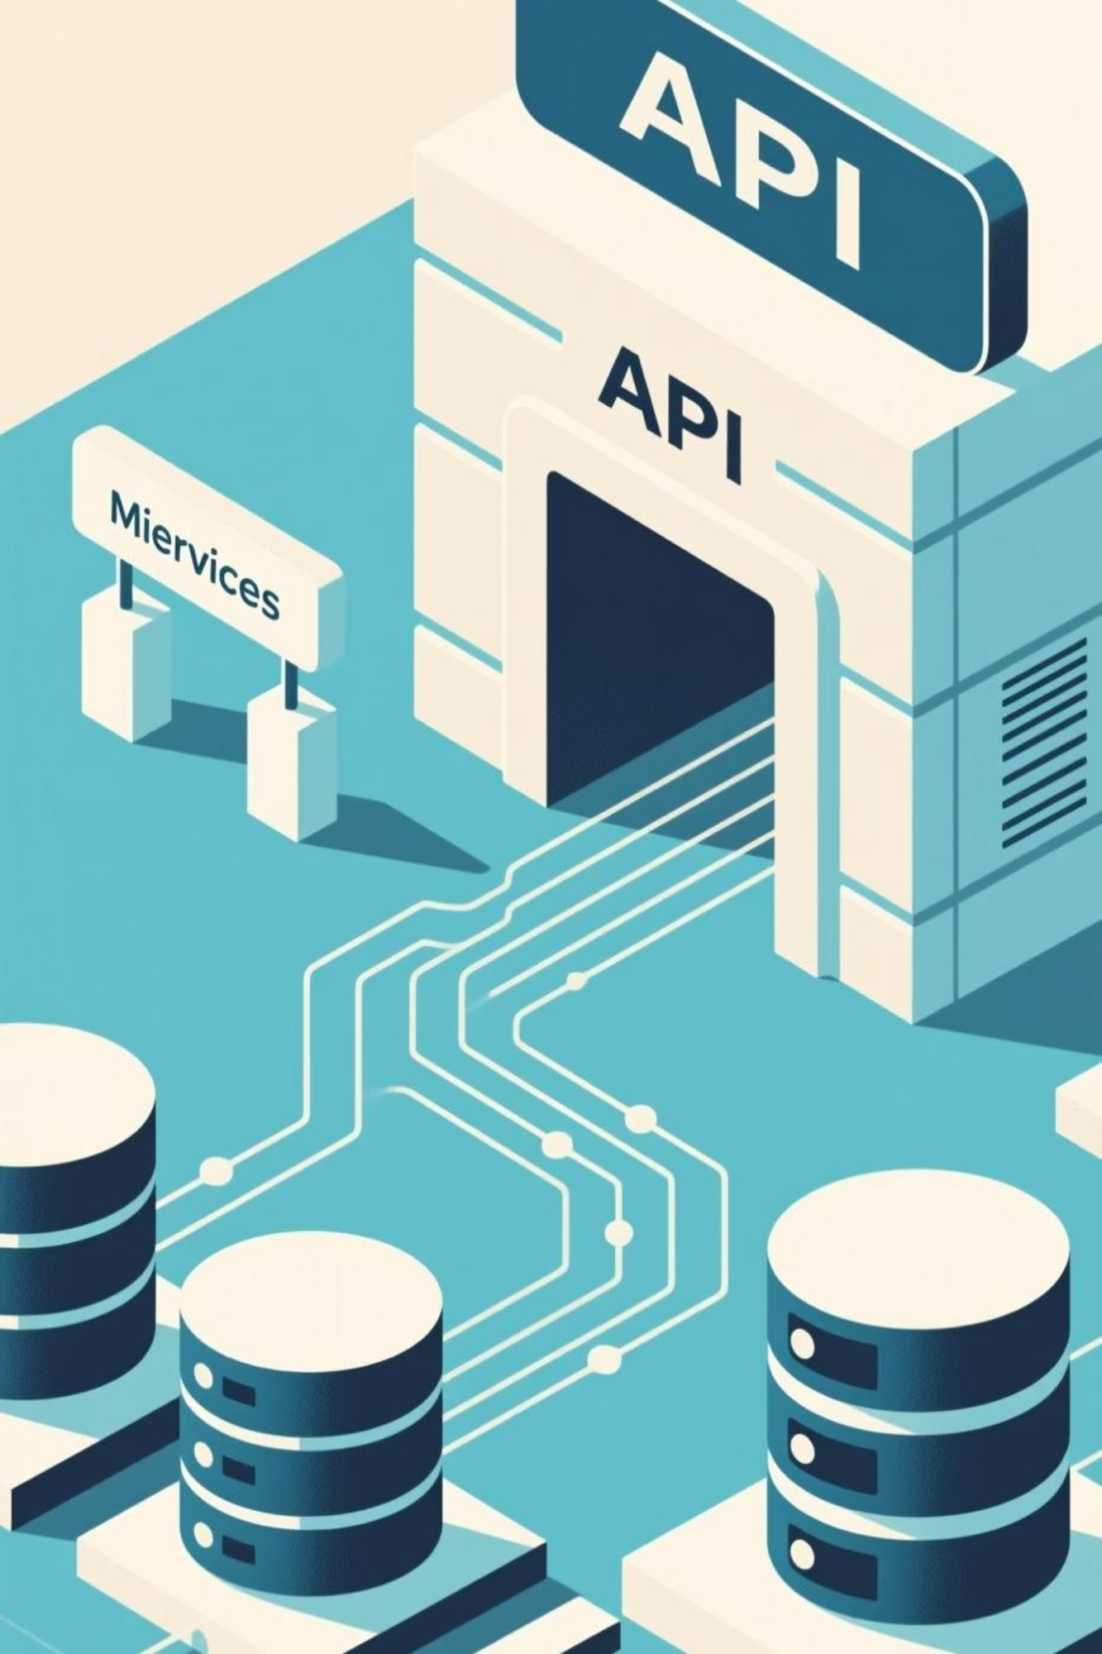
High-Level Architecture: Microservices Approach
Our platform leverages a microservices architecture to ensure modularity, scalability, and independent deployment cycles. Each service is responsible for a specific business capability.
Data flows through an API Gateway, which routes requests to appropriate microservices. Services communicate via asynchronous messaging (e.g., Kafka) and RESTful APIs, with dedicated databases per service.

Slide 6
Core Components: Specialised Services
Order Service
Dispatch Service
Tracking Service
Manages order lifecycle, from creation to completion, including menu aggregation and pricing.
Optimises courier assignment based on availability, location, and order characteristics.
Provides real-time location updates for couriers and orders to customers and restaurants.
Notification Service
Driver Service
Handles all communication: push notifications, SMS, and email for status updates.
Manages courier profiles, availability, shift scheduling, and earnings.

Slide 7
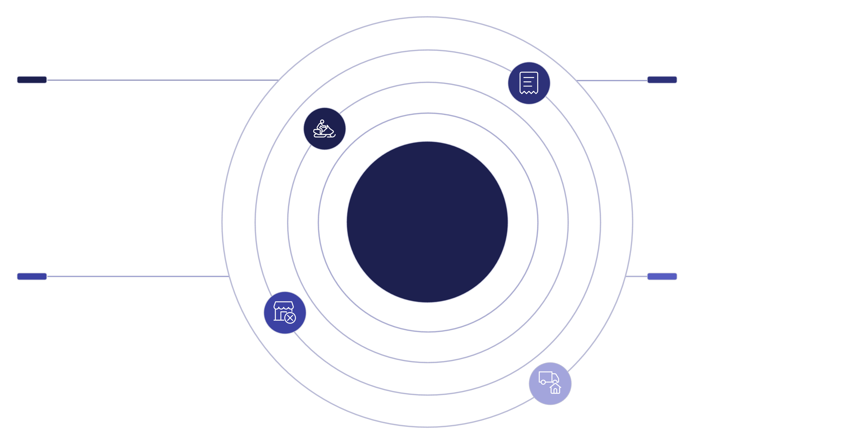
Data Model: Key Entities & Relationships
A well-defined data model is foundational for data integrity and efficient querying across our services. We utilise polyglot persistence, selecting the best database for each service's needs.
Customer
Order
customer_id, name, contact, address
order_id, customer_id, restaurant_id, courier_id, total
Delivery Platform ER Model
Restaurant
Courier
restaurant_id, name, location, cuisine
courier_id, name, phone, vehicle_id
Key entities include Customers, Orders, Restaurants, Menu Items, Couriers, and Payments, with clear relationships defining interactions.

Slide 8

Dispatch Algorithm: Optimising Delivery
Efficient dispatch is critical for customer satisfaction and operational cost-effectiveness. We explore two primary approaches to courier assignment.
Greedy Matching
Global Matching
Assigns the nearest available courier to an order immediately upon request. Simple and fast, ideal for low-density areas.
Considers all pending orders and available couriers to optimise multiple deliveries simultaneously. More complex, but reduces overall delivery times and costs in high-density areas.
Our system dynamically switches between greedy and global algorithms based on real-time demand and courier availability.

Slide 9
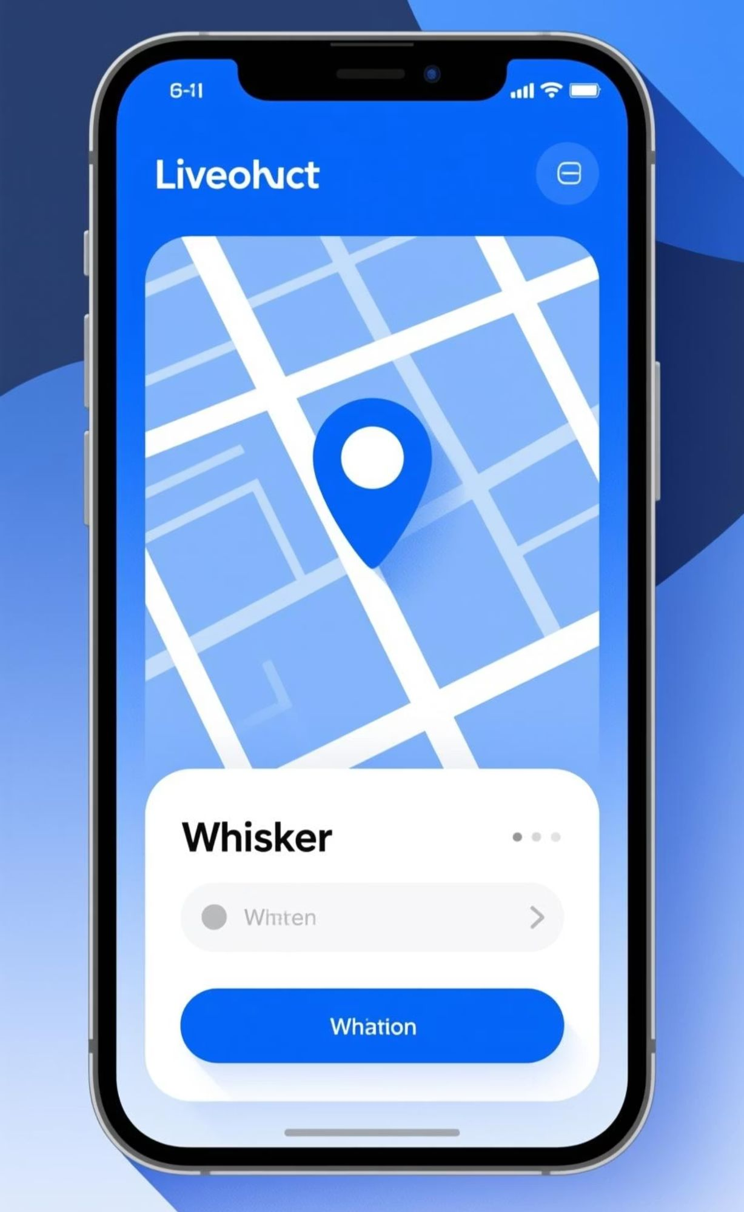

Real-Time Tracking: Keeping Users Informed
Providing accurate, up-to-the-minute tracking information is a cornerstone of our user experience. This involves a sophisticated real-time data pipeline.
Courier App
Sends frequent GPS updates
Customer App
Real-Time GPS Pipeline
Kafka Message Broker
Receives real-time location
Ingests and queues location events
WebSocket Server
Tracking Service
Pushes live updates to clients
Consumes and processes events
GPS Updates: Courier apps send frequent location data.
Kafka Stream: Updates are ingested into Kafka for high-throughput, low-latency processing.
Tracking Service: Processes location data, performs geo-fencing, and stores historical routes.
WebSocket Server: Maintains persistent connections with customer and restaurant apps to push real-time updates.

Slide 10

Performance & Scalability Considerations
Designing for high performance and scalability is paramount for handling peak demand and continuous growth.
Geo-Sharding
WebSocket Load Management
Distributing data and services geographically to reduce latency and manage load, particularly for location-based queries.
Utilising dedicated WebSocket servers and load balancers to efficiently handle millions of concurrent client connections for real-time tracking.
Concurrency Handling
Implementing robust queuing mechanisms and asynchronous processing to manage high volumes of concurrent orders and requests.
1M+
500K
<200ms
Concurrent Users
Orders/Hour
API Latency
Our system is designed to support over a million simultaneous users.
Scalable to process half a million orders per hour during peak times.
Target average API response time for critical operations.

