Slide 1
AMAZON SALES DATA
A Detailed Project Report
Vamshi Chowdary
iNeuron.ai

Slide 2
PROJECT DETAILS
Project Title | Analyzing Amazon Sales data
Technology | Business Intelligence
Domain | E-commerce
Project Difficulty level | Advanced
Programming Language Used | Python
Tools Used | Jupyter Notebook, MS-Excel, Tableau

Slide 3
Objective :
The goal of this project is to find Sales-trend :
Month wise
Year wise
Yearly month wise

Slide 4
Problem Statement
Sales management has gained importance to meet increasing competition and the need for improved methods of distribution to reduce cost and to increase profits. Sales management today is the most important function in a commercial and business enterprise.
Do ETL : Extract-Transform-Load some Amazon dataset and find for me
Sales-trend -> month wise , year wise , yearly_month wise
Find key metrics and factors and show the meaningful relationships between attributes.

Slide 5
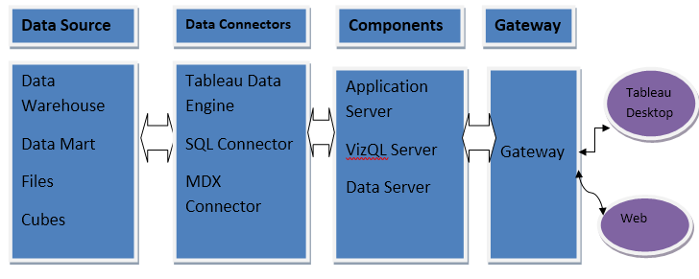
Architecture

Slide 6
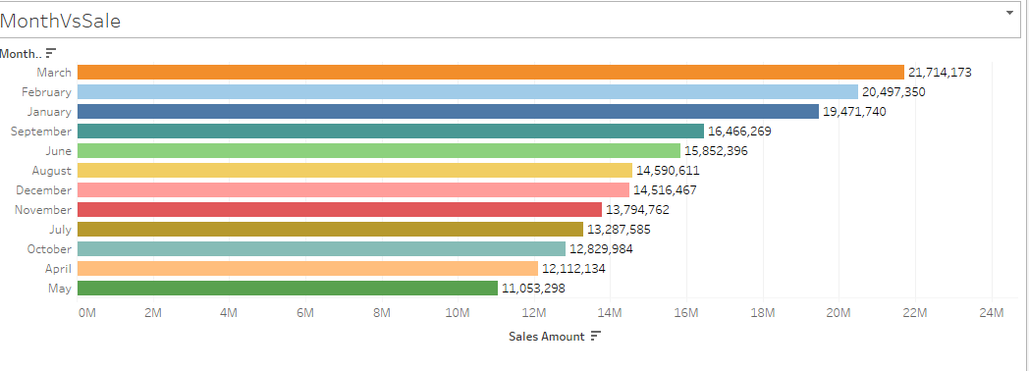
Total Investment Year Wise

Slide 7
Other Observations
Maximum sales done in month of march.
Maximum sales done in Year 2017 and minimum sales done in year 2018

Slide 8
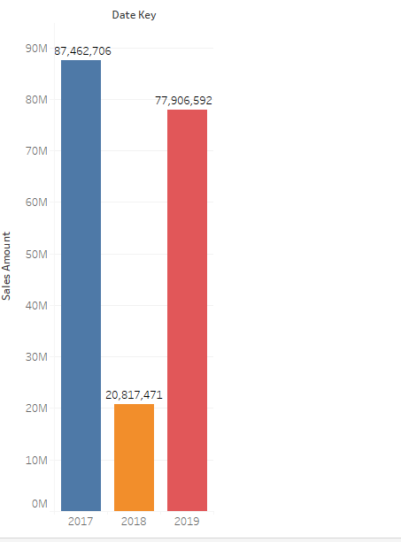
Year vs Sales

Slide 9
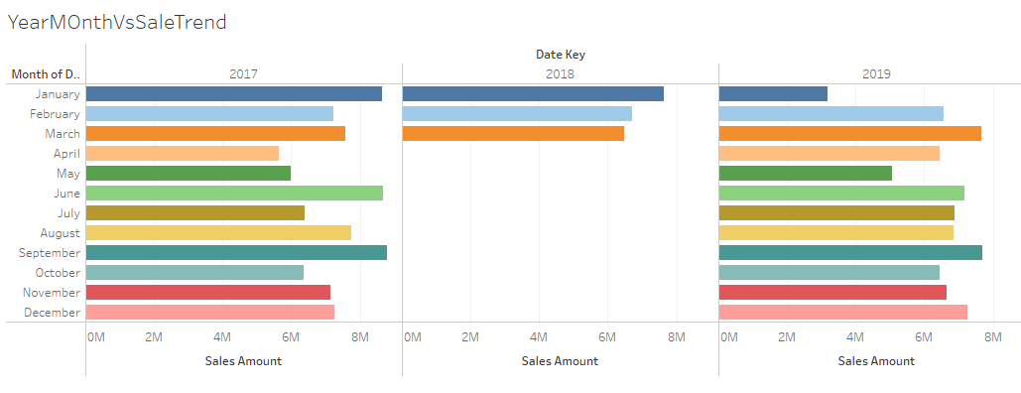
Yearly Month vs Sales

Slide 10
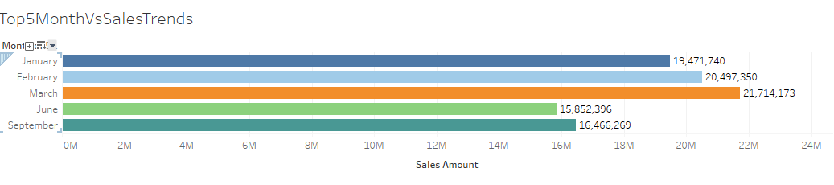
Top 5 Month vs Sales

Slide 11
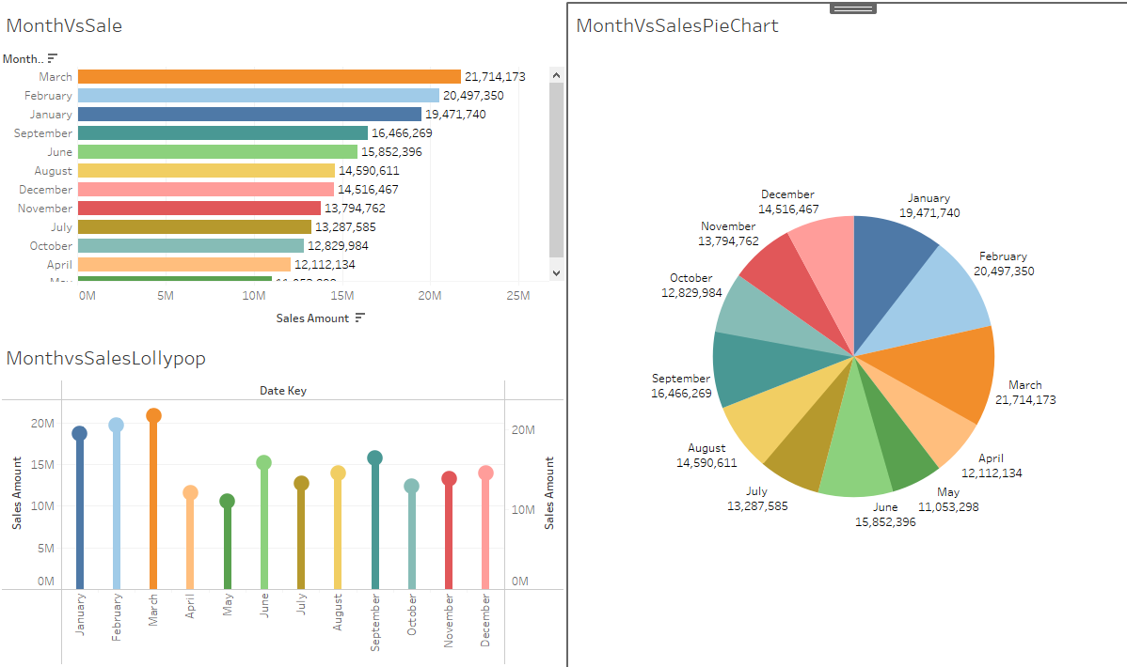
Month vs Sales Dashboard

Slide 12
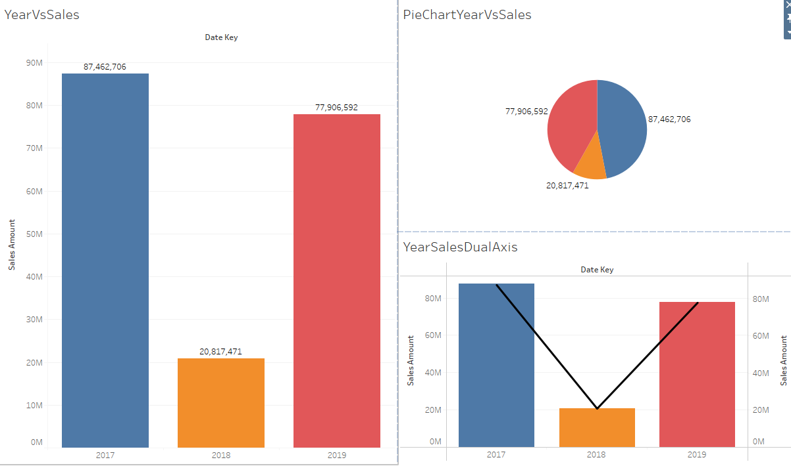
Year Vs Sales Dashboard

Slide 13
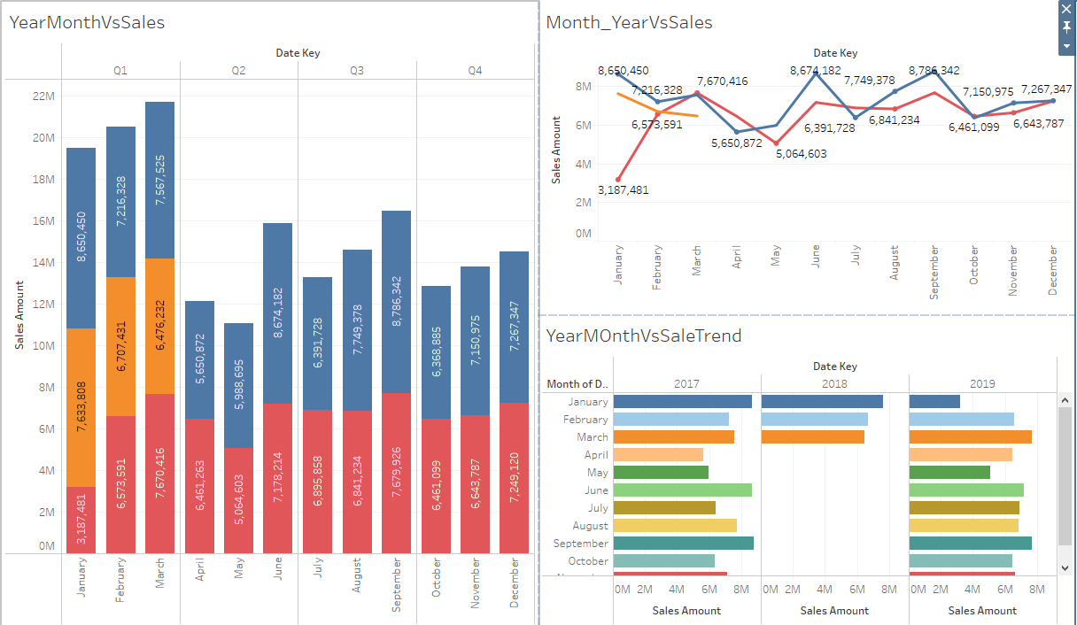
Yearly Month vs Sales Dashboard

Slide 14
THANK YOU

