Slide 1
UPI FRAUD DETECTION USING MACHINE LEARNING ALGORITHM
INTERNAL GUIDE: PRESENTED BY:
MS. RAYUDU SOWMYA KOLLU SRAVANI
23A910092(ADTP)
Aditya Engineering College

Slide 2
CONTENTS
Abstract
Existing System and Disadvantages
Proposed System and Advantages
Algorithm and Description
System Architecture
Functional Requirements
System Requirements Specification
Modules
UML Diagrams
Screenshots
Conclusion

Slide 3
ABSTRACT
This project is UPI Fraud detection which is used to reduce the upi fraud. Increase in UPI usage for online payments, cases of fraud associated with it are also rising. People can use UPIs for online transactions as it provides an efficient and easy-to-use facility. With the increase in usage of UPIs, the capacity of UPI misuse has also enhanced. UPI frauds cause significant financial losses for both UPI holders and financial companies. To detect counterfeit transactions, three machine-learning algorithms were presented and implemented. The classification and prediction accuracy is not high. The existing UPI fraud detection have drawbacks ,such as low prediction accuracy.

Slide 4
EXISTING SYSTEM
In existing method, the classification and prediction accuracy is not high. The existing UPI fraud detection have drawbacks ,such as low prediction accuracy. To detect counterfeit transactions, three machine-learning algorithms were presented and implemented. There are many measures used to evaluate the performance of classifiers or predictors, such as the Gradient Boost Classifier, Vector Machine, Random Forest, and Decision Tree. These metrics are either prevalence dependent or prevalence-independent.

Slide 5
DISADVANTAGES
Data Availability and Quality:
Fraudulent transactions are rare, leading to highly imbalanced datasets that make it challenging for machine learning models to identify patterns effectively. Inconsistent or noisy data can lead to inaccurate predictions
Lack of Real-Time Processing:
Many existing systems struggle with processing UPI transactions in real-time, which is crucial for preventing fraud before it occurs.
Scalability Issues:
Handling the volume of UPI transactions efficiently while maintaining accuracy is a challenge, especially for systems that are not designed to scale.

Slide 6
PROPOSED SYSTEM
This project uses various machine learning algorithms like Random Forests (RF), K-Nearest Neighbors (KNN), Convolutional Neural Network (CNN) to find the most effective and accuracy model for fraud detection. Comparing all these algorithms, CNN gives the most accuracy. This algorithm is a heuristic approach used to solve high complexity computational problems. The implementation of an efficient fraud detection system is imperative for all UPI issuing companies and their clients to minimize their losses. The proposed system is performance is high as comparing to existing methods. The main aim is to detect the fraudulent transaction and to develop a method of generating test data.

Slide 7
ADVANTAGES
High Accuracy in Predictions:
By leveraging advanced algorithms and feature extraction techniques, the system improves the accuracy of detecting fraudulent transactions.
Reduction in Manual Intervention:
Automates the fraud detection process, minimizing human involvement and reducing errors or delays.
Scalability:
Capable of handling a large volume of transactions, ensuring consistent performance as the system scales.

Slide 8
ALGORITHM AND DESCRIPTION
Convolutional Neural Networks (CNNs):
CNNs are ideal for image-like data, but can be adapted for sequential data like transaction histories. By treating each transaction as a data point in a sequence, CNNs can learn temporal patterns, identify anomalies, and classify transactions as fraudulent or legitimate.
K-Nearest Neighbors (KNN):
KNN is a simple yet effective algorithm for fraud detection. It classifies new transactions based on the majority class of their k-nearest neighbors in the feature space. By considering features like transaction amount, time, location, and device information, KNN can identify unusual patterns and flag potential fraud.
Random Forest:
Random Forest is an ensemble learning technique that combines multiple decision trees. Each tree is trained on a random subset of the data and ¹ features. By aggregating the predictions of these trees, Random Forest can effectively handle complex patterns in transaction data, improve accuracy, and reduce overfitting. It can capture non-linear relationships between features and the target variable, making it suitable for fraud detection

Slide 9
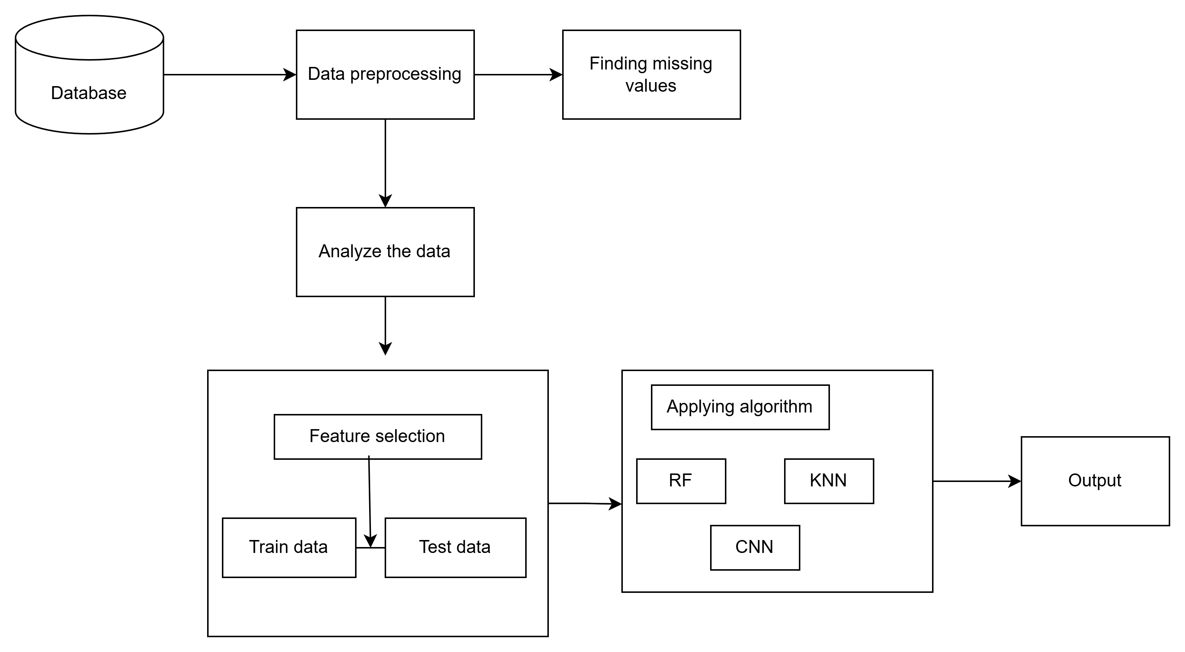
SYSTEM ARCHITECTURE

Slide 10
FUNCTIONAL REQUIREMENTS
The system should be capable of ingesting large volumes of transaction data from various sources
Relevant features should be extracted from raw transaction data to improve model performance.
Machine learning models for fraud pattern recognition
User interface for monitoring and investigation
Machine learning algorithms should be trained on historical transaction data, labeled as fraudulent or legitimate.
The system should detect the fraud or not.

Slide 11
SYSTEM REQUIREMENTS SPECIFICATION
Hardware Requirements:
Speed : 2.40 GHz
RAM : 8GB
Hard Disk : 512 GB
Software Requirements:
Operating System : Windows 11
Technology : Python 3.10
Tools : Visual Studio Code

Slide 12
MODULES

Slide 13
Modules Description:
Modules includes in this project:
1. Data Collection
2. Preprocessing
3. Feature Extraction
4. Model Training

Slide 14
Data Collection :
Module gathers transaction data, including details like user information, transaction amount, and timestamps.
PREPROCESSING :
In preprocessing, cleans the data by handling missing values, normalizing numerical features, and encoding categorical variables to make it ready for analysis.

Slide 15
FEATURE EXTRACTION:
Focuses on identifying important patterns and features, such as transaction frequency and geographic location, which are essential for distinguishing between legitimate and fraudulent transactions.
MODEL TRAINING:
Model training uses machine learning algorithms to train a classifier that can accurately predict fraud.

Slide 16
UML DIAGRAMS

Slide 17
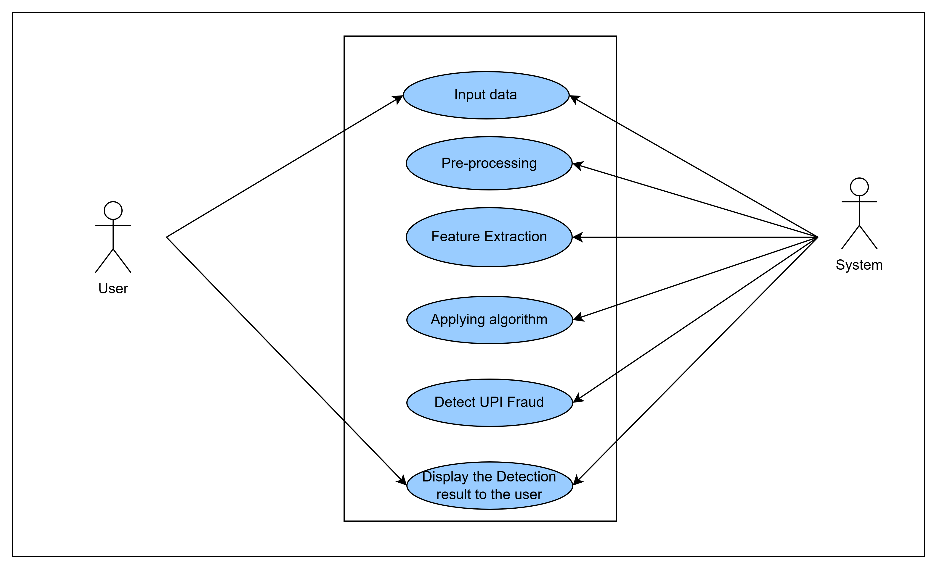
USECASE DIAGRAM FOR SYSTEM

Slide 18
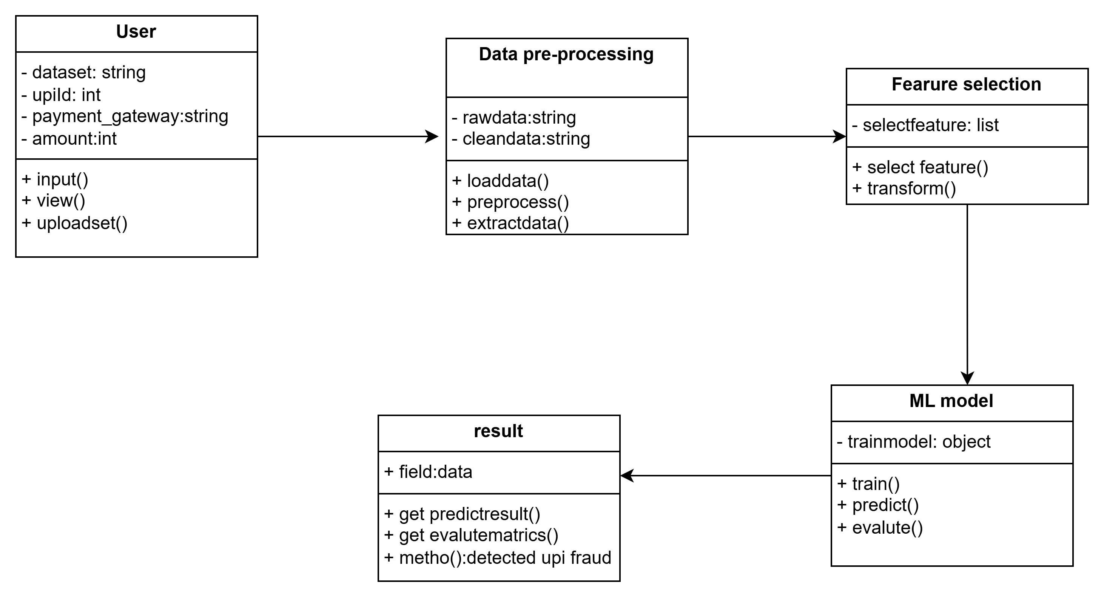
CLASS DIAGRAM FOR SYSTEM

Slide 19
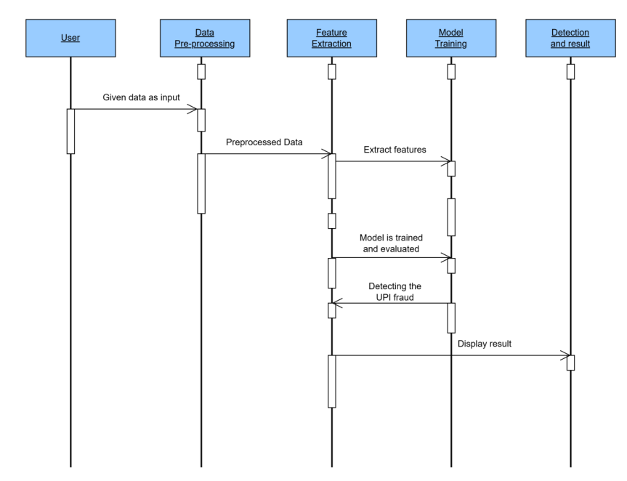
SEQUENCE DIAGRAM FOR SYSTEM

Slide 20
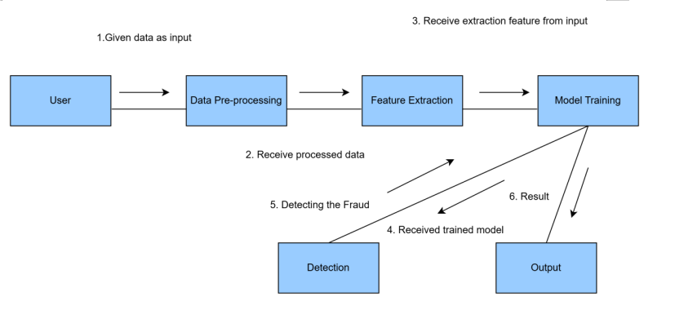
COLLABORATION DIAGRAM FOR SYSTEM

Slide 21
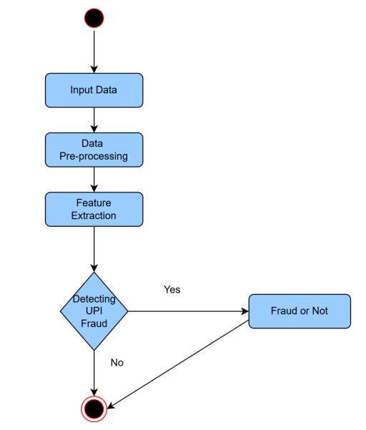
ACTIVITY DIAGRAM FOR SYSTEM

Slide 22
SCREENSHOTS

Slide 23
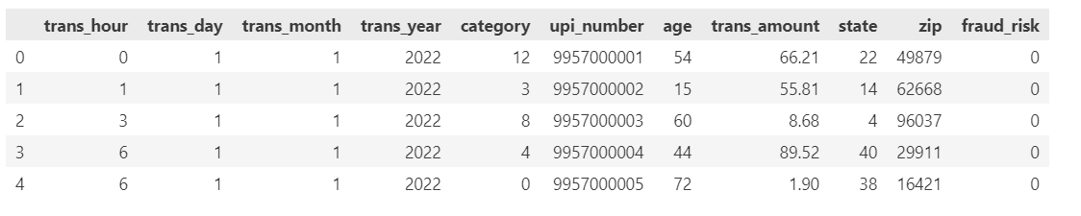

Slide 24
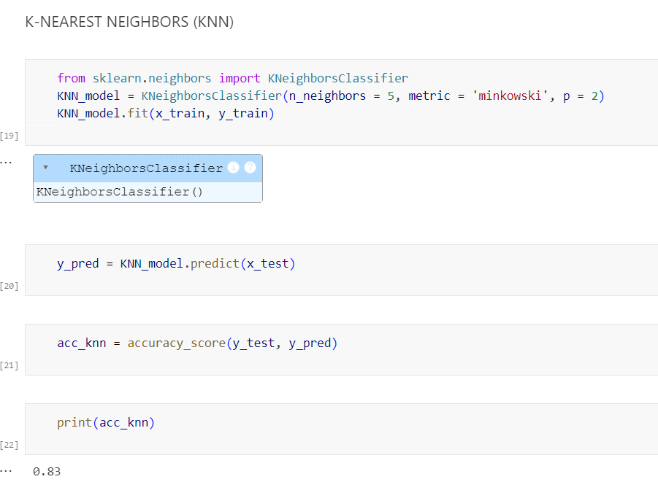

Slide 25
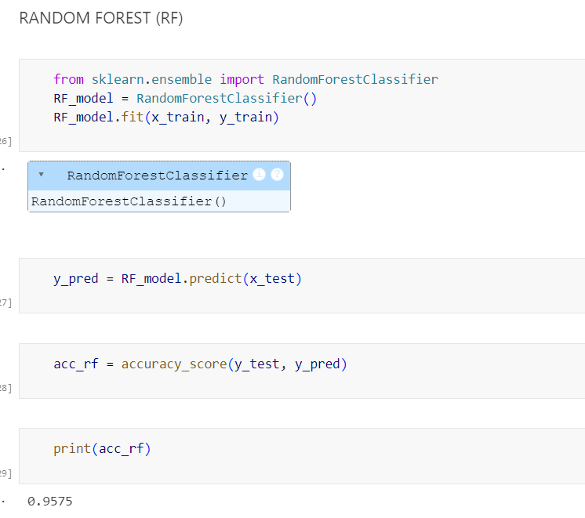

Slide 26
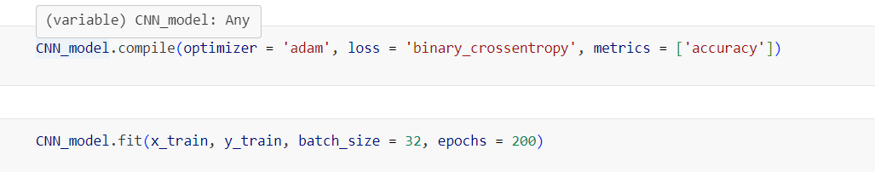
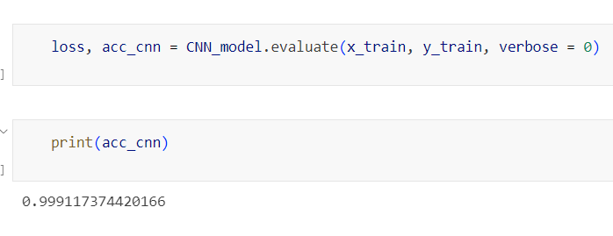

Slide 27
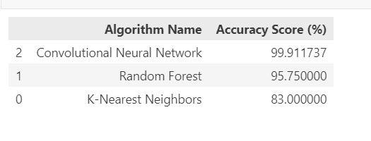

Slide 28
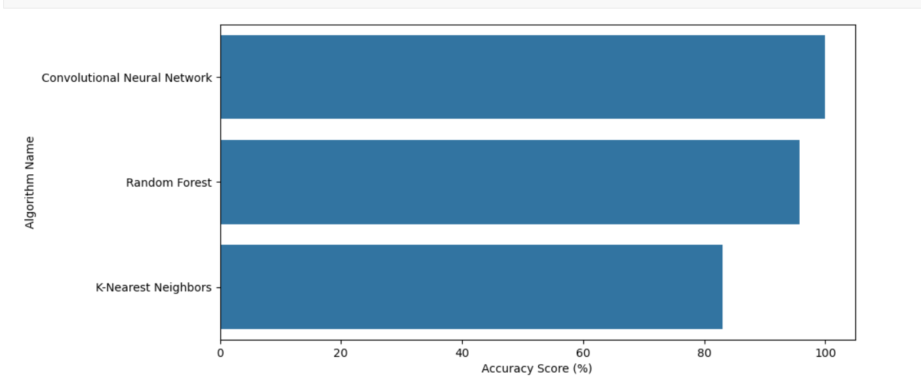

Slide 29
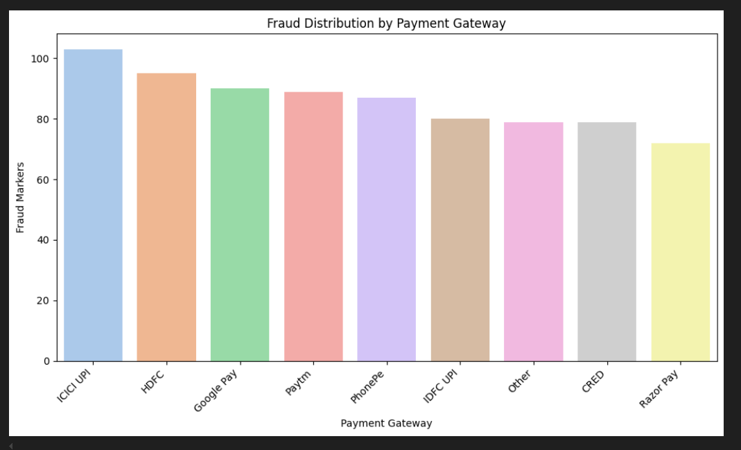

Slide 30
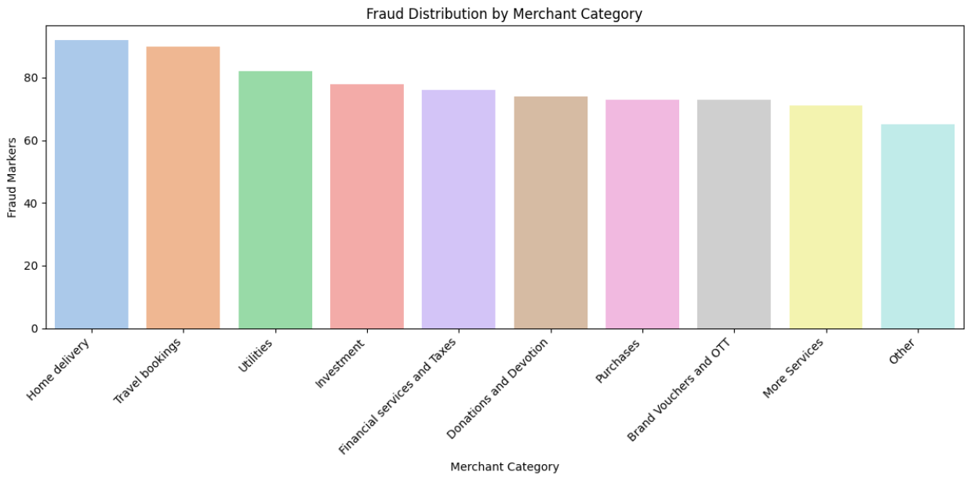

Slide 31
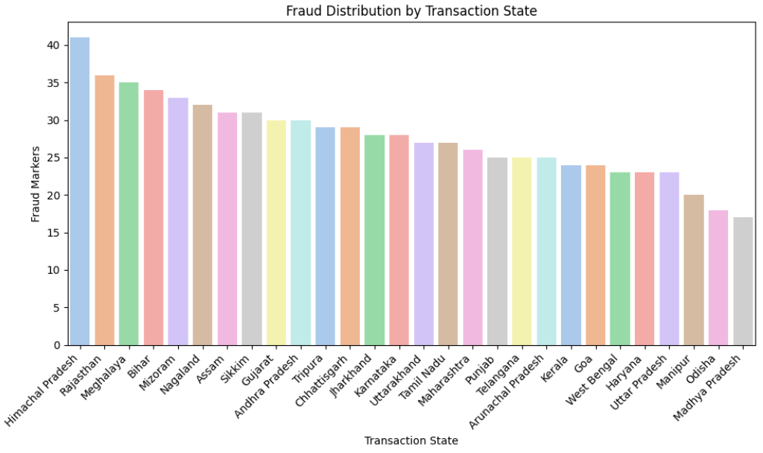

Slide 32
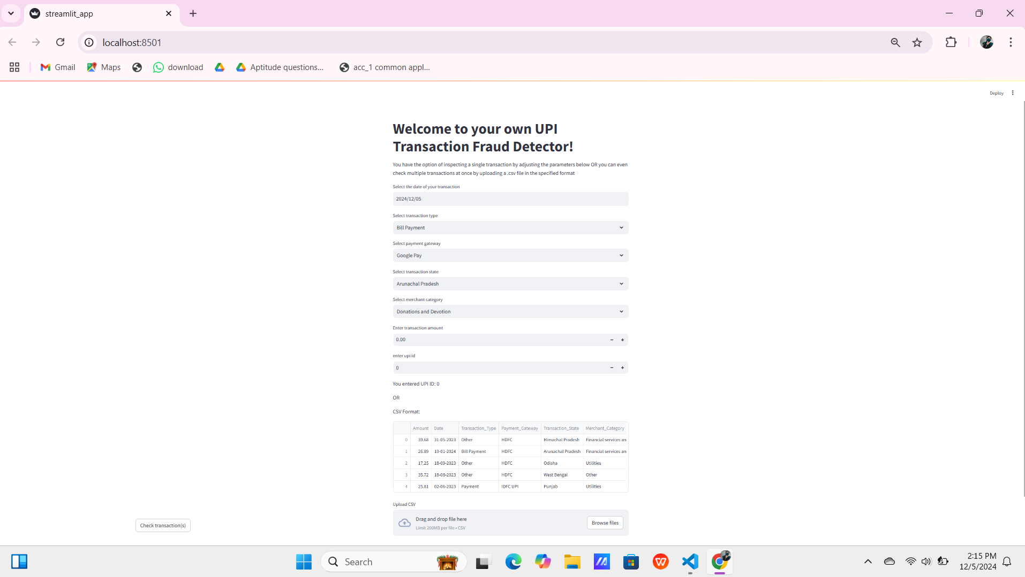
User interface

Slide 33
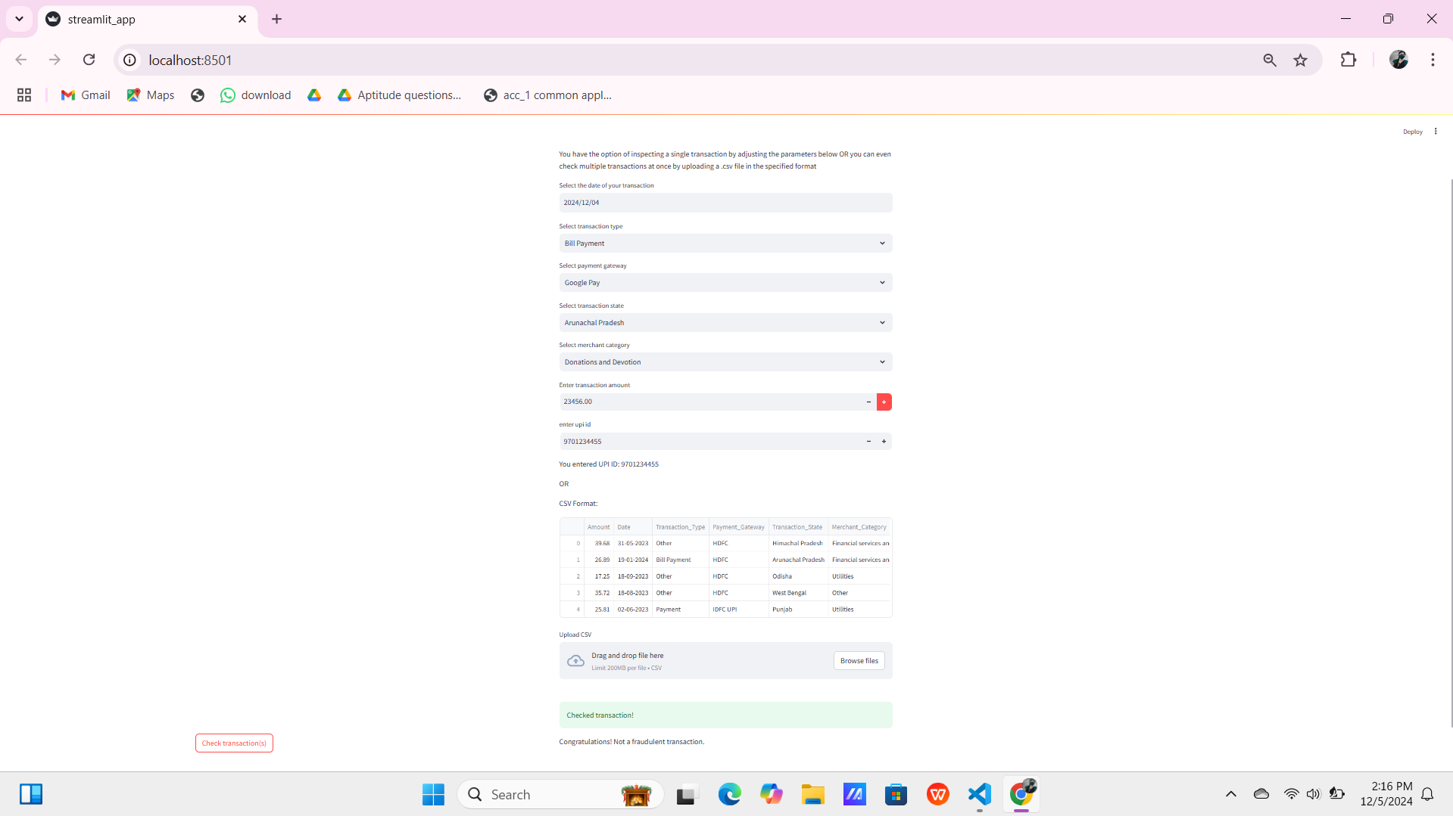
Adding input

Slide 34
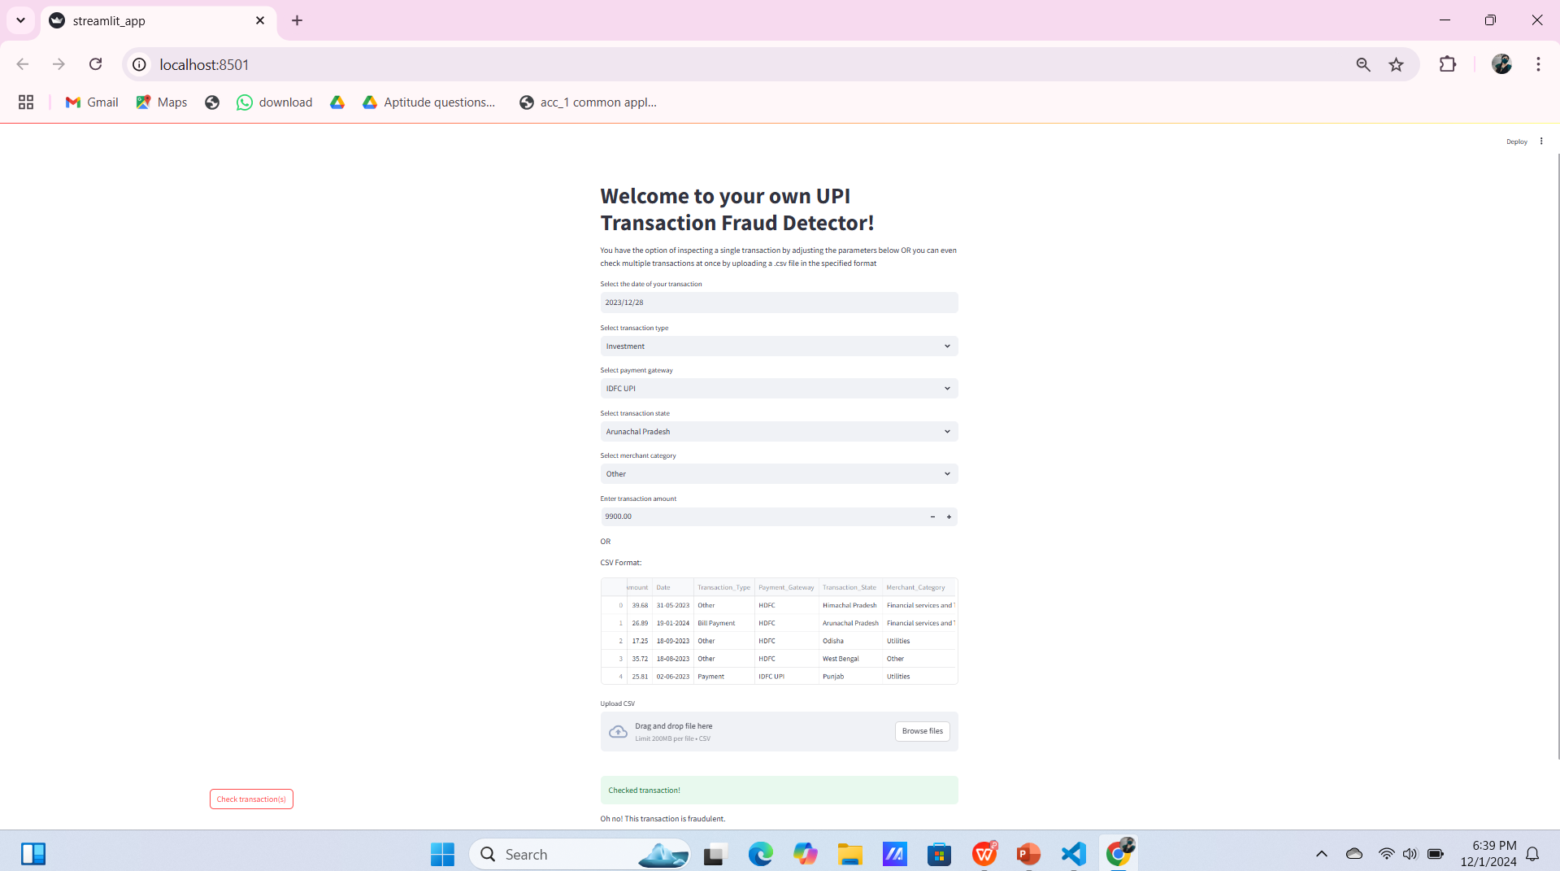

Slide 35
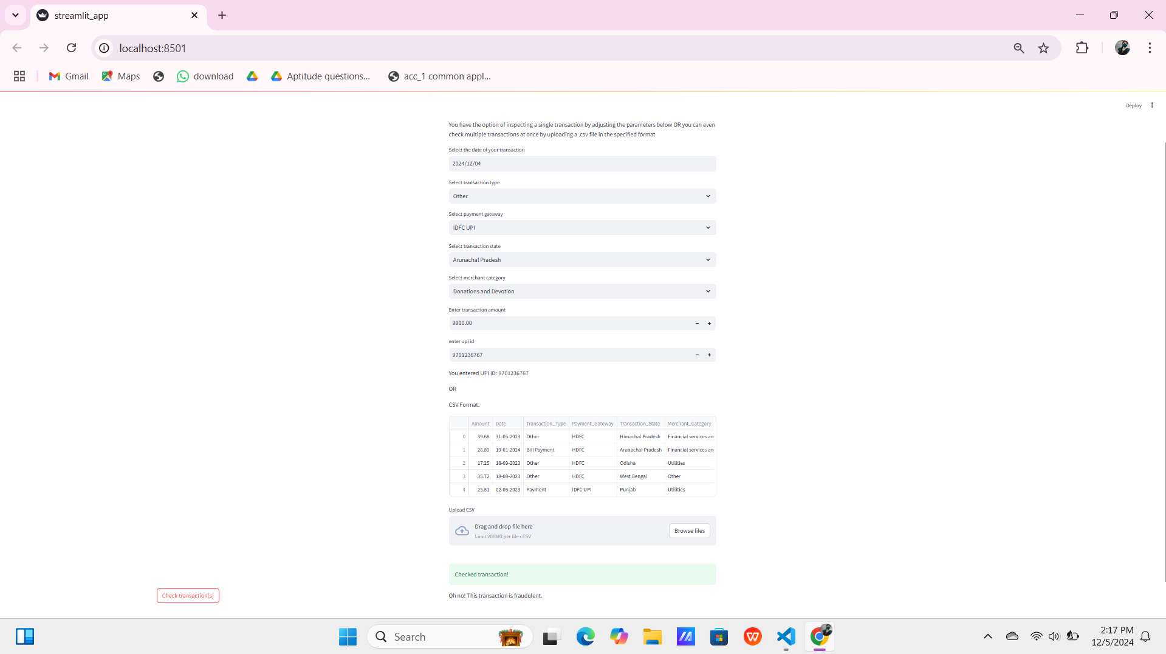

Slide 36
CONCLUSION
In conclusion, developing and putting into action a UPI fraud detection system is a crucial step to make Unified Payments Interface transactions safer and more trustworthy. As digital payments become more widespread, it's essential to safeguard users and financial institutions from fraud. The proposed system, using advanced machine learning, aims not only to spot unusual transactions but also to adapt to new fraud patterns. By analysing past transaction data, the system intends to identify subtle signs of fraud, strengthening the overall security of UPI transactions.

Slide 37
Thank you

