Slide 1
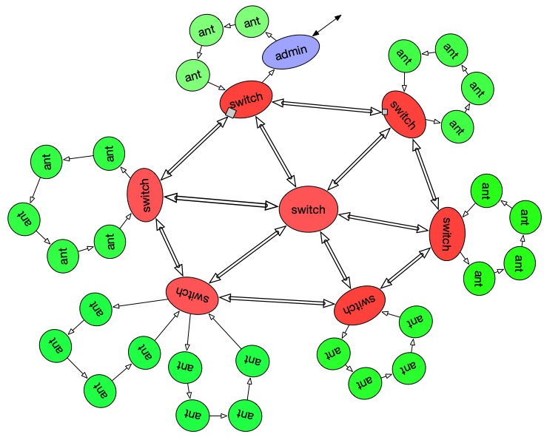


Chip wide net
work in progress
for the rest of us
Never again transaction goes into the NOC, just not to be seen again.
Ilia greenblat@mac.com
+972-54-4927322
May 13, 2019
Notes:
My perspective comes from working in many midsized and small chip/fpga design houses. While the projects are very different, the problems and obstacles slowing us down are pretty much the same. So here i want to share an effort to improve our competitive advantage in this area. Over the years i see tendency to be more and more afraid to open new horizons and design practices. Big companies many times just recycle older designs and call it reuse or derivatives. What worse is that bad (at least “not optimal”) industry standards take over and are revered as coming from above.

Slide 2
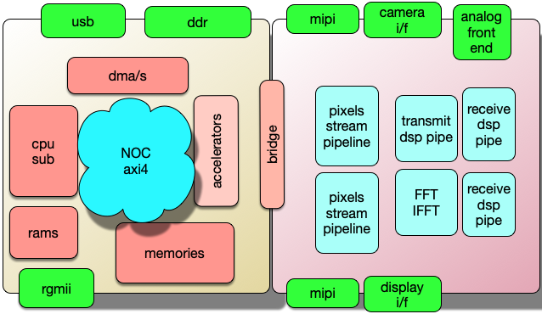
start with - Why?
typical chip (my perspective)
right side
Specific
left side
SOC
mostly of the shelf modules , assembled by NOC
Mipi, Camera, Display, Modem
in-house developed, sewn by “hand”.
What is wrong with this? What can be made simpler?
Notes:
So we start with Why? What is my perspective? And why i think we could do better. Typical design can be roughly divided in SOC part and application specific part. Commercial NOC stitch the SOC and in-house development stitch the rest.
What are the problems? If You don’t see these problems, You probably work in a great company or You are a manager.

Slide 3

NOC ip and axi4
commercial NOCs are black boxes: what goes in - not necessarily comes out.
NOCs solve partial problem: additional mechanisms are needed: especially in Specific part. no interrupts, no power, no scan, no bist.
piling more stuff: variations like AXI4Stream , AXI4Lite.
AXI4 does not specify how to turn individual modules into coherent connected system.
Is overkill for many systems. Scary for most designers.
commercial NOCs disappearing = being swallowed by bigger fish.
adHoc connectivity solutions present formidable verification challenges.

Slide 4
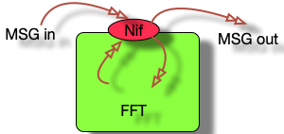

The approach…
First define the network, protocols, layers and ingredients. Network will shuffle messages.
and finally interface to modules.
Network is assembled in “LEGO” -like fashion. From standard building blocks.
Special module “NIF” is embedded into every “ANT” - working functional module.
One node on the network becomes the manager and monitor.
Make the network carry ALL the traffic in the design, including video frames, dsp pipes, interrupts, errors, validation, clocking, power, scan, bist.
Ideally no wire between modules besides the net
FFT - Ant
usual NOC approach is to define AXI4 /APB/AHB/AXI4lite / AXI4Stream first and then build NOC around it.
Notes:
We reverse the order. First we define the network, ingredients and protocols. The network shuffles messages around. The protocol means what each module can send and how it reacts to receiving one.
The stitching is done by picking infrastructure modules from the LEGO zoo and connecting them together. It is pretty easy as the interface of all modules is pretty much the same

Slide 5


Challenges to meet
safety
deadlocks
performance
modelling
verification
assembly
validation
QOS
functionality
security
friendly
to tools
Without addressing these issues any solution is not complete
Notes:
Before going on, these are the issues we need to cover in order to produce a viable solution. How we stitch it all together? How do we validate the topology? Verification issues?

Slide 6

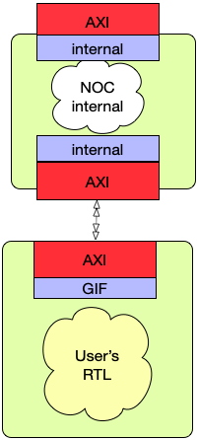
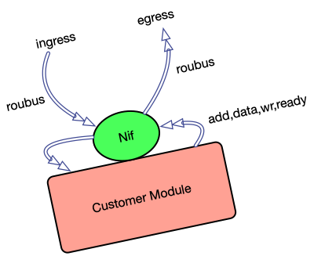

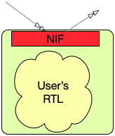
The ant
Each customer module has incoming message bus and outgoing message bus.
If incoming bus carries message not addressed to this module, it is just is sent out on
outgoing bus. Otherwise the message is "consumed".
Inclusion of standard rtl into functional module enables central control and monitoring. Simple interface options.
No DMAs in the system.
No masters, No slaves.
throw AXI logic to dustbin.
define “high” level protocol
Notes:
Lets start with basic. How a functional module, be it CPU, RAM, DDR, USB, dsp filter or vision frame filter can be connected to the network?
One of the provided is NIF. Network Interface.
It directly stitches to the network and on the internal side it has couple of simple options to connect to functional module. Most basic option is “RAM” like interface.
Each NIF claims an address space and when messages appears on the ingress port, it is examined and if it hits the address, Message is “consumed” - meaning it is passed to customer module. If not it is passed on to egress port. Thus each NIF introduces 1 clock delay on running messages.
All NIFs has the same basic functionality, so there are not masters and slaves. Rather talkers and listeners. No module is just passive listener. NIF is also an agent of the network supervisor. It can control the clock, power, BIST and SCAN. It can report the “health” of it’s module.
The user has to map all normally sideband signalling to messages. Error reports, Exceptions and Interrupts are just examples.
The NIF also removes the need for extensive AXI4 logic. If we look at open-source RISC5 implementations, it is not too complicated to “peel off” AXI layers just to expose simpler interface.

Slide 7
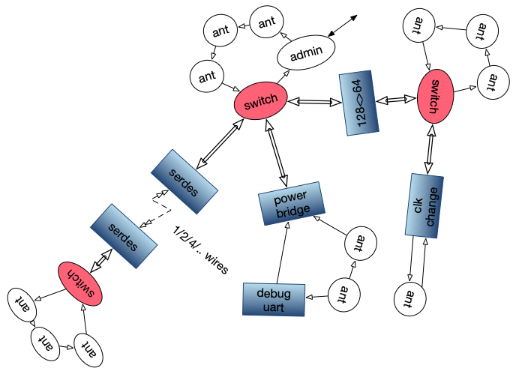
The network
Ant has no idea where it sends it’s data,
all it has is a register(s) with destination address.
The network takes care of the rest.
host
All nodes (processing modules ants) share same connection to the network.
There are neither masters nor slaves.
Some nodes are mostly talkers (like RX-fifo of some external interface) and some mostly listeners (TX-fifo).
Both examples are also listeners for setup info, and talkers for doorbells and buffer requests.
RAM connected to network is equally talker and listener. Though It talks only when addressed to.
Switches, DataWidth crossers, Clock and Power domain crossers,Off-Chip crossers and Serialiser/Deserialzer (for moving on chip long distance in small footprint). constitute the
"LEGO" like zoo of support.
You pick them up from a pile and they snap together.
The network is mostly self-organising in terms of addresses and routing, including inter-chip comms.
terminal
Notes:
Network has global addressing. An Ant is usually provided with setup registers that point to needed resources. It may be address of Transmit fifo or Next filter in video. Besides that pointer, Ant doesn’t have to “know” how the message is routed.
One of the Ants, usually serving always-on processor, can be designated as supervisor (dynamic assignment). It’s job is to initialise the network and configure the ants.
Pay attention to “Debug Part”. externally it looks like UART (or similar ). Inside it can build any message (typed as characters) and send. Effectively faking any other module, including supervisor.
Not shown is back pressure mechanism and provisions to limit rate of messages to slower parts of the design.

Slide 8
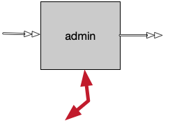
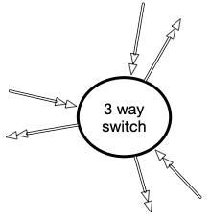
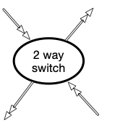
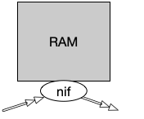
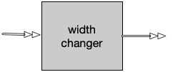


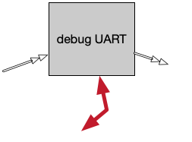
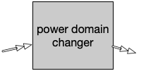
Lego Zoo
Switches build the network. However for small networks, no switch is essential.
They come in 54/128/256… bits data width
host sw
64/128/..
128/64/..
serialisers save number of wires. They come in variety of parallel wires from 1 to 16. They optionally have fast serial clock input. They may be used for inter or intra chip connectivity.
clk1
clk2
clk1’
simple character sequence can send any messages. and display any message received. Can impersonate any other module.
Notes:
Infrastructure modules from the shelf. Include most of the needed functions to stitch together full system.

Slide 9
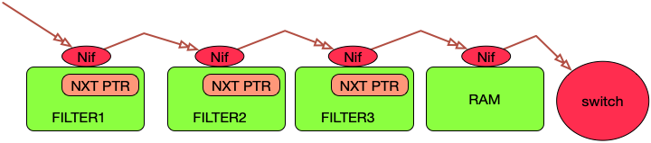
The sequence
As example, each filter is part of video frame pipeline.
Or modem’s numeric processing.
Each module has programmed pointer where to send the results. Bypassing a filter , or changing their order is trivial.
Also Ram can be used as temp buffer. Or not.
Notes:
Example of pipeline. It may be Modem pipeline, where each station does different filter or DSP job.
Or video processing pipeline.
The flexibility comes from the fact that order and activation of all filters is completely under software control.

Slide 10
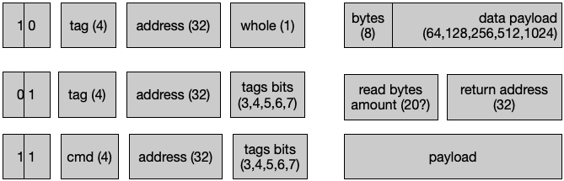
Message classes
send
00 -idle, no msg
01 = read
10 = write
11 = mngmnt
request
mngmnt
“send data” messages have destination address, data payload and tags. Tags may signify first in frame, first in line, increment address and such.
“request data” messages have destination address, return address, tags and amount of data requested. Ant that receives these messages, generates in return bunch of “send data” messages.
“management request” is usually sent by manager to initialise the network and query its topology and health.
“management response” is generated by workers to complain about errors or answer to management queries.
Notes:
3 and a half classes of messages.
“send” message (like write) carries data or commands. It has destination address and payload. Additional tags signify things like start of frame , start of buffer, end of frame and such.
“request” message (read) carries address and tags but also the return address and amount of data requested.
Management request messages setup the network and query the participants about topology and status.It can turn on clocks and power. And also start BISTs and maybe even SCAN.
Management responses may come from Ants when they discover exceptions or errors, or respond to queries from manager.

Slide 11
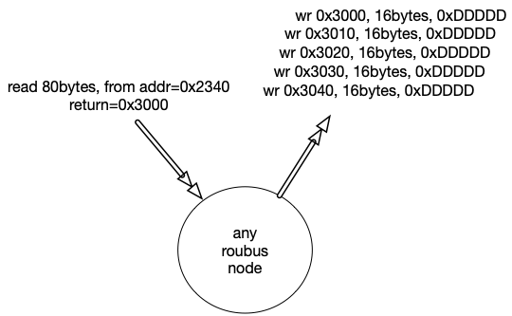
reading
Node receives a read message asking it to send 80 bytes to addr=0x3000.
It responds by sending 5 write messages (each with 16bytes) to incrementing addresses.
the sending node is not necessarily at return address. This is inherent “dma” like functionality.
there are several tags that go with messages, not shown here.
It is a system error, if the node doesn’t know how to respond to many bytes request. It will send “error” management messages.
Management response message, originating at any node, automatically routed to admin.
* Spill-over option
*No bursts!
Notes:
Just to expand.
When read request arrives at Ant , it causes the Ant to answer with bunch of write messages.
There are no explicit bursts
There is also “spill-over” option - when read address reaches end of current ram, it may send out read message with the current address and remaining count.
Tags in read request message signify things like increment source address or destination address or none.

Slide 12


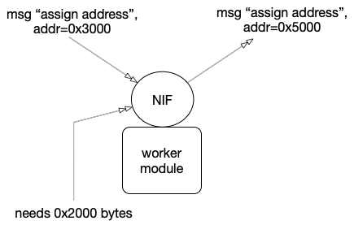


network wakeup
ADMIN
starts the sequence.
Each switch assigned an unique id on the spanning tree and port to root.
“who’s your daddy?”
Each ant requests and receives unique address range. The size of the range is an internal “ant” parameter.
Each switch configures it’s initial routing table. Admin may query the network.
Notes:
On wakeup, management runs discovery algorithms to order the switches.
Next step is to assign address ranges to Ants.
Routing is set up in the switches
Lastly software queries the network to build the image.
Address of Ants is set when special message arrives at Ant. It assigns this address as the starting address. Downstream it sends updated address message.

Slide 13
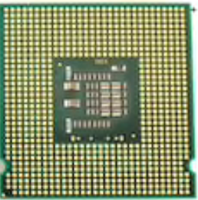
Dynamic addressing
Address map of any design is created on each power-up.
And why it is good for You?
WHEN DOING…..
Silicon
Multi Chip, Multi FPGA
partial test bench
self discovery and monitoring is pretty good self test on power up and during lifetime
transparent to software multichip configuration
insensitive to uneven chip design advances.
serdes
Uart
ULPI
full chip simulation
Software or Test-bench learns the addresses on each power up.
all tests are on the same page- less wasted cycles
No more chasing its own tale - when something changes anywhere.

Slide 14
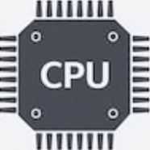

Errors & Interrupts
Mapping sideband signals to the Net.
During setup stage of power on sequence, each switch marks the shortest path to manager. Error detected by any agent on the network, are sent as manager response message. It will be automatically routed to the manager node. The data field is stuffed with whatever the sender thinks is relevant.
Switches also catch “stray” messages and send them to manager.
Any module that needs service is programmed with address to ask for service. This address in destination is “sensitive” - detection of writing to it triggers chain of events. For example, transmit fifo nearing emptiness, sends request to fill it. Or same fifo may read from preassigned buffer pool.
fifo near full
send doorbell to cpu
cpu sends buffer to dump into
Rx
Notes:
Mapping of sideband mechanisms to messaging system. The question is “can it be done”? So everything is mapped to network.
Here is couple of examples.

Slide 15
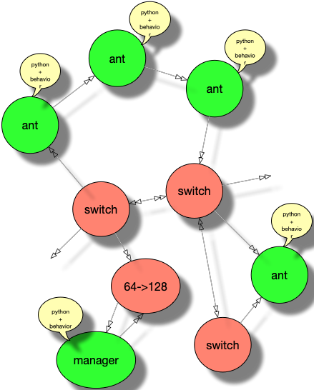
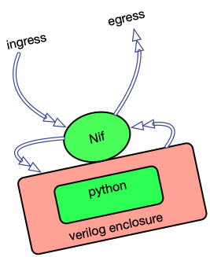
modelling
How to validate performance?
Verilog-Python connection
We connect the ants and the switches into netlist of the network. To prove the performance we can use real switches in simulation. But how about the ants?
SHELL
RTL
For ants we use verilog-python connection. The organisers of the ants is modelled using python code.
Since all ants, no matter what is inside, look the same from the outside, single python model with adaptable communication habits can fit the bill.
We take one ant shell verilog , stuffed with python filling and configure many copies of it with specific behaviors.
Functionality is not affected by topology, only performance.
Notes:
Quality of service!! Performance!!
We can build the topology either by writing the verilog code - or by simple graphical visualisation (graphviz dot as example).
To verify the topology we dont need RTL of each module, but rather stand in model.
The Lego zoo modules included as RTL, but Ants are modelled.

Slide 16
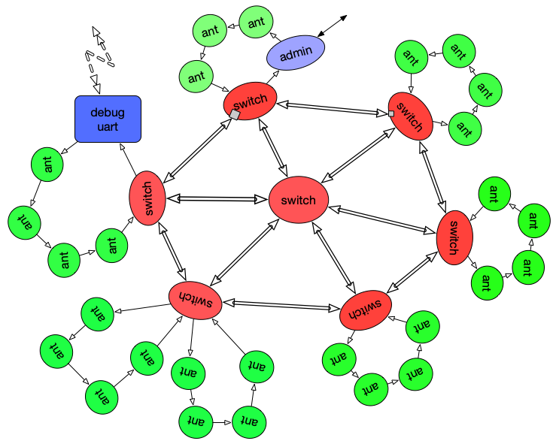


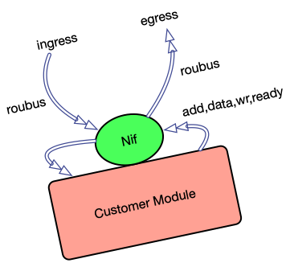


verification & Validation
Partial chip / Full chip or Silicon
Multi chip / FPGA
Each module by itself
Play all scenarios
Cover 90%
software
serdes
or
ULPI
test bench
Uart
any node can fake any other node
terminal
nodes without RTL implementation can be faked with python
Notes:
Verification is done on single ANT, combination of ANTS or full chip.
single Ant verification, since everything is mapped on the network - can test almost everything.
Even if this module interfaces external interfaces , like USB, DDR, MIPI.
on full chip, either software can drive the verification or debug-UART or both.
Same procedure can be applied during validation of silicon.
Validation of multi-chip system is pretty much the same.

Slide 17
what about GDSII?
Are we friendly to: Backend / Layout /Timing closure
Timing always stops at the gate of the Ant
All Constraints cut here
Place&Route blobs may bunch together any number of ants
Network topology can be tweaked up to few days before tapeout.
To meet chip level timing - reshuffle topology.
LEC ends at module level.
Notes:
is it relevant at all?

Slide 18
Promises…
Glue together numerous peripherals into manageable system.
Hit moving target of application / customer requests / market trends.
Reduce the cost of changes by doing truly modular design.
The chip serves software, should make the software job manageable.
Enable adequate level of verification.
Survive P&R and the rest of backend.
Make clocking / power / selftest easy.
Give enough time for system modelling.
Notes:
Quick and flexible assembly of Ants.
If Ant conforms to it’s protocol - any number of instances will work.
Quickly adapt to changing market demands.

Slide 19
not to forget…
security: there are ideas, alas not mine, but plausible.
safety: ECC, CRC, CHECKSUM
cache coherence: when (or if) we need it?
system design: it is different. mental switch needed. requires higher level agreements.
scan, bist, clocking, power : all included?
“comprehensive & total” approach. Modules are connected to the chip “EXCLUSIVELY” by ROUBUS. They talk only through ROUBUS. No sideband signals.
Can All these fine goals be achieved in the same design?
Will it end the world hunger?
for RTLs and more clone:
Thank You
https://github.com/greenblat/vlsistuff.git
Notes:
Thank You!

