Slide 1
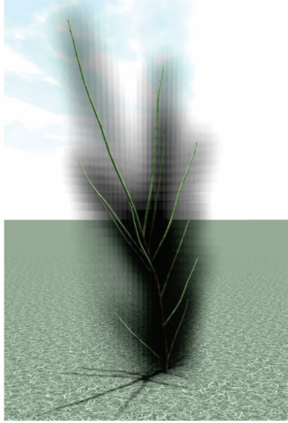
lateral
buds
leaf
internode
apical
bud
metamer
a) b)

