Slide 1
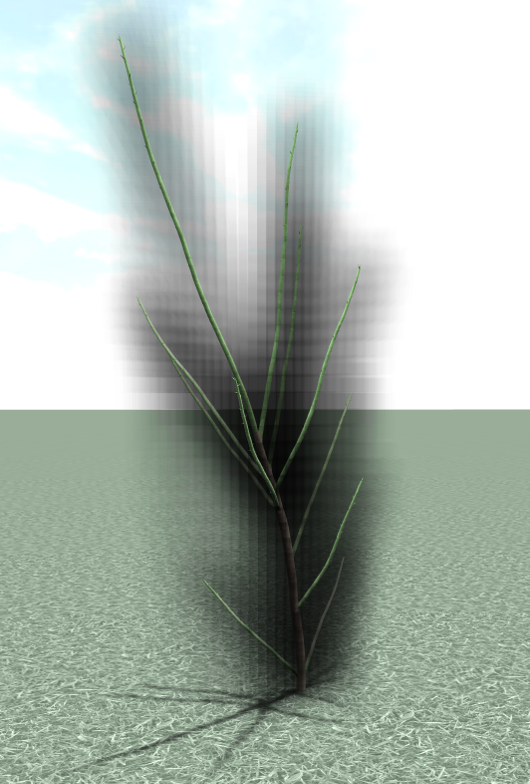
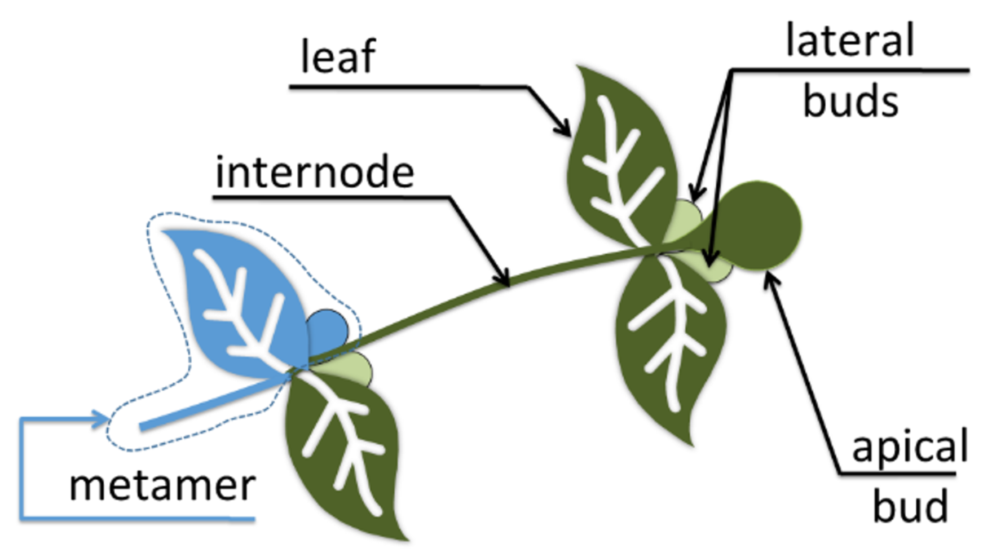
leaf
lateral
buds
internode
apical
metamer
bud
a)
b)

