Slide 1
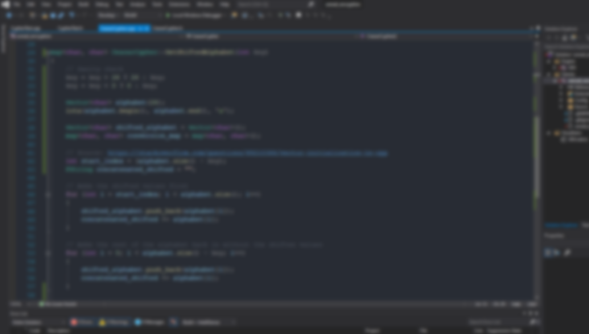
COMP280
Cyber-Security

Slide 2

Common Cyber-Attacks
Malware
Scanning
SQL Injection
Botnet
Subvert Supply Chain
DDoS
Water Holing
Phishing
Spear-Phishing
Ransomware

Slide 3
Distributed Denial of Service
A Distributed Denial of Service (DDoS) attack is where the attacker generates a large quantity of packages and requests to the server.
This ends up overwhelming the system and will slow down the server/stop functioning.
Specifically DDoS uses multiple sources rather than just a singular one in a DoS attack.
Firewalls and determine what traffic can reach your server to limit the number of users .
Web Application Firewall (WAF) deals with the prevention of SQLi, or any other exploits that that allow for a DDoS attack.
Scale your resource so that it can handle large volumes of data at any given time.

Slide 4
Phishing
Phishing involves the attacker directly targeting users into clicking a malicious link or download which contains malware.
This can be done through emails, text messages, or really anything that involves any sort of messaging.
From there sensitive data is then stolen and used.
A method to prevent this attack from happening to the users is to ensure that as an organisation you prevent your email addressed from being “spoofed”.
For Spoofing you can use Domain Keys Identified Mail (DKIM) to sign emails using encryption to prove its from your domain.
Inform users about phishing emails by stating what you will ever ask from them

Slide 5
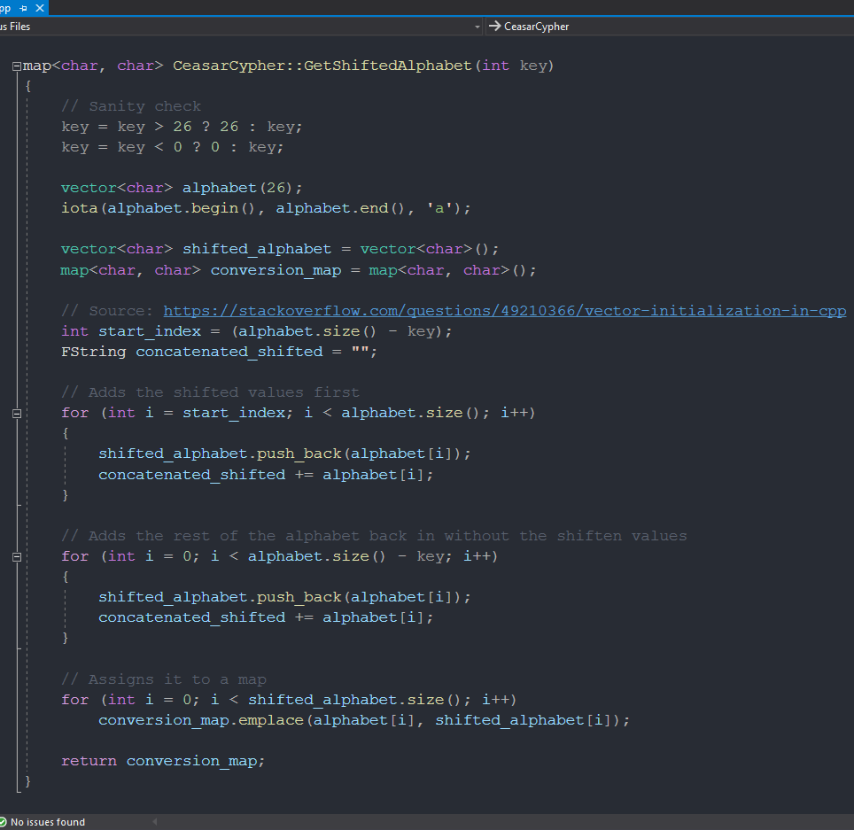
Caesar Cypher
Involves shifting the Alphabet by a key number.
You then use the new alphabet to encrypt and decrypt.
Can be easily cracked through trial and error due to common characters in languages.

