Slide 1

Note: The data and information in this document is reflective of a hypothetical situation and client. This document is to be used for KPMG Virtual Internship purposes only.
Sprocket Central Pty Ltd
Data analytics approach

Slide 2
Agenda
Data Exploration
Model Development
Interpretation

Slide 3
Introduction
In New Customer list we will analyze the columns :
Age
Industry
State that owns car
Purchased bike

Slide 4
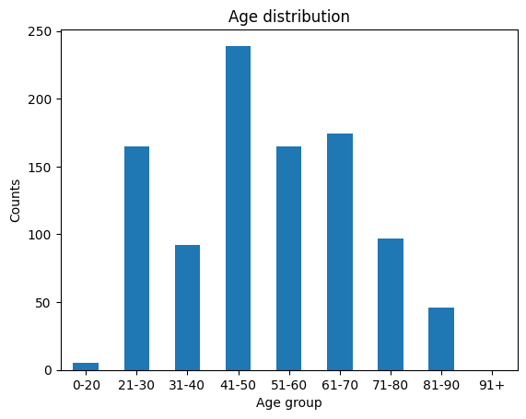
Data Exploration (1) – Age
New customer are from 41-50 age and followed by age range of 61-70.
Fewer customer are from age group of 0-20 & 91+ .
Moderate number of new customer are from age range 21-30 & 51-60.

Slide 5
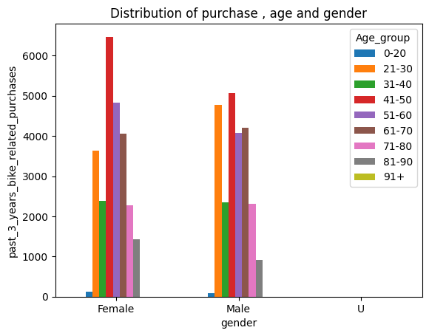
Data Exploration (2) – Bike purchased
From this Last past three year the highest purchased done by age group of 41-50.
And Female customer purchase more than male customer .
In Female , age range 41-50 & 51 – 60 has higher purchased.
In male , age range 41-50 & 21-30 has moderate purchased as compared to female .

Slide 6
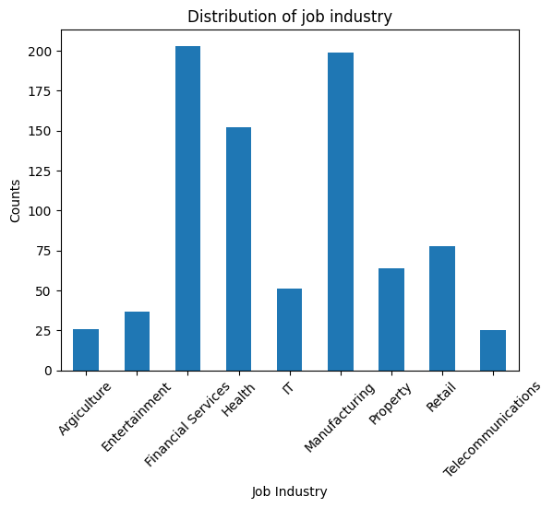
Data Exploration (3) – Job Industry(1)
The new customer are mostly from the Financial service , Manufacturing and Health Industry .
Therefore the this Top three industry job are high profit generating job as shown in the chart.

Slide 7
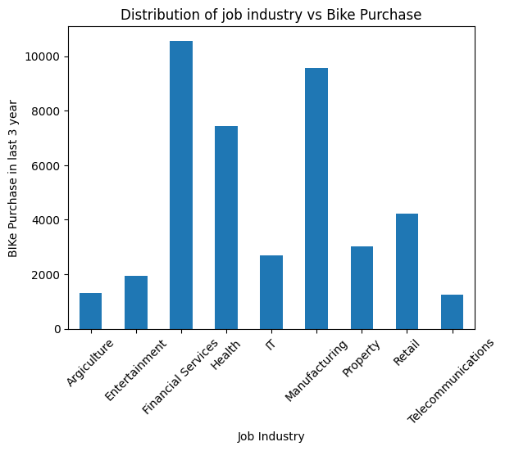
Data Exploration (3) – Job Industry(2)
The Top Industry which purchased the bikes is Financial service industry , and followed by Manufaturing & Health industry.
The lowest bike purchased is in Telecommunication & agriculture sector.

Slide 8
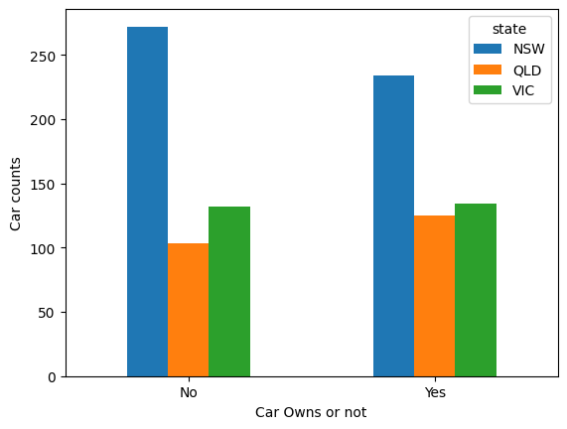
Data Exploration (4) – Car owned by states
The Highest number of car not owned is in state NSW . Therefore there great chance they can purchase bike .
And Therefore the customer owns car means they will not purchase bike .
Therefore the customer from NSW have highest chances of purchase bike.

Slide 9
Model Development
Customer Classification : (Targeting High value Customer)
The following are the high-value clients to target from the new list :
Aged between 41 – 50 .
Most value customer are Female than Male
Working in Financial seervice & Manufacturing industry .
They Currently live in NSW & VIC .

Slide 10
Interpretation
High Value Customer Summary Table
Customer ID | Gender | Age | Past 3 years bike related purchases | Job industry category | Owns car | State
272 | Female | 47.0 | 99 | Manufacturing | No | NSW
546 | Female | 51.0 | 99 | Financial Services | No | NSW
683 | Female | 45.0 | 98 | Health | Yes | NSW
315 | Female | 45.0 | 96 | Manufacturing | No | VIC

Slide 11
Note: The data and information in this document is reflective of a hypothetical situation and client. This document is to be used for KPMG Virtual Internship purposes only.
Thank you

