Slide 1



Calculating with Contract Lenses
Hanliang Zhang¹, Wenghao Tang², Ruifeng Xie³, Meng Wang¹, Zhenjiang Hu³
^{1. University of Bristol}
^{2. University of Edinburgh}
^{3. Peking University}
Notes:
Hello everyone, I’m Hanliang. It’s my honour to introduce our JFP paper on calculating with contract lenses. This is a joint work with

Slide 2
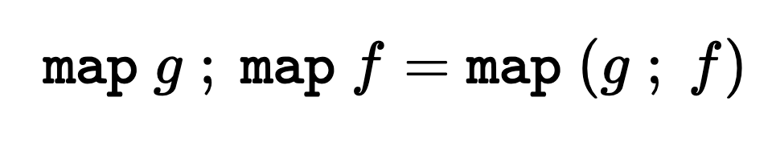
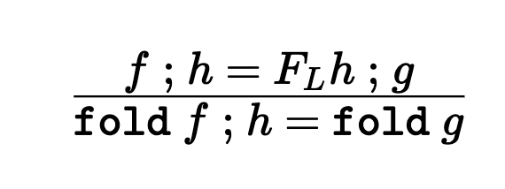
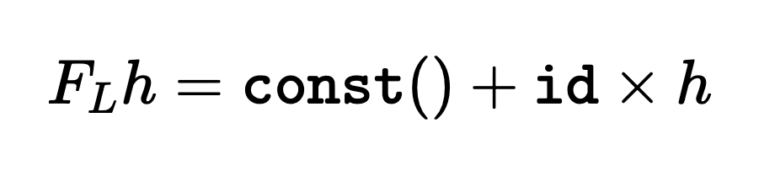
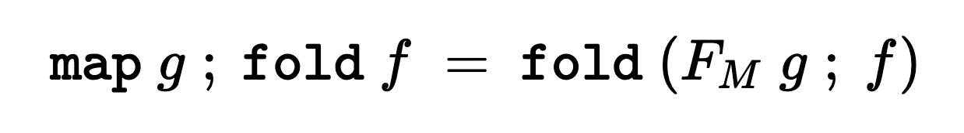
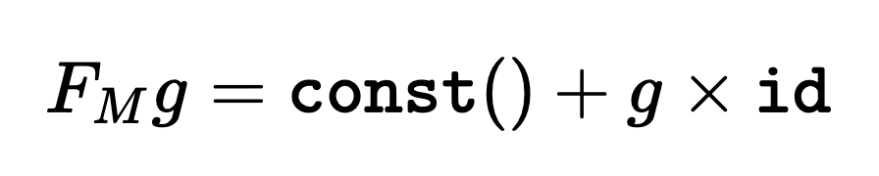
Program Calculation
filter isLetter ; map toUpper
= { Expressing filter as fold }
fold (…) ; map toUpper
= { Fold Fusion }
fold f
where
f: (Either () (Char, [Char])) -> [Char]
f (Left ()) = []
f (Right (x, xs)) =
if isLetter x then toUpper x :: xs else xs
combinator functions
Compositional
Total
Notes:
Program calculation is an established technique for reasoning about and optimizing functional programs. A calculation framework consists of many calculation laws that transforms programs in another forms. The transformation is semantics preserving and often have the extra benefits of pruning intermediate data structures and reducing time complexity. For example, the map fusion laws for list data structure states that composition of two maps can be fused into a single map, avoiding the intermediate list produced by the first map. Note that, here we use the semicolon to represent sequential composition, so the composition goes from left to right.
Also, we have fold fusion law, which is perhaps the most important fusion law, states that, under condition listed in the above, we can fuse a fold composed by another function h into as single fold. Again, avoiding the intermediate data structure produced by the fold.
We also have fold-map fusion law, which states that a map composed by a fold can be fused into a single fold.
As a concrete calculational example, consider this string processing function that returns the capitalization of all letters in a string. The initial specification says that we first filter out all letter chars in a string, and for each of this chars, we use toUpper to perform the transformation. To calculate this program, we first express the program by using combinators like map and fold. Indeed, list filtering can be expressed by fold. In the next step, we apply the fold fusion law to obtain a final program as a single fold.
The benefits of calculating this program is two-folds, firstly, the resulting program is more efficient as it avoid producing the intermediate list comparing to the original speicificaion. Secondly, the initial specification is simple, whereas the final program contains a more complicated f function. However, since calculation laws are semantics preserving, we prove that the final program is euiqivalent to the original speicification, without looking into this complicated f.
So essentially, To calculate a program, one would first express the program as compositions of combinator functions, and use those calculation laws to perform program transformation. Being functions, those combinators usually have the expected nice properties of being total and compositional.

Slide 3
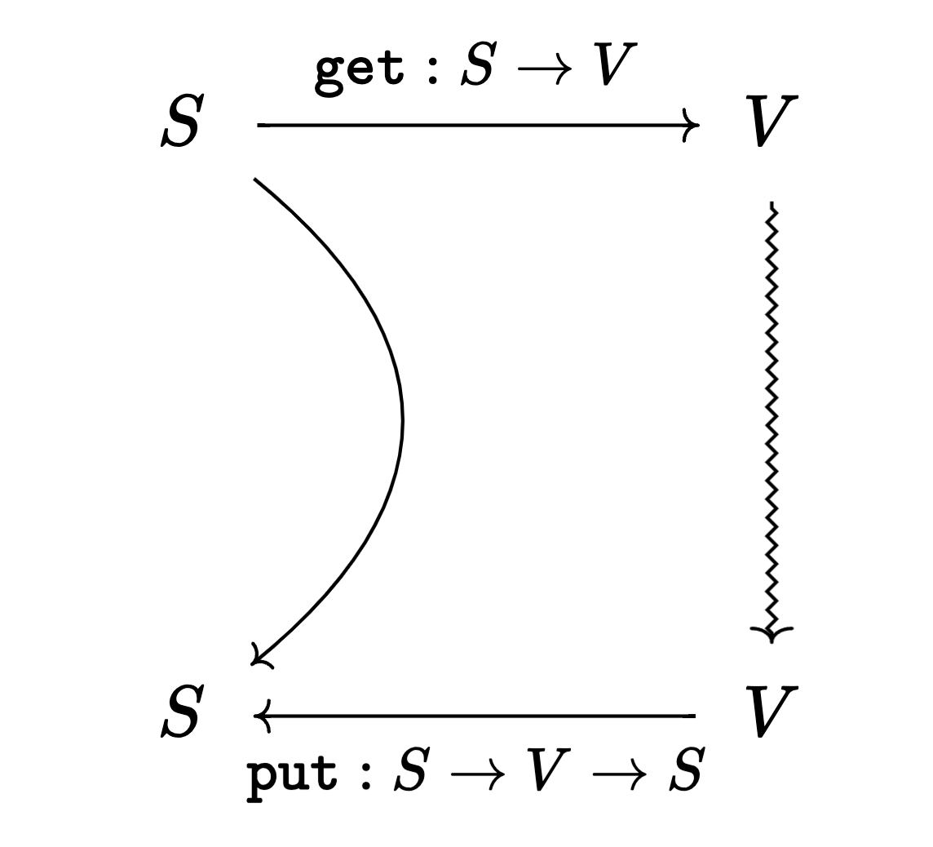


Lenses
Round-tripping:
put s (get s) = s (GetPut)
get (put s v) = v (PutGet)
l: $S↔V$
bfilter bisLetter ; bmap btoUpper
= { Expressing bfilter as bfold }
bfold (…) ; bmap btoUpper
= { Bidirectional Fold Fusion }
bfold l
where
l = (Either () (Char, [Char])) <-> [Char]
l = …
Compositional
Partial
Notes:
The lens framework is a leading combinator approach to bidirectional programming. A lens comprises of a pair of transformations, a forward transformation get producing a view data object from a source data object; the view data object is subject to direct manipulation, and a backward transformation put which takes a source and a possibly modified view and reflects the modification on the view to the source, producing an updated source data object. We use the type notation with double-headed arrows to represent a lens.
In addition to functional behaviors, these two transformations need to satisfy correctness properties, which are these two roundtripping properties.
The GetPut states that no-change to the view should be reflected as no-change to the source. While the PutGet property requires that all changes in the view should be completely reflected to the source so that the changed view can be successfully recovered by applying the forward transformation to the updated source.
We are interested in whether we can develop a calculational framework for lenses. Specifically, can we develop a set of lens combinators and related calculation laws.
Turns out it is challenging, as we will see soon in later slides, lenses are compositional but many useful lenses often partially defined.

Slide 4
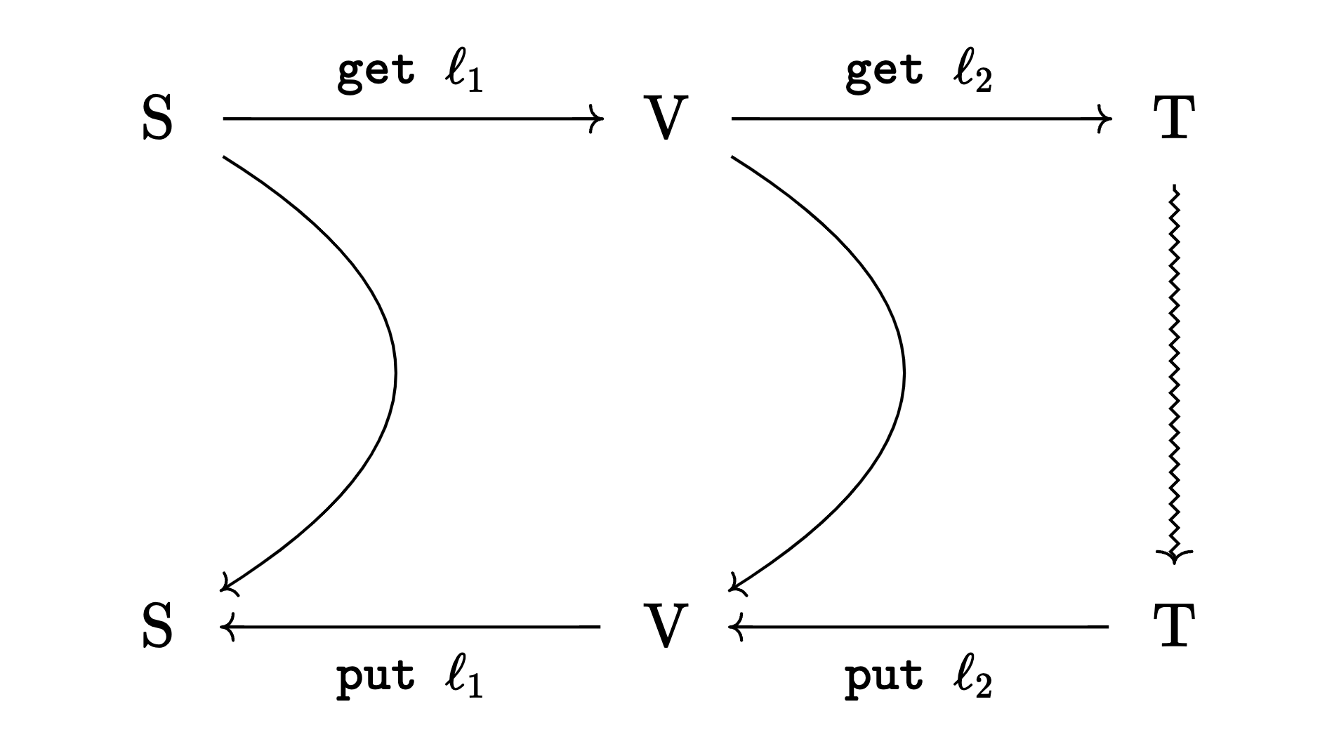
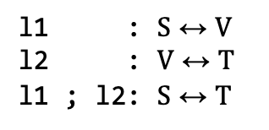
Lens Composition
l1 : $S↔V$
l2 : $V↔T$
l1 ; l2: $S↔T$
get = get l1 ; get l2
put s t =
let v’ = put l2 (get l1 s) t in
put l1 s v’
Composition preserves correctness
Notes:
As mentioned just now, one big advantage of lenses is their compositionality. Given a lens l1 from S to V, and a lens l2 from V to T, we can obtain a composed lens from S to T. In the forward direction, lens composition is simply a function composition of the two get functions. In the backward direction, an updated T value is first put back by using the lens l2 and the original V value to obtain an updated V –value. Which is subsequently used to update the original source, by using the lens l1.
Besides functional behavior, the most important things about lens composition is that it preserves correctness. Namely, if the two lenses satisfy round-tripping property, then their composition satisfy round-tripping properties

Slide 5
Partiality of Lenses
Round-tripping:
put s (get s) = s (GetPut)
get (put s v) = v (PutGet)
Partiality: Lenses fail to restore consistency
bmap: (A <-> B) -> [A] <-> [B]
bmap l = Lens (map (get l)) p
where
p (x::xs) (y::ys) = put l x y :: p xs ys
p _ _ = []
get [1, 2] = [1, 2]
put [1, 2] [2, 3] = [2, 3]
put [1, 2] [2, 3, 4] = [2, 3]
get (put [1, 2] [2, 3, 4]) = [2, 3] != [2, 3, 4]
Conditionally Correct?
Composition preserves correctness?
Notes:
Despite being compositional, lenses are often partially defined. In this context, the term partiality links to round-tripping properties, which are strong requirements to the `put` component, as it needs to handle arbitrary view changes.
A lens is partial when its put component cannot successfully restore consistency for certain inputs, even if the get and put functions are total. This partiality can be inherent, where the get component is non-surjective; there is no meaningful put semantics for values outside the codomain of get.
This partiality can also be of design choices. As an example, consider the definition of list mapping as a (high-order) lens. The put direction will first peek head elements of both source and view list and apply the backward transformation on these two elements, the rest of both lists are processed recursively in the same way. If any of the lists are empty, the backward transformation returns empty list.
This lens is partial, as it cannot restore consistency when the view list is updated to be longer than before.
As an example, assuming the component lens l is an identity lens, the forward transformation of this map is a list identify. When the length of the view lists don’t change, the backward transformation simply returns the view list, no law is broken in these cases. However, if the length changes to be longer, the backward transformation will break the put-get law
So we kind of have a feeling that, this bmap construction is actually conditionally correct, since if you only allow limited updates to the view, then the round-tripping properties are satisfied, but we want a formal way to describe this kind of conditional correctness. We’re also interested in the compositional behavior of those partial lenses. And we want to answer the question of whether composition preserves correctness.

Slide 6
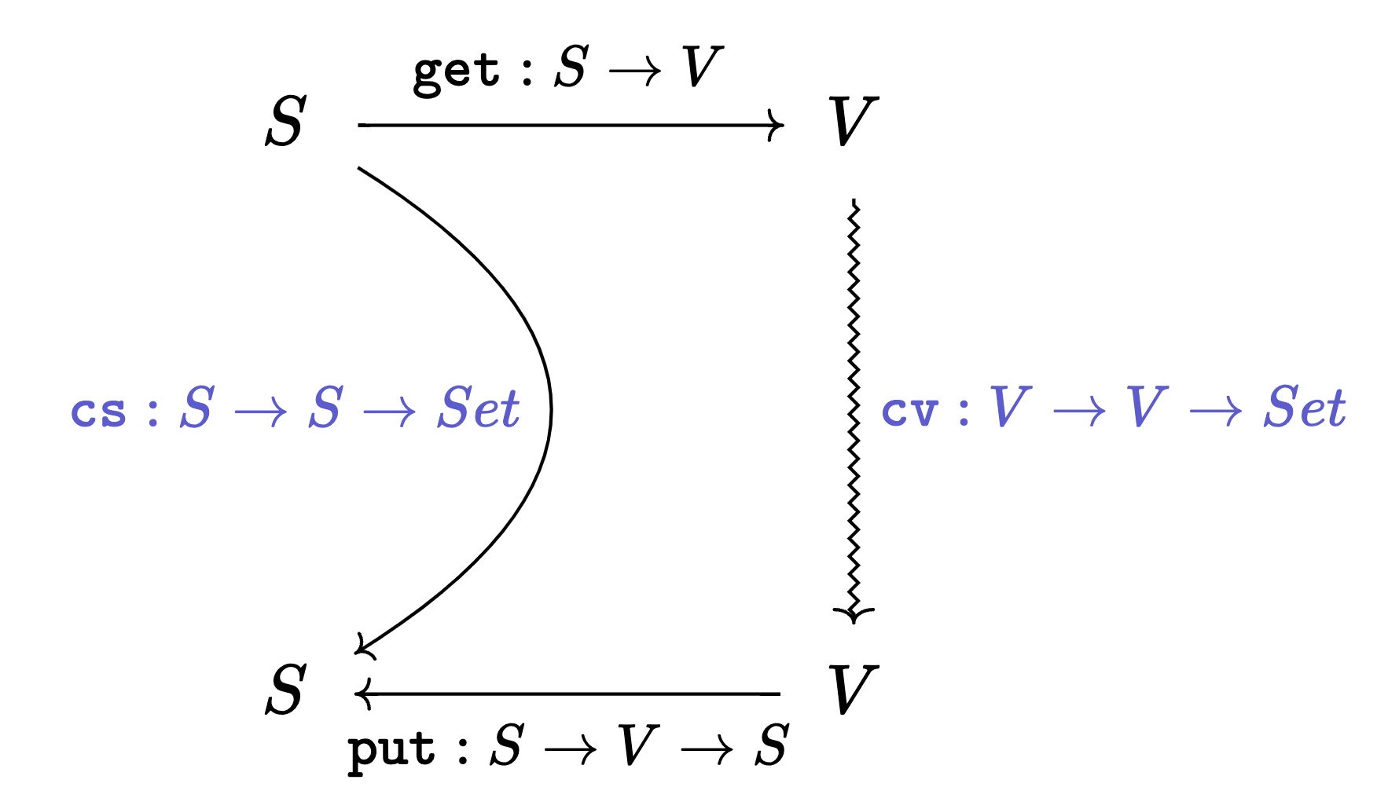

Contract Lenses
{cs} l {cv}: $S↔V$
Conditionally correct
Roundtripping Properties:
cs s s => put s (get s) = s (GetPut)
cv (get s) v => get (put s v) = v (PutGet)
cv (get s) v => cs s (put s v) (BackwardValidity)
cs s s => cv (get s) (get s) (ForwardValidity)
Contract Lens Composition
Composition preserves correctness
{cs} l1 {cv} ; {cv’} l2 {ct} : $S↔T$
Backward Implication: $∀$ v, v’, cv’ v v’ => cv v v’
Forward Implication: $∀$ v, cv v v => cv’ v v
Notes:
And infact In this work, our solution is to extend traditional lenses with a pair of predicates to constrain the changes on the source and view (which we call source and view contracts), so that partial lenses can be constructed correctly and composed well.
view contract cv is a predicate that takes two arguments: the original view obtained by calling the forward transformation get and updated view, restricting the permitted values of the updated view in relation to the original view. The source contract cs has a similar structure. It takes two arguments: the original source and the updated source obtained by calling the backward transformation put, specifying an invariant that must hold for source changes as a result of valid view changes.
Here we explicity write contracts around a lens variable to indicate that this lens has the corresponding contracts.
More formally, a contract lens comprises of a pair of transformations and a pair of relations, together satisfying the following round-tripping properties.
The Get Put law is now conditioned upon identity source changes permitted by source contract. The precondition can be understood as a weakened property that all contracts are reflexive, namely identity changes should always be permitted.
The Put Get law is now conditioned upon view changes constrained by the view contract.
BackwardValidity states that valid view changes imply that source changes satisfy the source contract.
forward validity is, again, a weakened property that all contracts are reflexive. This property is crucial to prove composition correctness etween contract lenses.
So essentially, the view contract is the correctness condition of a possibly partial lens, and the source contract represent the effects of applying backward semantics under valid view changes.
Designed in this way, contract lens has the nice property of being compositional.
In general, given two contract lenses l1 with source contract cs and view contract cv, and l2 with source contract cv’ and view contract ct. If the source contract of the l2 implies the view contract of l1, then the lens constructed by using usual lens composition is still a contract lens, meaning that it satisfy the roundtripping properties. And cs and ct becomes the source and view contracts of the composed lens.
But to formally prove this, we, again, need a forward implication that is a weakened property that all contracts are reflexive.

Slide 7
Bidirectional Map as Contract Lens
bmap: (A <-> B) -> [A] <-> [B]
bmap l = Lens (map (get l)) p csList cvList
where
p (x::xs) (y::ys) = put l x y :: p xs ys
p _ _ = []
csList s s’ = length s == length s’
cvList v v’ = length v == length v’
length (get s) == length v => get (put s v) = v
length (get s) == length v => length s == length (put s v)
Notes:
With contract lens, we can now talk about the conditional correctness of the bidirectional map we constructed before, here we simply added predicates equal length as source and view contracts. One can verify that this lens now satisfies the conditional putget law, that if the lengths of view list doesn’t change, then we have the usual put-get law. Also, if the view changes are subject to eqlength constraint, this lens guarantees that source changes are also subject to eqlength constraint.

Slide 8
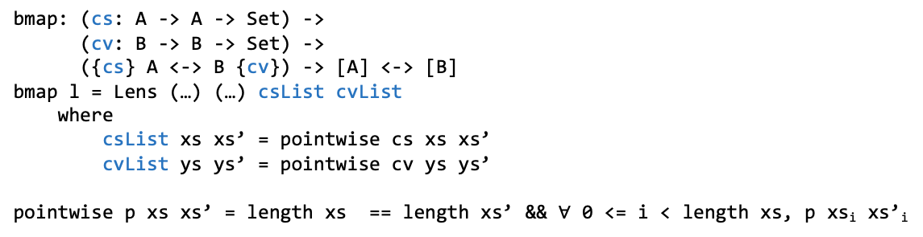
bmap as high-order Contract Lens
bmap: ({anyChanges} A <-> B {anyChanges}) -> [A] <-> [B]
bmap l = Lens (…) (…) csList cvList
where
csList xs xs’ = length xs == length xs’
cvList ys ys’ = length ys == length ys’
bmap: (cs: A -> A -> Set) ->
(cv: B -> B -> Set) ->
({cs} A <-> B {cv}) -> [A] <-> [B]
bmap l = Lens (…) (…) csList cvList
where
csList xs xs’ = pointwise cs xs xs’
cvList ys ys’ = pointwise cv ys ys’
pointwise p xs xs’ = length xs == length xs’ && $∀$ 0 <= i < length xs, p xs_{i} xs’_{i}
Notes:
In fact, the bidirectional map defined before is a high-order contract lens, meaning that its input component lens is also contract lenses, but we don’t put any restriction on it. tthe input lens should have source/view contracts that are trivially true, here we use anyChanges to indicate contracts that are triviall true. We write contracts around the lens type to indicate a requirement on the input lens
We can go a bit more generic and put a different requirements on the input lens. This gives us a bidirectional map combinator that takes a component lens l with generic contract cs and cv as input. The resulting lens permits only view changes that satisfies pointwise constraint, which is stricter than the eqlength constraint. But it also provides stronger guarantess on the source updates: that they satisfy pointwise constraint as well.

Slide 9
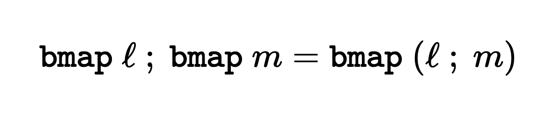
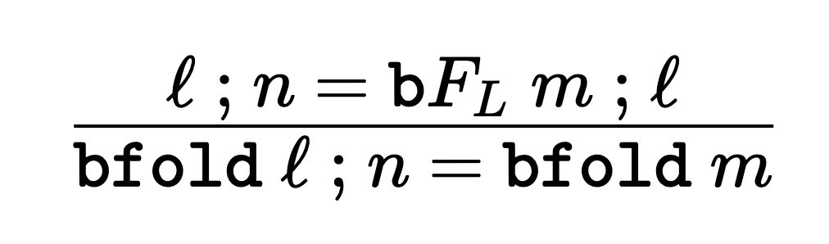
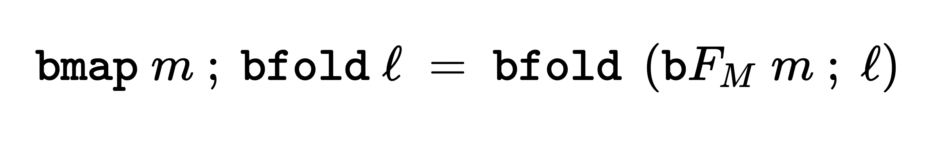
Calculating Bidirectional Programs over List
bfold: ({anyChanges} Either () (S, V) <-> V {anyChanges})
-> [S] <-> V
bfold l = Lens (fold (get l)) (curry $ unfold h) ctrue ctrue
bfold’: (cs: S -> S -> Set) -> (cv: V -> V -> Set)
-> ({keepshape cs cv} Either () (S, V) <-> V {cv})
-> [S] <-> V
bfold’ cs cv l = bfold l {cs = pointwise cs, cv = cv}
keepshape p q a a’ = (a = Left () && a’ = Left ()) ||
(a = Right (x, y) && a’ = Right (x’, y’) &&
p x x’ && q y y’)
…
Notes:
In this work, we have developed a set of lens combinators specific for list data structure. For instance,, we have developed a bidirectional fold as a high order lens that permits any view changes if the input component lens permits any view changes. Additionally, we have bidirectional fold with stricter view contract, which guarantees that source updates satisfy pointwise constraint.
Targeting at those combinators, we have also developed related calculation laws. For example, we have bidirectional map fusion law that states that the composition of two bmap can be fused into a single bidirectional map. We’ve developed bidirectional fold fusion law, and fold-map fusion law as well. And the list goes on. For more combinators and calculation laws, we refer to the original paper.

Slide 10
Bidirectional String Processing
bfilter bisLetter ; bmap btoUpper
= { Expressing bfilter as bfold }
bfold (…) ; bmap btoUpper
= { Bidirectional Fold Fusion }
bfold l
where
l: (Either () (Char, [Char])) <-> [Char]
l = …
Notes:
Back to the calculational example mentioned before, with contract lenses and the calculation laws we develop, we were able to bidirectionalise the string Processing program as composition of contrat lenses. Further, those lenses can be expressed by the combinator we developed. Eventually, we can apply the bidirectional fusion law to fuse the entire program into a single fold.

Slide 11
Conclusion
More contract lens combinators/calculation laws in the paper
An Agda library that formalizes all contract lens combinators and laws (https://github.com/KomaEc/ContractLens-artifact/tree/master/proof)
Notes:
So to conclude, we have developed a bidirectional calculation framework specific to the list data structures,please do check out the paper to find out more combinators and laws and applications. We have also developed an Agda library that formalizes all the contract lens combinators and calculation laws.

