Slide 1


MATLAB 图像处理入门
彭真明
E-mail:zmpeng@uestc.edu.cn
pengzm_ioe@163.com
电子科技大学光电科学与工程学院
2018.09

Slide 2
MATLAB 与图像处理
一、 MATLAB简介
二、 MATLAB图像处理工具箱

Slide 3
MATLAB 与图像处理
一、 MATLAB简介
二、 MATLAB图像处理工具箱

Slide 4
一、MATLAB 简介
什么是Matlab ?
Matlab 常见符号
基本矩阵表示法
矩阵的基本运算
程式流程控制
M文档与M函数
常用指令

Slide 5
1、什么是 Matlab?
MATrix LABoratory
History
  1978, 新墨西哥大学 Pf. Cleve Moler原创, using Fortran
  Stanford的 Jack Little 将 Matlab以C言改写；
  于1984年首次由 MathWorks 推出商用版；
  目前，最新版本为2017b。
Property
  以矩阵运算为主
  Toolbox: image processing, Wavelet, etc.
  Simulink

Slide 6
如何获得帮助?
1) 通过 MATLAB的命令行，键入:
help, lookfor, helpwin, helpdesk, demos.
2) 通过 Web方式:
http://www.mathworks.com/support

Slide 7
MATLAB’s Workspace(工作区)
who,whos - current variables in workspace
save - save workspace variables to *.mat file
load - load variables from *.mat file
clear all - clear workspace variables

Slide 8
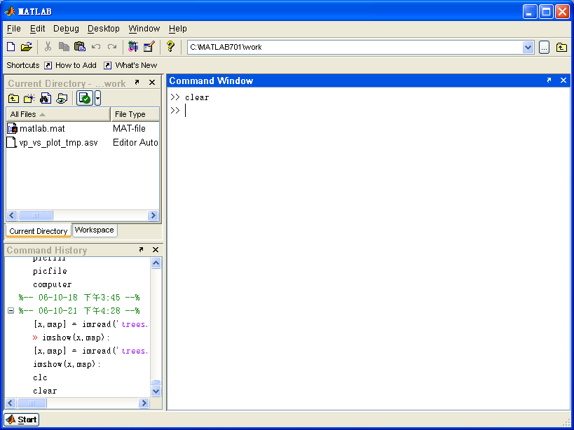
MATLAB’s Workspace(工作区)

Slide 9
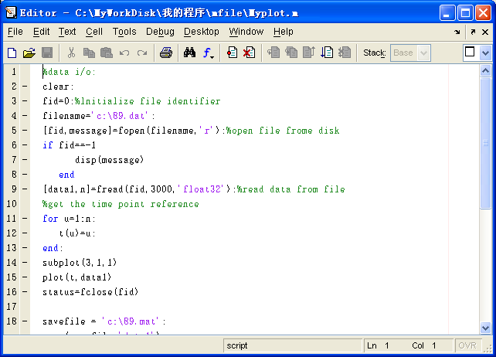
MATLAB’s Editor(编辑器)

Slide 10
MATLAB’s Workspace(工作区)
>> load durer
>> whos
Name Size Bytes Class
X 648x509 2638656 double array
ans 1x1 8 double array
caption 2x28 112 char array
m 1x16 128 double array
map 128x3 3072 double array
Grand total is 330289 elements using 2641976 bytes

Slide 11
2、Matlab 常見符号
常見符号
  i、j 表示虚数
  NaN 沒有意义的数
  Inf 无限大的数目
  eps Matlab浮点数的精度
  pi 圓周率
  分号( ; )表示敘述的结束，但不会显示执行结果。

Slide 12
3、Matrices in MATLAB
Matrix is a main MATLAB’s data type
How to build a matrix?
A = [ 1 2 3; 4 5 6; 7 8 9 ];
Creates matrix A with size 3x3.
Special matrices :
zeros(n,m), ones(n,m),eye (n,m)

Slide 13
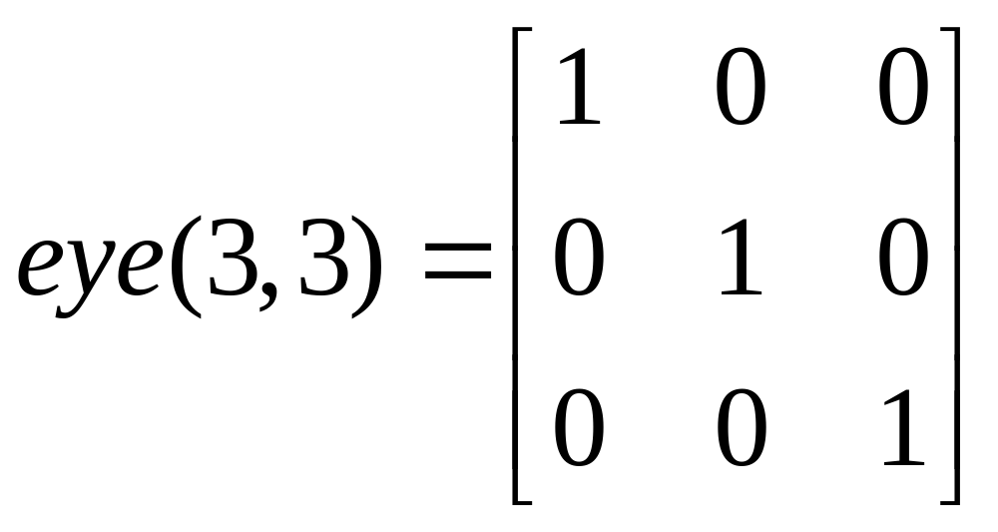
3、Matrices in MATLAB

Slide 14
基本矩阵表示法
Matlab的变量不需申明即可直接使用；
Matlab中，英文字母的大小写是有分別的；
用中括号[ ]表示矩阵开始与结束；
用逗号(,)或空白键区別矩阵中的元素；
用分号(;)或是换行键(Enter)来区分別每列的结束；
向量表示法 x=起始值:增加值:結束值
(若无指定增加值，則预设增加值为1)
取出矩阵中的单一元素：x(n,m)

Slide 15
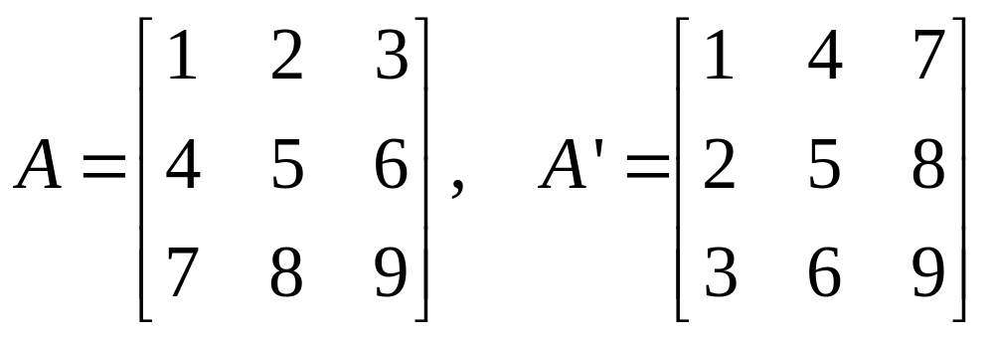
4、矩阵的基本运算 (1/3)
矩阵的Hermitian (共轭转置):
  a = a’
矩阵的加减
  c = a + b;
  d = a - b;

Slide 16
4、矩阵的基本运算 (2/3)
矩阵的乘除及次方
  c = a*b;
  d = a/b; → ( a*b⁻¹ )
    note: a,b must be square matrices and b is nonsingular (行列式不等于0的方阵)
  e = a\b; → (a⁻¹*b )
    note: a,b must be square matrices and a is nonsingular
  f = a^3;
    note: a must be square matrix

Slide 17
4、矩阵的基本运算 (3/3)
阵列的乘除及次方
  c = a .* b;
  d = a ./ b;
  e = a .\ b;
  f = a .^ 3;
注意，阵列的运算是“对应位置”的元素做运算，与矩阵运算差异甚大，请小心分辨使用时机。

Slide 18
5、程序流程控制
5.1 Logical Conditions
== , < , > , (not equal)~= ,(not)~
find(‘condition’) - Returns indexes of A’s elements that satisfies the condition.

Slide 19
5.1 Logical Conditions (cont.)
Example:
>> A = [1 2; 3 4], I = find(A<4)
A =
1 2
3 4
I =
1
2
3

Slide 20
5、程序流程控制
5.2 Flow Control
MATLAB has 5 flow control constructs:
    if statements
    switch statements
    for loops
    while loops
    break statements

Slide 21
5、程序流程控制
for n=1:1:10
  statement;
end
if condition
statement;
elseif
statement;
else
statemnet;
end
while n~=10
statemant;
end

Slide 22
if (cont.)
Example:
if I == J
A(I,J) = 2;
elseif abs(I-J) == 1
A(I,J) = -1;
else
A(I,J) = 0;
end

Slide 23
for (cont.)
Example:
for I = 1:N,
for J = 1:N,
A(I,J) = 1/(I+J-1);
end
end

Slide 24
while (cont.)
Example:
E = 0*A; F = E + eye(size(E)); N = 1;
while norm(E+F-E,1) > 0,
E = E + F;
F = A*F/N;
N = N + 1;
end
注：norm(矩阵的范数)，[m,n]=size(A)

Slide 25
6、M文档与M函数
M文档(类似批处理文档)
  将一群指令输入至文档中(.m档)，执行该文档即可依序执行文档內的指令
M函数(可有输入、输出参数)
  必需在文档开头声明函数名称、输入参数及输出参数function function [output1,output2…] = function_name(input1,input2…)
辅助符号及函数
  % 注解符号
  pause 暂停程式

Slide 26
Functions in MATLAB (cont.)
Example :
The existence of a file on disk called STAT.M with:
function [mean,stdev] = stat(x)
% STAT Interesting statistics.
n = length(x);
mean = sum(x) / n;
stdev = sqrt(sum((x - mean).^2)/n);
defines a new function called STAT that calculates the
mean(均值) and standard deviation(标准差) of a vector.

Slide 27
7、常用辅助指令
常用辅助指令
  help %查看副函式用法
  lookfor %查询相关函数式
  who, whos %察看变量
  load, save %工作区数据存取
  clc %清除屏幕
  clear %清除所有变量
常用技巧
  Ctrl + C %可中断程式执行

Slide 28
常用运算指令
inv() %计算反矩阵
det() %计算行列式值
real(), imag() %取实部、虚部
abs(), angle() %取绝对值、角度
conj() %取共轭
eig() %计算特征值及特征向量
zeros() %产生全为０的矩阵
ones() %产生全为１的矩阵
sin(), cos(), tan(), … log(), exp(), sqrt()
%各种数学函数

Slide 29
常用绘图指令
subplot( n,m,k )
%切割成n×m个子图，并将其绘于第k个子图。
plot() %画标准的线性坐标图
  title() %设定标题文字
  xlabel()，ylabel() %设定x、y轴文字
  figure() %打开新的图形窗口
stem() %绘制离散针状图
hist() %绘制统计图

Slide 30
Visualization and Graphics
plot(x,y), plot(x,sin(x)) % plot 1-D function
figure , figure(k) % open a new figure
hold on, hold off % refreshing
mesh(x_ax,y_ax,z_mat) % view surface
contour(z_mat) % view z as top. map
subplot(3,1,2) % locate several plots in figure
axis([xmin xmax ymin ymax]) % change axes
title(‘figure title’) % add title to figure

Slide 31
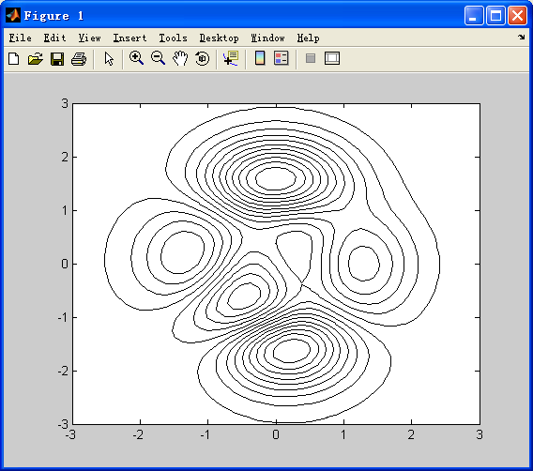
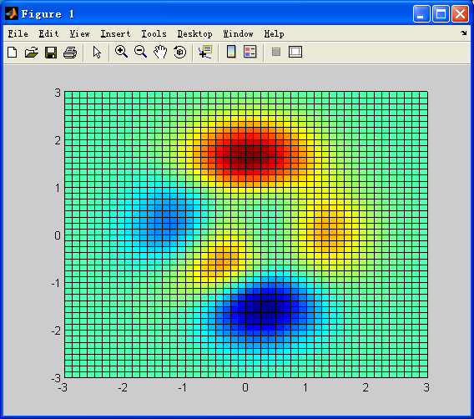
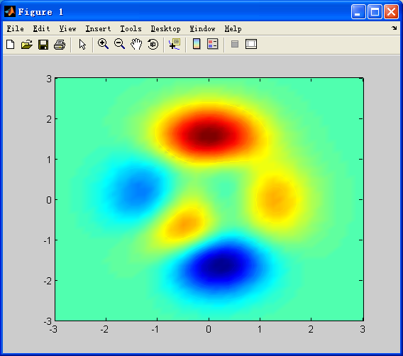
例子
[x,y,z] = peaks;
contour(x,y,z,20,'k')
hold on
pcolor(x,y,z)
shading interp
hold off

Slide 32
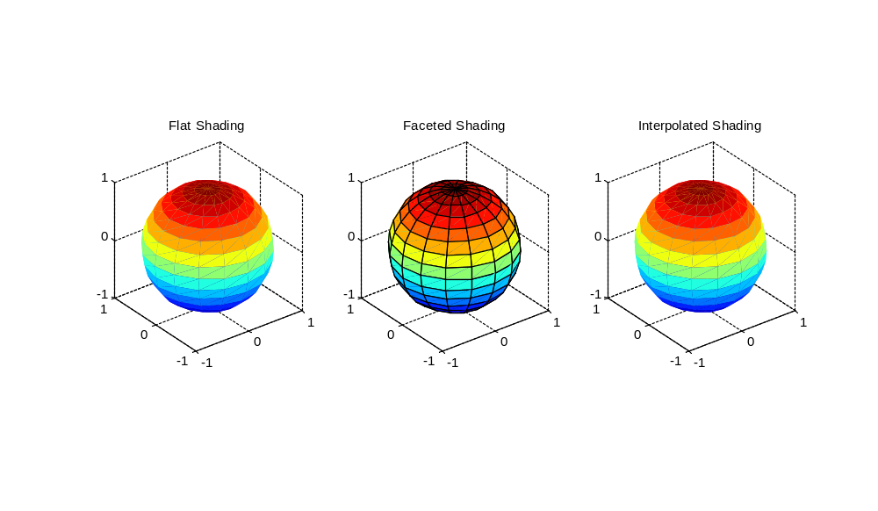

Slide 33
MATLAB 与图像处理
一、 MATLAB简介
二、 MATLAB图像处理工具箱

Slide 34
二、MATLAB图像处理
图像处理工具箱
matlab图像类型
图像读与写
图像显示
图像类型转换等

Slide 35
What Is the Image Processing Toolbox?
The Image Processing Toolbox is a collection of functions that extend the capability of the MATLAB ® numeric computing environment. The toolbox supports a wide range of image processing operations, including:
  Geometric operations
  Neighborhood and block operations
  Linear filtering and filter design
  TransformsImage analysis and enhancement
  Binary image operations
  Region of interest operations

Slide 36
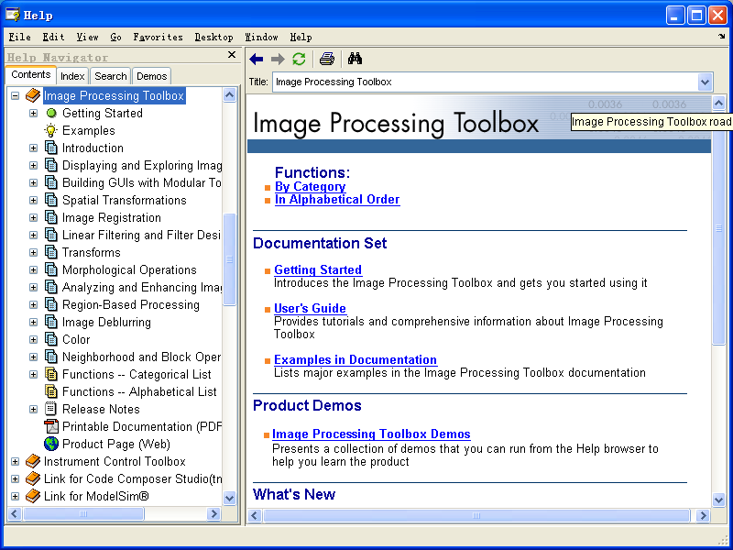
What Is the Image Processing Toolbox?

Slide 37
MATLAB Image Types
Indexed images:
m-by-3 color map
Intensity images:
[0,1] or uint8
Binary images:
{0,1}
RGB images:
m-by-n-by-3

Slide 38
Indexed Images(索引图像)
An indexed image consists of a data matrix, X, and a colormap matrix, map. The data matrix can be of class uint8, uint16, or double. The colormap matrix is an m-by-3 array of class double containing floating-point values in the range [0,1]. Each row of map specifies the red, green, and blue components of a single color. An indexed image uses direct mapping of pixel values to colormap values. The color of each image pixel is determined by using the corresponding value of X as an index into map. The value 1 points to the first row in map, the value 2 points to the second row, and so on.

Slide 39
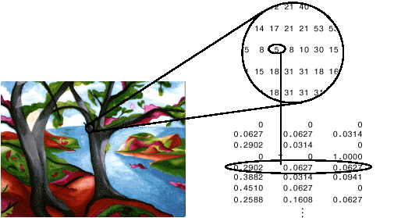
Indexed Images(索引图像)
» [x,map] = imread('trees.tif');
» imshow(x,map);

Slide 40
Intensity Images(灰度图象)
An intensity image is a data matrix, I, whose values represent intensities within some range. MATLAB stores an intensity image as a single matrix, with each element of the matrix corresponding to one image pixel. The matrix can be of class double, uint8, or uint16.While intensity images are rarely saved with a colormap, MATLAB uses a colormap to display them.

Slide 41
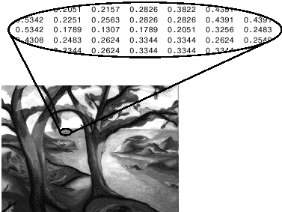
Intensity Images(灰度图象)
» image = ind2gray(x,map);
» imshow(image);

Slide 42
Binary Images(二值图像)
In a binary image, each pixel assumes one of only two discrete values. Essentially, these two values correspond to on and off. A binary image is stored as a logical array of 0's (off pixels) and 1's (on pixels). The figure below depicts a binary image.

Slide 43
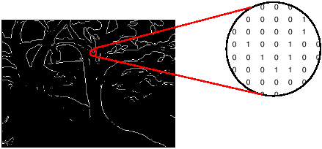
Binary Images(二值图像)
» imshow(edge(image));

Slide 44
RGB Images
An RGB image, sometimes referred to as a truecolor image, is stored in MATLAB as an m-by-n-by-3 data array that defines red, green, and blue color components for each individual pixel. RGB images do not use a palette. The color of each pixel is determined by the combination of the red, green, and blue intensities stored in each color plane at the pixel's location. Graphics file formats store RGB images as 24-bit images, where the red, green, and blue components are 8 bits each. This yields a potential of 16 million colors. The precision with which a real-life image can be replicated has led to the commonly used term truecolor image.

Slide 45
RGB Images
An RGB MATLAB array can be of class double, uint8, or uint16. In an RGB array of class double, each color component is a value between 0 and 1. A pixel whose color components are (0,0,0) displays as black, and a pixel whose color components are (1,1,1) displays as white. The three color components for each pixel are stored along the third dimension of the data array. For example, the red, green, and blue color components of the pixel (10,5) are stored in RGB(10,5,1), RGB(10,5,2), and RGB(10,5,3), respectively.

Slide 46
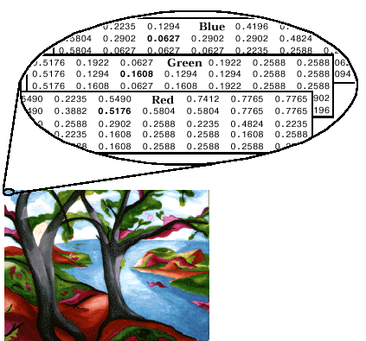
RGB Images

Slide 47
Image Read and Write (读与写)
A = imread(filename,fmt)
[X,map] = imread(filename,fmt)
[...] = imread(filename)
[...] = imread(URL,...)
[...] = imread(...,idx) (CUR, ICO, and TIFF only)
[...] = imread(...,'frames',idx) (GIF only)
[...] = imread(...,ref) (HDF only)
[...] = imread(...,'BackgroundColor',BG) (PNG only)
[A,map,alpha] = imread(...) (ICO, CUR, and PNG only)

Slide 48
Image Read and Write (读与写)
imwrite(A,filename,fmt)
imwrite(X,map,filename,fmt)
imwrite(...,filename)
imwrite(...,Param1,Val1,Param2,Val2...)

Slide 49
Image Display(图像显示)
image % create and display image object
imagesc % scale and display as image
imshow % display image
colorbar % display colorbar
getimage % get image data from axes
truesize % adjust display size of image
zoom % zoom in and zoom out of 2D plot

Slide 50
Image Conversion (图像转换)
gray2ind — %intensity image to index image
im2bw — %image to binary
im2double — %image to double precision
im2uint8 — %image to 8-bit unsigned integers
im2uint16 — %image to 16-bit unsigned integers
ind2gray — %indexed image to intensity image
mat2gray — %matrix to intensity image
rgb2gray — %RGB image to grayscale
rgb2ind — %RGB image to indexed image
ind2gray — %index image to intensity image
ind2rgb — %indexed image to an RGB image

Slide 51
实现图像双线性插值MATLAB示例代码
new_width = 512;
new_height = 512;
newimg = uint8(zeros(new_width,new_height));
I1=imread('C:\r33.bmp');
imshow(I1);
[nrows,ncols]=size(I1);
widthScale = nrows/new_width;
heightScale = ncols/new_height;

Slide 52
实现图像双线性插值MATLAB示例代码(续)
for newx = 1:new_width - 1 % To avoid exceeding the permitted matrix index
for newy = 1:new_height - 1
x = newx * widthScale;
y = newy * heightScale;
if (x/double(uint16(x)) == 1.0) & (y/double(uint16(y)) == 1.0)
newimg(newx,newy) = I1(int16(x),int16(y));
else
a = double(uint16(x)); % (a,b) is the base-dot
b = double(uint16(y));
x11 = double(I1(a,b)); % x11 &lt;- I(a,b)
x12 = double(I1(a,b+1)); % x12 &lt;- I(a,b+1)
x21 = double(I1(a+1,b)); % x21 &lt;- I(a+1,b)
x22 = double(I1(a+1,b+1)); % x22 &lt;- I(a+1,b+1)
newimg(newx,newy) = uint8( (b+1-y) * ((x-a)*x21 + (a+1-x)*x11) + (y-b) * ((x-a)*x22
+(a+1-x) * x12) );
end
end
end
Figure,imshow(newimg)

Slide 53
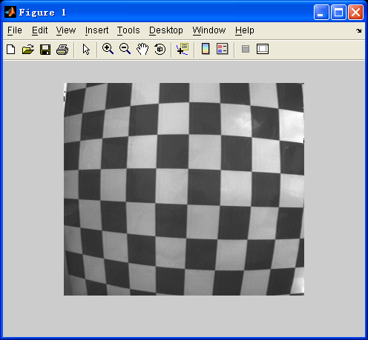
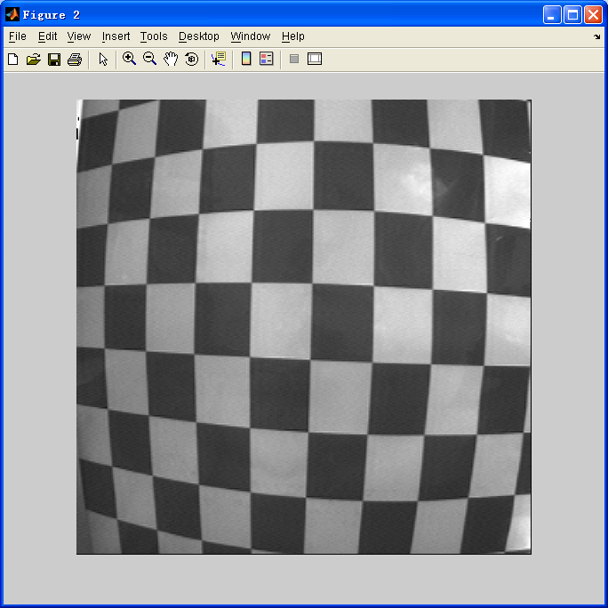
图像双线性插值结果
运行结果

Slide 54
直接调用matlab功能
I=imread(‘c:\money.bmp’);
imshow(I);
%==============
% ‘bilinear’ or 'bicubic'
J = imresize(I,2,‘nearest’);
figure, imshow(J)

Slide 55
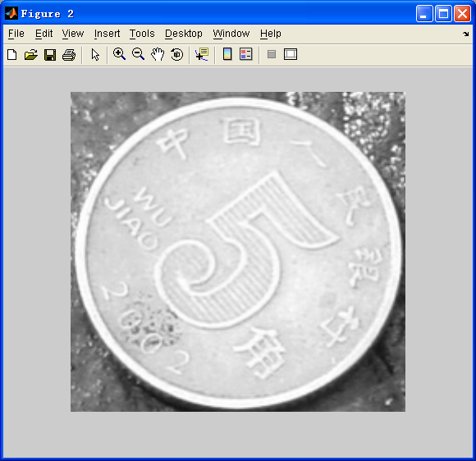
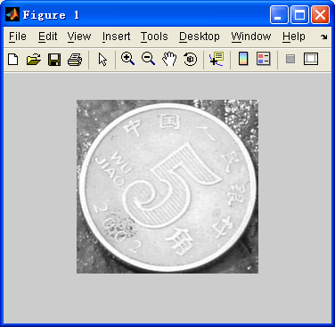
运行结果

Slide 56
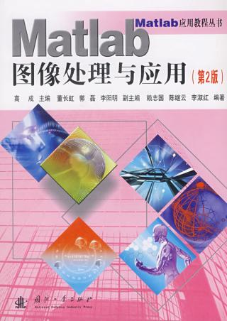
参考书目：
飞思科技产品研发中心编著，Matlab 6.5 辅助图象处理，电子工业出版社，2003。
张威,MATLAB基础与编程入门,西安电子科技大出版社 , 2004 。
罗军辉 ，MATLAB 7.0在图象处理中的应用，机械工业出版社 ，2005。
Matlab图象处理与应用(第2版) ,国防工业出版社，2007。

Slide 57
MATLAB 与图像处理
一、 MATLAB简介
二、 MATLAB图像处理工具箱

Slide 58
Any Questions ?

Slide 59
Read an Image
Read in an image
Validates the graphic format
(bmp, hdf, jpeg, pcx, png, tiff, xwd)
Store it in an array
clear, close all
I = imread(‘pout.tif`);
[X, map] = imread(‘pout.tif’);

Slide 60
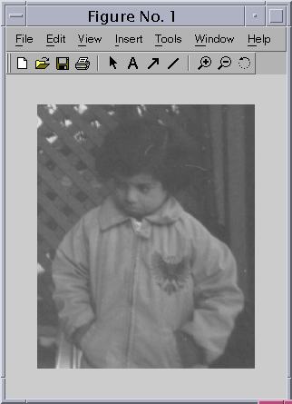
Display an Image
>>imshow(I)

Slide 61
Check the Image in Memory
< Name, Size, Bytes, Class >
>>whos
Name Size Bytes Class
ans 291x240 69840 uint8 array
Grand total is 69840 elements using 69840 bytes
uint8 | [0, 255]
uint16 | [0, 65535]
double | [0, 1]

Slide 62
Histogram Equalization
Histogram: distribution of intensities
>> figure, imhist(I)
Equalize Image (contrast)
>> I2 = histeq(I);
>> figure, imshow(I2)
>> figure, imhist(I2)

Slide 63
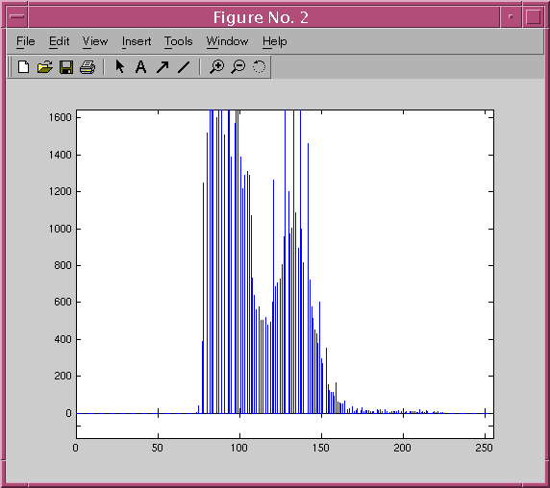
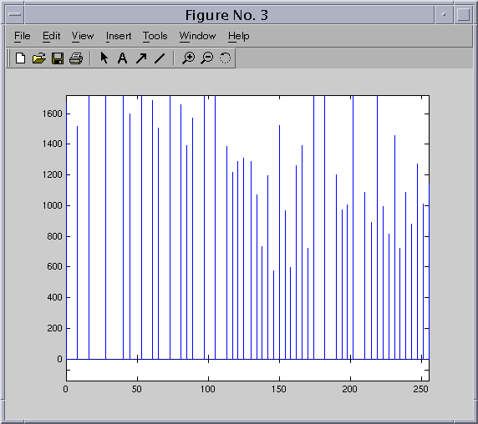
Histogram Equalization (cont.)

Slide 64
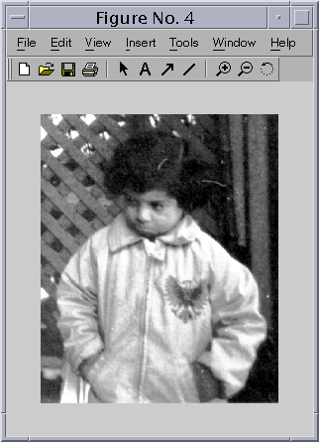
Histogram Equalization (cont.)

Slide 65
Write the Image
Validates the extension
Writes the image to disk
imwrite(I2, ’pout2.png’);
imwrite(I2, ‘pout2.png’, ‘BitDepth’, 4);

Slide 66
Morphological Opening
Remove objects that cannot completely contain a structuring element
Estimate background illumination
clear, close all
I = imread(‘rice.tif’);
imshow(I)
background = imopen(I, strel(‘disk’, 15));
imshow(background)

Slide 67
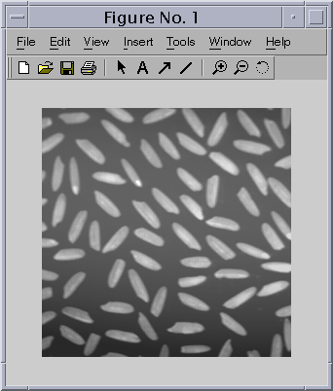
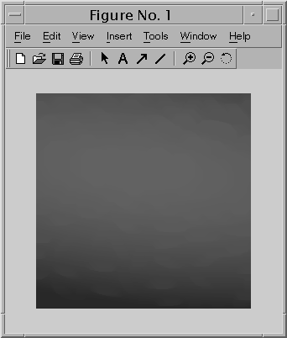
Morphological Opening (cont.)

Slide 68
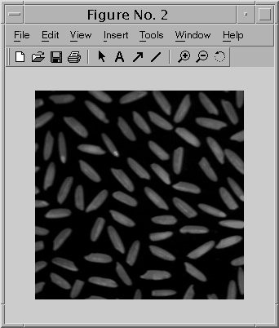
Subtract Images
Create a more uniform background
I2 = imsubtract(I, background);
figure, imshow(I2)

Slide 69
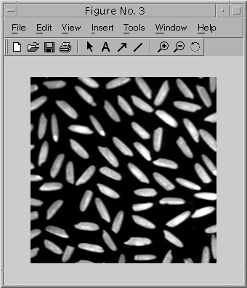
Adjust the Image Contrast
stretchlim computes [low hight] to be mapped into [bottom top]
I3 = imadjust(I2, stretchlim(I2), [0 1]);
figure, imshow(I3)

Slide 70
Apply Thresholding to the Image
Create a binary thresholded image
  Compute a threshold to convert the intensity image to binary
  Perform thresholding creating a logical matrix (binary image)
    level = graythresh(I3);
    bw = im2bw(I3, level);
    figure, imshow(bw)

Slide 71
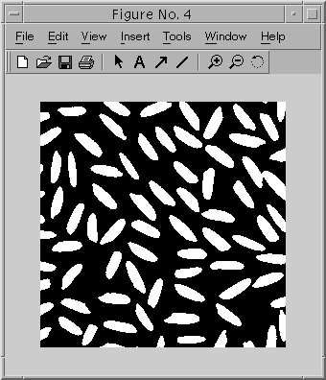
Apply Thresholding to the Image (cont.)

Slide 72
Labeling Connected Components
Determine the number of objects in the image
Accuracy
    (size of objects, approximated background, connectivity parameter, touching objects)
    [labeled, numObjects] = bwlabel(bw, 4);
    numObjects {= 80}
    max(labeled(:))

Slide 73
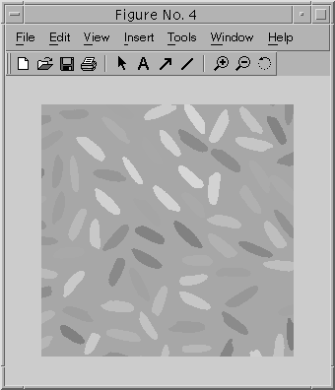
Select and Display Pixels in a Region
Interactive selection
grain = imcrop(labeled)
Colormap creation function
RGB_label = label2rgb(labeled,
@spring, ‘c’, ‘shuffle’);
imshow(RGB_label);
rect = [15 25 10 10];
roi = imcrop(labeled, rect)

Slide 74
Resizing Images
Change the size of an image
I = imread(‘ic.tif’);
J = imresize(I, 1.25);
K = imresize(I, [100 150]);
figure, imshow(J)
figure, imshow(K)

Slide 75
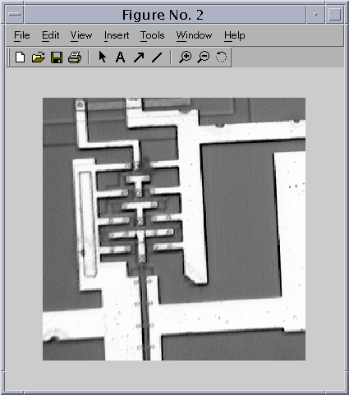
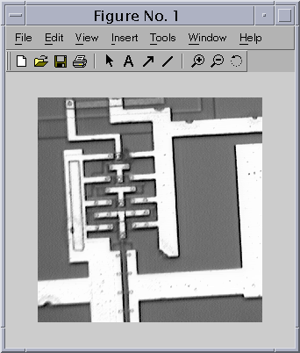
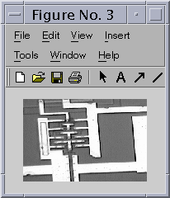
Resizing Images (cont.)

Slide 76
Rotating Images
Rotate an image by an angle in degrees
I = imread(‘ic.tif’);
J = imrotate(I, 35, ‘bilinear’);
imshow(I)
figure, imshow(J)

Slide 77
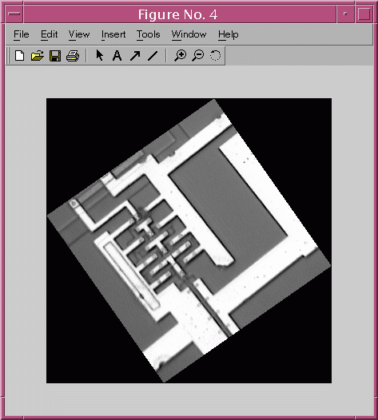
Rotating Images (cont.)

Slide 78
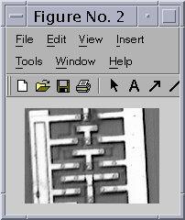
Cropping Images
Extract a rectangular portion of an image
imshow ic.tif
I = imcrop;

