Slide 1
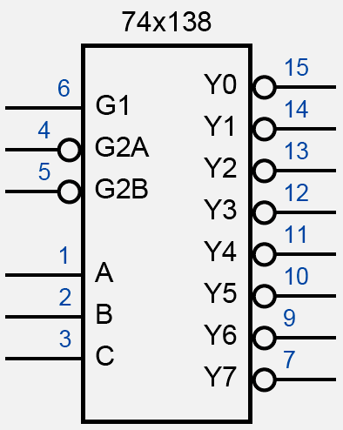
译码器：74x138
Digital Logic Design and Application (数字逻辑设计及应用)
module msi74x138(G1,G2A_L, G2B_L, C, B, A, Y_L);
input G1, G2A_L, G2B_L;
input C, B, A;
output [7:0] Y_L;
reg [7:0] Y_L;
always @ (G1 or G2A_L or G2B_L or C or B or A)
begin
if(G1 & ~G2A_L & ~G2B_L)
case({C,B,A})
3’b000: Y_L=8’b11111110;
3’b001: Y_L=8’b11111101;
3’b010: Y_L=8’b11111011;
3’b011: Y_L=8’b11110111;
3’b100: Y_L=8’b11101111;
3’b101: Y_L=8’b11011111;
3’b110: Y_L=8’b10111111;
3’b111: Y_L=8’b01111111;
default: Y_L=8’b11111111;
endcase
else
Y_L=8’b11111111;
end
endmodule

Slide 2
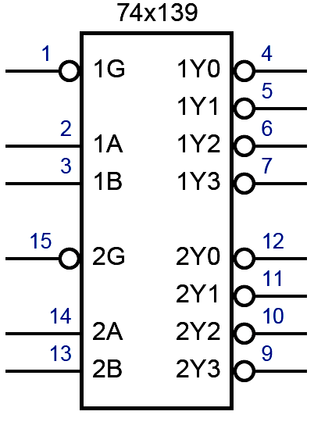
译码器：74x139
Digital Logic Design and Application (数字逻辑设计及应用)
module msi74x139(G1_L, G2_L, A1, A2, Y1_L, Y2_L);
input G1_L, G2_L;
input [1:0] A1, A2 ;
output [3:0] Y1_L, Y2_L;
reg [3:0] Y1_L, Y2_L;
always @ (G1_L or A1)
begin
if(~G1_L)
case(A1)
2’b00: Y1_L=4’b1110;
2’b01: Y1_L=4’b1101;
2’b10: Y1_L=4’b1011;
2’b11: Y1_L=4’b0111;
endcase
else
Y1_L=4’b1111;
end

Slide 3
译码器：74x139
Digital Logic Design and Application (数字逻辑设计及应用)
always @ (G2_L or A2)
begin
if(~G2_L)
case(A2)
2’b00: Y2_L=4’b1110;
2’b01: Y2_L=4’b1101;
2’b10: Y2_L=4’b1011;
2’b11: Y2_L=4’b0111;
endcase
else
Y2_L=4’b1111;
end
endmodule

Slide 4
利用74x139实现3-8译码功能
Digital Logic Design and Application (数字逻辑设计及应用)
module decoder_3_8(A, Y_L);
input [2:0] A;
output [7:0] Y_L;
msi74x139 msi74x139_inst
(.G1_L(A[2]),
.G2_L(~A[2]),
.A1(A[1:0]),
.A2(A[1:0]),
.Y1_L(Y_L[3:0]),
.Y2_L(Y_L[7:4])
);
endmodule

Slide 5
利用74x139实现3-8译码功能
Digital Logic Design and Application (数字逻辑设计及应用)
module decoder_3_8(A, Y_L);
input [2:0] A;
output [7:0] Y_L;
wire [3:0] Y1_L, Y2_L;
msi74x139 msi74x139_inst
(.G1_L(A[2]),
.G2_L(~A[2]),
.A1(A[1:0]),
.A2(A[1:0]),
.Y1_L(Y1_L),
.Y2_L(Y2_L)
);
assign Y_L={Y2_L, Y1_L};
endmodule

Slide 6
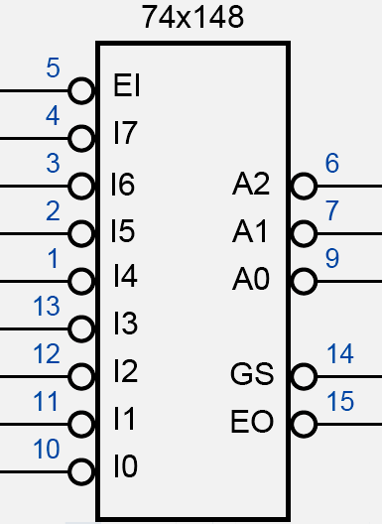
编码器：74x148
Digital Logic Design and Application (数字逻辑设计及应用)
module msi74x148(EI_L, I_L, A_L, GS_L, EO_L);
input EI_L;
input [7:0] I_L;
output GS_L, EO_L;
output [2:0] A_L;
reg GS_L, EO_L;
reg [2:0] A_L;
always @ (EI_L or I_L)
begin
if(~EI_L)
casex(I7_L)
8’b0xxxxxxx:
begin
A_L=3’b000;
GS_L=1’b0;
EO_L=1’b1;
end
8’b10xxxxxx:
begin
A_L=3’b001;
GS_L=1’b0;
EO_L=1’b1;
end

Slide 7
编码器：74x148
Digital Logic Design and Application (数字逻辑设计及应用)
8’b110xxxxx:
begin
A_L=3’b010;
GS_L=1’b0;
EO_L=1’b1;
end
8’b1110xxxx:
begin
A_L=3’b011;
GS_L=1’b0;
EO_L=1’b1;
end
8’b11110xxx:
begin
A_L=3’b100;
GS_L=1’b0;
EO_L=1’b1;
end
8’b111110xx:
begin
A_L=3’b101;
GS_L=1’b0;
EO_L=1’b1;
end

Slide 8
编码器：74x148
Digital Logic Design and Application (数字逻辑设计及应用)
8’b1111110x:
begin
A_L=3’b110;
GS_L=1’b0;
EO_L=1’b1;
end
8’b11111110:
begin
A_L=3’b111;
GS_L=1’b0;
EO_L=1’b1;
end
default:
begin
A_L=3’b111;
GS_L=1’b1;
EO_L=1’b0;
end
endcase
else
begin
A_L=3’b111;
GS_L=1’b1;
EO_L=1’b1;
end
end
endmodule

Slide 9
编码器：74x148
Digital Logic Design and Application (数字逻辑设计及应用)
module msi74x148(EI_L, I_L, A_L, GS_L, EO_L);
input EI_L;
input [7:0] I_L;
output GS_L, EO_L;
output [2:0] A_L;
reg GS_L, EO_L;
reg [2:0] A_L;
always @ (EI_L or I_L)
begin
if(~EI_L)
begin
if(~I_L[7])
begin
A_L=3’b000;
GS_L=1’b0;
EO_L=1’b1;
end
else if(~I_L[6])
begin
A_L=3’b001;
GS_L=1’b0;
EO_L=1’b1;
end

Slide 10
编码器：74x148
Digital Logic Design and Application (数字逻辑设计及应用)
else if(~I_L[5])
begin
A_L=3’b010;
GS_L=1’b0;
EO_L=1’b1;
end
else if(~I_L[4])
begin
A_L=3’b011;
GS_L=1’b0;
EO_L=1’b1;
end
else if(~I_L[3])
begin
A_L=3’b100;
GS_L=1’b0;
EO_L=1’b1;
end
else if(~I_L[2])
begin
A_L=3’b101;
GS_L=1’b0;
EO_L=1’b1;
end

Slide 11
编码器：74x148
Digital Logic Design and Application (数字逻辑设计及应用)
else if(~I_L[1])
begin
A_L=3’b110;
GS_L=1’b0;
EO_L=1’b1;
end
else if(~I_L[0])
begin
A_L=3’b111;
GS_L=1’b0;
EO_L=1’b1;
end
else
begin
A_L=3’b111;
GS_L=1’b1;
EO_L=1’b0;
end
end
else
begin
A_L=3’b111;
GS_L=1’b1;
EO_L=1’b1;
end
end
endmodule

Slide 12
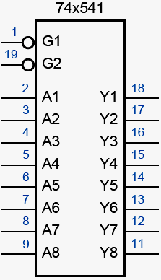
三态缓冲器：74x541
Digital Logic Design and Application (数字逻辑设计及应用)
module msi74x541(G1_L,G2_L, A, Y);
input G1_L, G2_L;
input [8:1] A;
output [8:1] Y;
wire G;
assign G=(~G1_L & ~G2_L);
assign Y= G? A : 8’hzz;
endmodule

Slide 13
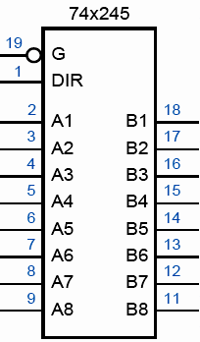
双向三态缓冲器：74x245
Digital Logic Design and Application (数字逻辑设计及应用)
module msi74x245(G_L, DIR, A, B);
input G_L, DIR;
inout [8:1] A, B;
assign B = (~G_L & DIR) ? A : 8’hzz;
assign A = (~G_L & ~DIR) ? B : 8’hzz;
endmodule

Slide 14
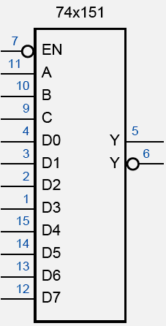
多路复用器：74x151
Digital Logic Design and Application (数字逻辑设计及应用)
module msi74x151(EN_L, A, D, Y, Y_L);
input EN_L;
input [2:0] A;
input [7:0] D;
output Y, Y_L;
reg Y;
always @ (EN_L or A or D)
begin
if(~EN_L)
case(A)
3’b000: Y=D[0];
3’b001: Y=D[1];
3’b010: Y=D[2];
3’b011: Y=D[3];
3’b100: Y=D[4];
3’b101: Y=D[5];
3’b110: Y=D[6];
3’b111: Y=D[7];
endcase
else
Y=1’b0;
end
assign Y_L=~Y;
endmodule

Slide 15
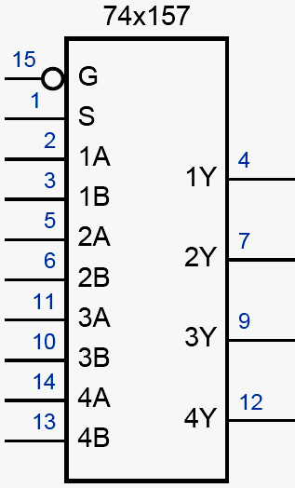
多路复用器：74x157
Digital Logic Design and Application (数字逻辑设计及应用)
module msi74x157(G_L, S, A, B, Y);
input G_L, S;
input [3:0] A, B;
output [3:0] Y;
reg [3:0] Y;
always @ (G_L or S or A or B)
begin
if(~G_L)
case(S)
1’b0: Y=A;
1’b1: Y=B;
endcase
else
Y=4’h0;
end
endmodule

Slide 16
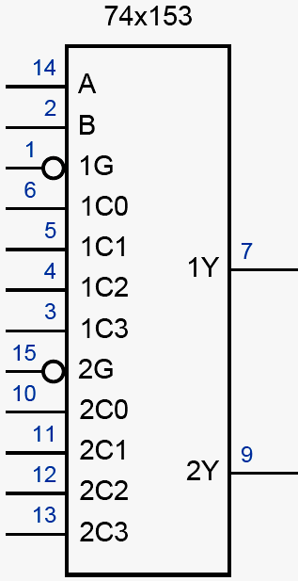
多路复用器：74x153
Digital Logic Design and Application (数字逻辑设计及应用)
module msi74x153(G1_L, G2_L, A, C1, C2, Y1, Y2);
input G1_L, G2_L;
input [1:0] A;
input [3:0] C1, C2;
output Y1, Y2;
reg Y1, Y2;
always @ (G1_L or A or C1)
begin
if(~G1_L)
case(A)
2’b00: Y1=C1[0];
2’b01: Y1=C1[1];
2’b10: Y1=C1[2];
2’b11: Y1=C1[3];
endcase
else
Y1=1’b0;
end

Slide 17
多路复用器：74x153
Digital Logic Design and Application (数字逻辑设计及应用)
always @ (G2_L or A or C2)
begin
if(~G2_L)
case(A)
2’b00: Y2=C2[0];
2’b01: Y2=C2[1];
2’b10: Y2=C2[2];
2’b11: Y2=C2[3];
endcase
else
Y2=1’b0;
end
endmodule

Slide 18
利用74x153实现8选1功能
Digital Logic Design and Application (数字逻辑设计及应用)
module mux8to1(A, D, Y);
input [2:0] A;
input [7:0] D;
output Y;
wire Y1, Y2;
msi74x153 msi74x153 _inst
(.G1_L(A[2]),
.G2_L(~A[2]),
.A(A[1:0]),
.C1(D[3:0]),
.C2(D[7:4]),
.Y1(Y1),
.Y2(Y2));
assign Y=Y1 | Y2;
endmodule

Slide 19
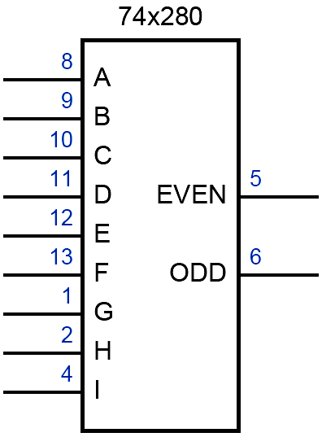
奇偶校验发生器：74x280
Digital Logic Design and Application (数字逻辑设计及应用)
module msi74x280(D, EVEN, ODD);
input [8:0] D;
output EVEN, ODD;
assign ODD=D[0] ^ D[1] ^ D[2] ^ D[3] ^ D[4] ^ D[5]
^ D[6] ^ D[7] ^ D[8];
assign EVEN=~ODD;
endmodule

Slide 20
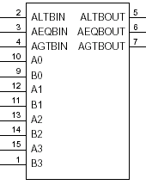
比较器：74x85
Digital Logic Design and Application (数字逻辑设计及应用)
module msi74x85 (ALTBIN, AEQBIN, AGTBIN, A, B, ALTOUT,
AEQBOUT, AGTBOUT);
input ALTBIN, AEQBIN, AGTBIN;
input [3:0] A,B;
output ALTBOUT, AEQBOUT, AGTBOUT;
wire ALTB, AEQB, AGTB;
assign ALTB= (A<B)? 1’b1: 1’b0;
assign AEQB= (A==B)? 1’b1: 1’b0;
assign AGTB= (A>B)? 1’b1: 1’b0;
assign ALTBOUT= ALTB | (AEQB & ALTBIN);
assign AEQBOUT= AEQB & AEQB IN;
assign AGTBOUT= AGTB | (AEQB & AGTBIN);
endmodule
74x85

Slide 21
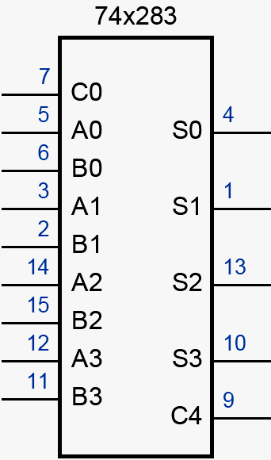
加法器：74x283
Digital Logic Design and Application (数字逻辑设计及应用)
module msi74x283 (C0, A, B, S, C4);
input [3:0] A, B;
input C0;
output [3:0] S;
output C4;
assign {C4, S}= {1’b0, A} + {1’b0, B} + {4’h0, C0};
endmodule

Slide 22
锁存器：74x375
Digital Logic Design and Application (数字逻辑设计及应用)
module msi74x375(C12, C34, D1, D2, D3, D4, Q1, Q1_L,
Q2, Q2_L, Q3, Q3_L, Q4, Q4_L);
input C12,C34, D1, D2, D3, D4;
output Q1, Q1_L, Q2, Q2_L, Q3, Q3_L, Q4, Q4_L;
reg Q1, Q1_L, Q2, Q2_L, Q3, Q3_L, Q4, Q4_L;
always @ (C12 or C34 or D1 or D2 or D3 or D4)
begin
if(C12)
begin
Q1=D1;
Q1_L=D1’;
Q2=D2;
Q2_L=D2’;
end
if(C34)
begin
Q3=D3;
Q3_L=D3’;
Q4=D4;
Q4_L=D4’;
end
end
endmodule
74x375
1Q
1Q
2Q
2Q
3Q
3Q
4Q
4Q
1,2C
1D
2D
3,4C
3D
4D

Slide 23
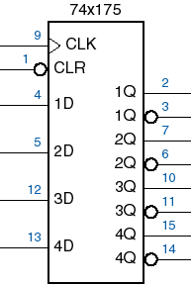
4位寄存器：74x175
Digital Logic Design and Application (数字逻辑设计及应用)
module msi74x175(CLK, CLR_L, D, Q, Q_L);
input CLK, CLR_L;
input [3:0] D;
output [3:0] Q, Q_L;
reg [3:0] Q, Q_L;
always @ (posedge CLK or negedge CLR_L)
begin
if(~CLR_L)
begin
Q <= 4’h0;
Q_L <= 4’hf;
end
else
begin
Q <= D;
Q_L <= ~D;
end
end
endmodule

Slide 24
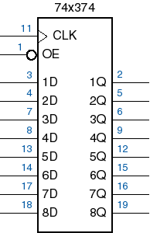
8位寄存器：74x374(输出使能)
Digital Logic Design and Application (数字逻辑设计及应用)
module msi74x374(CLK, OE_L, D, Q);
input CLK, OE_L;
input [7:0] D;
output [7:0] Q;
reg [7:0] Q_temp;
always @ (posedge CLK)
begin
Q_temp <= D;
end
assign Q = (~OE_L)? Q_temp : 8’hzz;
endmodule

Slide 25
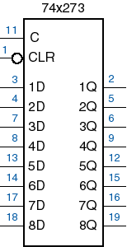
8位寄存器：74x273(异步清零)
Digital Logic Design and Application (数字逻辑设计及应用)
module msi74x273(CLK, CLR_L, D, Q);
input CLK, CLR_L;
input [7:0] D;
output [7:0] Q;
reg [7:0] Q;
always @ (posedge CLK or negedge CLR_L)
begin
if(~CLR_L)
Q <= 8’h00;
else
Q <= D;
end
endmodule
CLK

Slide 26
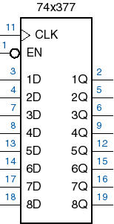
8位寄存器：74x377(时钟使能)
Digital Logic Design and Application (数字逻辑设计及应用)
module msi74x377(CLK, EN_L, D, Q);
input CLK, EN_L;
input [7:0] D;
output [7:0] Q;
reg [7:0] Q;
always @ (posedge CLK)
begin
if(~EN_L)
Q <= D;
end
endmodule

Slide 27
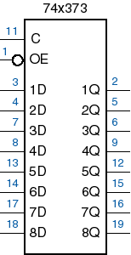
8位锁存器：74x373
Digital Logic Design and Application (数字逻辑设计及应用)
module msi74x373(C, OE_L, D, Q);
input C, OE_L;
input [7:0] D;
output [7:0] Q;
reg [7:0] Q_temp;
always @ (C or D)
begin
if(C)
Q_temp = D;
end
assign Q= (~OE_L)? Q_temp : 8’hzz;
endmodule

Slide 28
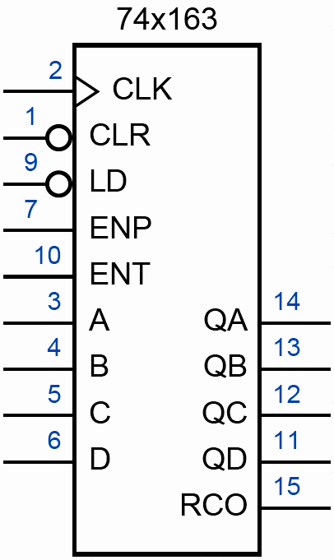
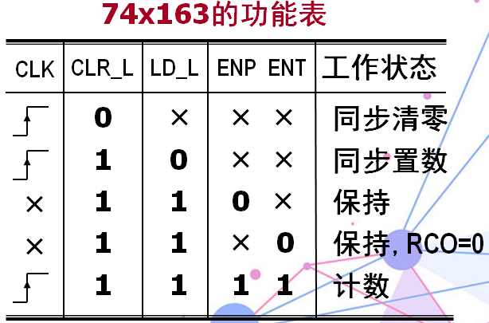
计数器：74x163
Digital Logic Design and Application (数字逻辑设计及应用)
module msi74x163(CLK, CLR_L, LD_L, ENT, ENP, D, Q, RCO);
input CLK, CLR_L, LD_L, ENP, ENT;
input [3:0] D;
output [3:0] Q;
output RCO;
reg [3:0] Q;
always @ (posedge CLK)
begin
if(~CLR_L)
Q <= 4’h0;
else if(~LD_L)
Q <= D;
else if (ENT & ENP)
Q <= Q + 1’b1;
end
assign RCO= ENT & Q[3] & Q[2] & Q[1] & Q[0];
endmodule

Slide 29
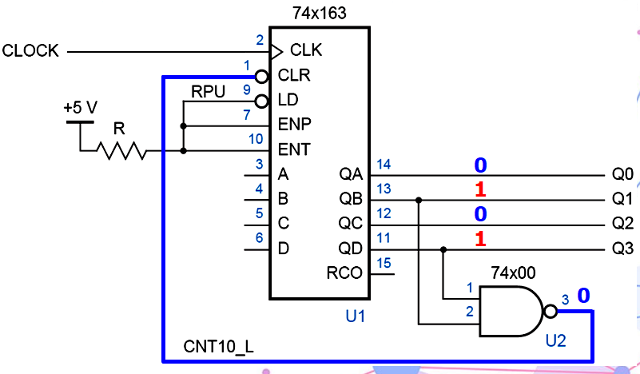
清零法实现模11计数器
Digital Logic Design and Application (数字逻辑设计及应用)
module m11counter(CLK, Q);
input CLK;
output [3:0] Q;
wire CLR_L;
msi74x163 msi74x163_inst
(.CLK(CLK),
.CLR_L(CLR_L),
.LD_L(1’b1),
.ENT(1’b1),
.ENP(1’b1),
.D(4’h0),
.Q(Q),
.RCO());
assign CLR_L= ~(Q[3] & Q[1]);
endmodule

Slide 30
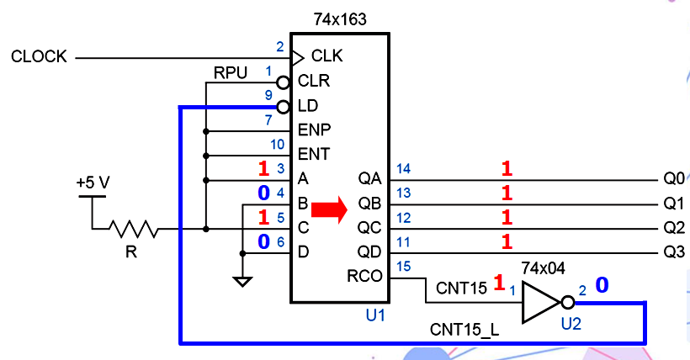
置数法实现模11计数器
Digital Logic Design and Application (数字逻辑设计及应用)
module m11counter(CLK, Q);
input CLK;
output [3:0] Q;
wire LD_L;
wire RCO;
msi74x163 msi74x163_inst
(.CLK(CLK),
.CLR_L(1’b1),
.LD_L(LD_L),
.ENT(1’b1),
.ENP(1’b1),
.D(4’h5),
.Q(Q),
.RCO(RCO));
assign LD_L= ~RCO;
endmodule

Slide 31
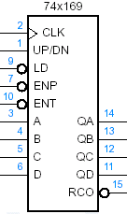
可逆计数器：74x169
Digital Logic Design and Application (数字逻辑设计及应用)
module msi74x169(CLK, UPDN, LD_L, ENT, ENP, D, Q, RCO_L);
input CLK, UPDN, LD_L, ENP_L, ENT_L;
input [3:0] D;
output [3:0] Q;
output RCO_L;
reg [3:0] Q;
reg RCO_L;
always @ (posedge CLK)
begin
if(~LD_L)
Q <= D;
else if (~ENT_L & ~ENP_L)
begin
if(UPDN)
Q <= Q + 1’b1;
else
Q <= Q – 1’b1;
end
end

Slide 32
可逆计数器：74x169
Digital Logic Design and Application (数字逻辑设计及应用)
always @ (UPDN or ENT_L or Q)
begin
if(UPDN)
RCO_L = ENT_L + (Q[3] & Q[2] & Q[1] & Q[0]);
else
RCO_L = ENT_L + Q[3] + Q[2] + Q[1] + Q[0];
end
endmodule

Slide 33
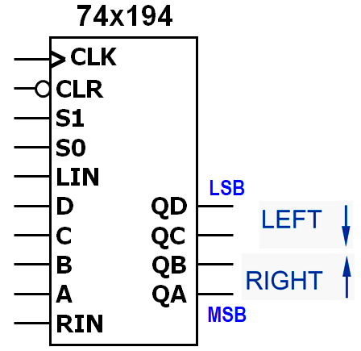
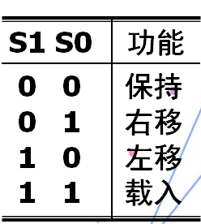
4位通用移位寄存器：74x194
Digital Logic Design and Application (数字逻辑设计及应用)
module msi74x194 (CLK, CLR_L, S, LIN, D, C, B, A, RIN,
QD, QC, QB, QA);
input CLK, CLR_L, S, LIN, RIN;
input D, C, B, A;
output QD, QC, QB, QA;
reg QD, QC, QB, QA;
always @ (posedge CLK or negedge CLR_L)
begin
if(~CLR_L)
{QD, QC, QB, QA} <= 4’h0;
else
begin
case(S)
2’b00:
begin
QD <= QD;
QC <= QC;
QB <= QB;
QA <= QA;
2’b01:
begin
QD <= QC;
QC <= QB;
QB <= QA;
QA <= RIN;
end

Slide 34
4位通用移位寄存器：74x194
Digital Logic Design and Application (数字逻辑设计及应用)
2’b10:
begin
QD <= LIN;
QC <= QD;
QB <= QC;
QA <= QB;
2’b11:
begin
QD <= D;
QC <= C;
QB <= B;
QA <= A;
end
endcase
end
end
endmodule

Slide 35
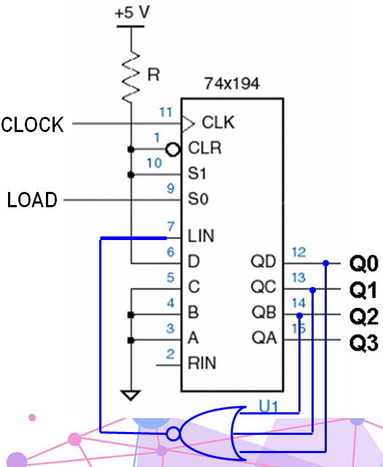
利用74x194实现自启动单个1循环的环形计数器
Digital Logic Design and Application (数字逻辑设计及应用)
module ringcounter (CLOCK, LOAD, Q);
input CLK, LOAD;
output [3:0] Q;
wire leftin;
msi74x194 msi74x194_inst
(.CLK(CLOCK),
.CLR_L(1’b1),
.S({1’b1, LOAD}),
.LIN(leftin),
.D(1’b1),
.C(1’b0),
.B(1’b0),
.A(1’b0),
.RIN(1’b0),
.QD(Q[0]),
.QC(Q[1]),
.QB(Q[2]),
.QA(Q[3]));
assign leftin = ~(Q[0] | Q[1] | Q[2]);
endmodule

