Slide 1

重要知识点
1、译码器/多路复用器实现逻辑函数
2、奇偶校验的定义及74X280应用
3、比较器和加法器的功能及应用
4、理解各种锁存器/触发器的功能表、特征方程、状态图
5、各种触发器之间的互相转换
6、状态机分析（Mearly机和Moore机区别）
7、状态机设计
8、模m计数器设计及74X163的应用
9、移位寄存器功能及74X194的应用

Slide 2
重要知识点
10、环形计数器、扭环计数器、线性反馈移位寄存器计数器有效状态个数，理解最小成本和最小风险（自启动）
11、序列检测器的分析和设计
12、序列发生器的分析和设计
a、状态机设计方法（触发器+门电路）
b、计数器+151
c、移位寄存器+组合逻辑
13、RAM的位扩展和字扩展
14、ROM实现组合逻辑函数
15、DAC输出编码与电压的关系

Slide 3
优先编码器输出
The 74x148 is an 8-input priority encoder with active low inputs and outputs. If its I0,I2 and I4 inputs are activated then the output code is ( 011).

Slide 4


多路复用器实现组合逻辑函数
Example
How to realize F = ∑_{W,X,Y,Z} (0,1,3,7,9,13,14) with 74x151?
F = Z·F(W,X,Y,1) + Z’·F(W,X,Y,0)
填卡诺图
WX
WX
00 01 11 10
00 01 11 10
Y
YZ
0
1
0
Z
Z
00
01
11
10
1
0
0
0
F(W,X,Y,1) = F(W,X,Y,0) = 0, 填0
1
Z
Z
Z’
0
1
0
1
1
F(W,X,Y,1) = F(W,X,Y,0) = 1, 填1
F(W,X,Y,1)=1, F(W,X,Y,0)=0, 填Z
1
1
0
0
F(W,X,Y,1)=0, F(W,X,Y,0)=1, 填Z’
0
0
1
0

Slide 5
Multiplexer
Application of Multiplexers
Example
How to realize F = ∑_{W,X,Y,Z} (0,1,3,7,9,13,14) with 74x151?
74x151
EN
WX
Y
X
W
A
B
C
00 01 11 10
V_{CC}
Y
0
1
0
Z
Z
D0
D1
D2
D3
D4
D5
D6
D7
Y
Y
F
1
Z
Z
Z’
0
Z

Slide 6
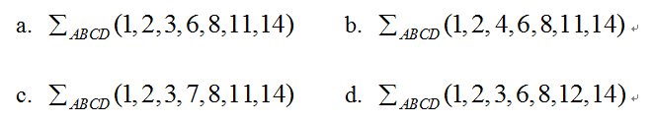
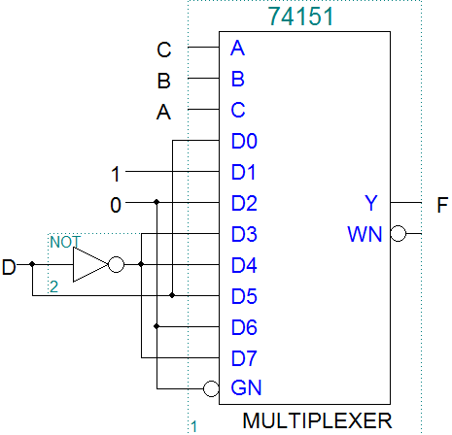
According to the circuit as shown in Fig.1, the output F is ( a )

Slide 7
比较器
The 74x85 is a 4-bit magnitude comparator. If input A=B, and the less-than output ALTBOUT=1, then the cascading inputs should be AGTBIN = ( 0 ), AEQBIN =( 0 ) and ALTBIN = ( 1 ).
If use a 74x85 magnitude comparator to compare only two 4-bits binary numbers, the 74x85’s cascading inputs should be ( B ).
ALTBIN=0, AEQBIN=0, AGTBIN=1
ALTBIN=0, AEQBIN=1, AGTBIN=0
ALTBIN=1, AEQBIN=0, AGTBIN=0
ALTBIN=1, AEQBIN=0, AGTBIN=1

Slide 8
加法器
If a 74x283 4-bit binary adder has A=1011 and B=1100 and C0=0 on its inputs, the 74x283’s outputs C4S3S2S1S0 is ( 10111 ).

Slide 9
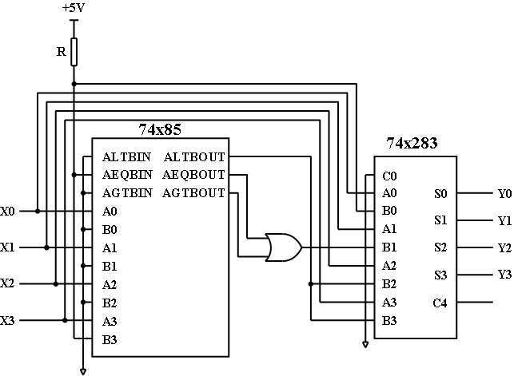
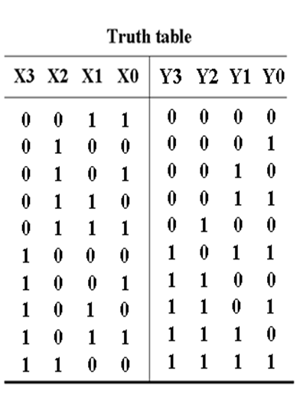
比较器/加法器
A combinational circuit is shown as below, which contains a 74x85 comparator and a 74x283 adder. [13’]
1.Write out the logic expression of ALTBOUT, AEQBOUT and AGTBOUT.[6’]
2. List out the truth table for the circuit.[5’]
3. Indicate the logic function of the circuit.[2’]
ALTBOUT=X3/,
AEQBOUT=X3X2/X1/X0/,
AGTBOUT=X3(X2+X1+X0)
余3码转换为2421码

Slide 10
奇偶校验电路
Which of the following device is a combinational circuit? ( a )
parity circuit b. shift register
c. counter d. flip flop
Parity circuit can be used to detect errors during data transfer. Suppose that a 9-bit parity code with 8-bit information data and 1-bit parity is implemented in one data transfer system and the receiver get a data string 010011001 without error indicated, then the parity circuit realize a ( even ) (odd/even) parity.

Slide 11
锁存器及触发器
Which of the following statements is CORRECT? ( D )
A. An edge-triggered D flip-flop never goes into metastable status.
B. A master/slave J-K flip-flop keep the current status when input J=1 and K=1.
C. if S is asserted, an S-R latch is forced to logic status Q=1.
D. A D latch will follow the input as long as the control input C is active.

Slide 12
锁存器及触发器
For an edge-triggered D flip-flop, ( D ) is correct.
A) a change in the state of the flip-flop can only at a clock pulse edge
B) the state that the flip-flop goes to depends on the D input
C) the output follows the input at each clock pulse
D) all of these answers
务必熟悉每种锁存器及触发器的特征方程、状态图及特性！

Slide 13
触发器转换技巧
If a D flip-flop is constructed by a T flip-flop with an enable input EN, then the input EN=( D⊕Q ).
If a T flip flop with an enable input EN is constructed by a D flip flop, then the input
D=( EN⊕Q ).

Slide 14
Mearly机与Moore机/同步与异步
A ( mealy ) state machine is a sequential circuit whose output depends on the state and inputs.
A sequential circuit whose output depends only on its state is called a ( moore) state machine.
An asynchronous counter differs from a synchronous counter in ( B ).
A)the value of the modulus B) the method of clocking
C) the type of flip-flops used D) the number of states in its sequence

Slide 15
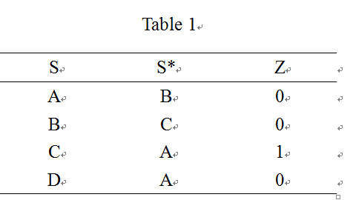
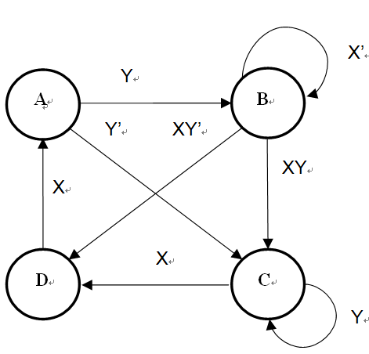
状态机分析中的相关概念
According to the state/output table shown in Table 1, there are ( 3 ) states in the cycle.
How many states are ambiguous according to the state diagram shown in Figure 3 ? ( B )
A. 1 B. 2 C. 3 D. 4

Slide 16
状态机分析
The state/output table of a clocked synchronous state machine is shown in Table 2. Suppose that the initial state of the state machine is “A”, When input sequence is X=”10101110”, the corresponding output sequence Z will be ( A ).
A. 00010010 B. 00110010
C. 01000110 D. 00100010
 | X
S | 0 | 1 | Z
A | B | D | 0
B | C | B | 0
C | B | A | 1
D | B | C | 0
 | S*

Slide 17
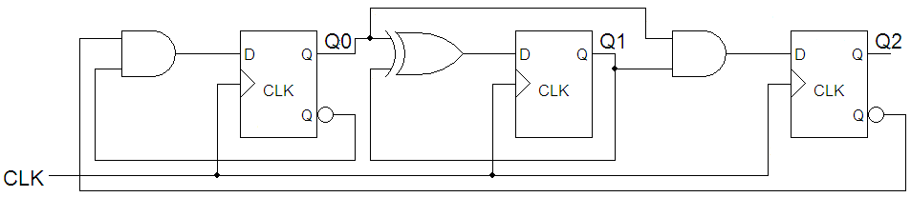
状态机分析
A sequential circuit is shown in Fig. 1, where the frequency of CLK is 1MHz. Assume the initial state for Q2Q1Q0 is 000. (15')
(1) Write out the excitation equation and the transition equation for the circuit. (3')
(2) Draw the timing diagram for Q2, Q1 and Q0. （6'）
(3) Indicate the modulus of the circuit, and check whether it is self-correction. (4')
(4) What is the frequency for Q2 ? （2'）

Slide 18
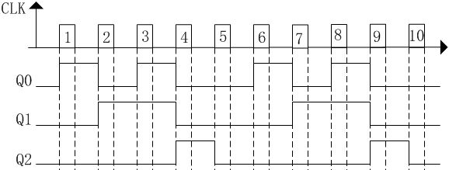
状态机分析

Slide 19
状态机分析
状态转换关系是：000--001--010--011--100--000 101--010 110--010 111--100
没有无效循环，因此该电路能自启动
由于Q2的频率是CLK的1/5，因此Q2的频率是200kHz

Slide 20
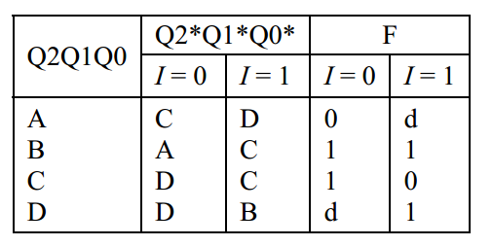
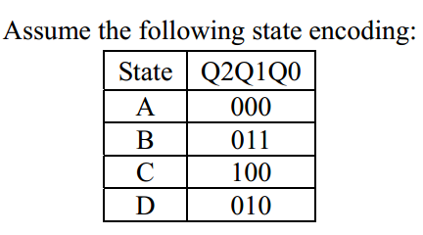
状态机设计
Consider the following Mealy machine with initial state A. (“d” means don’t care.)
(1) Please fill out the transition/output table .
(2) Fill-in K-Map of D2,D1,D0, and output F if realized with D flip-flops.
(3) Derive the minimum two-level logic for D2, D1, D0 and F.

Slide 21
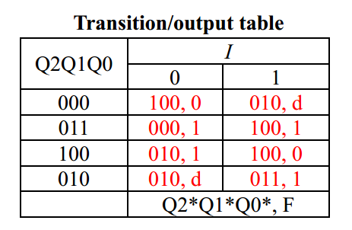
状态机设计

Slide 22
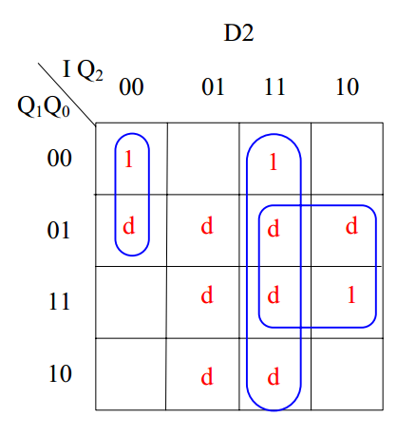
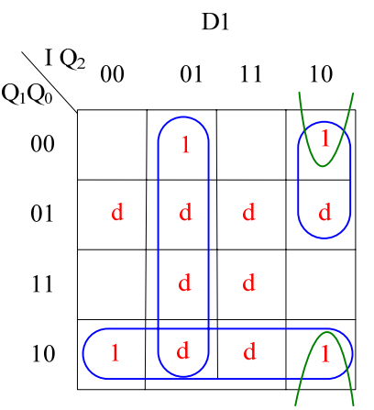
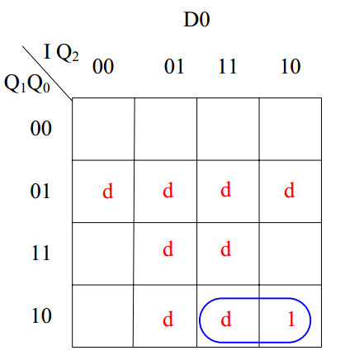
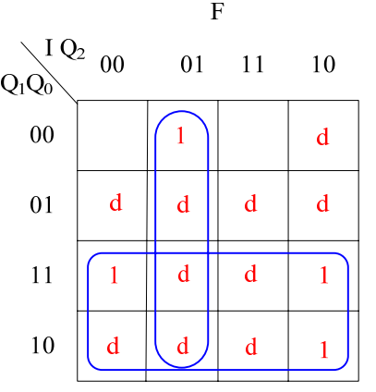
状态机设计
D2 = I’·Q2’·Q1’ + I·Q2 + I·Q0
D1 = I·Q2’·Q1’ + I’·Q2 + Q1·Q0’
D0 = I·Q1·Q0’
F = I’·Q2 + Q1

Slide 23
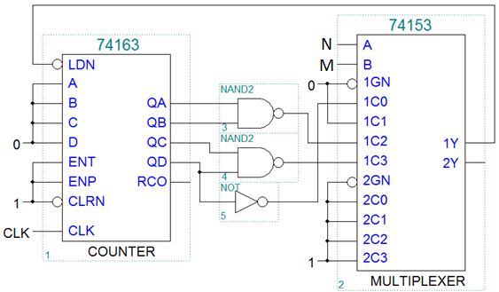
计数器
To build a modulo-256 counter, it requires at least ( 8 ) flip flops.
If a modulus-4 counter is got from the circuit as shown in Fig.2, then the inputs M and N should be ( c )
a. 00 b. 01
c. 10 d. 11

Slide 24
计数器
To build a modulus -191 counter, it requires at least ( 3 ) 74x162s, if its initial count is 808, its terminal count is ( 998 ).
With a 100KHz clock frequency for the decade counter 74x162 free-running mode, ( A ) is correct..
f_{QA}= 50KHz B) f_{QB}= 25KHz
C) f_{QC}= 12.5KHz D) f_{QD}=6.25KHz

Slide 25
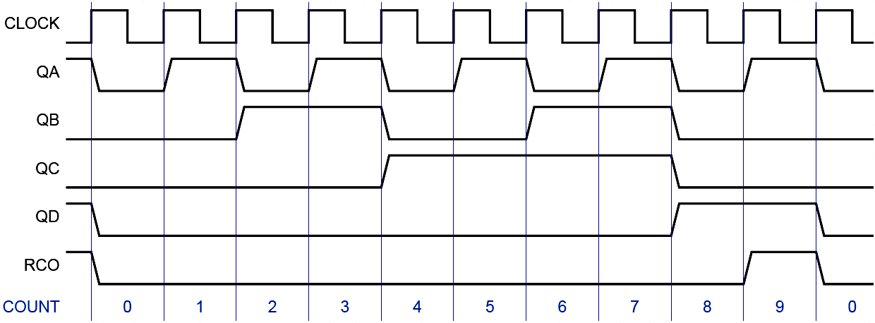
Other MSI counters
BCD Counter —— 74x160, 74x162
—— 模10计数器
QC和QD为10分频信号，但占空比不是50%

Slide 26
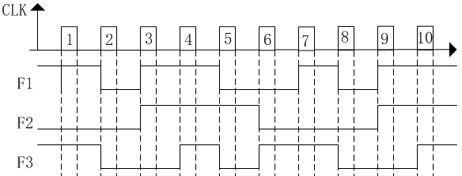
计数器
The output timing diagram of a synchronous sequential circuit is shown in Fig. 2. Design the circuit only using one 74163, one 74138 and necessary NAND gates. Assume the initial state QDQCQBQA for 74163 is 0000, and the output F1F2F3 is 101.
(1) Indicate the modulus of the counter, and write out LD_L（QC，QB，QA）. (3')
(2) Write out the canonical sum for F1(QC, QB, QA)，F2(QC, QB, QA)和F3(QC, QB, QA). (9')
(3) Draw the schematic diagram. (3')

Slide 27



计数器
101--000--110--111--010--001--101，该电路是一个模6计数器
QCQBQA | F1F2F3
000 | 101
001 | 000
010 | 110
011 | 111
100 | 010
101 | 001

Slide 28
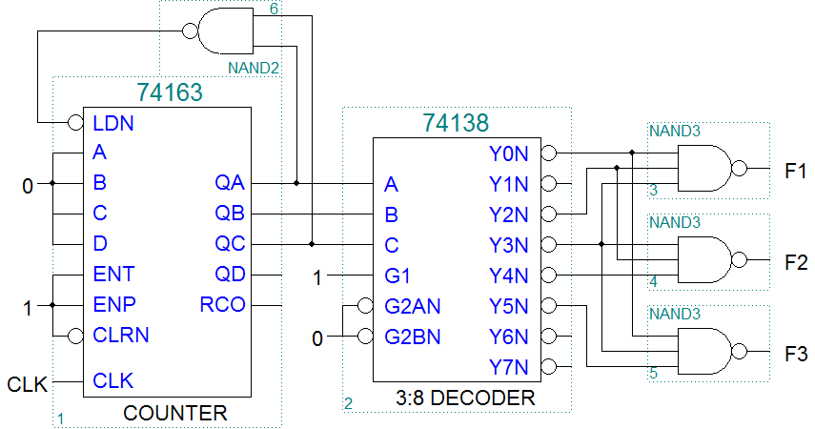
计数器
QCQBQA | F1F2F3
000 | 101
001 | 000
010 | 110
011 | 111
100 | 010
101 | 001

Slide 29
移位寄存器
A 5-bit Johnson counter without self-correcting has ( 10 ) valid states at most. A 4-bit ring counter without modification has ( 4 ) states in the cycle at most.
A 4-bit LFSR counter with feedback equation D0=Q3⊕Q2 yields a modulo-( 15 ) counter.
When an 8-bit serial in/serial out shift register is used for a 16μs time delay, the clock frequency must be ( A ).
A)500KHz B) 5KHz
C) 50KHz D) 500Hz

Slide 30
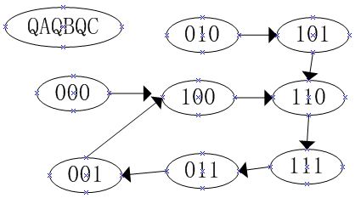
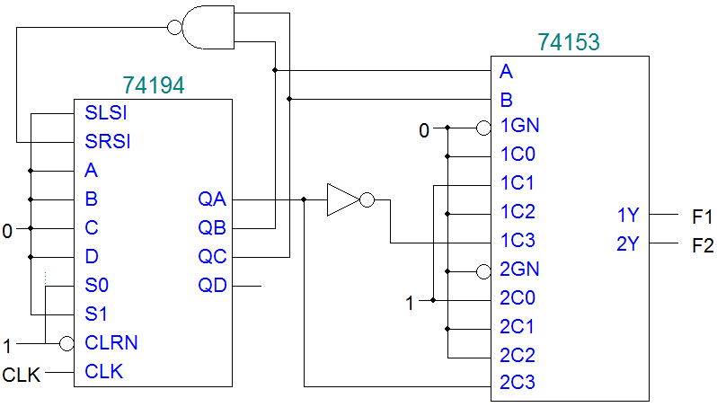

移位寄存器
Analyze the circuit shown in Fig. 3. (10')
(1) Draw the whole state diagram for 74194. (6')
(2) Write out the logic function F1(QA ,QB,QC) and F2(QA,QB,QC). (4')
F1 = QB·QC’+ QA’·QB·QC

Slide 31
序列产生
To design a "110111" serial sequence generator by shift-register, ( 5 或 3 ) flip-flops are need at least

Slide 32
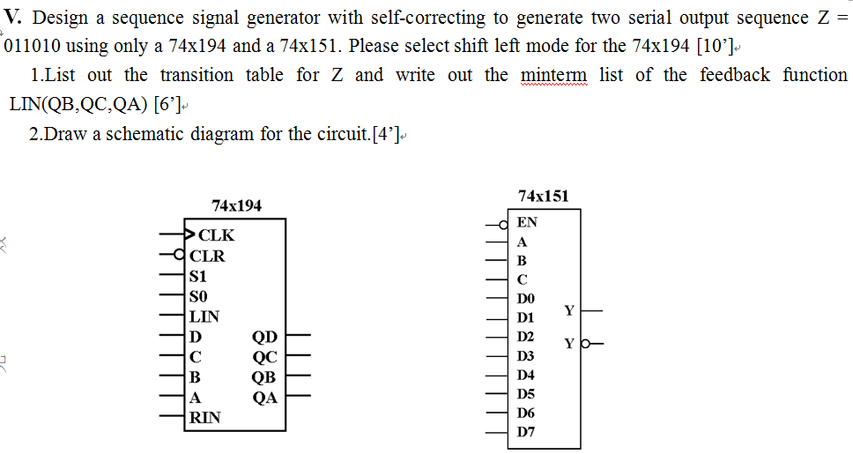
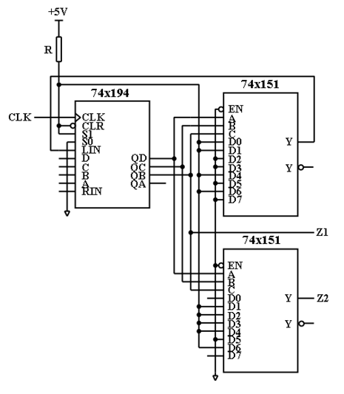
译码器/多路复用器/序列产生
LIN=∑_{(QB,QC,QD)}(0,1,4,6)
用74X138如何实现？
序列产生的另外两种方法？

Slide 33
序列检测
Design a Mealy machine for a sequence detector with a serial input sequence of 1011 or 1101 using a 74x194, an AND and a XOR gate, the sequence may be overlap. The output Z=1 ,when the sequence of 1011 or 1101 is detected, and Z=0 otherwise. Please select shift left mode for the 74x194. (19’)
1. List out the states meaning and minimal state/output table. [10’]
2. Write out the logic expression of output Z(X,QB,QC,QD). [4’]
3. Draw the circuit diagram. [5’]

Slide 34
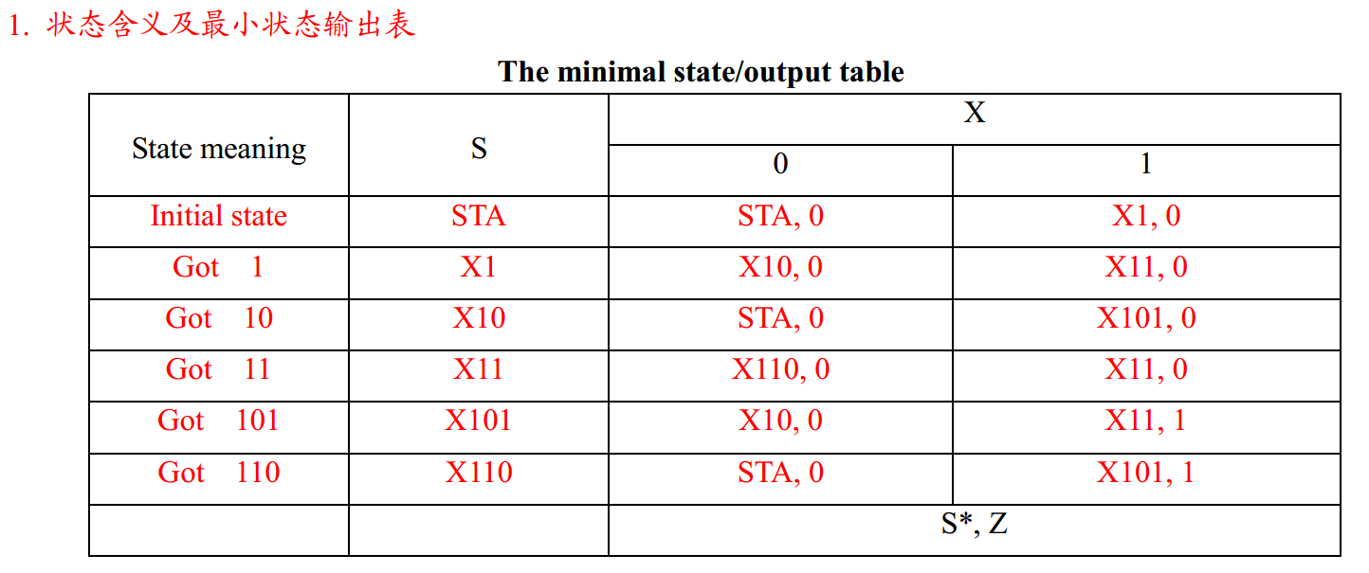

Slide 35
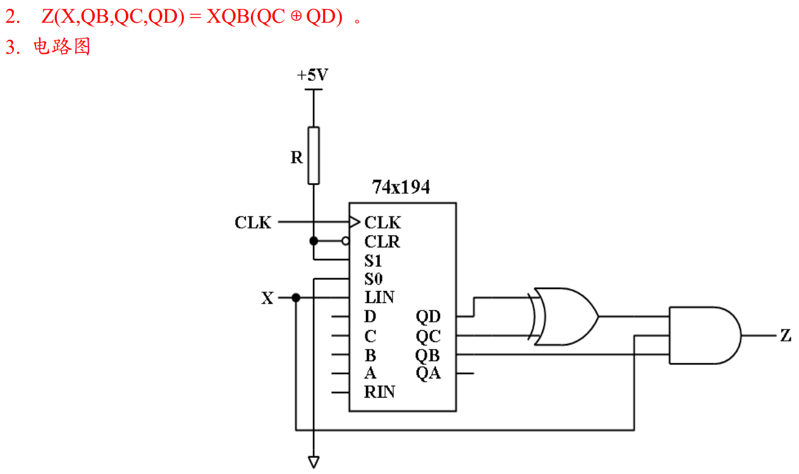

Slide 36
存储器
The capacity of a memory that has 20 bits address bus and can store 8 bits at each address is ( 1 )MB.
A 16Kx8 ROM, which can implement a combinational circuit with ( 14 ) inputs and ( 8 ) outputs at most, can be built by ( 4 ) 8Kx4 ROMs .
If a ROM has 8-bit address inputs and 4-bit data outputs, then it can be used to implement ( 4 ) combinational logic functions. Its capacity is ( 1024 ) bits.

Slide 37
DAC
When the input is 00001000 of an 8 bit DAC, the corresponding output voltage is -2V. The output voltage range for the DAC is ( -63.75 ~ 0 )V.
For an8-bit DAC, its output voltage is 1.00V when the input is 01100100. If the input is 10001010, the corresponding output voltage will be ( 1.38 )V.

Slide 38
Thank you!

