Slide 1
Digital Logic Design and Application (数字逻辑设计及应用)
Review of Chapter 2
(第二章内容回顾)
General Positional-Number-System Conversion
(常用按位计数制的转换)
Addition and Subtraction of Non-decimal Numbers
(非十进制的加法和减法)

Slide 2
Review of Chapter 2
(第二章内容回顾)
Digital Logic Design and Application (数字逻辑设计及应用)
Representation of Negative Numbers
(负数的表示)
  Signed-Magnitude [ 符号－数值（原码）]
  Complement Number Systems (补码数制)
Radix – Complement (基数补码)
Diminished Radix – Complement
[ 基数减1补码（基数反码）]

Slide 3
Review of Chapter 2
(第二章内容回顾)
Digital Logic Design and Application (数字逻辑设计及应用)
Binary Signed-Magnitude, Ones’ – Complement, and Two’s – Complement Representation
(二进制的原码、反码、补码表示)
直接由补码(反码)求二进制数值的大小：最高位位权为 -2^{n-1} (-2^{n-1} -1)
(1011)2补=（ ）10

Slide 4
Review of Chapter 2
(第二章内容回顾)
Digital Logic Design and Application (数字逻辑设计及应用)
Two’s – Complement Addition and Subtraction
  (二进制补码的加法和减法)
Overflow（溢出）
如果加法运算产生的和超出了数制表示的范围，则结果发生了溢出（Overflow）。
如何判断溢出？
  MSB C _{in} 与 C _{out} 不同

Slide 5
Review of Chapter 2
(第二章内容回顾)
Digital Logic Design and Application (数字逻辑设计及应用)
How to represent a 1-bit Decimal number with a 4-bit Binary code
(如何用 4位二进制码 表示 1位十进制码)？
  —— Binary Coded Decimal (BCD码）
    (0.301)10=( )8421BCD

Slide 6
Review of Chapter 2
(第二章内容回顾)
Digital Logic Design and Application (数字逻辑设计及应用)
How to represent a 1-bit Decimal number with a 4-bit Binary code
(如何用 4位二进制码 表示 1位十进制码)？
  —— Binary Coded Decimal (BCD码）

Slide 7
Review of Chapter 2
(第二章内容回顾)
Digital Logic Design and Application (数字逻辑设计及应用)
Examples:
use BCD code for decimal numbers A = 1946
8421 code : A = 0001 1001 0100 0110
2421 code : A = 0001 1111 0100 1100
Excess-3 code: A = 0100 1100 0111 1001
    (0.301)10=( )8421BCD

Slide 8
Review of Chapter 2
(第二章内容回顾)
Digital Logic Design and Application (数字逻辑设计及应用)
Addition of BCD Digits (BCD数的加法)
思考：
两个BCD码
与两个4位二进制数
相加的区别?

Slide 9
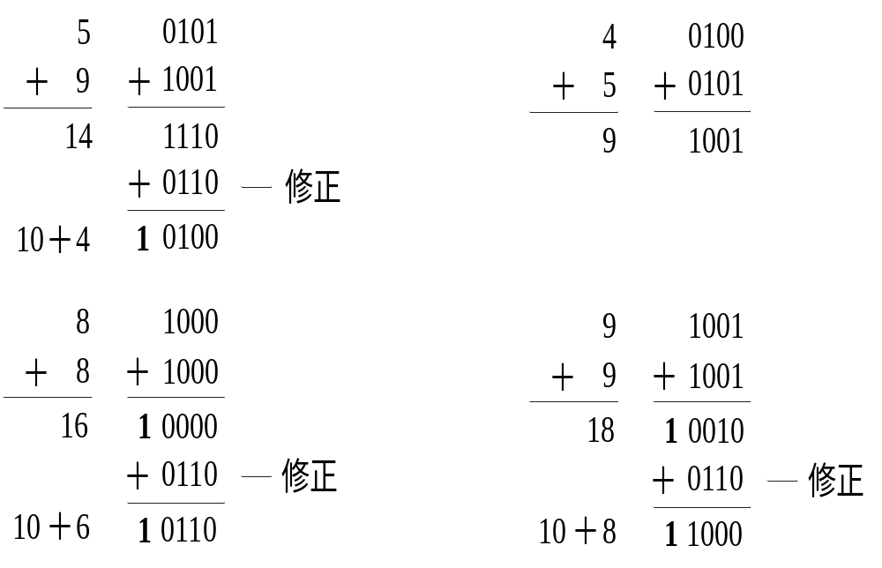
Digital Logic Design and Application (数字逻辑设计及应用)

Slide 10
Review of Chapter 2
(第二章内容回顾)
Digital Logic Design and Application (数字逻辑设计及应用)
Addition of BCD Digits (BCD数的加法)
思考：
何时需要进行修正？
如果(X+Y)产生进位信号C
或 在 1010~1111 之间
如何修正？
—— 结果加6

Slide 11
Review of Chapter 2
(第二章内容回顾)
Digital Logic Design and Application (数字逻辑设计及应用)
Gray code（格雷码）
任意相邻码字间只有一位数位变化
最高位的0和1只改变一次
最大数回到0也只有一位码元不同

Slide 12
2.11 Gray code（格雷码）
Digital Logic Design and Application (数字逻辑设计及应用)
构造方法
  Reflected Code（反射码）
  直接构造
  The bits of an n-bit binary cord word are numbered from right to left, from 0 to n-1.
  [对 n 位二进制的码字从右到左编号（0 ~ n-1）]
  Bit i of a Gray-code code word is 0 if bits i and i+1 of the corresponding binary code word are the same, else bit i is 1.
  (若二进制码字的第 i 位和第 i + 1 位相同，则对应的葛莱码码字的第 i 位为0，否则为1。)

Slide 13
Review of Chapter 2
(第二章内容回顾)
Digital Logic Design and Application (数字逻辑设计及应用)
From binary number to Gray code
The width is same, the MSB is same;
From left to right, if a bit in binary number is same as its left bit, the gray code is 0, if it is different, the gray code is 1.
Examples:
binary number: 1001 0010 0110 0011
Gray code: 1101 1011 0101 0010

Slide 14
Review of Chapter 2
(第二章内容回顾)
Digital Logic Design and Application (数字逻辑设计及应用)
构造方法
异或（XOR）运算：相异为1，相同为0
Gn = Bn Bn = Gn
Gn-1 = Bn ⊕ Bn-1 Bn-1 = Gn ⊕ Gn-1
… …
G0 = B1 ⊕ B0 B0 = Gn⊕Gn-1⊕… ⊕ G0

Slide 15
Digital Logic Design and Application (数字逻辑设计及应用)
Chapter 3 Digital Circuits (数字电路)
Give a knowledge of the Electrical aspects of Digital Circuits
(介绍数字电路中的电气知识)

Slide 16
Consider some Questions
（思考几个问题）
Digital Logic Design and Application (数字逻辑设计及应用)
在模拟的世界中如何表征数字系统？
如何将物理上的实际值
映射为逻辑上的 0 和 1 ？
什么时候考虑器件的逻辑功能；
什么时候考虑器件的模拟特性？

Slide 17
3.1 Logic Signals and Gates
(逻辑信号和门电路)
Digital Logic Design and Application (数字逻辑设计及应用)
How to get the HIGH and LOW Voltage (如何获得高、低电平)？
HIGH to 0 or 1 (高电平对应 0 还是 1)？
Vcc
R
1
0
V_{OUT}
V_{IN}
0
1
Positive
(正逻辑)
Negative
(负逻辑)
获得高、低电平的基本原理

Slide 18
3.1 Logic Signals and Gates
(逻辑信号和门电路)
Digital Logic Design and Application (数字逻辑设计及应用)
从物理的角度
  考虑电路如何工作，工作中的电气特性
  实际物理器件不可避免的时间延迟问题
从逻辑角度
  输入、输出的逻辑关系
三种基本逻辑：与、或、非

Slide 19
1、Basic Logic Function: AND
（基本逻辑运算：与）
Digital Logic Design and Application (数字逻辑设计及应用)
Switch:1-on,0-off (开关：1通,0断)
Lamp: 1-Light,0-out (灭灯:1亮,0不亮)
A
B
Z
Logic Circuit
Produce a 1 output if and only if its inputs are all 1 (当且仅当所有输入全为1时，输出为1)
Truth Table
(真值表)
（逻辑符号）
A B Z
A
&
0 0 0
0 1 0
1 0 0
1 1 1
Z
B
Logic Expression
(逻辑表达式)
Z = A · B
A
Z
B

Slide 20
2、Basic Logic Function: OR
（基本逻辑运算：或）
Digital Logic Design and Application (数字逻辑设计及应用)
A
Truth Table
Logic Circuit
真值表
B
Z
逻辑符号
A B Z
Produce a 1 output if any input is 1
(只要有任何一个输入为1，输出就为1)
0 0 0
0 1 1
1 0 1
1 1 1
A
≥1
Z
B
A
Z
B
Logic Expression
(逻辑表达式)：
Z = A + B

Slide 21
Digital Logic Design and Application (数字逻辑设计及应用)
3、Basic Logic Function: NOT
（基本逻辑运算：非）
Truth Table
Logic Circuit
R
真值表
(逻辑符号)
A
Z
A Z
0 1
1 0
1
Produce an output value that is the opposite of its input value. (产生一个与输入相反的输出)
A
Z
A
Z
Logic Expression
(逻辑表达式)：Y = A = A’
Usually called an Inverter （通常称为反相器）

Slide 22
4、NAND and NOR Gates (与非 和 或非)
Digital Logic Design and Application (数字逻辑设计及应用)
NAND (与非)
Logic Expression (逻辑表达式)：
Z = ( A · B ) ’
Logic Circuit
( 逻辑符号)：
NOR (或非)
Logic Expression (逻辑表达式)：
Z = ( A + B ) ’
Logic Circuit
(逻辑符号)：
&
≥1

Slide 23
Digital Logic Design and Application (数字逻辑设计及应用)
Logical Operation
(逻辑运算)
NAND (与非)
NOR (或非)
&
≥1
Logic Circuit
(逻辑符号)
Logic Expression
(逻辑表达式)
Y=(A
B)
’
‘
Y=(A+B)
’
ž
‘
A B
Y
Y
0
0
1
1
Truth Table
(真值表)
0
1
1
0
1
0
1
0
1 1
0
0

Slide 24
Axioms of Logic Algebra
(关于逻辑代数的几个公理)
Digital Logic Design and Application (数字逻辑设计及应用)
X = 0, if X ≠ 1 (若X ≠ 1, 则X = 0 )
X = 1, if X ≠ 0 (若X ≠ 0, 则X = 1)
0’ = 1 1’ = 0
0 · 0 = 0 1 + 1 = 1
1 · 1 = 1 0 + 0 = 0
0·1 = 1·0 = 0 1+0 = 0+1 = 1

Slide 25
3.2 Logic Families（逻辑系列）
Digital Logic Design and Application (数字逻辑设计及应用)
  同一系列的芯片具有类似的输入、输出及内部电路特征，但逻辑功能不同。
  不同系列的芯片可能不匹配
CMOS系列
TTL逻辑系列

Slide 26
3.3 CMOS Logic (CMOS 逻辑)
Digital Logic Design and Application (数字逻辑设计及应用)
CMOS Logic levels (COMS 逻辑电平)
5.0V
Logic 1 (High)
[逻辑1（高态）]
3.5V
1.5V
Logic 0 (Low)
[逻辑0（低态）]
0.0V
A Typical Logic Circuit: 5-Volt Power Supply
(典型的5V电源电压)
Other Power-Supply Voltages: 3.3 ,2.5 or 1.8Volts
(其它电源电压：3.3V ,2.5V或1.8V)

Slide 27
2、MOS Transistors (MOS晶体管)
Digital Logic Design and Application (数字逻辑设计及应用)
Two Types: N-Channel and P-Channel (分为：N沟道 和 P沟道)
N-Channel
(N沟道)
Source (源极)
V_{gs}
+
Drain (漏极)
Gate
(栅极)
Gate
(栅极 )
Drain
(漏极)
+
V_{gs}
P-Channel
(P沟道)
Source (源极)

Slide 28
2、MOS Transistors (MOS晶体管)
Digital Logic Design and Application (数字逻辑设计及应用)
Two Types: N-Channel and P-Channel (分为：N沟道 和 P沟道)
Usually (通常)：
V_{gs} < = 0
V_{gs} = 0
R_{ds} Very High
Off (截止状态)
V_{gs}  R_{ds} 
On (导通状态)
Source (源极)
V_{gs}
+
Gate
(栅极)
Drain (漏极)
P-Channel
(P沟道)

Slide 29
2、MOS Transistors (MOS晶体管)
Digital Logic Design and Application (数字逻辑设计及应用)
The Gate of a MOS transistor has a very high impedance. [ Over megohm (10⁶ ohms)]
[ MOS晶体管栅极阻抗非常高（>兆欧）]
Regardless of gate voltage (无论栅电压如何)
Almost no current flows from the gate to source, or from the gate to drain. ( 栅－源、栅－漏之间几乎没有电流)
（ Leakage Current, Less than microampere (漏电流, μA, 10⁻⁶A ）
The Gate is Capacitively coupled to the source and drain
( 栅极与源和漏极之间有电容耦合)
The power need to charge and discharge this capacitance on each input signal transition accounts for a nontrivial portion of a circuit’s power consumption (信号转换时，电容充放电，功耗较大).

Slide 30
MOS管的基本开关电路
Digital Logic Design and Application (数字逻辑设计及应用)
+ V_{DD}
只要电路参数选择合理
R_{D}
输入低，截止，输出高
D
+
G
i_{D}
v_{O}
输入高，导通，输出低
+
v_{I}
S
–
–

Slide 31
3、Basic CMOS Inverter Circuit
( 基本的CMOS反相器)
Digital Logic Design and Application (数字逻辑设计及应用)
Functional Behavior
(工作原理)
1、V_{IN} = 0.0V
  V_{GSN} = 0.0V，
  Tn Off (截止)
  V_{GSP} = V_{IN} –V_{DD} = –5.0V，
  Tp On (导通)
  V_{OUT} ≈ V_{DD} = 5.0V
V_{DD} = +5.0V
Tp
V_{OUT}
V_{IN}
Tn

Slide 32
3、Basic CMOS Inverter Circuit
( 基本的CMOS反相器)
Digital Logic Design and Application (数字逻辑设计及应用)
2、V_{IN} = V_{DD} = 5.0V
  V_{GSN} = 5.0V
  Tn On (导通)
  V_{GSP} = V_{IN} –V_{DD} = 0.0V
  Tp Off (截止)
  V_{OUT} ≈ 0
V_{DD} = +5.0V
Tp
V_{OUT}
V_{IN}
Tn

Slide 33
4、CMOS NAND (CMOS与非门)
Digital Logic Design and Application (数字逻辑设计及应用)
Functional Behavior
(工作原理)：
  1、Either Input Low, (A、B至少有一个为低), Then
  Either T1, T3 Off
  ( T1、T3至少有一个截止)
  Either T2, T4 On
  ( T2、T4至少有一个导通)
  Z is High [Z为高 ≈ V_{DD}）]
V_{DD} = +5.0V
T2
T4
Z
A
T1
B
T3

Slide 34
4、CMOS NAND Gate (CMOS与非门)
Digital Logic Design and Application (数字逻辑设计及应用)
V_{DD} = +5.0V
  2、Both Inputs High
  (A、B都为高), Then
  Both T1, T3 On (T1、T3都导通)
  Both T2, T4 Off (T2，T4都截止)
  Z is Low
  [ Z为低（ ≈ 0V）]
T2
T4
Z
A
T1
B
T3

Slide 35
5、CMOS NOR Gate (CMOS或非门)
Digital Logic Design and Application (数字逻辑设计及应用)
Functional Behavior
(工作原理)：
1、 Both Inputs Low
  (A、B都为低), Then
Both T1、T3 Off
( T1、T3都截止)
Both T2, T4 On
( T2，T4都导通 )
Z is High
[ Z为高（≈ V_{DD}）]
V_{DD} = +5.0V
A
T2
B
T4
Z
T1
T3

Slide 36
5、CMOS NOR Gate (CMOS或非门)
Digital Logic Design and Application (数字逻辑设计及应用)
Functional Behavior
(工作原理)：
2、 Either Input High
  (A、B至少有一个为高)
Then
Either T1、T3 On
(T1、T3至少有一个导通)
Either T2, T4 Off
(T2、T4至少有一个截止)
Z is Low
[Z为低（≈ 0V）]
V_{DD} = +5.0V
A
T2
B
T4
Z
T1
T3

Slide 37
6、 Fan－In（扇入）
Digital Logic Design and Application (数字逻辑设计及应用)
The Number of Inputs that a Gate have
(门电路所具有的输入端的数目)
The Additive “on” Resistance of series transistors limits the Fan – In of CMOS gates.
(导通电阻的可加性限制了CMOS门的扇入数)
A large number of inputs can be made by cascading gates with fewer inputs
(可用较少输入门级联得到较多的输入)

Slide 38
7、Non-inverting Gates (非反相门)
Digital Logic Design and Application (数字逻辑设计及应用)
V_{DD} = +5.0V
(Non-inverting buffers)
非反相缓冲器
Z
A
Add an inverter to the inverse output !

Slide 39
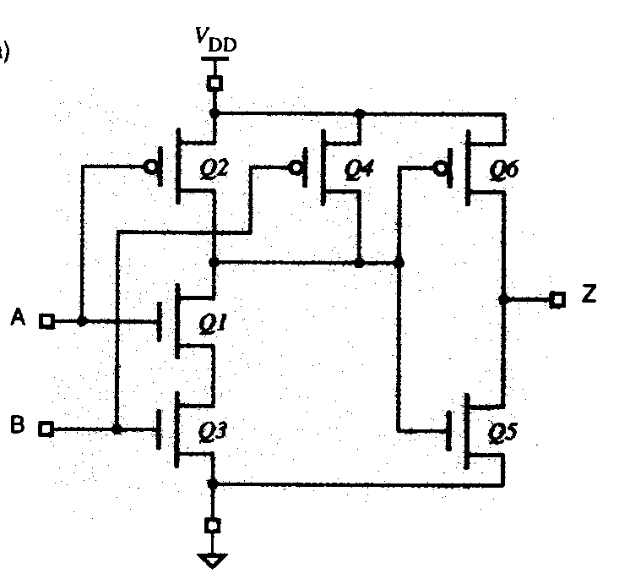
7、Non-inverting Gates (非反相门)
Digital Logic Design and Application (数字逻辑设计及应用)
AND gate

Slide 40
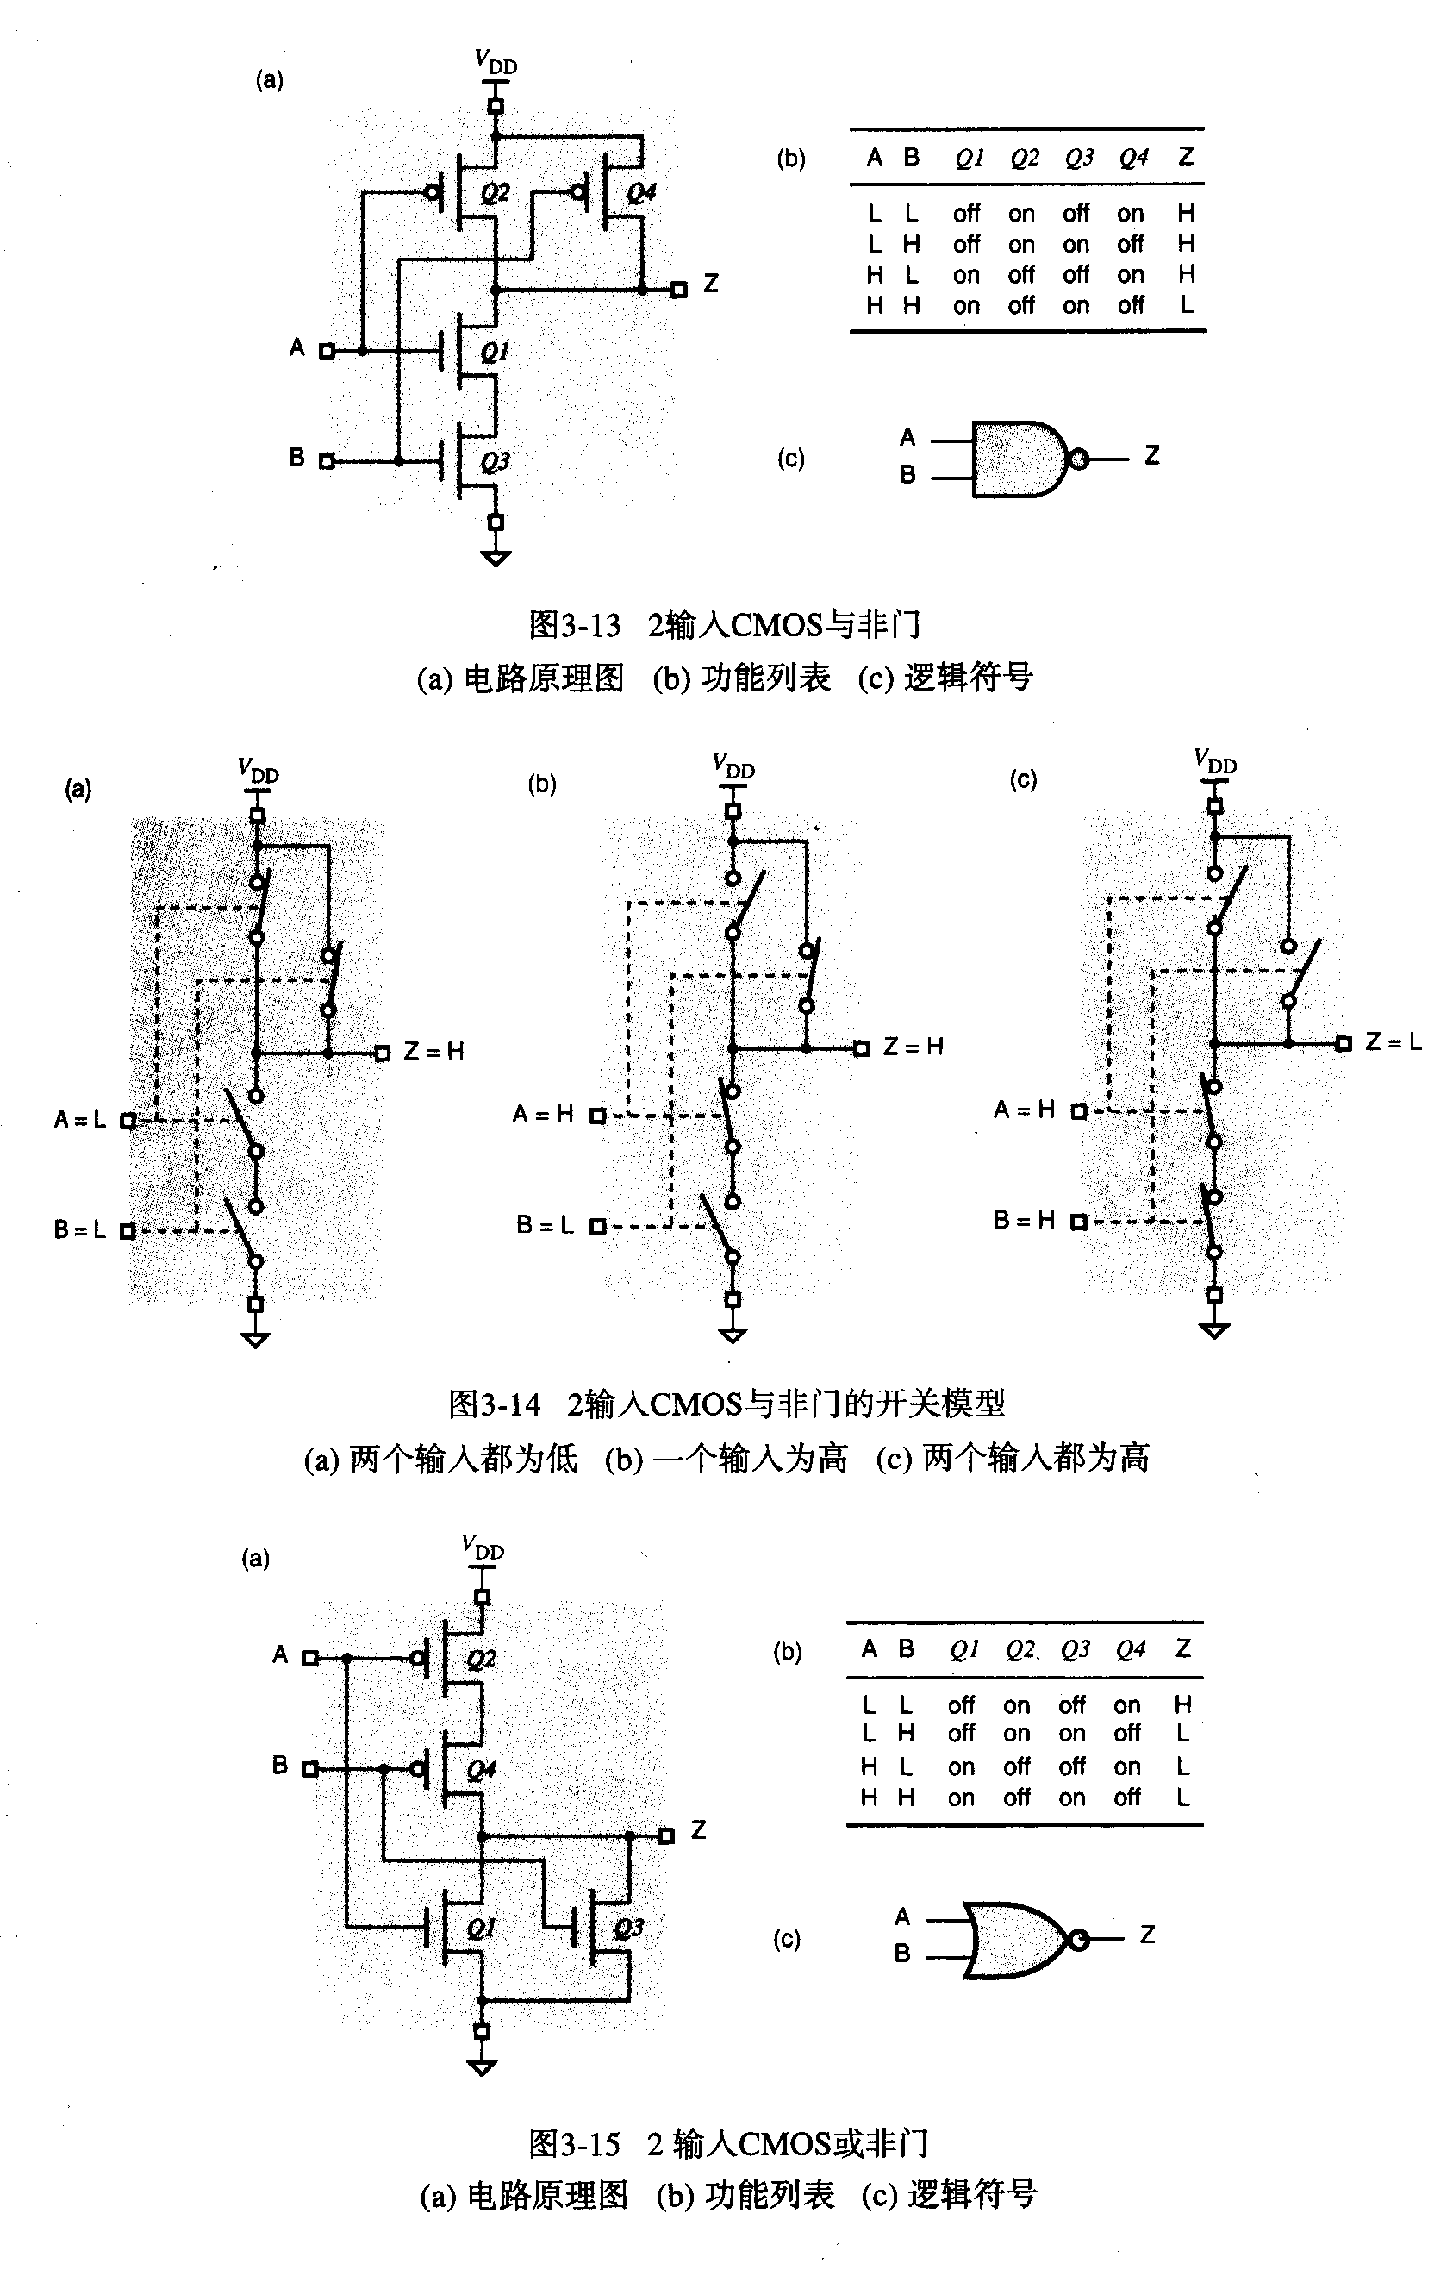
Digital Logic Design and Application (数字逻辑设计及应用)
NAND / NOR
NAND: NMOS serial , PMOS parallel; NOR: NMOS parallel, PMOS serial;

Slide 41
Digital Logic Design and Application (数字逻辑设计及应用)
NAND / NOR
Each input control a PMOS and an NMOS;
Logic function is represented by NMOS connections :
AND -- series OR -- parallel
PMOS is a duality connection.

Slide 42
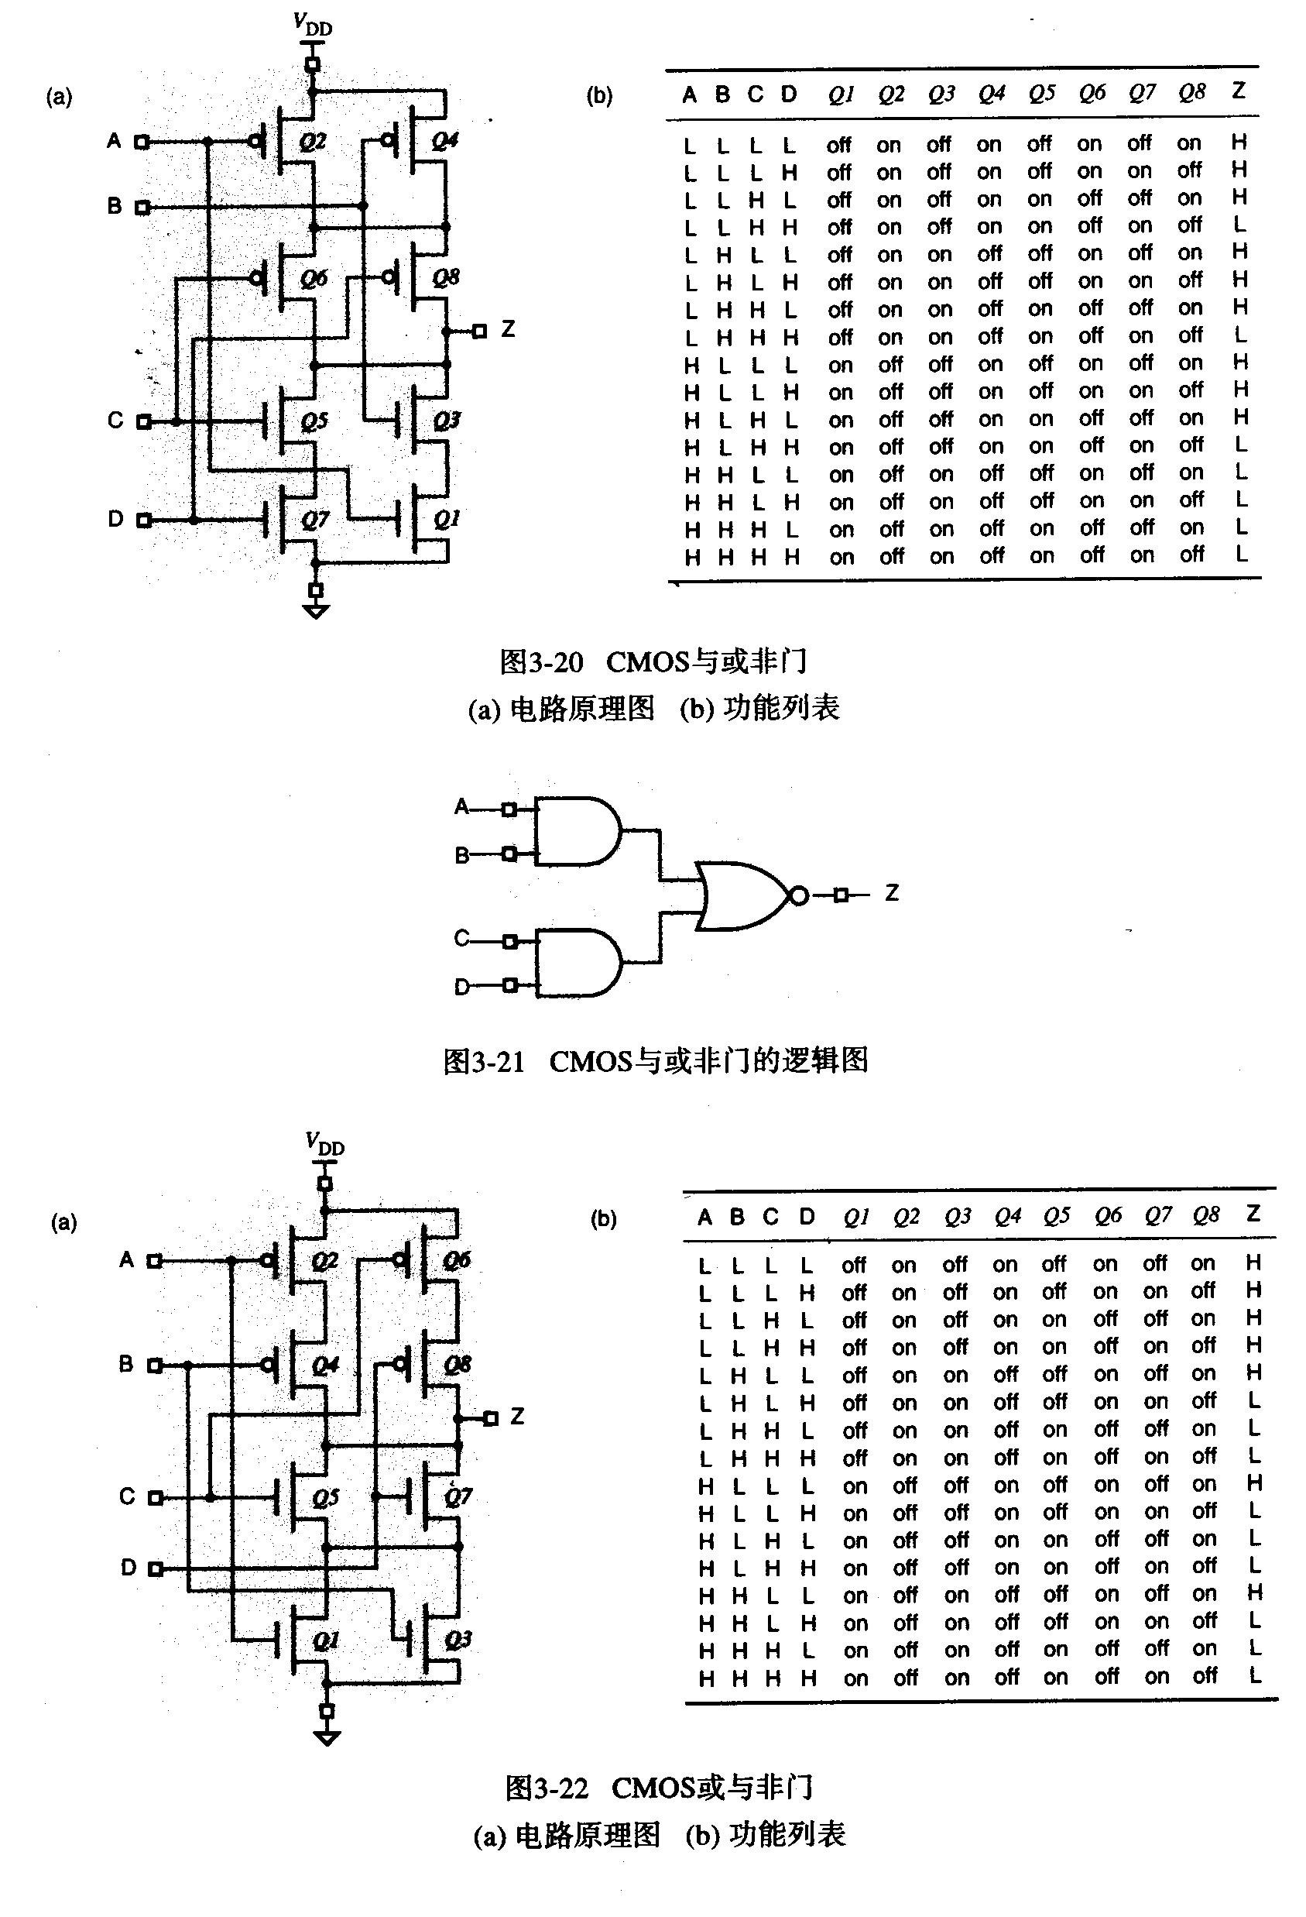
Digital Logic Design and Application (数字逻辑设计及应用)
V_{DD} = +5.0V
8、CMOS AND-OR-INVERT
Gate ( CMOS与或非门)
A
B
Z
C
AOI
D

Slide 43
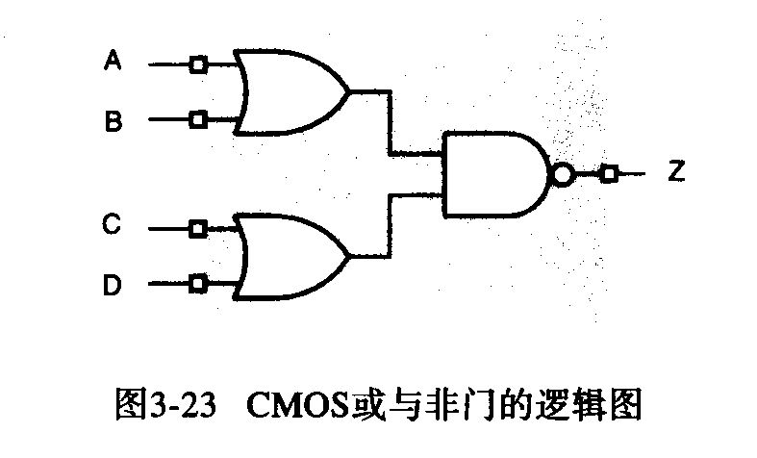
Digital Logic Design and Application (数字逻辑设计及应用)
8、CMOS OR-AND-INVERT
Gate ( CMOS或与非门)
OAI

Slide 44
A Class Problem
Digital Logic Design and Application (数字逻辑设计及应用)
Write out the BCD code of 8421 , 2421 , and Excess-3 for the decimal number, then write out the corresponding binary Gray code:
+1247

