Slide 1
Digital Logic Design and Application (数字逻辑设计及应用)
Chapter 4 Combinational Logic Design Principles
(组合逻辑设计原理)
Basic Logic Algebra
(逻辑代数基础)
Combinational-Circuit Analysis
(组合电路分析)
Combinational-Circuit Synthesis
(组合电路综合)

Slide 2
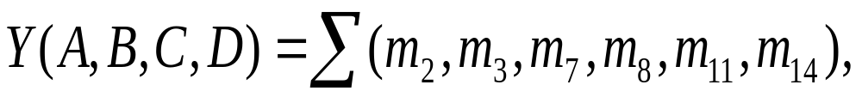
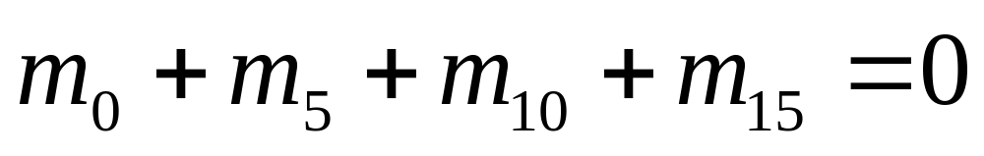
A Class Problem ( 每课一题 )
Digital Logic Design and Application (数字逻辑设计及应用)
将下列函数化为最简与或函数式。
给定约束条件为

Slide 3
Digital Logic Design and Application (数字逻辑设计及应用)
A Class Problem ( 每课一题 )
Finding Static Hazards Using Maps
(利用卡诺图发现并消除静态冒险)
CD
00 01 11 10
AB
00
01
11
10
1
1
1
1
1
1
1
1

Slide 4
第四章 组合逻辑设计原理
Digital Logic Design and Application (数字逻辑设计及应用)
开关代数
  公理、定理、逻辑函数的表示
组合电路分析
  得到指定电路的功能（公式法化简）
组合电路综合
  根据命题，得到电路实现（卡诺图化简）
定时冒险

Slide 5
Digital Logic Design and Application (数字逻辑设计及应用)
思考：五变量如何利用卡诺图化简？
BC
BC
00 01 11 10
00 01 11 10
DE
DE
00
01
11
10
0
4
12
8
00
01
11
10
16
17
19
18
20
21
23
22
28
29
31
30
24
25
27
26
1
5
13
9
3
7
15
11
2
6
14
10
A = 0
A = 1

Slide 6
Digital Logic Design and Application (数字逻辑设计及应用)
F = Σ_{A,B,C,D,E}(0,1,2,3,4,5,10,11,14,20,21,24,25,26,27,28,29,30)
BC
BC
00 01 11 10
00 01 11 10
DE
DE
00
01
11
10
1
1
00
01
11
10
1
1
1
1
1
1
1
1
1
1
1
1
1
1
1
1
A = 0
A = 1
F = + + + +
A’·B’·D’
A’·C’·D
A·C·D’
A·B·C’
B·D·E’

Slide 7
Chapter 6 Combinational Logic Design Practices
(组合逻辑设计实践)
Digital Logic Design and Application (数字逻辑设计及应用)
Documentation Standard and Circuit Timing (文档标准和电路定时)
Commonly Used MSI Combinational Logic Device (常用的中规模组合逻辑器件)

Slide 8
第6章教学大纲要求
Digital Logic Design and Application (数字逻辑设计及应用)
重点学习掌握：学习利用基本的逻辑门完成规定的组合逻辑电路的设计任务：如译码器、编码器、多路选择器、多路分配器、异或门、比较器、全加器。学习利用基本的逻辑门和已有的中规模集成电路（MSI）逻辑器件如译码器、编码器、多路选择器、多路分配器、异或门、比较器、全加器、三态器件等作为设计的基本元素完成更为复杂的组合逻辑电路设计的方法。

Slide 9
6.1 Documentation Standard
(文档标准)
Digital Logic Design and Application (数字逻辑设计及应用)
Structure Thinking (结构化的理念)
Specification: Description of Interface and Function
(说明书：接口及功能描述)
Block Diagram: System’s Major Function Module and their Basic Interconnections
(方框图 ：主要功能模块及其互联 Figure 6-1)
Schematic Diagram [原理图 （Figure 6-17）]

Slide 10
6.1.1 Documentation Standard
(文档标准)
Digital Logic Design and Application (数字逻辑设计及应用)
Timing Diagram
[定时图 （Figure 6-19）]
Structure Logic Device Description
(结构化逻辑器件描述)
Circuit Description : Explains how the circuit works internally.
(电路描述：解释电路内部如何工作)

Slide 11
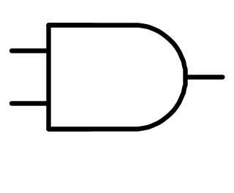
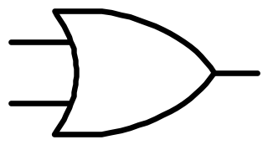
6.1.2 Gate Symbols (门的符号)
Digital Logic Design and Application (数字逻辑设计及应用)
&
≥1
1

Slide 12
Equivalent Gate Symbols under the Generalized Demorgan’s Theorem [等效门符号（摩根定理）]
Inverter (反相器)
Buffer (缓冲器)

Slide 13
6.1.3 Signal Name and Active Levels
(信号名和有效电平)
Digital Logic Design and Application (数字逻辑设计及应用)
Name a Signal (信号的命名)
An Active Level Associated with a Signal
(与信号相关的有效电平)
  Active High
  （高电平有效）
  Active Low
  （低电平有效）
Asserted (有效）
Deasserted（无效）
Negated（取消）

Slide 14
6.1.3 Signal Name and Active Levels
(信号名和有效电平)
Digital Logic Design and Application (数字逻辑设计及应用)
An Inversion Bubble to Indicate an Active-Low Pin
(有反相圈的引脚 表示低电平有效)
READY
READY_L
GO
GO_L
REQUEST
REQUEST_L
Given Logic Function as Occurring inside that symbolic outline.
(给定逻辑功能只在符号框的内部发生)
Figure 6-5,6,7,8,9,10

Slide 15
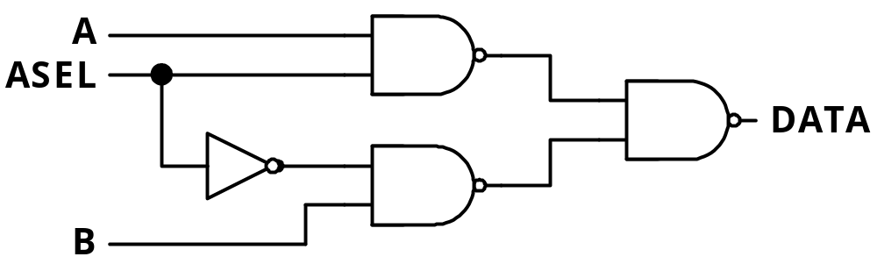
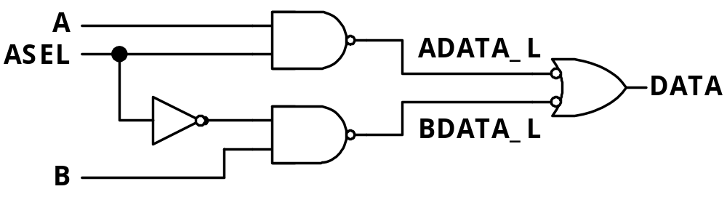
6.1.5 Bubble-to-Bubble Logic Design
(“圈到圈”的逻辑设计)
Digital Logic Design and Application (数字逻辑设计及应用)
Figure 6-11

Slide 16
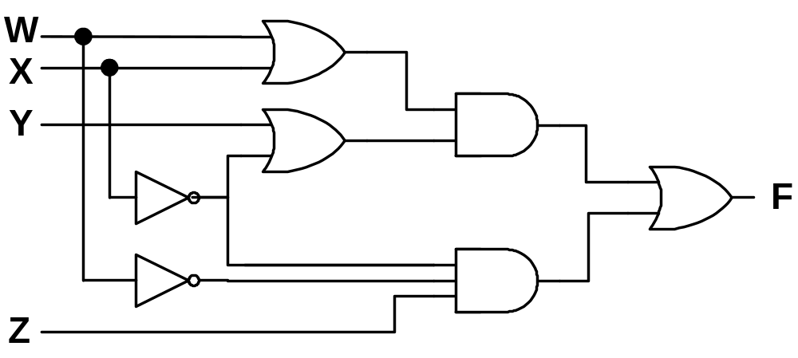
6.2 Circuit Timing (电路定时)
Digital Logic Design and Application (数字逻辑设计及应用)
Propagation Delay (传播延迟)
—— A Signal Path as the Time that it takes for a Change at the
Input to Produce a Change at the Output of the Path
(信号通路输入端的变化引起输出端变化所需的时间)
t_{pHL} and t_{pLH} Maybe Different
Figure 6-19

Slide 17
6.2 Circuit Timing (电路定时)
Digital Logic Design and Application (数字逻辑设计及应用)
Maximum Delay
(最大延迟)
Typical Delay
(典型延迟)
Minimum Delay
(最小延迟)
Propagation Delay (传播延迟)
Timing Analysis: Worst-Case Delay
(定时分析：取最坏情况延迟)
’32
’08
’08
表 6-2
’32
22
20
’32
’04
22
15
t_{pHL} and t_{pLH} Maybe Different

Slide 18
6.2 Circuit Timing (电路定时)
Digital Logic Design and Application (数字逻辑设计及应用)
Timing Diagram
[定时图（时序图）]
READY
GO
DAT
GO
READY
t_{RDY}
t_{RDY}
DAT
t_{DAT}
t_{DAT}
Causality and Propagation Delay (因果性和传播延迟）

Slide 19
6.2 Circuit Timing (电路定时)
Digital Logic Design and Application (数字逻辑设计及应用)
Timing Diagram
[定时图（时序图）]
READY
GO
DAT
GO
READY
t_{RDYmin}
t_{RDYmax}
DAT
Minimum and Maximum Delay (最小和最大延迟）

Slide 20
6.2 Circuit Timing (电路定时)
Digital Logic Design and Application (数字逻辑设计及应用)
WRITE_L
DATAIN
DATAOUT
t_{setup}
t_{OUTmin}
t_{OUTmax}
Certain and Uncertain Transitions
(确切的和不确切的转换）

Slide 21
Commonly Used MSI Combinational Logic Device
（常用中规模组合逻辑器件）
Digital Logic Design and Application (数字逻辑设计及应用)
Encoders (编码器)
Decoders (译码器)
Multiplexers (多路复用器)
Parity Circuits (奇偶校验)
Comparators (比较器)
Adders (加法器)

Slide 22
Decoder and Encoder
(译码器和编码器)
Digital Logic Design and Application (数字逻辑设计及应用)
Multiple-Input, Multiple-Output Logic Circuit
(多输入、多输出电路)
Enable Inputs must be
Asserted to perform
Normal Mapping
Function
(使能输入有效才能
实现正常映射功能)
Input
Cord Word
Output
Cord Word
(输入
编码)
Map
映射
(输出
编码)
Enable
Inputs
(使能输入)

Slide 23
Most Commonly Used Case
(一种最常用的情况)
Digital Logic Design and Application (数字逻辑设计及应用)
Decoder（译码器）
2^{n}中取1码
N-Bit Binary Code
(n位二进制码)
输入
编码
Map
映射
输入
编码
输出
编码
Map
映射
输出
编码
使能
使能
n位二进制码
2^{n} 中取1码
Encoder（编码器）
( One-out-of 2^{n} )
Table 6-4, Figure 6-32

Slide 24
Decoder and Encoder
(译码器和编码器)
Digital Logic Design and Application (数字逻辑设计及应用)
Decoder（译码器）
Normally Output Code has More bits than its Input Code
(一般来说，输出编码比输入编码位数多)
Encoder（编码器）
Output Code has Fewer bits than its Input Code called an Encoder
(输出编码比输入编码位数少，则常称为编码器)

Slide 25
6.4 Decoder（译码器）
Digital Logic Design and Application (数字逻辑设计及应用)
Truth Table for a 2-to-4 Binary Decoder
Binary Decoder
(二进制译码器)
( 2-4二进制译码器真值表 )
Inputs
EN I1 I2
Outputs
Y3 Y2 Y1 Y0
2-to-4
Decoder
0 X X 0 0 0 0
1 0 0 0 0 0 1
1 0 1 0 0 1 0
1 1 0 0 1 0 0
1 1 1 1 0 0 0
I0
I1
EN
Y0
Y1
Y2
Y3

Slide 26
6.4 Decoder（译码器）
Digital Logic Design and Application (数字逻辑设计及应用)
Truth Table for a 2-to-4 Binary Decoder
Y0 = EN · ( I1’ · I2’ )
Y1 = EN · ( I1’ · I2 )
Y2 = EN · ( I1 · I2’ )
Y3 = EN · ( I1 · I2 )
( 2-4二进制译码器真值表 )
Inputs
EN I1 I2
Outputs
Y3 Y2 Y1 Y0
0 X X 0 0 0 0
1 0 0 0 0 0 1
1 0 1 0 0 1 0
1 1 0 0 1 0 0
1 1 1 1 0 0 0
Yi = EN · m_{i}

Slide 27
Digital Logic Design and Application (数字逻辑设计及应用)
6.4 Decoder（译码器）
Truth Table for a 3-to- 8 Binary Decoder
(3-8二进制译码器真值表)
Y_{i} = EN · m_{i}
I₂
I₁
I₀
Y₇
Y₆
Y₅
Y₄
Y₃
Y₂
Y₁
Y₀
0 0 0
0 0 1
0 1 0
0 1 1
1 0 0
1 0 1
1 1 0
1 1 1
0 0 0 0 0 0 0 1
0 0 0 0 0 0 1 0
0 0 0 0 0 1 0 0
0 0 0 0 1 0 0 0
0 0 0 1 0 0 0 0
0 0 1 0 0 0 0 0
0 1 0 0 0 0 0 0
1 0 0 0 0 0 0 0
1 1 1 1 1 1 1 0
1 1 1 1 1 1 0 1
1 1 1 1 1 0 1 1
1 1 1 1 0 1 1 1
1 1 1 0 1 1 1 1
1 1 0 1 1 1 1 1
1 0 1 1 1 1 1 1
0 1 1 1 1 1 1 1
I₂
3-to-8
Decoder
Y₀
Y₁
I₁
I₀
Y₇

Slide 28
Logic Symbols for Large-Scale Element (大规模元件的逻辑符号)
Digital Logic Design and Application (数字逻辑设计及应用)
1/2 74x139
1/2 74x139
Y0
Y1
Y2
Y3
G
A
B
Y0
Y1
Y2
Y3
G
A
B
1/2 74x139
G_L
G
A
B
Y0
Y1
Y2
Y3
Y0_L
Y1_L
A
Y2_L
B
Y3_L
Figure 6-36

Slide 29
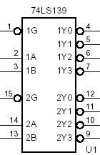
The 74x139 Dual 2-to-4 Decoder
(双2-4译码器74x139)
Truth Table for One-half of a 74x139
Dual 2-to-4 Decoder
74x139
( 1/2 74x139双2-4译码器真值表 )
Inputs
G B A
Outputs
Y3_L Y2_L Y1_L Y0_L
1 X X 1 1 1 1
0 0 0 1 1 1 0
0 0 1 1 1 0 1
0 1 0 1 0 1 1
0 1 1 0 1 1 1

Slide 30
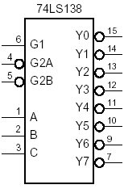
The 74x138 3-to-8 Decoder
(3-8译码器74x138)
Digital Logic Design and Application (数字逻辑设计及应用)
G1
G2A_L
G2B_L
Y3 = G1 · G2A · G2B · C’· B · A
Enable (使 能)
Select (选 择)
Y3_L = Y3’
= (G1 · G2A_L’ · G2B_L’ · C’·B·A)’
= G1’ + G2A_L + G2B_L + C+B’+A’
Figure 6-34, 35

Slide 31
第六章 作业
Digital Logic Design and Application (数字逻辑设计及应用)
6.9 6.10
6.13
6.16
6.17

Slide 32
A Class Problem ( 每课一题 )
Using the information given in Table 6-2 with 74HCTxx,74AHCTxx and 74LSxx, Determine the exact maximum propagation delay from IN to OUT of the following Circuit. Compare and Comment on your results.

