Slide 1
Digital Logic Design and Application (数字逻辑设计及应用)
Chapter 3 Digital Circuits
(数字电路)
Give a knowledge of the Electrical aspects of Digital Circuits
(介绍数字电路中的电气知识)

Slide 2
Digital Logic Design and Application (数字逻辑设计及应用)
Review of Chapter 3
Positive Logic and Negative Logic
(正逻辑和负逻辑)
Three basic logic functions: AND, OR, and NOT
(三种基本逻辑：与、或、非)
Vcc
R
V_{OUT}
V_{IN}
获得高、低电平的基本原理

Slide 3
Review of Chapter 3 (第三章内容回顾)
Digital Logic Design and Application (数字逻辑设计及应用)
Three kinds of Description Method
(三种描述方法)：
Truth Table (真值表)
Logic Expression (逻辑表达式)
Logic Circuit (逻辑符号)
NAND and NOR (与非和或非)

Slide 4
Review of Chapter 3 (第三章内容回顾)
Digital Logic Design and Application (数字逻辑设计及应用)
Logic Families: TTL Family and CMOS Family (逻辑系列：TTL系列 和 CMOS系列)
CMOS Logic Level (CMOS逻辑电平)
N-Channel
(N沟道)
Source (源极)
V_{gs}
+
Gate
(栅极)
Drain (漏极)
Gate
(栅极 )
Drain
(漏极)
+
V_{gs}
P-Channel
(P沟道)
Source (源极)

Slide 5
Review of Chapter 3
Digital Logic Design and Application (数字逻辑设计及应用)
CMOS Inverter
(CMOS反相器)
V_{CC}
V_{DD} = +5.0V
Tp
V_{OUT}
Z
V_{IN}
Tn
A

Slide 6
Review of Chapter 3
Digital Logic Design and Application (数字逻辑设计及应用)
CMOS NAND Gate
(CMOS与非门)
CMOS Inverter
(CMOS反相器)
V_{DD} = +5.0V
V_{CC}
Z
A
Z
B
A

Slide 7
Review of Chapter 3
Digital Logic Design and Application (数字逻辑设计及应用)
CMOS NOR Gate
(CMOS或非门)
CMOS Inverter
(CMOS反相器)
V_{DD} = +5.0V
V_{CC}
A
B
Z
Z
A

Slide 8
Review of Chapter 3
Digital Logic Design and Application (数字逻辑设计及应用)
Non-inverting Gate
(非反相门)
CMOS Inverter
(CMOS反相器)
V_{DD} = +5.0V
V_{CC}
Z
Z
A
A

Slide 9
Review of Chapter 3
Digital Logic Design and Application (数字逻辑设计及应用)
The Additive “on” Resistance of series transistors limits the Fan – In of CMOS gates.
(导通电阻的可加性限制了CMOS门的扇入数)
V_{DD} = +5.0V
V_{DD} = +5.0V
A
B
Z
Z
A
B

Slide 10
3.4 Electronic Behavior of CMOS Circuits (CMOS电路的电气特性)
Digital Logic Design and Application (数字逻辑设计及应用)
Logic Voltage Levels
(逻辑电压电平)
DC Noise Margins
(直流噪声容限)
Fun-Out (扇出)
物理上的
而不是逻辑上的

Slide 11
3.4 Electronic Behavior of CMOS Circuits (CMOS电路的电气特性)
Digital Logic Design and Application (数字逻辑设计及应用)
Speed, Power Consumption
(速度、功耗)
Noise, Electrostatic Discharge
(噪声、静电放电)
Open-Drain Outputs, Three State Outputs (漏极开路输出、三态输出)
Data Sheet
（数据表）
Specifications
(规格说明)
（Table 3-3 P99）

Slide 12
3.5 CMOS Steady-State Electrical Behavior (CMOS稳态电气特性)
Digital Logic Design and Application (数字逻辑设计及应用)
Logic Levels and Noise Margins
( 逻辑电平和噪声容限)
V_{OUT}
V_{DD} = +5.0V
5.0
Tp
V_{OUT}
V_{IN}
Tn
V_{IN}
1.5
3.5
5.0
电压传输特性

Slide 13
3.5 CMOS Steady-State Electrical Behavior (CMOS稳态电气特性)
Digital Logic Design and Application (数字逻辑设计及应用)
Logic Levels Specifications (逻辑电平规格)
V_{OHmin}
HIGH (高态)
ABNOMAL
(不正常状态)
LOW (低态)
V_{IHmin}
V_{CC}－0.1V
0.7V_{CC}
V_{ILmax}
0.3V_{CC}
V_{OLmax}
地＋0.1V

Slide 14
3.5 CMOS Steady-State Electrical Behavior (CMOS稳态电气特性)
Digital Logic Design and Application (数字逻辑设计及应用)
DC Noise Margin（直流噪声容限）
  How much noise it takes to corrupt a worse-case output voltage into a value that may not be recognized properly by an input.
  (多大的噪声会使最坏输出
  电压被破坏得不可识别)
HIGH (高态)
ABNOMAL
(不正常状态)
LOW (低态)
V_{OHmin}
V_{IHmin}
V_{ILmax}
30%V_{CC}－0.1V
V_{OLmax}

Slide 15
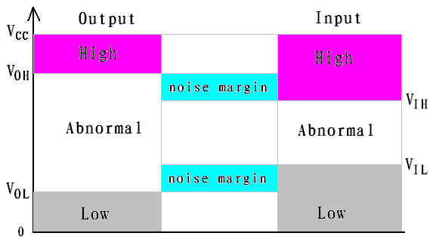
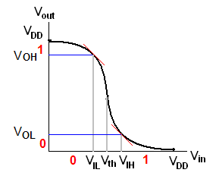
Logic level and noise margin
The input limit : to avoid the noise be amplified!

Slide 16


3.5.2 Circuit Behavior with Resistive Loads (带电阻性负载的电路特性)
Digital Logic Design and Application (数字逻辑设计及应用)
Require nontrivial amounts of current to operate
(要求有一定的驱动电流才能工作)
V_{CC}
V_{CC}
Rp
R_{Thev}
V_{OUT}
Z
V_{IN}
A
+
Rn
V_{Thev}

Slide 17
3.5.2 Circuit Behavior with Resistive Loads (带电阻性负载的电路特性)
Digital Logic Design and Application (数字逻辑设计及应用)
V_{CC} = + 5.0V
When the Output in the LOW state
( 输出为低态时)
V_{OUT} < = V_{OLmax}
The Output sink Current
( 输出端吸收电流 )
The Maximum Current the Output can sink
[ 能吸收的最大电流 I_{OLmax}（灌电流）]
Rp
>1MΩ
Resistive
Loads
(电阻性
负载)
V_{OLmax}
I_{OLmax}
Rn

Slide 18
3.5.2 Circuit Behavior with Resistive Loads (带电阻性负载的电路特性)
Digital Logic Design and Application (数字逻辑设计及应用)
V_{CC} = + 5.0V
When the Output in the HIGH state
(输出为高态时)
V_{OUT} > = V_{OHmin}
The Output Source Current
(输出端提供电流)
The Maximum Current the Output can Source
[能提供的最大电流 I_{OHmax}（拉电流）]
Rp
Resistive
Loads
(电阻性
负载)
V_{OHmin}
I_{OHmax}
Rn
>1MΩ

Slide 19
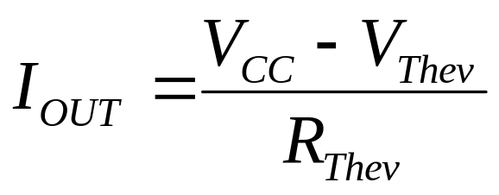
3.5.2 Circuit Behavior with Resistive Loads (带电阻性负载的电路特性)
Digital Logic Design and Application (数字逻辑设计及应用)
When the Output in the HIGH state,
Estimate the Source current
(输出为高态时，
估计提供电流)：
V_{CC} = + 5.0V
R_{Thev}
+
V_{Thev}

Slide 20
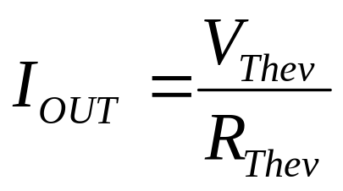
3.5.2 Circuit Behavior with Resistive Loads (带电阻性负载的电路特性)
Digital Logic Design and Application (数字逻辑设计及应用)
When the Output in the LOW state,
Estimate the Sink current
(输出为低态时，
估计吸收电流)：
V_{CC} = + 5.0V
R_{Thev}
+
V_{Thev}

Slide 21
3.5.3 Circuit Behavior with Non-ideal Inputs (非理想输入时的电路特性)
V_{CC} = + 5.0V
V_{CC} = + 5.0V
400Ω
4kΩ
V_{IN}
1.5V
V_{OUT}
4.31V
V_{IN}
3.5V
V_{OUT}
0.24V
2.5kΩ
200Ω
Output voltage away from the power-supply rail (Further with a resistive load [输出电压变坏（有电阻性负载时更差）]
What’s worse: Output current , Power Consumption (更糟糕的是：输出端电流 ，功耗 )

Slide 22
3.5.4 Fan-out（扇出）
Digital Logic Design and Application (数字逻辑设计及应用)
The Number of Inputs that the Gate can drive without exceeding its worst-case loading specifications.
(在不超出其最坏情况负载规格的条件下，
一个逻辑门能驱动的输入端个数。)
Fan-out must be examined for both possible output states, HIGN and LOW
(扇出需考虑输出高电平和低电平两种状态)
Overall Fan-out = Min (HIGH-state and LOW-state [ 总扇出＝min（高态扇出，低态扇出）]
DC Fan-out and AC Fan-out
(直流扇出 和 交流扇出)

Slide 23
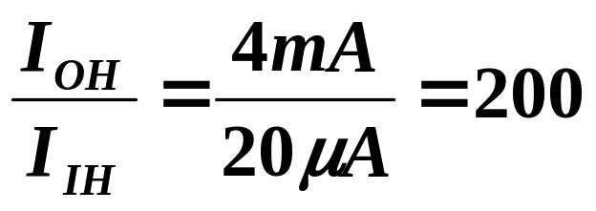
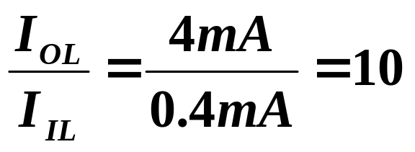

Digital Logic Design and Application (数字逻辑设计及应用)
Fan-out (扇出)
CMOS: 74HCT
I_{OH} = – 4 mA
I_{OL} = 4 mA
I_{IH} = 1 μA
I_{IL} = – 1 μA
TTL: 74LS
I_{OH} = – 400 μA
I_{OL} = 8 mA
I_{IH} = 20 μA
I_{IL} = – 0.4 mA
74HCT Drives 74LS
LOW Fan-Out
(低态扇出):
HIGH Fan-Out
(高态扇出)：
高态剩余驱动能力：
总扇出

Slide 24
3.5.5 Effects of Loading (负载效应)
Digital Logic Design and Application (数字逻辑设计及应用)
Loading an Output Beyond its rated Fan-out [ 当输出负载大于它的扇出能力时]
Output Voltage become Worse
[ 输出电压变差（不符合逻辑电平的规格）]
Propagation Delay, Rise and Fall time may Increase
( 传输延迟和转换时间变长 )
Temperature of the device may Increase, Reducing Reliability, Causing device Failure (温度可能升高，可靠性降低，器件失效)

Slide 25
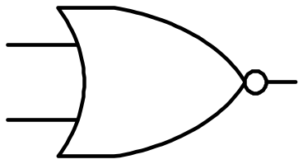
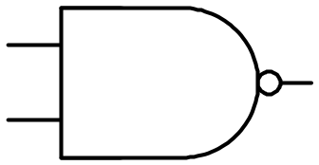
3.5.6 Unused Inputs
(不用的CMOS输入端)
Digital Logic Design and Application (数字逻辑设计及应用)
Never be left Unconnected (or Floating)
( 不用的CMOS输入端绝不能悬空 )
X
Z
X
Z
+5V
Increase the capacitive load on the driving signal and may slow things down. (增加了驱动信号的电容负载，使操作变慢)
1kΩ
Z
X

Slide 26
Current Spikes and Decoupling Capacitors (电流尖峰和去耦电容器)
Digital Logic Design and Application (数字逻辑设计及应用)
V_{DD} = +5.0V
i_{D}
电流传输特性
Tp
V_{OUT}
V_{IN}
Tn
1
2
v_{I}
V_{DD}

Slide 27
3.6 CMOS Dynamic Electrical Behavior (CMOS动态电气特性)
Digital Logic Design and Application (数字逻辑设计及应用)
Both the Speed and Power Consumption of a CMOS device depend to a large extent on AC or Dynamic Characteristics of the device and its load
( CMOS器件的速度和功耗在很大程度上取决于器件及其负载的动态特性。)

Slide 28
3.6 CMOS Dynamic Electrical Behavior (CMOS动态电气特性)
Digital Logic Design and Application (数字逻辑设计及应用)
Speed depends on two characteristics ( 速度取决于两个特性)：
  Transition Time（转换时间）
  Propagation Delay（传播延迟）
Figure 3-36
The amount of Time that the Output of a logic circuit
takes to Change from one state to another.
(逻辑电路的输出从一种状态变为另一种状态所需的时间)
Figure 3-42
The amount of Time that it takes for a Change in the
Input signal to produce a Change in the Output signal.
(从输入信号变化到产生输出信号变化所需的时间)

Slide 29
3.6.1 Transition Time (转换时间)
Digital Logic Design and Application (数字逻辑设计及应用)
Rise time (t_{r}) and Fall time (t_{f} ) (上升时间t_{r} 和 下降时间t_{f} )
  The “On” transistor Resistance
  ( 晶体管的“导通”电阻 )
  Stray Capacitance（寄生电容）
V_{CC} = + 5.0V
Rp
电容两端电压不能突变
R_{L}
“Time-Constant equals Transition-Time”
(在实际电路中,可用时间常数近似转换时间)
+
C_{L}
V_{L}
Rn

Slide 30
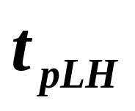
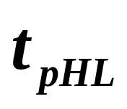
3.6.2 Propagation Delay (传播延迟)
Signal Path: the electrical path from a particular input signal to a particular output signal of a logic element.
(信号通路：一个特定输入信号到逻辑元件的特定
输出信号所经历的电气通路。)
Figure 3-42
V_{IN}
V_{OUT}

Slide 31
3.6.3 Power Consumption (功率损耗)
Digital Logic Design and Application (数字逻辑设计及应用)
Static Power Dissipation ( 静态功耗 )
Dynamic Power Dissipation ( 动态功耗 )
  两个管子瞬间同时导通产生的功耗 P_{T}
  对负载电容充、放电所产生的功耗 P_{L}
P_{L} 与负载电容、输入信号频率、 (V_{CC} ) ² 成正比
P_{T} 与V_{CC} 的大小、
输入波形的好坏、
输入信号频率有关

Slide 32
第3章作业（P175～181）
Digital Logic Design and Application (数字逻辑设计及应用)
3.1 (a) (e) (h)
3.2 (a) (e) (h)
3.5 3.9 3.16
3.27 (d)
3.37
理解
3.39 3.42 3.47
计算扇出
3.49 (a) (b) (g)
3.57 (a)
计算直流噪声容限
3.53 3.56 (a)
选做
3.61 3.62 3.83
3.29 (自学3.5.7)

Slide 33
A Class Problem ( 每课一题 )
Digital Logic Design and Application (数字逻辑设计及应用)
A 74LS00 has
VOHmin=2.7V, VOLmax=0.5V, VIHmin=2.0V, VILmax=0.8V,
determine the worst-case LOW-state and HIGH-state DC noise margins of the 74LS00.

