Slide 1
Digital Logic Design and Application (数字逻辑设计及应用)
Chapter 4 Combinational Logic Design Principles
(组合逻辑设计原理)
Basic Logic Algebra
(逻辑代数基础)
Combinational-Circuit Analysis
(组合电路分析)
Combinational-Circuit Synthesis
(组合电路综合)

Slide 2
Digital Logic Design and Application (数字逻辑设计及应用)
Review of 4.1 Switching Algebra
(开关代数内容回顾)
1、 Axioms (公理)
2、 Single-Variable Theorems
(单变量开关代数定理)
3、 Two-and Three-Variable Theorems
(二变量或三变量开关代数定理)
需要特别记忆：A + B·C = (A+B)·(A+C)
  A·B + A’·C + B·C = A·B + A’·C
  补充：代入定理

Slide 3
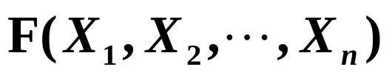
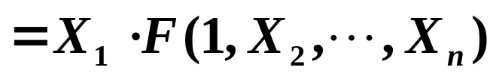
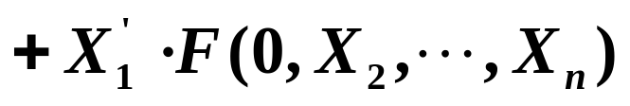
Review of 4.1 Switching Algebra
(开关代数内容回顾)
4、 n-Variable Theorems (n变量定理)
Generalized Idempotency
(广义同一律)
Shannon’s Expansion Theorems
(香农展开定理)
Demorgan’s Theorems
[ 摩根定理（反演）]
Duality (对偶)
X + X + … + X = X
X · X · … · X = X

Slide 4
Digital Logic Design and Application (数字逻辑设计及应用)
Review of 4.1 Switching Algebra
(开关代数内容回顾)
n-Variable Theorems (n变量定理)
Generalized Idempotency
(广义同一律)
Shannon’s Expansion Theorems
(香农展开定理)
Demorgan’s Theorems
[ 摩根定理（反演）]
Duality (对偶)
与⇔或，0 ⇔ 1
变量取反
与⇔或，0 ⇔ 1
[ F(X₁ , X₂ , … , X_{n}) ]’ = F^{D}(X₁’ , X₂’, … , X_{n}’ )

Slide 5
Digital Logic Design and Application (数字逻辑设计及应用)
The relationship of Positive-Logic Convention and Negative-Logic Convention are Duality
(正逻辑约定和负逻辑约定互为对偶关系)
Positive-Logic
(正逻辑)：
F = A·B
Negative-Logic
(负逻辑)：
F = A+B
A
G1
F
B
Electrical Function
Table (电气功能表)
Positive-Logic
Convention
Negative-Logic
Convention
A B F
A B F
A B F
L L L
L H L
H L L
H H H
0 0 0
0 1 0
1 0 0
1 1 1
1 1 1
1 0 1
0 1 1
0 0 0

Slide 6
补充：逻辑函数及其表示方法
Digital Logic Design and Application (数字逻辑设计及应用)
举重裁判电路
真值表
开关ABC
1表闭合
指示灯
1 表亮
C
A
B
C
Y
A
B
Y
0 0 0
0 0 1
0 1 0
0 1 1
1 0 0
1 0 1
1 1 0
1 1 1
0
0
0
0
0
1
1
1
Y = F (A,B,C ) = A·(B+C)
逻辑函数
A
&
B
≥1
Y
C
逻辑图

Slide 7
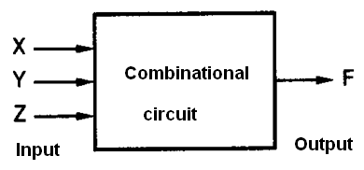
Combinational logic
The output is determined only by its input.
Output can be changed when input changed.

Slide 8
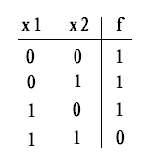
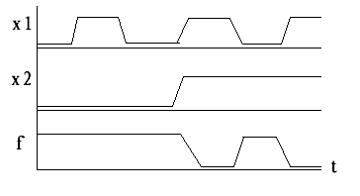


Representations of logic functions
Truth table
Timing diagram
Logic equations
Logic circuits

Slide 9
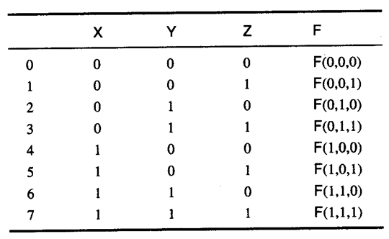
Truth table
Left: the input combinations in binary order
Right: the output for the input

Slide 10
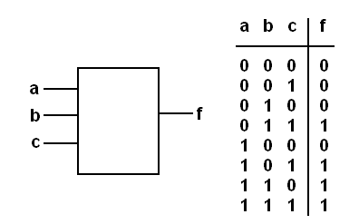
Logic design: Construct a Truth table
A device with majority judge function
output the majority input state .

Slide 11
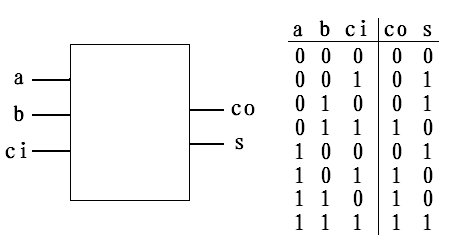
Logic design: Construct a Truth table
Full adder
add three input numbers to get their sum.

Slide 12
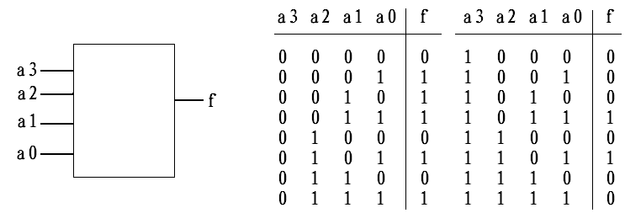
Logic design: Construct a Truth table
4-bits prime-number detector
when input is (1,2,3,5,7,11,13), the output is 1, otherwise the output is 0 .

Slide 13
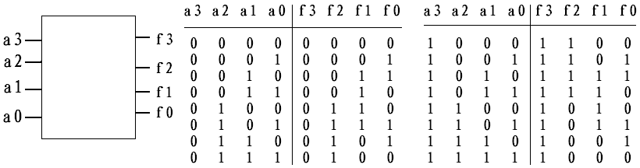
Logic design: Construct a Truth table
4-bit Binary to Gray code converter
change binary input to Gray code output.

Slide 14
Logic Expression to Truth Table
(逻辑表达式 ➔ 真值表)
Digital Logic Design and Application (数字逻辑设计及应用)
Y = (B’+C) · (A’+B+C’)
Product-of-Sums
Expression
(“和之积”表达式
“或-与”式)
A
B
C
B’+C
A’+B+C’
Y
0 0 0
0 0 1
0 1 0
0 1 1
1 0 0
1 0 1
1 1 0
1 1 1
1
1
1
1
1
1
0
0
0
0
0
1
1
1
1
1
1
0
1
1
1
1
1
0

Slide 15
Truth Table to Logic Expression
(真值表 ➔ 逻辑表达式)
Digital Logic Design and Application (数字逻辑设计及应用)
A
B
C
F
F = A’·B·C + A·B’·C + A·B·C’
0 0 0 0
0 0 1 0
0 1 0 0
0 1 1 1
1 0 0 0
1 0 1 1
1 1 0 1
1 1 1 0
Sum-of-Products“积之和”表达式
“与-或”式
真
值
表
A’·B·C
乘积项：
A·B’·C
0 →反变量
1 →原变量
A·B·C’

Slide 16
Truth Table to Logic Expression
(真值表 ➔ 逻辑表达式)
Digital Logic Design and Application (数字逻辑设计及应用)
A
B
C
F
G
F = A’·B·C
0 0 0 0
0 0 1 0
0 1 0 0
0 1 1 1
1 0 0 0
1 0 1 0
1 1 0 0
1 1 1 0
1
1
1
0
1
1
1
1
G = (A+B’+C’)
真
值
表
(A’·B·C)’ = A+B’+C’
0 →原变量
1 →反变量

Slide 17
Truth Table to Logic Expression
(真值表 ➔ 逻辑表达式)
Digital Logic Design and Application (数字逻辑设计及应用)
0 →原变量
1 →反变量
A
B
C
F
求和项
0 0 0 1
0 0 1 1
0 1 0 0
0 1 1 1
1 0 0 0
1 0 1 1
1 1 0 1
1 1 1 1
真
值
表
A+B’+C
A’+B+C
“和之积”表达式
“或-与”式
F = (A+B’+C) · (A’+B+C)

Slide 18
4.1.6 Standard Representations of Logic Functions (逻辑函数的标准表示法)
Product
Term
(乘积项)
Minterms (最小项)
  —— An n-variable Minterm is a normal product term with n literals (n个因子的标准乘积项)
  There are 2^{n} such product terms
  (n变量函数具有2^{n}个最小项)
  Any two different product terms produce 0.
  (任意两个不同最小项的乘积为0)
A
B
C
0 0 0
0 0 1
0 1 0
0 1 1
1 0 0
1 0 1
1 1 0
1 1 1
A’·B’·C’
A’·B’·C
A’·B·C’
A’·B·C
A·B’·C’
A·B’·C
A·B·C’
A·B·C

Slide 19
Properties of minterm
For any input combinations, there is one and only one minterm will be 1;
The sum of all the minterm must be 1;
The product of any two different minterm must be 0.

Slide 20
4.1.6 Standard Representations of Logic Functions (逻辑函数的标准表示法)
Digital Logic Design and Application (数字逻辑设计及应用)
Maxterms (最大项)
  —— An n-variable maxterm is a normal sum term with n literals.
  (n变量最大项是具有n个因子的标准求和项)
  There are 2^{n} such sum terms.
  (n变量函数具有2^{n}个最大项)
  Product of all maxterms is 0.
  (全体最大项之积为0)
  Any two different sum terms produce 1.
  (任意两个最大项的和为1)
Sum Term
(求和项)
A
B
C
0 0 0
0 0 1
0 1 0
0 1 1
1 0 0
1 0 1
1 1 0
1 1 1
A+B+C
A+B+C’
A+B’+C
A+B’+C’
A’+B+C
A’+B+C’
A’+B’+C
A’+B’+C’

Slide 21
Properties of maxterm
For any input combinations, there is one and only one maxterm will be 0;
The product of all the maxterm must be 0;
The sum of any two different maxterm must be 1.

Slide 22
Properties of maxterm
For any input combinations, there is one and only one maxterm will be 0;
The product of all the maxterm must be 0;
The sum of any two different maxterm must be 1.

Slide 23
Digital Logic Design and Application (数字逻辑设计及应用)
Minterms(最小项)
A
B
C
编号
Maxterms (最大项)
m₀
m₁
m₂
m₃
m₄
m₅
m₆
m₇
A’·B’·C’
A’·B’·C
A’·B·C’
A’·B·C
A·B’·C’
A·B’·C
A·B·C’
A·B·C
0 0 0 0
0 0 1 1
0 1 0 2
0 1 1 3
1 0 0 4
1 0 1 5
1 1 0 6
1 1 1 7
A+B+C
A+B+C’
A+B’+C
A+B’+C’
A’+B+C
A’+B+C’
A’+B’+C
A’+B’+C’
M₀
M₁
M₂
M₃
M₄
M₅
M₆
M₇

Slide 24
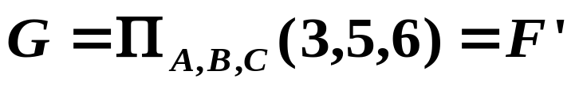
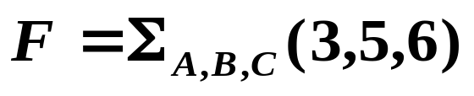
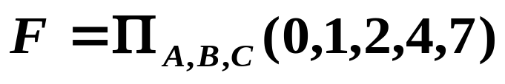
Relationship of Maxterms and Minterms
(最大项与最小项之间的关系)
Digital Logic Design and Application (数字逻辑设计及应用)
A
B
C
F
G
0 0 0 0
0 0 1 0
0 1 0 0
0 1 1 1
1 0 0 0
1 0 1 1
1 1 0 1
1 1 1 0
1
1
1
0
1
0
0
1
标号互补
(A’·B·C)’ = A+B’+C’
M_{i} = m_{i}’
(A·B’·C)’ = A’+B+C’
m_{i} = M_{i}’
(A·B·C’)’ = A’+B’+C

Slide 25
Relationship of Maxterms and Minterms
(最大项与最小项之间的关系)
Digital Logic Design and Application (数字逻辑设计及应用)
①、 M_{i} = m_{i}’ ； m_{i} = M_{i}’ ；
②、某逻辑函数 F，若用 P项最小项之和表示，
则其反函数 F’ 可用 P 项最大项之积表示，
两者标号完全一致。
③、一个n变量函数，既可用最小项之和表示，
也可用最大项之积表示。两者下标互补。

Slide 26
4.1.6 Standard Representations of Logic Functions (逻辑函数的标准表示法)
Digital Logic Design and Application (数字逻辑设计及应用)
Normal Term (标准项）
标准和
标准积
—— 最小项之和
Truth Table (真值表)
Product Term, Sum Term (乘积项、求和项)
Sum-of-Products Expression (“积之和”表达式)
Product-of-Sum Expression (“和之积”表达式)
Canonical Sum and Product (标准和与标准积)
N-variable Minterm (n 变量最小项)
N-variable Maxterm (n 变量最大项) (4.1.6)
—— 最大项之积

Slide 27
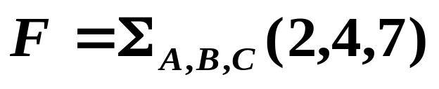
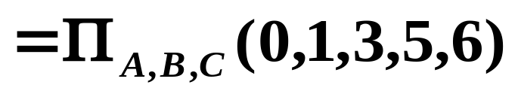
Digital Logic Design and Application (数字逻辑设计及应用)
课堂练习：分别写出下面逻辑函数的
Canonical Sum
(标准和)
Canonical Product
(标准积)
的表示。
A
B
C
F
0 0 0 0
0 0 1 0
0 1 0 1
0 1 1 0
1 0 0 1
1 0 1 0
1 1 0 0
1 1 1 1
On-Set
(开集)
Off-Set
(闭集)

Slide 28
Digital Logic Design and Application (数字逻辑设计及应用)
用标准和(Canonical Sum)的形式表示函数：
F(A,B,C) = A·B +A’·C
利用基本公式 A + A’ = 1
F(A,B,C) = A·B + A’·C
= A·B·(C+C’) + A’·C·(B+B’)
= A·B·C + A·B·C’ + A’·B·C + A’·B’·C
= Σ_{A,B,C}(1,3,6,7)
1 1 1
1 1 0
0 1 1
0 0 1

Slide 29
Digital Logic Design and Application (数字逻辑设计及应用)
用标准积(Canonical Product)的形式表示函数：
G(A,B,C) = (A+B) · (A’+C)
= (A+B+C·C’) · (A’+C+B·B’)
= (A+B+C)·(A+B+C’)·(A’+B+C)·(A’+B’+C)
0 0 0
0 0 1
1 0 0
1 1 0
= Π_{A,B,C}(0,1,4,6)

Slide 30
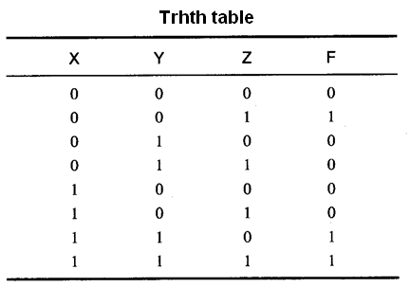
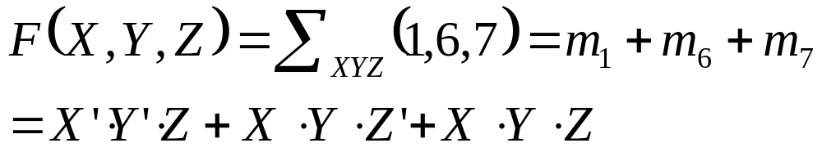
Standard logic equation
Minterm list (Canonical sum) : list of “1”

Slide 31
Standard logic equation
Maxterm list (Canonical product): list of “0”

Slide 32
Standard logic equation
Any logic can be realized in two level circuit :
Minterm list , Canonical sum, sum of product;
Maxterm list , Canonical product, product of sum;

Slide 33
Standard logic equation
Any logic can be realized in two level circuit :

Slide 34
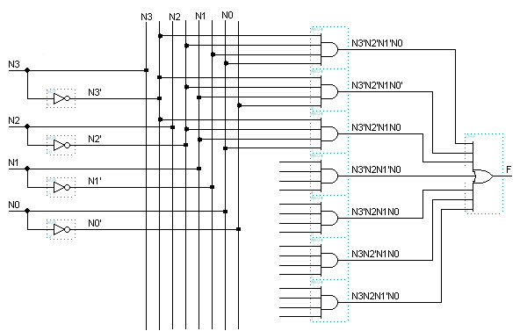
From logic equation to logic circuit

Slide 35
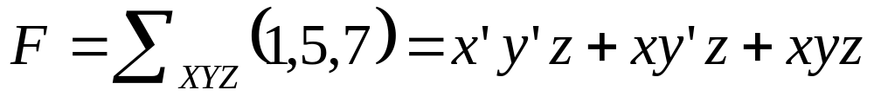
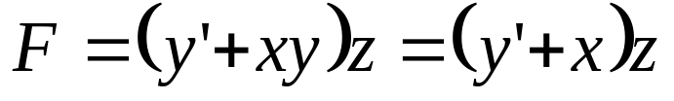
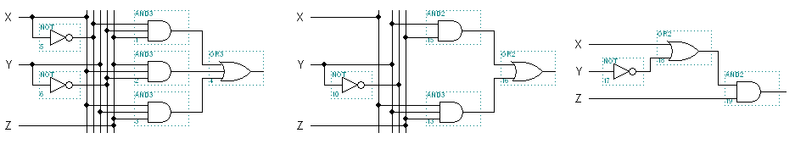
How to make a circuit better ?

Slide 36
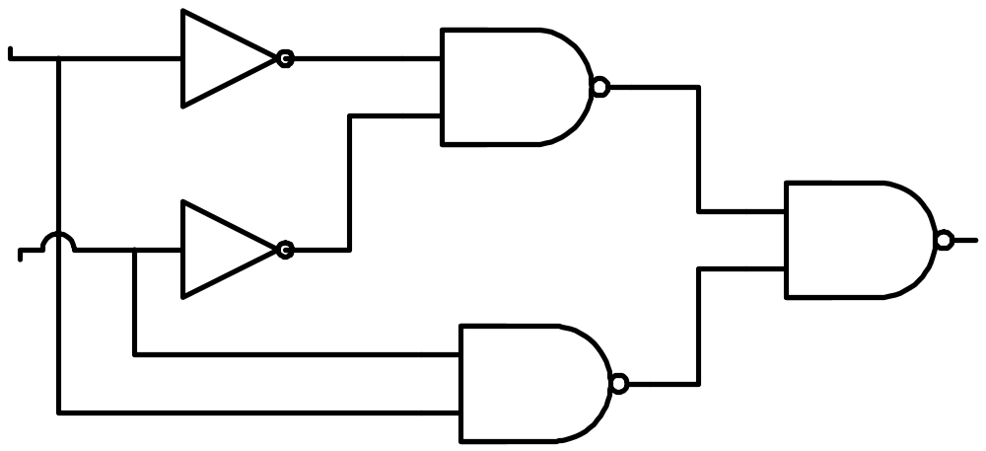
4.2 Combinational-Circuit Analysis
(组合电路分析)
Digital Logic Design and Application (数字逻辑设计及应用)
给出组合电路的逻辑图，分析电路的功能
—— 通过获得逻辑函数的形式来分析
A’
(A’·B’)’
A
B’
F
B
(A·B)’
F = [ (A’·B’)’ · (A·B)’ ]’
= A’·B’ + A·B = AB

Slide 37
第4章作业（P230）
Digital Logic Design and Application (数字逻辑设计及应用)
4.9 (a) (b)
4.10 (c) (f)
4.12

Slide 38
A Class Problem ( 每课一题 )
Digital Logic Design and Application (数字逻辑设计及应用)
A
B
C
F
Corresponding the right Truth Table， write the Canonical Sum（标准和）and Canonical Product（标准积）。
0 0 0 1
0 0 1 1
0 1 0 0
0 1 1 1
1 0 0 0
1 0 1 1
1 1 0 0
1 1 1 1
真
值
表

