Slide 1
Simulation of Employment Environment Using Multi-agent Model
AROB 25th 2020
Jan. 22-24, 2020. B-Con PLAZA, Beppu. JAPAN
National Institute of Technology, Toyama College
Ryuichi Matoba
Takahiro Nanba
Koshi Komai
Shingo Hagiwara
Niigata Institute of Technology, Japan
Makoto Nakamura

Slide 2
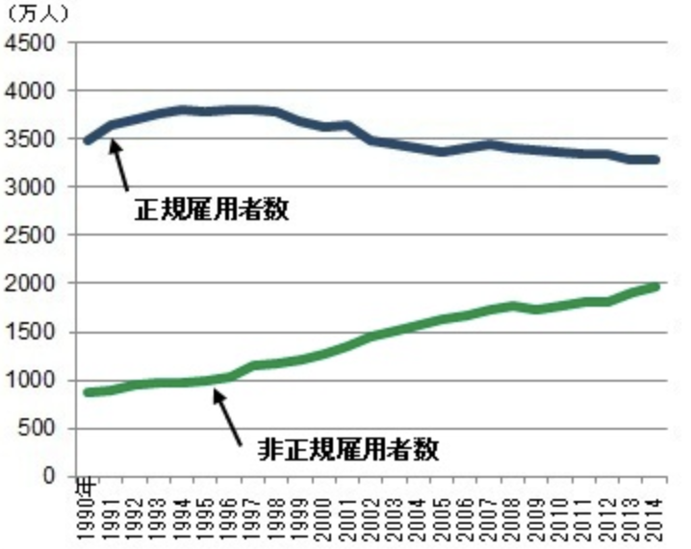
Background
The fixed-term workers account for about 40% of whole workers in Japan (Fig.1). Therefore, fixed-term worker is indispensable for Japanese society.
The 2012 amendment of the Labor Contract Law allows fixed-term workers who have been employed for five years to replace with permanent workers to stabilize their lives. However, the permanent workers have not been increased, but the fixed-term workers have been increased.
The amended law did not realize its purpose. It is caused that the fixed-term workers were fired before 5 years.
Structuring of the law is possibly not to realize the fixed-term workers into permanent one.
Fig. 1 Regular VS Temporary
(Statistics Bureau of Japan)
Notes:
左の文とグラフを絡めつつ1分

Slide 3
Motivation & Approach
The amended law directly makes the fixed-term workers the permanent workers. There is no consideration with the indirect effect of the amended law. Accordingly, the result is not equivalent to the purpose.
It is difficult for legislators to recognize the social response which the law affected.
We suggest that a new amended law is evaluated with multi-agent model.
In this study, we target the article 18, the Labor Contract Act in Japan; “Conversion of a Fixed-term Labor Contract to a Labor Contract Without a Fixed Term”
We confirm what the employer agents learn on changing of the law with employer agents and employee agents as stated above.
Notes:
非正規労働者が増加すると・・・
・低賃金
・不安定な雇用
・能力アップの機会が少ない
→社会的な格差が広がる(貧困化、少子高齢化)
→イノベーションを生み出すことができない
→景気の悪化で、企業の利益が減少する
現実とシミュレーション間で相関関係を発見
→今後の雇用状態を予測する

Slide 4
Fixed-term Worker VS Permanent Worker
Fixed-term Worker
Fixed-term contract (e.g. 1 year)
The employer can decide whether he renews the contract next term.
Permanent Worker
Permanent contract
The employer cannot fire the worker without a rational reason.
(Article 16, Labor Contract Act)
Article 16 If a dismissal lacks objectively reasonable grounds and is not considered to be appropriate in general societal terms, it is treated as an abuse of rights and is invalid.

Slide 5
Before 2012 in Japan
Continuous Renew
An Employer renew the fixed-term contract repeatedly, because can stop to renew the contract anytime.
Renew
Renew
Renew
……
Employed
Planning Fixed-term worker’s life
The fixed-term workers are difficult to be a permanent worker or a regular worker.
Then, marriage, birth, etc...

Slide 6
The article 18, Labor Contract Act.
Article 18
(1) If a Worker whose total contract term of two or more fixed-term labor contracts (excluding any contract term which has not started yet; the same applies hereinafter in this Article) concluded with the same Employer (referred to as the "total contract term" in the next paragraph) exceeds five years applies for the conclusion of a labor contract without a fixed term before the date of expiration of the currently effective fixed-term labor contract, to begin on the day after the said date of expiration, it is deemed that the said Employer accepts the said application. In this case, the labor conditions that are the contents of said labor contract without a fixed term are to be the same as the labor conditions (excluding the contract term) of the currently effective fixed-term labor contract (excluding parts separately provided for with regard to the said labor conditions (excluding the contract term)).
Renew
Renew
Renew
Renew
Conversion
……
Employed
Notes:
This is the original document’s of the labor contract law in japan.
As the Japanese law sentences have many parentheses like this, it is so bad for our eyes. haha
Then, they are turned to gray color.

Slide 7
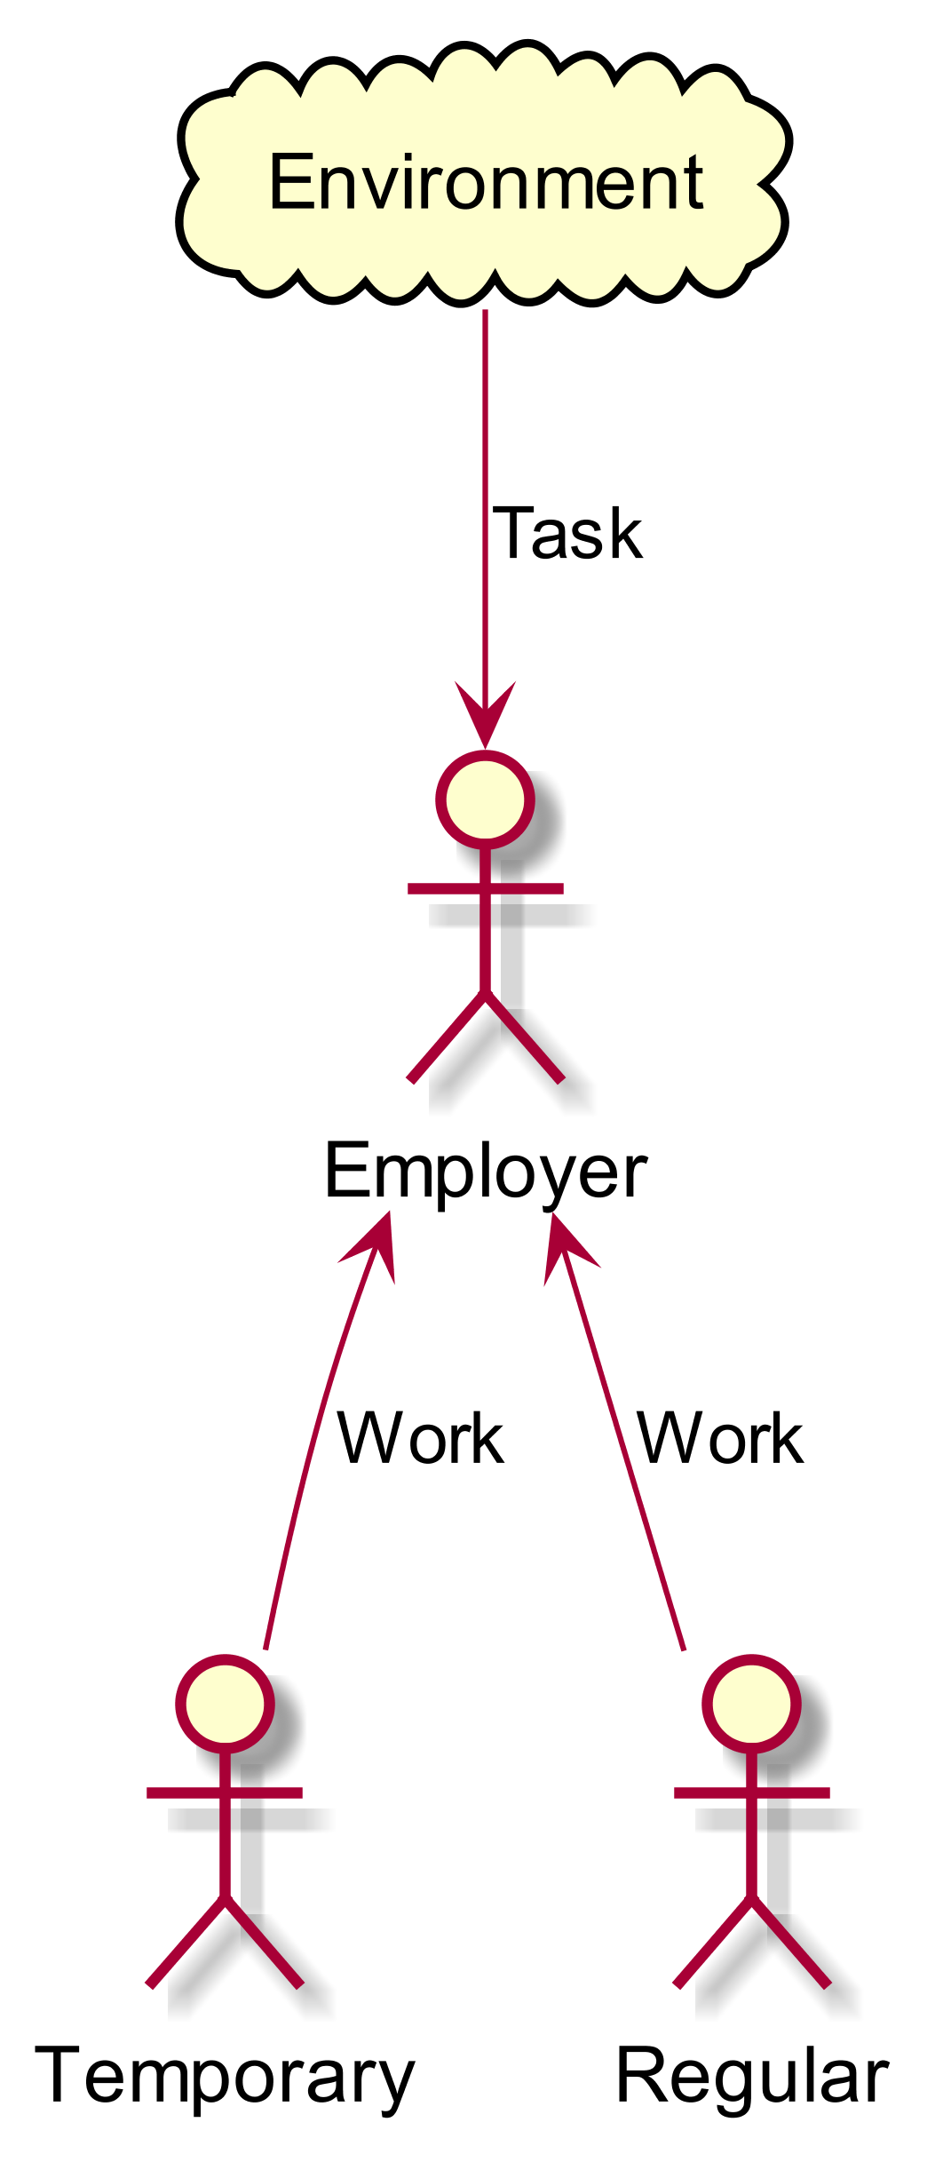
Multi-agent system: Overview
Two types of workers
Temporary workers
Regular workers
Employer
One person per company
Distributes works to workers

Slide 8
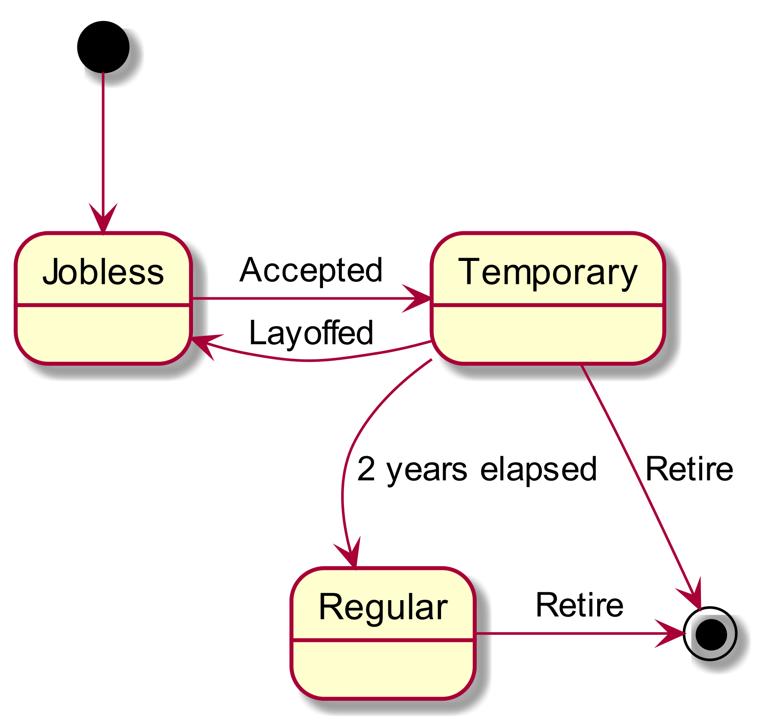
Employee Agent State Transition
Jobless
The state of initial worker agent is jobless.
Temporary
It means the worker is on the fixed-term contract.
In the system, in the case that it’s length of service exceeds 2 years, the worker can convert the contract to permanent contract.
Regular
It means permanent worker.
This worker is not fired.

Slide 9
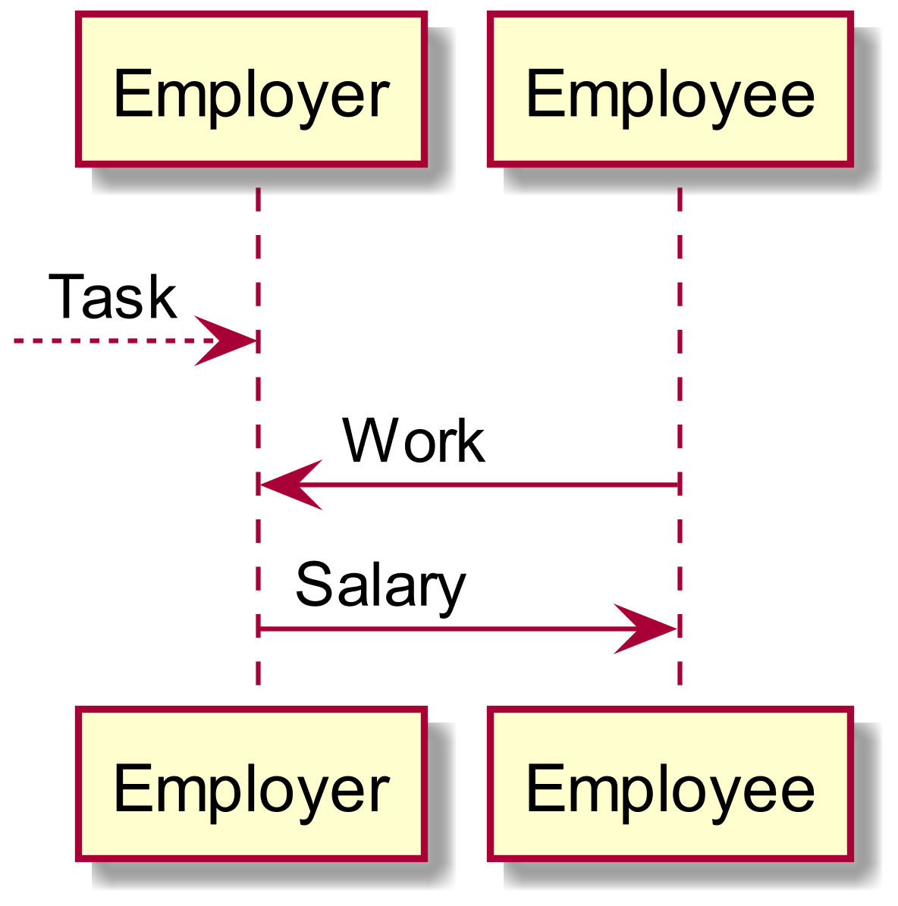
Working Procedure
1: The task is given to the employer. The employer tries to digest the task with workers.
2: The employee provide working power.
Longer years of service provide more working power.
3: The employer pay salary to the employee.
The salary increases with the working power.
``Principle of equal pay for equal work’’

Slide 10
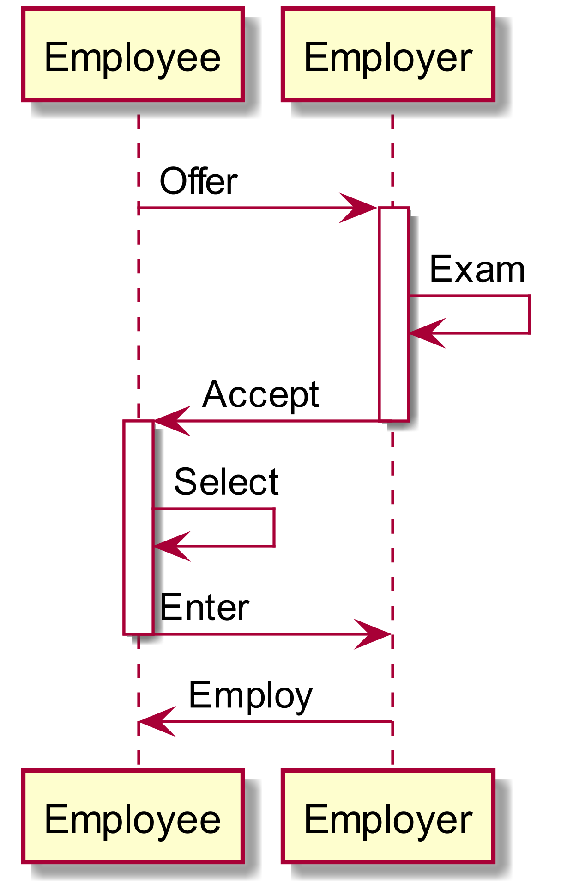
Recruitment Procedure
Exam
Employer decides whether he employs the applicants with Q-learning.
Select
Every applicant selects a company to be hired.
The selection method is a roulette selection depend on salary from some employers.

Slide 11
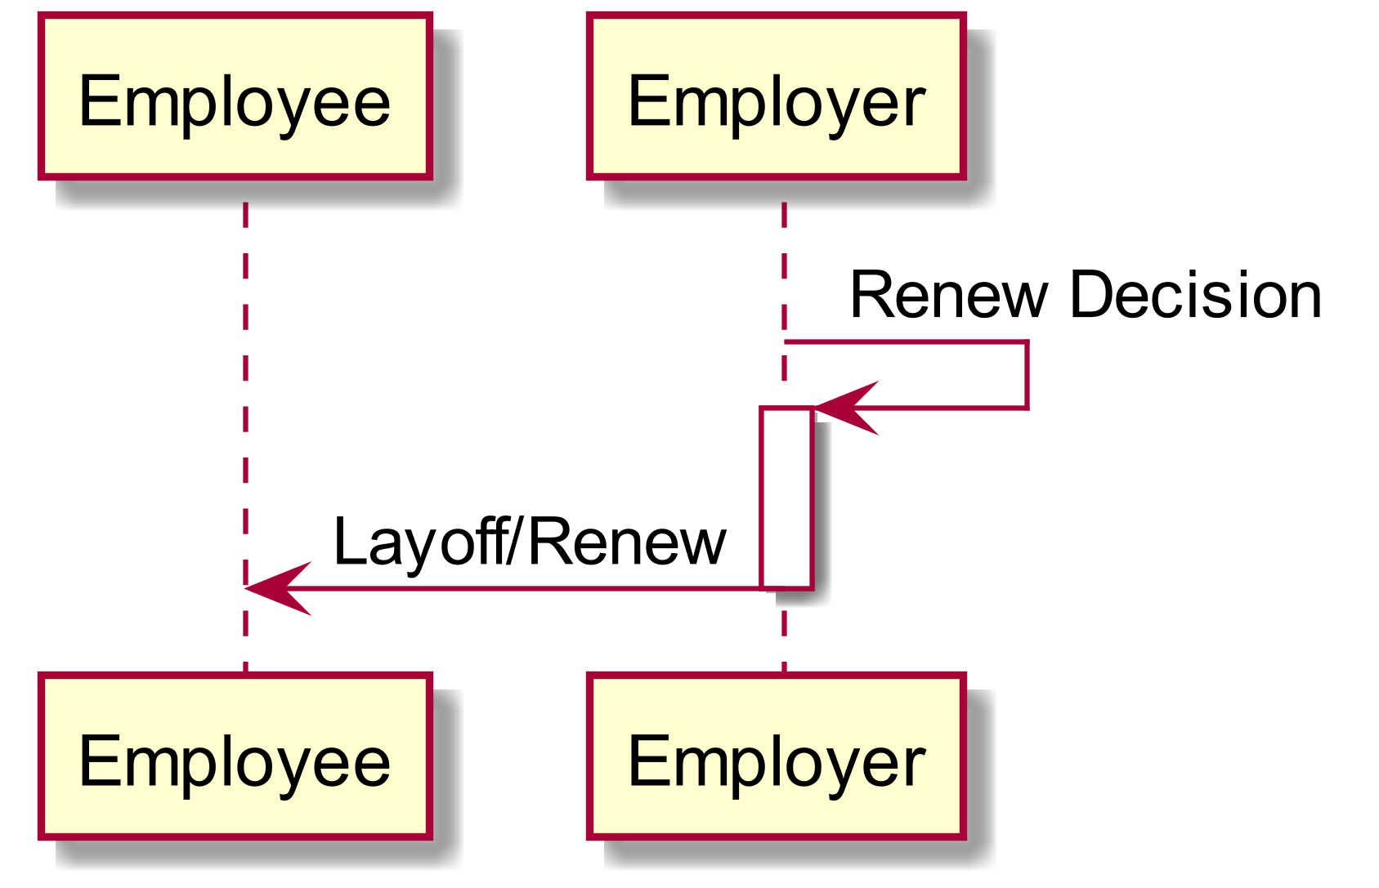
Renew Procedure
Renew
Employer decide whether renews the contract of the employee with Q-learning.
If the decision is not, then the employer fire the employee.

Slide 12
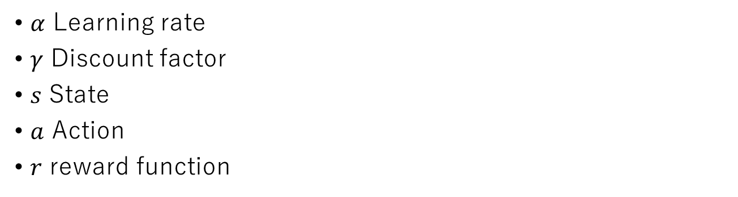
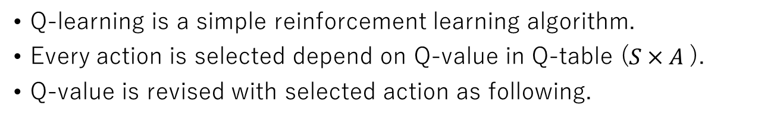
Q-learning
Q-learning is a simple reinforcement learning algorithm.
Every action is selected depend on Q-value in Q-table ($S×A$).
Q-value is revised with selected action as following.
$$Q\left(s_{t},a_{t}\right)←Q\left(s_{t},α_{t}\right)+α(r_{t+1}+γ⋅\max_{α_{t+1}}{Q\left(s_{t+1},a_{t+1}\right)−Q(s_{t},a_{t}))}$$
$α$ Learning rate
$γ$ Discount factor
$s$ State
$a$ Action
$r$ reward function

Slide 13
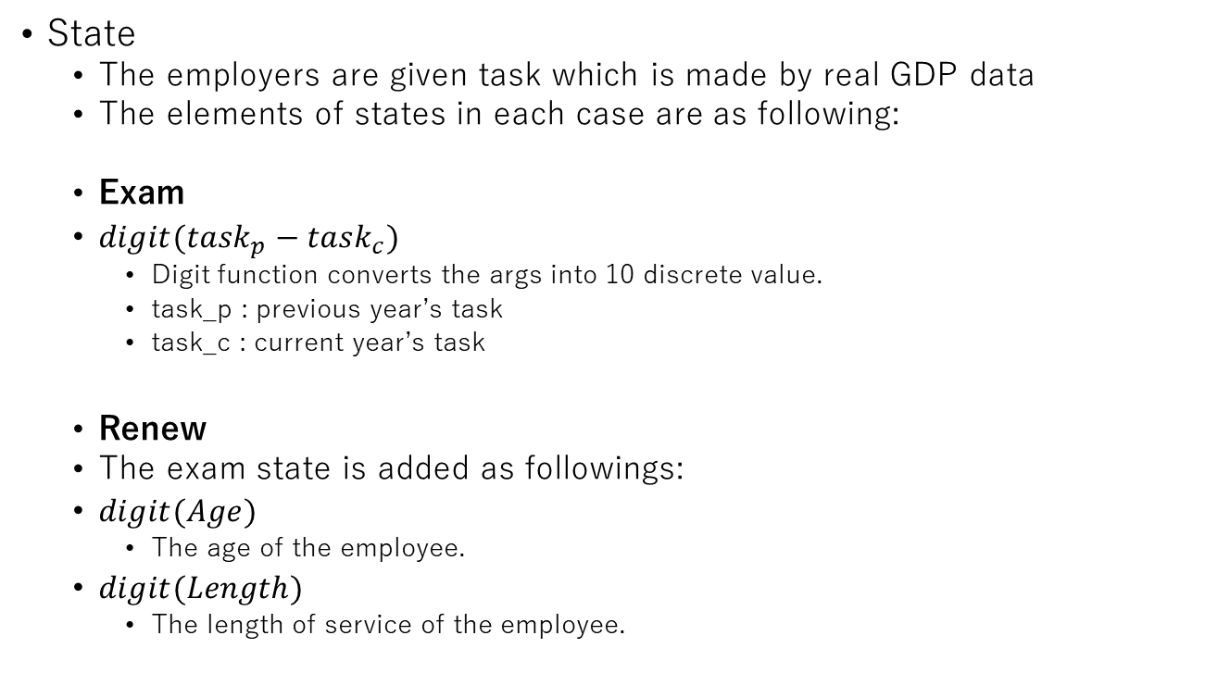
Q-learning on Employer (1)
State
The employers are given task which is made by real GDP data
The elements of states in each case are as following:
Exam
$digit(task_{p}−task_{c})$
Digit function converts the args into 10 discrete value.
task_p : previous year’s task
task_c : current year’s task
Renew
The exam state is added as followings:
$digit(Age)$
The age of the employee.
$digit(Length)$
The length of service of the employee.

Slide 14
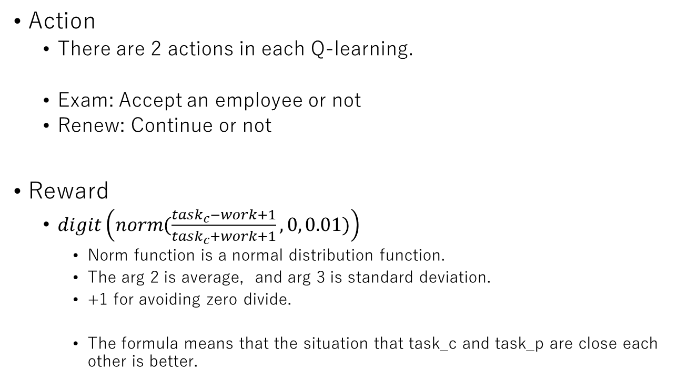
Q-learning on Employer (2)
Action
There are 2 actions in each Q-learning.
Exam: Accept an employee or not
Renew: Continue or not
Reward
$digit\left(norm(\frac{task_{c}−work+1}{task_{c}+work+1},0, 0.01)\right)$
Norm function is a normal distribution function.
The arg 2 is average, and arg 3 is standard deviation.
+1 for avoiding zero divide.
The formula means that the situation that task_c and task_p are close each other is better.

Slide 15
Experiment Setting
Employer Agent
1 person
As each agent has not relations with others in the system, there is one employer.
Employee Agent
30 people
In Japan, the average number of employees for one employer is about 20. Therefore, we set the number of employee agents to remain some agents.
GDP data
Real data from 1944 to 2012
The data is used for task which deriver to employers.
Result
The result is 10 times average after 100 times training .

Slide 16
Experiment 1: Before the amended law
Broken line:
working amount of employers
Continuous line:
the number of workers whose contracts are temporary
In the experiment, all workers are temporary at first.
The employer learned how they adjust the amount workers.

Slide 17
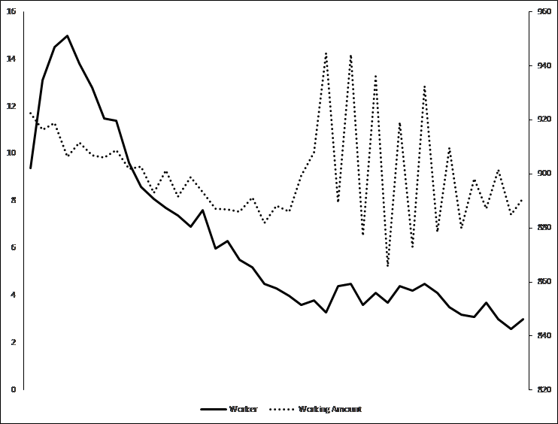
Experiment2: After the amended law
Broken line:
working amount of employer
Continuous line:
the number of temporary workers + regular workers
Temporary workers are decreasing.

Slide 18
Experiment2:
Broken line:
regular workers
Continuous line:
temporary Workers
Dots line:
employed agents
Dotted solid line:
fired agents
The employer agent learned to fire workers before conversions of contracts.

Slide 19
Experiment3:
Used same environment
Result
100 times average after 200 times training.
The situation is similar to the real situation, there are more permanent workers more than temporary workers.
However, the permanent workers are not increasing.

Slide 20
Summary
The labor contract act was amended in 2012 in Japan.
The purpose of amendment was to convert fixed-term workers to permanent workers.
However, the fixed-term workers were fired before the conversion of contract without fixed-term. The amendment has been, without considering response of the society.
Preparing multi-agent system which consists of an employer agent which have Q-learning with epsilon-greedy methods and employee agents, we simulated the effect of the amendment with the system.
The employer agent did not learn to use regular worker instead of fixed-term workers, but learn to use fixed-term workers as buffer. The case is the same in real world.
Therefore, we guess that the amendment can not convert the fixed-term workers to permanent workers.

