Slide 1
Analyzing Airbnb listings in Greater Manchester
Done by :
Abdulrahim Alabdeli
Komail Alhelli
Malak Abdulla
1

Slide 2
Problem Statement : An investor is considering to invest in an Airbnb property in Greater Manchester but lacks the information needed to confidently decide which neighborhood to buy the property in that has been popular over the past year and what type of property to invest in .
Aim :
- To analyze Airbnb listings in Greater Manchester .
- To Identify the most popular and profitable properties and neighborhoods.
- To Estimate revenue generation for successful hosts .
- To Provide data-driven recommendations for investment decisions.
Objectives :
- “Certain neighborhoods in Greater Manchester have significantly more listings and higher guest ratings, indicating higher demand and potential for profitability”.
- What property types receive the most positive reviews?
- How much revenue do successful hosts generate?
2

Slide 3
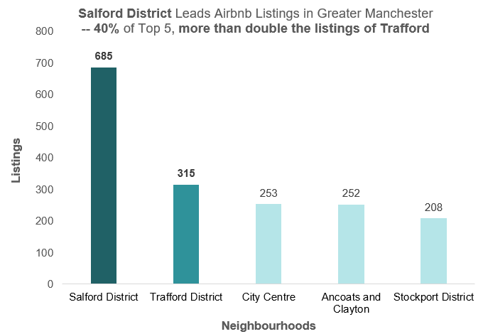
Neighbourhoods that host the most listings
- Salford tops all neighbourhoods with 685 listings (21% of Greater Manchester’s total).
- It accounts for 40% of listings among the
top 5 areas, showing clear dominance.
- Salford’s count is over 2× Trafford’s (315), the next highest.
- This suggests high demand, visibility, and strong revenue potential, making it the best investment option.
3

Slide 4
Top-Rated Property Types Based On Guest Reviews
Insights:
-This horizontal column chart displays the top 10 property types that received the best guest reviews.
-With most having a perfect score of 5.0, which means that guests were very happy with their stay.
These include places like:
1. Shared rooms in homes.
2. Private rooms in “casa particular”.
3. Casa particular.
These types of places offer a unique and cozy personal experience.
Hypothesis:
"Guests give the best reviews to places that feel more personal or special, like shared rooms, because they enjoy the cozy atmosphere and friendly experience."
4

Slide 5
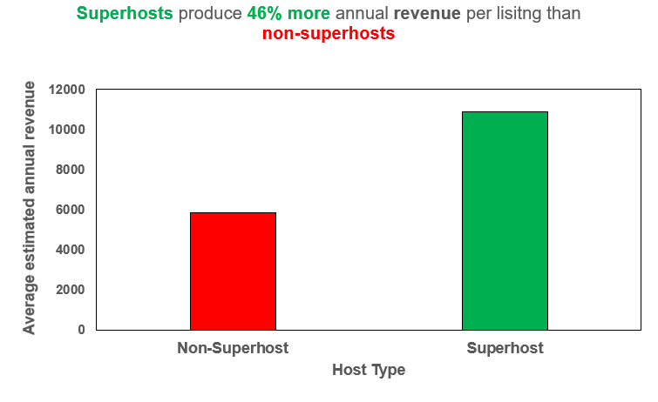
Annual revenue generated by successful hosts
- Superhosts earn over $10,000/year per listing, nearly 2x more than non-superhosts
- This makes superhosts successful.
- Non-superhosts average under $6,000/year.
- Annual revenue offers a clearer view by smoothing seasonal ups and downs.
- Superhost status boosts trust, visibility, and bookings, driving higher revenue.
5

Slide 6
Recommendations :
Invest in Salford District, as it accounts for 21% of all Airbnb listings in Greater Manchester and a significant 40% of listings among the top 5 neighbourhoods.
Learn what makes certain top-property types special and use those ideas to list and promote more of them.
Invest in listings managed by Superhosts to maximize revenue potential, as they earn 46% more annually than non-superhosts.
6

Slide 7
Thank You!
7

