Slide 1

Real-Time Crime Detection System: Full-Stack Implementation
An end-to-end solution for real-time crime and incident detection, built with a focus on security, scalability, and instant situational awareness.

Slide 2
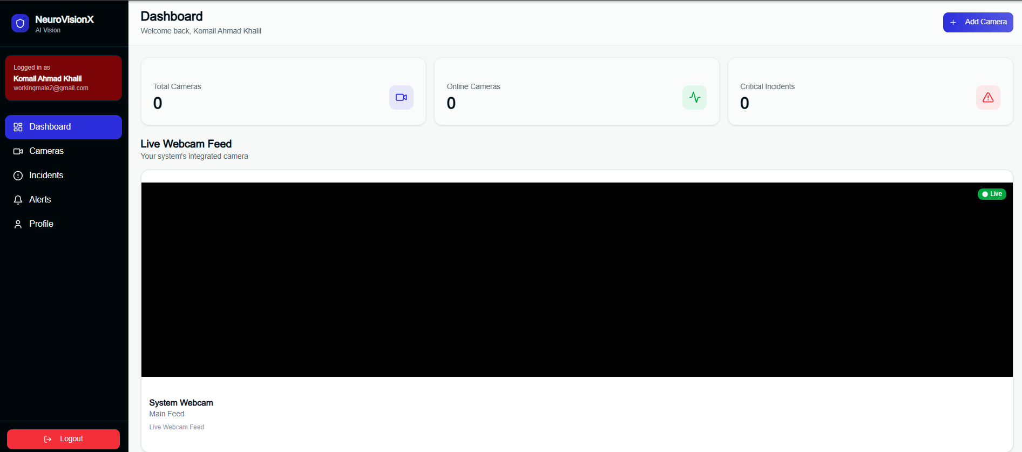

Slide 3
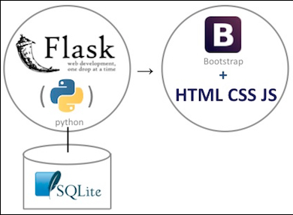

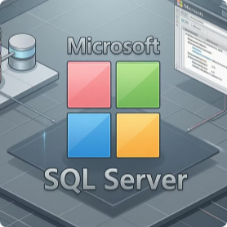

SYSTEM ARCHITECTURE
Robust Full-Stack Foundation
Backend: Flask (Python) with REST APIs
Frontend: Next.js (React)
Database: SQL Server
Real-time Updates: WebSockets
Delivers a dynamic, responsive user interface, ensuring a seamless experience across all monitoring and management functions.
Provides secure, structured storage for all operational data, from user profiles to incident logs, ensuring data integrity.
Facilitates instant alerts and data synchronisation, critical for effective real-time incident detection and response.
Powers the core logic, handling data processing, API endpoints, and system communications with high efficiency.

Slide 4
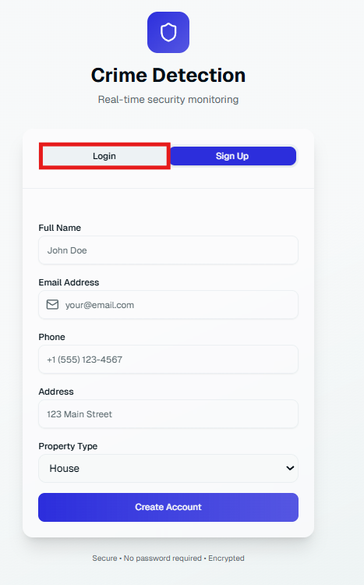
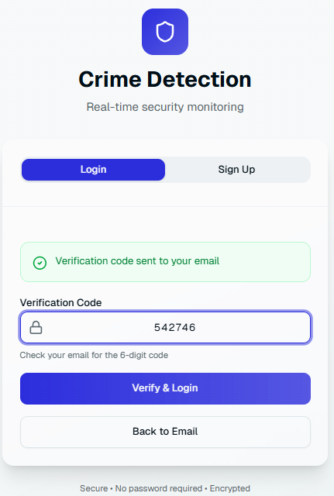
Streamlined Authentication System
Combined Login & Signup with Email Verification
Single, intuitive flow streamlines access for both new registrations and existing users.
Email-based verification uses secure, time-limited 6-digit codes, eliminating password vulnerabilities.
No sensitive passwords are ever stored or transmitted, enhancing overall security posture.
Secure session handling with JWT tokens ensures robust user authentication post-verification.

Slide 5
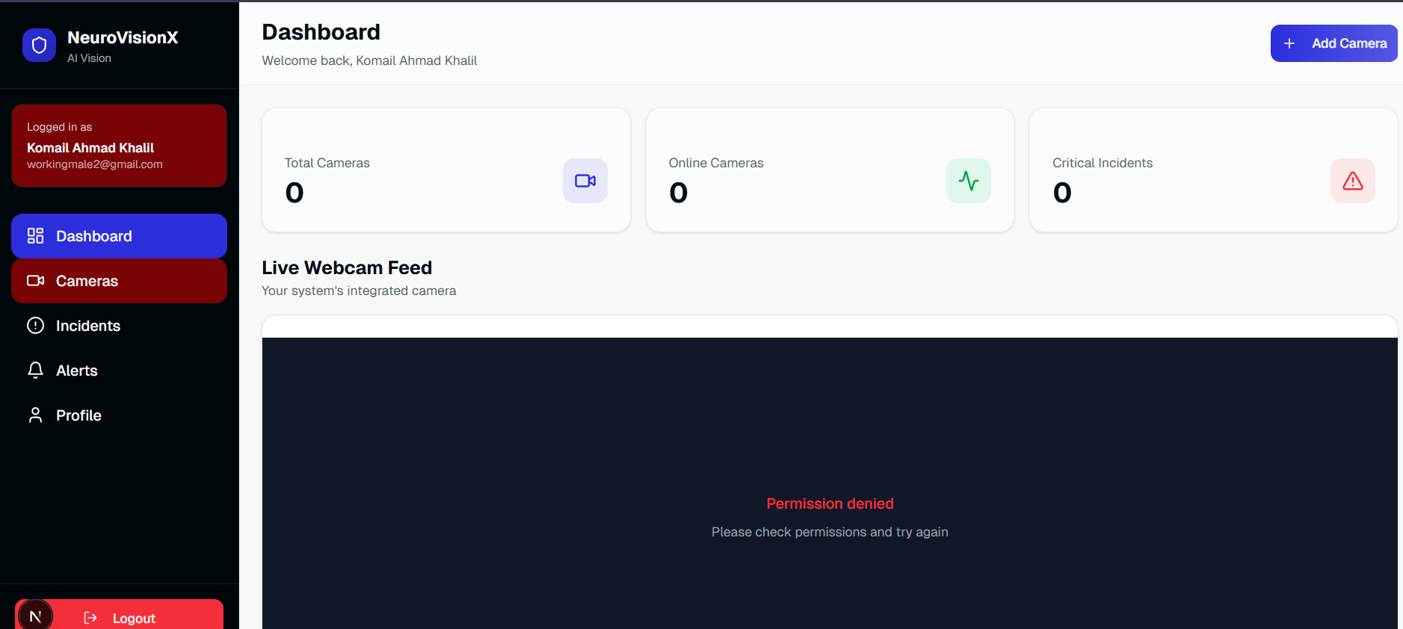

MONITORING
Dynamic Live Camera Dashboard
The central hub for surveillance, offering immediate visual oversight:
Responsive 2x2 camera grid layout maximises screen real estate for concurrent monitoring.
Displays real-time feeds from all registered cameras, providing instant situational awareness.
Optimised for rapid assessment of potential threats and incident verification.

Slide 6

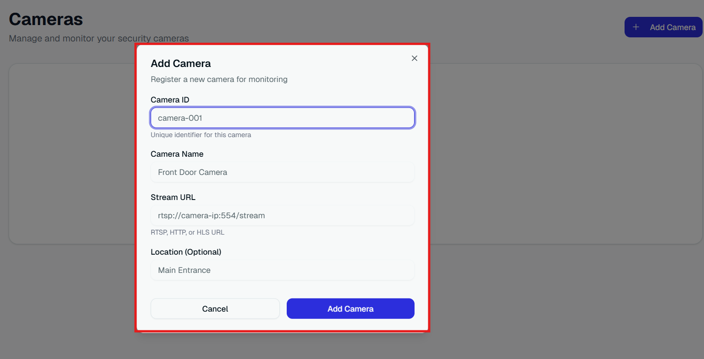
MANAGEMENT
Effortless Camera Management
Our system offers comprehensive tools for controlling your surveillance infrastructure:
Users can easily add, edit, and delete cameras, tailoring their monitoring setup.
Each camera is uniquely linked to the authenticated user, preventing unauthorised access.
Robust backend validation prevents duplicate camera registrations, maintaining data integrity.
All changes are reflected instantly on the live dashboard, ensuring up-to-date surveillance.

Slide 7

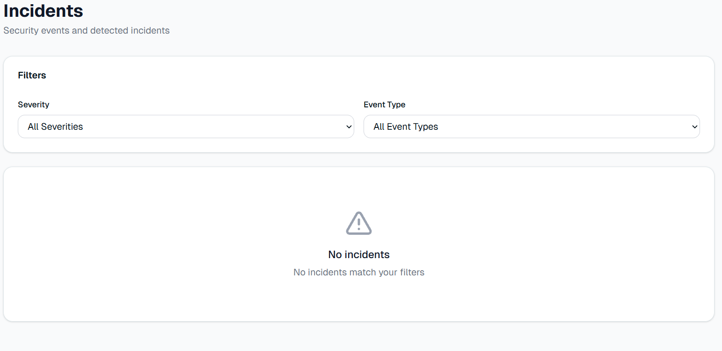
INCIDENTS
Comprehensive Incident Monitoring & History
Stay informed and maintain a clear record of all security events:
Clearly displays all detected incidents with precise timestamps for accurate logging.
Incidents are classified by type and severity, enabling prioritised response.
Powerful filtering capabilities allow for easy review and analysis of past security events.
Designed as a critical tool for audit trails, post-incident analysis, and continuous improvement.

Slide 8

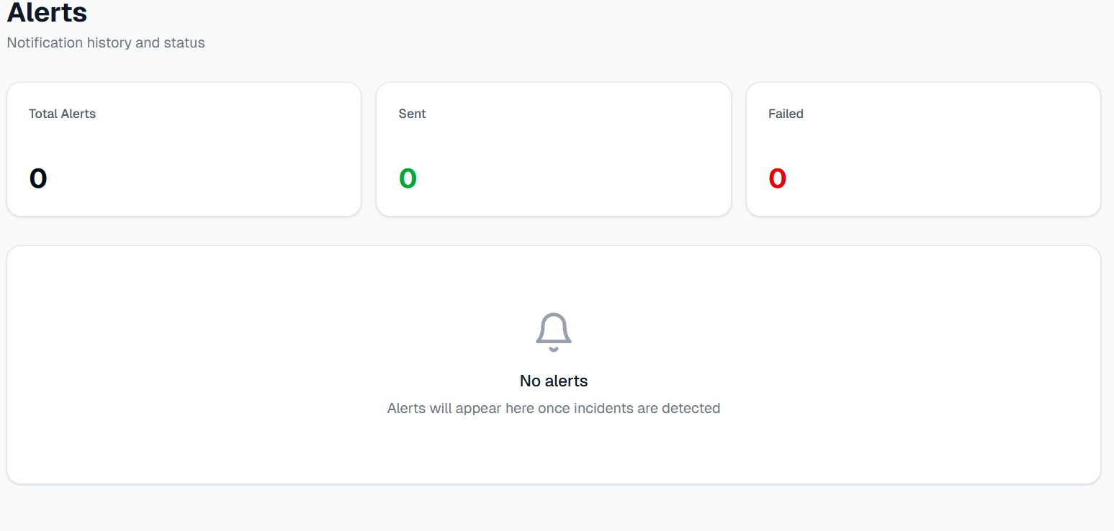
ALERTS
Real-Time Alerting System
Our system ensures you are immediately notified of critical events:
Real-time alert delivery via WebSockets guarantees instant notification of incidents.
A comprehensive history of all sent alerts is maintained for record-keeping.
Ability to resend alerts ensures critical notifications are not missed and can be reinforced.
Full traceability of all communications provides an auditable record of security responses.

Slide 9

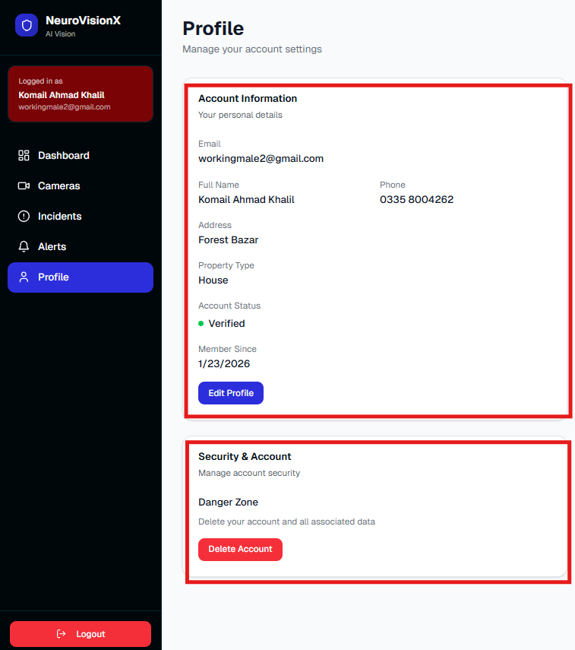
PROFILE
Secure User Profile Management
Empowering users with control over their account information:
Users can easily view and manage their account details, including contact information.
Displays verification status and active session information for enhanced security awareness.
Centralised user-specific settings allow for personalised system configuration.
Secure access is strictly restricted to authenticated users, safeguarding personal data.

Slide 10

TECHNICAL CORE
Real-Time Communication & Data Design
SQL Server for Data Integrity
Structured Schema for Scalability
A robust relational database ensures all data—users, cameras, incidents, and alerts—is stored securely and consistently.
Optimised database tables (Users, Verification Tokens, Cameras, Incidents, Alerts) are designed for both performance and future expansion.

Slide 11
Key Outcomes: Project Achievements
01
02
03
Fully Functional Full-Stack Application
Secure Passwordless Authentication
Real-Time Monitoring and Alerting
Implemented a robust authentication method that eliminates common password-related vulnerabilities.
Delivered a complete, integrated system from user interface to backend services and database.
Achieved immediate situational awareness and rapid notification for critical events.
04
05
Clean Architectural Separation
Ready for Real-World Deployment
Ensured maintainability and scalability through distinct frontend, backend, and database layers.
Designed with security, performance, and reliability in mind, suitable for operational environments.

