Slide 1
A PRESENTATION ON
"Operating System-Level Virtualization"
By
Komal Anil Patel_BTech_B_221101125
Subject Name: Social Network Analysis
Under the Guidance of
Prof. S. B. Raghuwanshi
R. C. PATEL INSTITUTE OF TECHNOLOGY
An Autonomous Institute

Slide 2
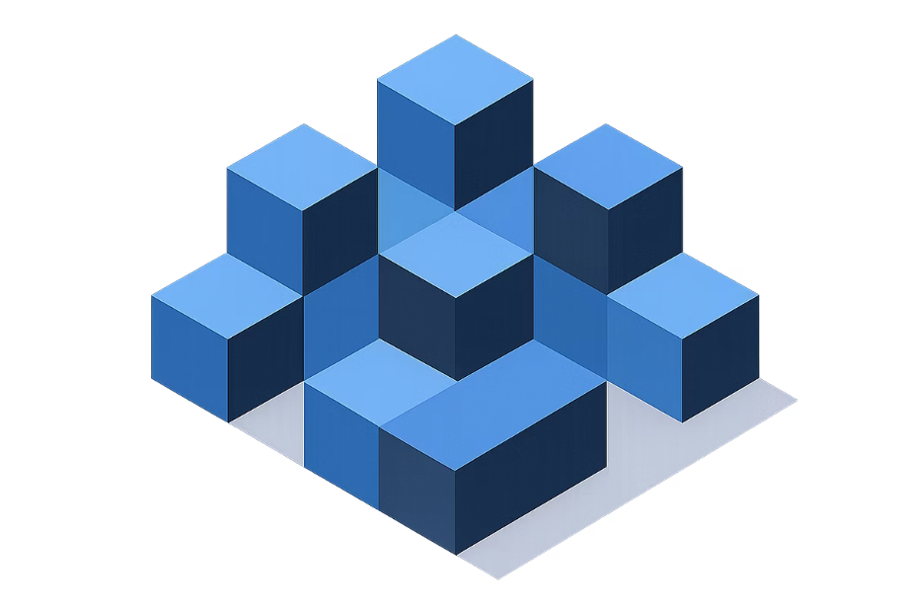
Content
What is Virtualization?
Why Do We Need It?
The Problem: Wasted Computer Power
The Solution: Containers
How Containers Work
Real-World Examples
Benefits of Containers
The Future
Conclusion

Slide 3
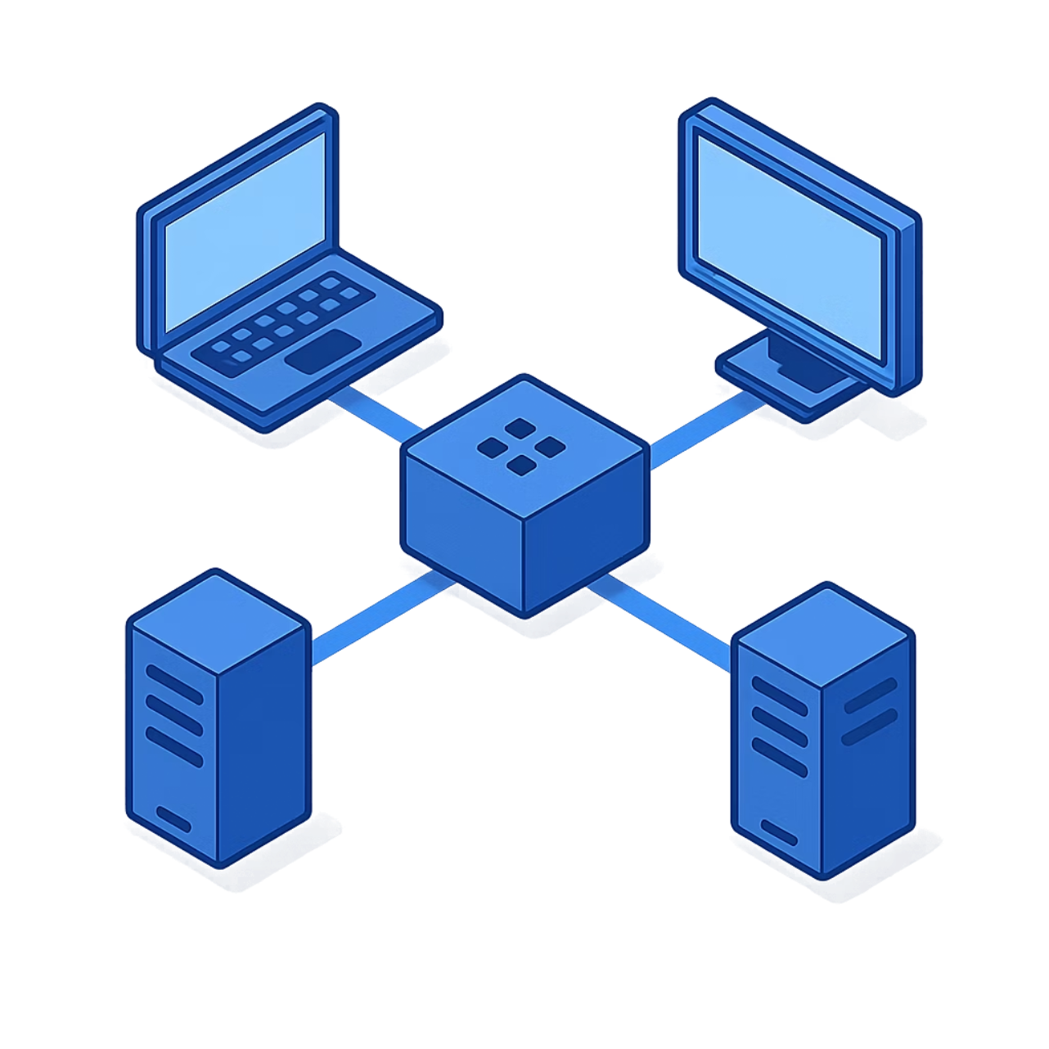
What is Virtualization?
Virtualization means running many programs on one computer at the same time.
Instead of one program using the whole computer, we split the computer's power among many programs.
Each program thinks it has its own computer, but they all share the same machine.
It's like having many rooms in one building instead of many separate buildings.

Slide 4
Why Do We Need It?
Save Money
Use Power Better
Work Faster
Computers are expensive. Instead of buying many computers, we can use one powerful computer and split it among many programs. This saves a lot of money.
Old computers waste a lot of power. One program uses only a small part of the computer, leaving the rest unused. Virtualization uses the computer's power better.
We can start new programs in seconds instead of hours. This helps companies work faster and get things done quicker.

Slide 5

The Problem: Wasted Computer Power
■ Old computers work like this: One computer = One program
Problems:
1. Wasted Power
There was an error generating this image
Each program uses only a small part of the computer. The rest sits empty and unused.
2. Too Expensive
Companies need to buy many computers, which costs a lot of money.
3. Hard to Manage
Managing many computers is difficult and takes a lot of time.

Slide 6
The Solution: Containers
A container is like a small box that holds everything a program needs to run. Many containers can live on one computer, and they don't bother each other. Each container has its own space and thinks it's alone, but they all share the same computer.
There was an error generating this image

Slide 7

How Containers Work
There was an error generating this image
One Operating System
All containers share one operating system. This is the heart of the computer.
Many Containers
Each container is separate and isolated. They don't see each other or interfere with each other.
Shared Resources
All containers share the computer's power (CPU, memory, storage) but stay separate and safe.

Slide 8
Real-World Examples
There was an error generating this image
There was an error generating this image
There was an error generating this image
Websites
Mobile Apps
Data Centers
Big websites like Netflix and Facebook use containers to run thousands of copies of their programs at the same time.
Apps on your phone use containers to run safely without crashing other apps.
Companies use containers to run many programs on fewer computers, saving money and space.

Slide 9
Benefits of Containers
Containers make computers work better and smarter. They help companies save money, work faster, and use computers more efficiently.
There was an error generating this image
Fast Start
Programs start in seconds, not hours
Save Money
Use fewer computers to do the same work
Works Everywhere
Containers work the same on any computer

Slide 10
Conclusion
Operating System-Level Virtualization, or containers, is changing how computers work. Instead of one program per computer, we can now run many programs on one computer safely and efficiently. This saves money, uses power better, and helps companies work faster. Containers are the future of computing!

Slide 11
Thank You

