Slide 1

FOOD DONATION SYSTEM
GROUP 11 :
Komal Suhas Albhar - 002776417
Gauri Nagesh Basutkar - 002747429
Kalyani Patil - 002776416

Slide 2
CONTRIBUTION
KOMAL SUHAS ALBHAR Table initialization, User creation, insertion packages, insert proc, function, exception handling.
GAURI NAGESH BASUTKAR Table initialization, User creation, insertion packages, insert proc,Role creation and User creation.
KALYANI NARENDRA PATIL
Table initialization, User creation, insertion packages, insert proc,trigger,reports.

Slide 3
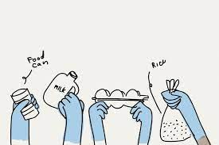
PROBLEM STATEMENT
A public health and economic disaster have been brought on by the 2019 coronavirus disease (COVID-19). And the number of people who face hunger has considerably increased since the outbreak of COVID-19.
In the United States (US), rates of food insecurity have significantly increased, and more families are relying on the charitable food system to meet their requirements.
Rates of food insecurity are anticipated to rise higher as the US continues to deal with high unemployment and unpredictable economic conditions.

Slide 4
PROPOSED SOLUTION
More than 34 million individuals, including 9 million children, are food insecure, according to the USDA (U.S. DEPARTMENT OF AGRICULTURE).
Food insecurity is becoming more and more recognized as a serious public health concern due to its multiple negative social and health effects.
The designed system will ensure proper utilization of surplus food that is being wasted and will contribute towards solving food wastage as well as the hunger problem that is prevalent on the streets.
The solution also aims towards obtaining a seamless operation of food distribution while prioritizing food safety and hygiene. Every pound of food wasted results in a greater loss of resources than that meets the eye.

Slide 5
CONCEPTS EXECUTED
Stored Procedure
Views
Function
Indexes
Packages
Sequence
Triggers
Exception Handling
Grants

Slide 6
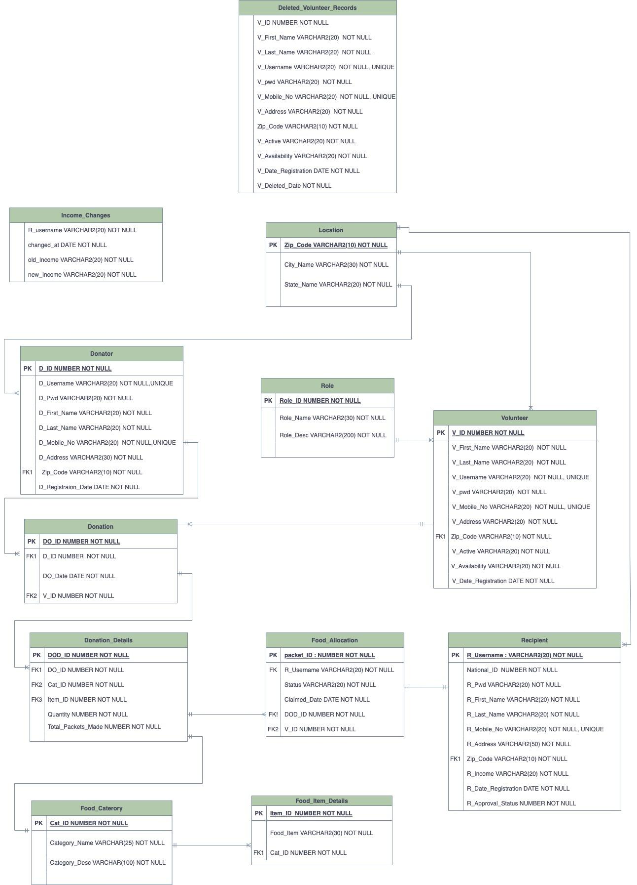
ERD

Slide 7
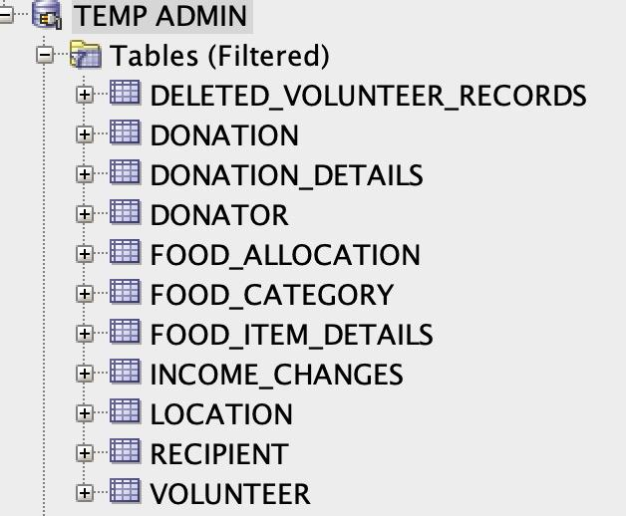
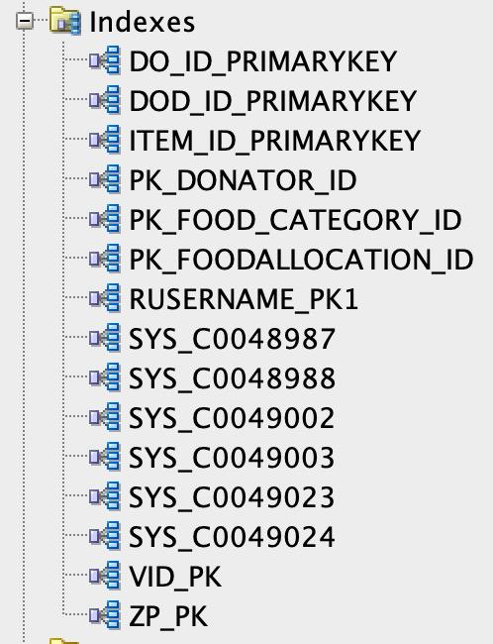
DB OBJECTS

Slide 8
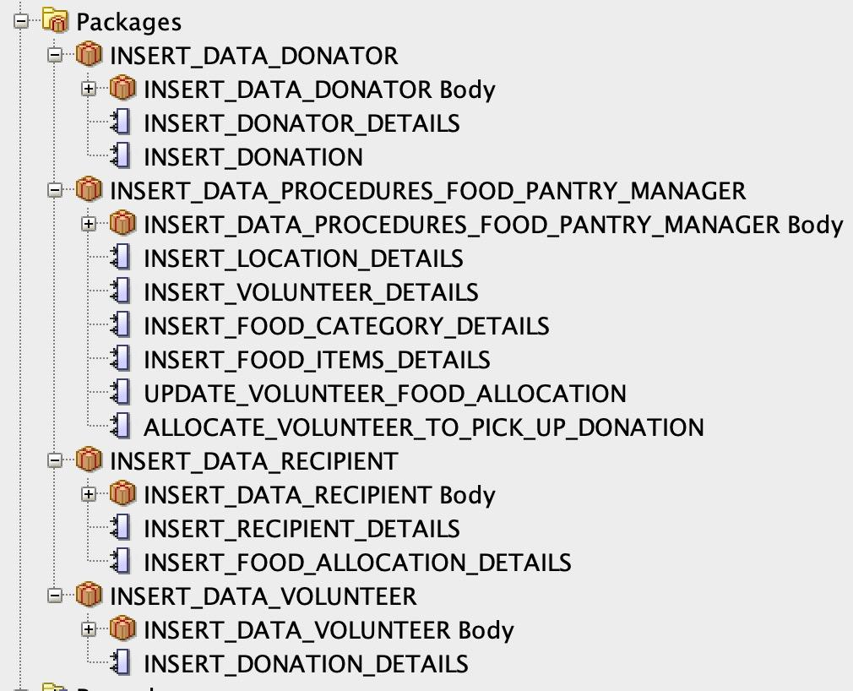
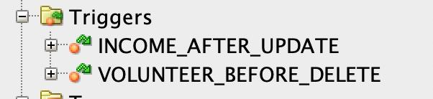
DB OBJECTS

Slide 9
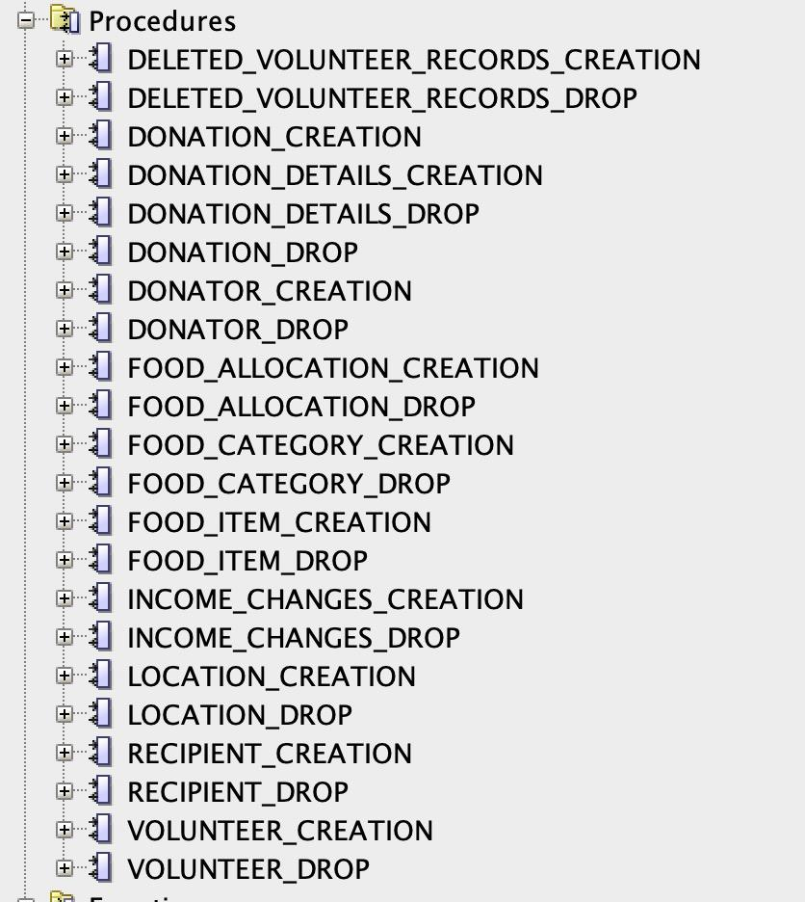

DB OBJECTS

Slide 10
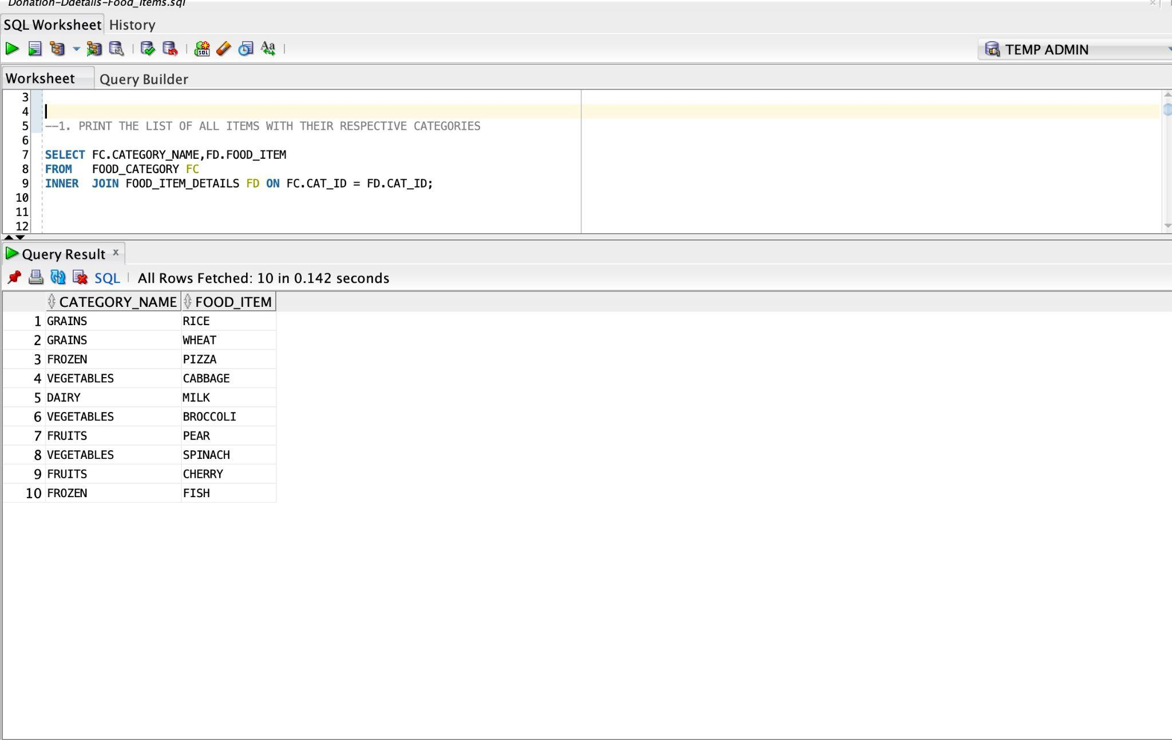
REPORTS

Slide 11
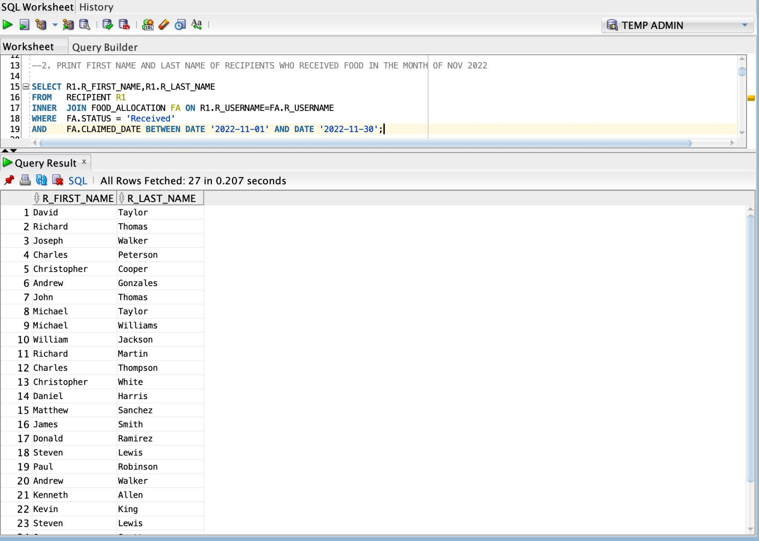

Slide 12
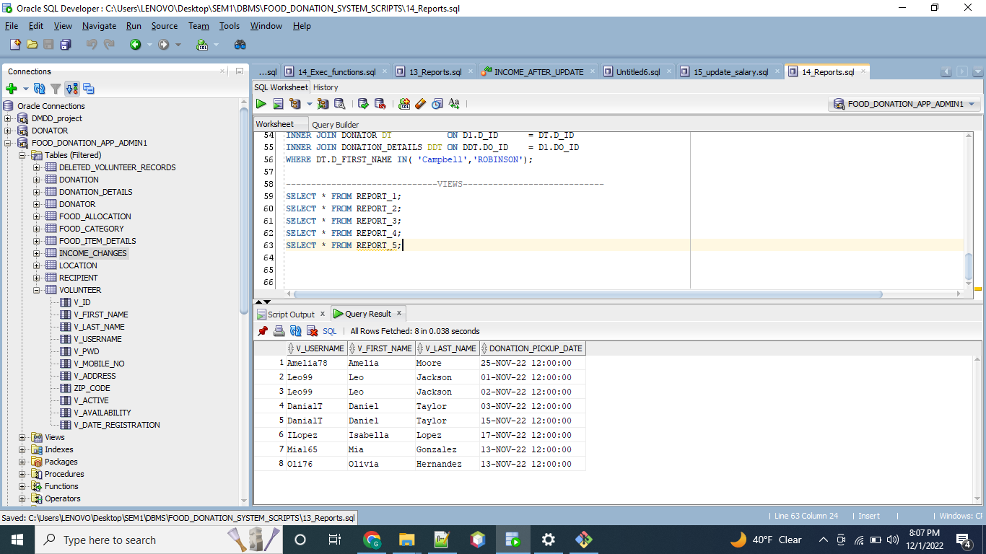

Slide 13
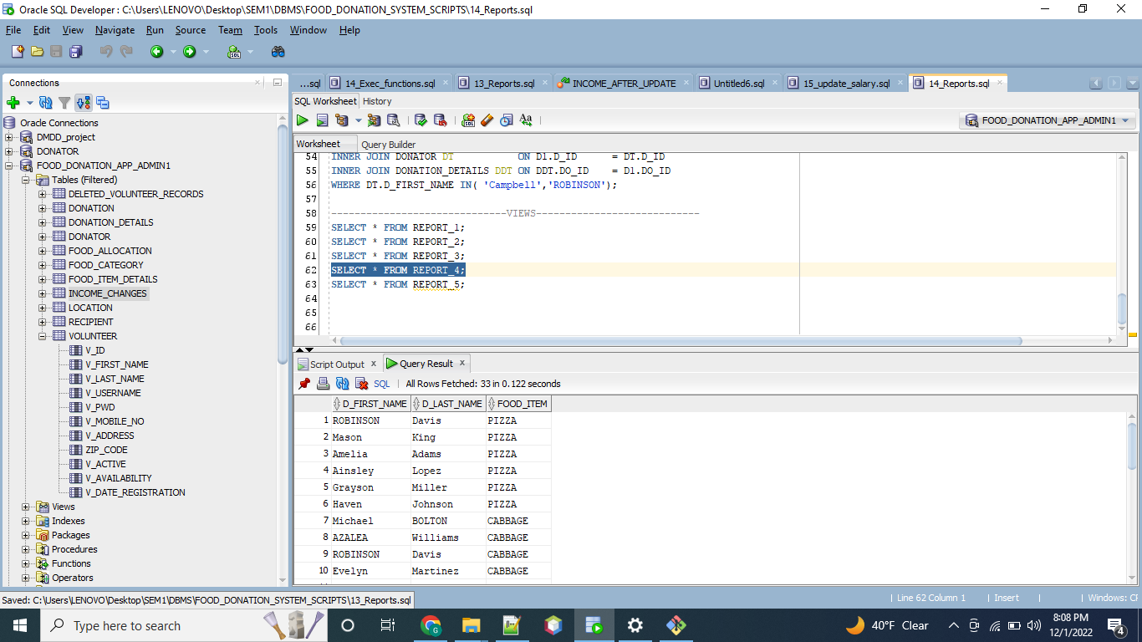

Slide 14
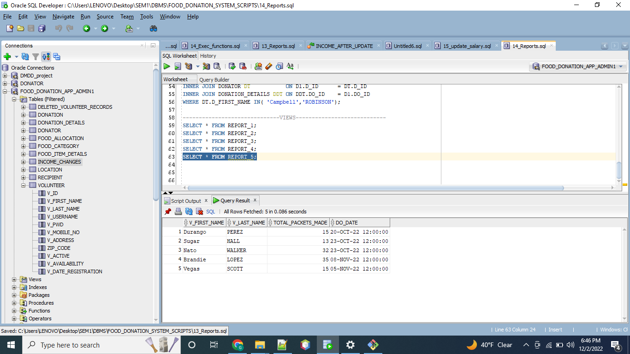

Slide 15

THANK YOU
tackle hunger

