Slide 1



Data-Driven Hotspot Identification
By Group -09
Vidhi Shiyani
Komal Dodiya
Aniket Patel

Slide 2


DATA SOURCE
https://opendata.cityofnewyork.us/
New York State Division of Criminal Justice Services (DCJS)

Slide 3
PROBLEM STATEMENT
To classify the hotspots in the New York State county where the number of criminals aged 18 or older is significantly higher, so that the government can implement measures to reduce the conversion rate of juvenile offenders.
We often hear about rising crime rates, but one of the biggest concerns is the transition of juvenile offenders into adult criminals. If we can identify where adult crimes are concentrated, we can better understand the environment influencing youth and take preventive action.

Slide 4

Why Dataset matters the most ?
1) Juvenile crime can turn into adult crime if early intervention is not applied.
2) Identifying High risk counties allows the government to focus resources.
3) Helps in designing Youth Programs, community support and policy strategies.
4) Data Driven Decision making makes crime inventions smarter and more effective.

Slide 5
ABOUT THE DATASET
Adult Arrests (18 and Older) by County – Beginning 1970
  Total Records: 3,410
  Time Period Covered: 1970 – 2024 (55 years of data)
  Geographic Coverage: 62 counties across New York State
  Population Group: Adults aged 18 years and older
  Observation Unit: County-Year combination (e.g., Albany–1970)

Slide 6
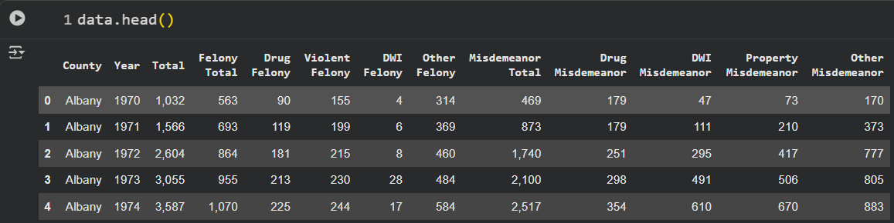
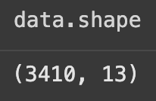
EXPLORING THE DATA
It shows sample values for Albany County from 1970–1974, helping to understand how arrest counts are distributed across different categories (felonies and misdemeanors).
The dataset contains 3,410 rows and 13 columns.
Each row represents arrest data for a specific county and year,
while the columns represent different offense categories and totals.

Slide 7

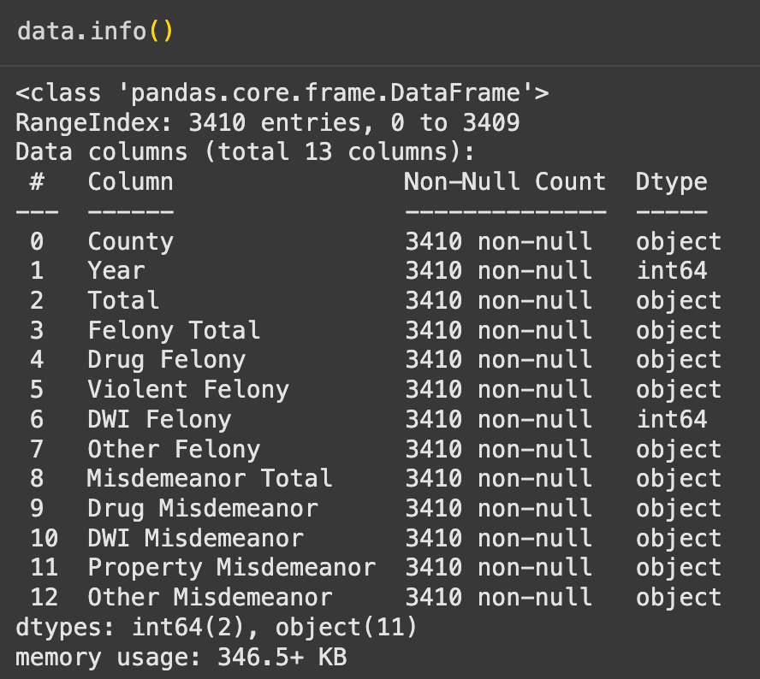
EXPLORING THE DATA
The summary shows the data types, non-null counts, and memory usage.
It reveals that there are no missing values, but most columns are stored as objects (strings) instead of numeric types—indicating the need for data cleaning before analysis.

Slide 8
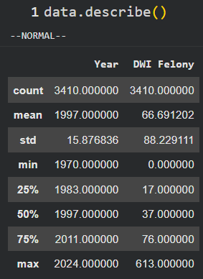
EXPLORING THE DATA
This table gives descriptive statistics of dataset. Total records of 3410, The average number of DWI felony cases is around 67, but the maximum goes up to 613, showing a very high variation across counties.
This tells us that some counties are extremely high crime zones compared to others, which is why hotspot classification is necessary.

Slide 9
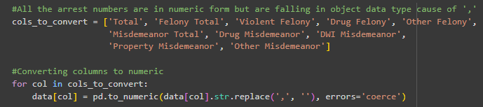
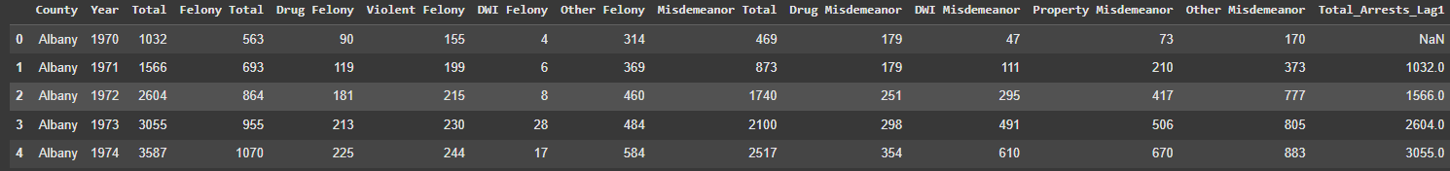
FEATURE ENGINEERING
We converted the features consisting of object data type into numeric data type by using the string replacement function.
Further we added a dummy column titled as ‘Total_Arrests_Lag1’, where the data of previous year’s Total is added for better accuracy of predictive models like cumulative frequency.

Slide 10
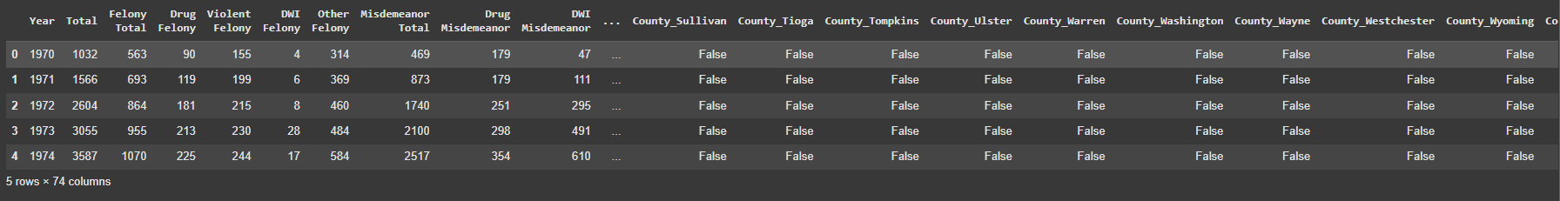
FEATURE ENGINEERING
We then used One-Hot Encoding method to create dummy features for all the counties and the dummy features we created are in boolean , basically it creates new Binary columns for each category.

Slide 11
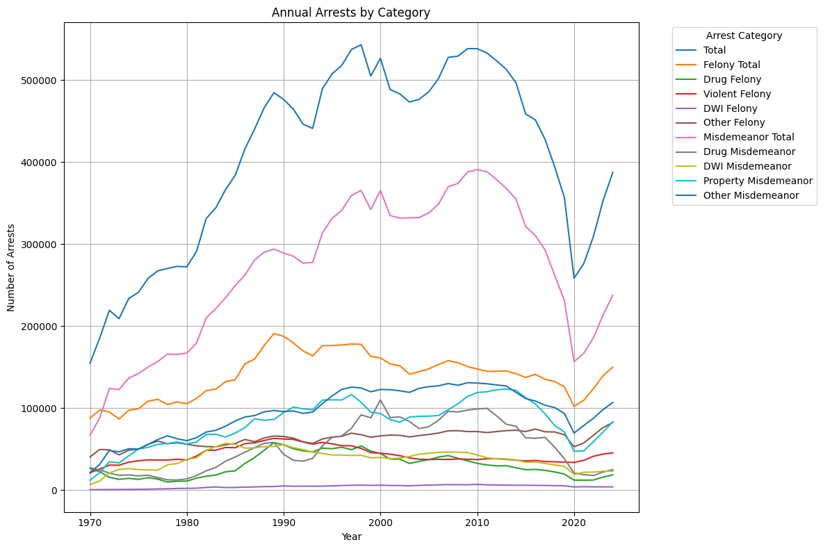
INITIAL VISUALIZATION
We grouped the data for all types of crime and total of all the years from 1970 - 2024 almost 54 years, to visualize it in a line graph for easier and better understanding.

Slide 12
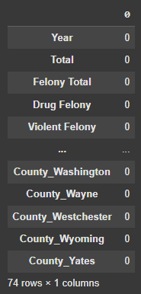
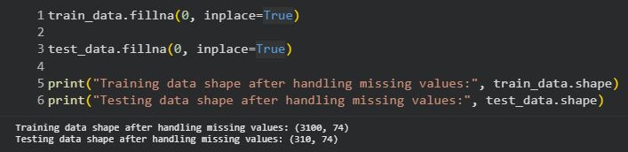
HANDLING MISSING VALUES
We then handled missing values in the data. We didn’t have any missing values as such but once we added the ‘Total_Arrests_Lag’ feature the value of it for the year 1970 became NaN for all counties which we replaced with ‘0’ using ‘fillna’ feature.

Slide 13

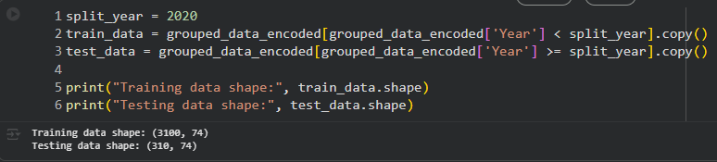
SPLITING DATA INTO TRAINING AND TESTING
Now, using the ‘train_test_split’ feature we split the data into training and testing datasets where data from 2020 to 2024 is taken in consideration for test case.

Slide 14
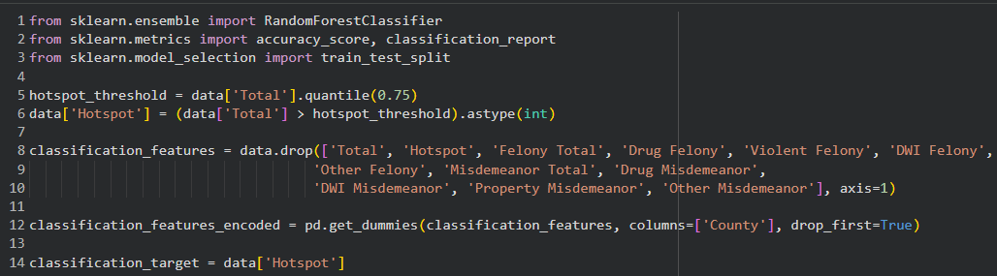
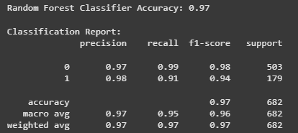
RANDOM FOREST CLASSIFIER
We used Random Forest Classifier model as a complex model for classification and were able to achieve an accuracy of 0.97 along with recall of 0.99.

Slide 15
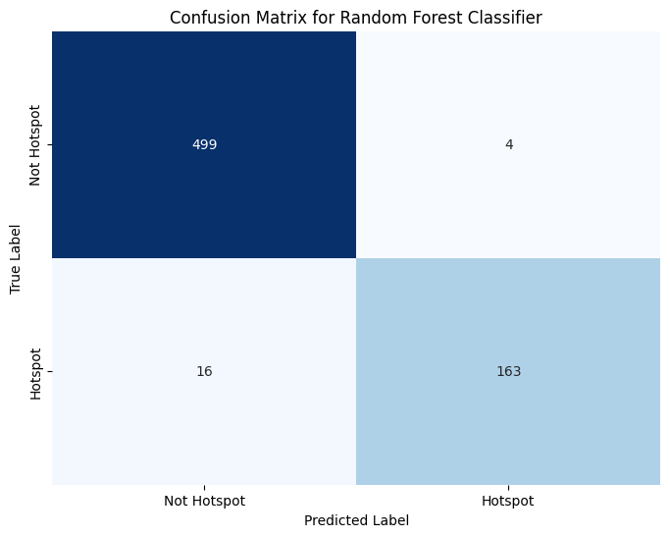
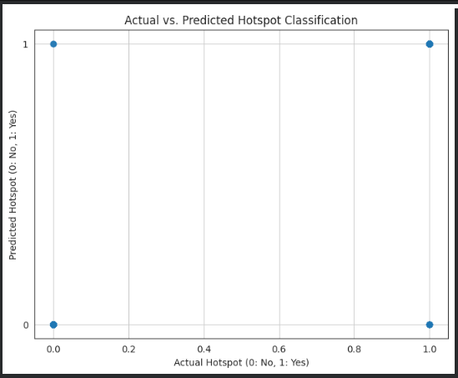
RANDOM FOREST CLASSIFIER
We can clearly see the efficiency of the random forest model through the confusion matrix visualization. Only 20 samples were misidentified from which we can state that the model is highly efficient for our dataset and problem statement.

Slide 16
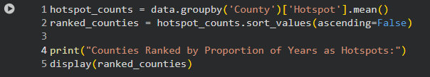
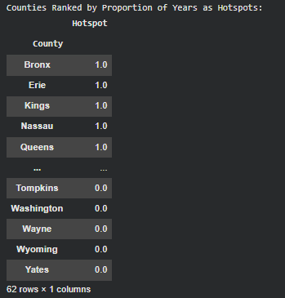
Counties Ranked by Proportion of Years as Hotspots
This table displays New York counties ranked based on how often they were identified as crime hotspots over the years.
“Hotspot value 1.0” means the county was a hotspot every year in the dataset (100% of the time).
“Hotspot value 0.0” means the county was never a hotspot in any year.
This helps us clearly identify regions that are chronically high-risk vs consistently safe, giving policymakers a priority list for interventions.

Slide 17
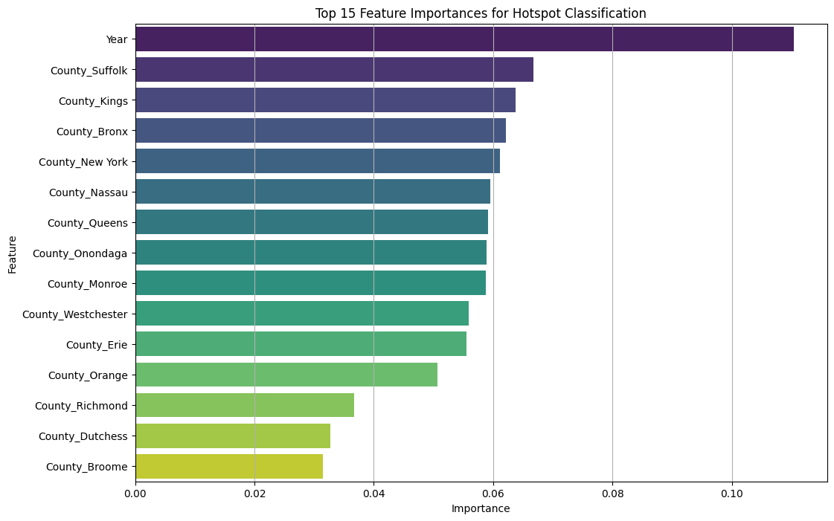
FEATURE IMPORTANCE OF RFC
Here’s the feature importance graph for the top 15 features as per the random forest classifier.

Slide 18
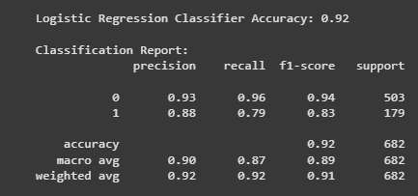
LOGISTIC REGRESSION
We used Logistic Regression Classifier model as a simpler model for classification and were able to achieve an accuracy of 0.93 along with recall of 0.96.

Slide 19
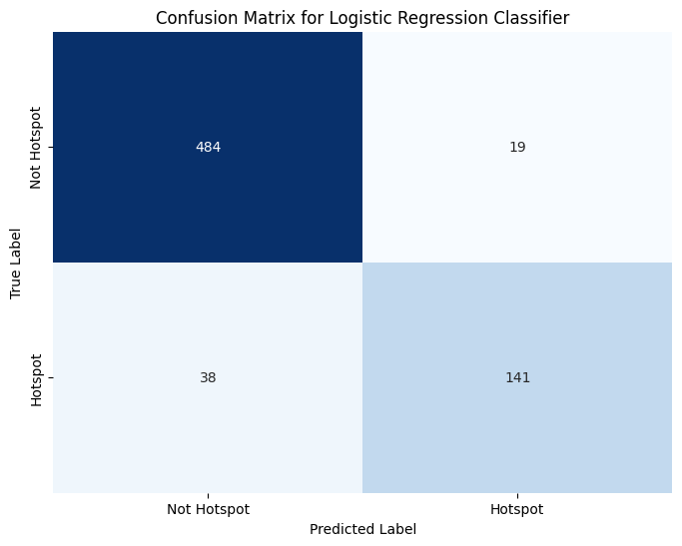
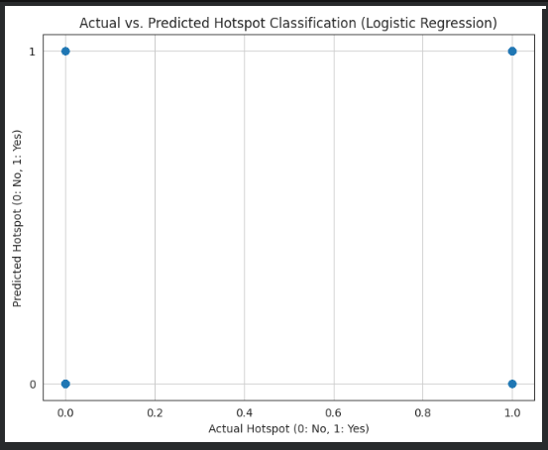
LOGISTIC REGRESSION
  We can clearly see the efficiency of the logistic regression model through the confusion matrix visualization. Only 50 samples were misidentified from which we can state that the model is efficient for our dataset and problem statement but not as efficient as the Random Forest Classifier.

Slide 20
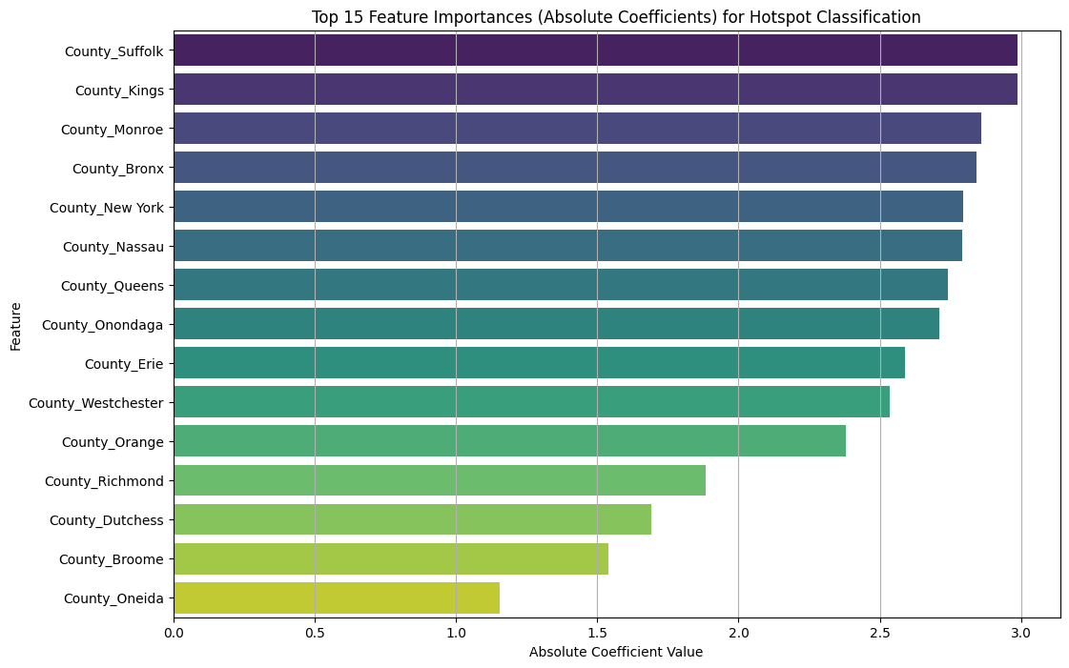
FEATURE IMPORTANCE OF LR
Here’s the feature importance graph for the top 15 features as per the logistic regression model.

Slide 21
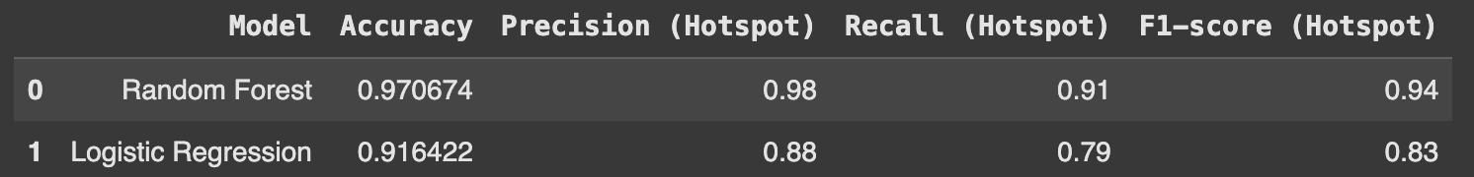
MODEL COMPARISON
Here’s the comparison of both the models that we used to identify the hotspot counties of New York state based on past records. We are clearly able to make out that Random Forest classifier works better for our dataset and problem statement.

Slide 22
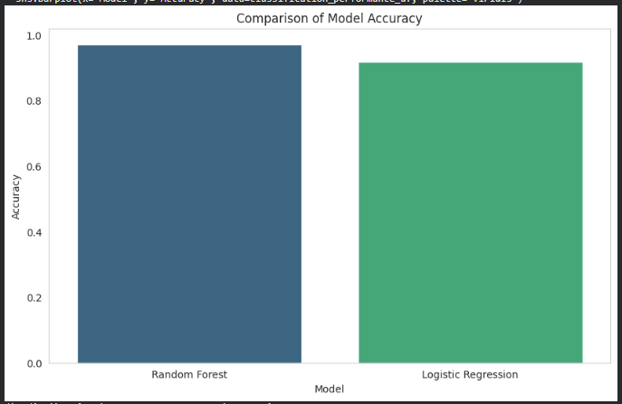
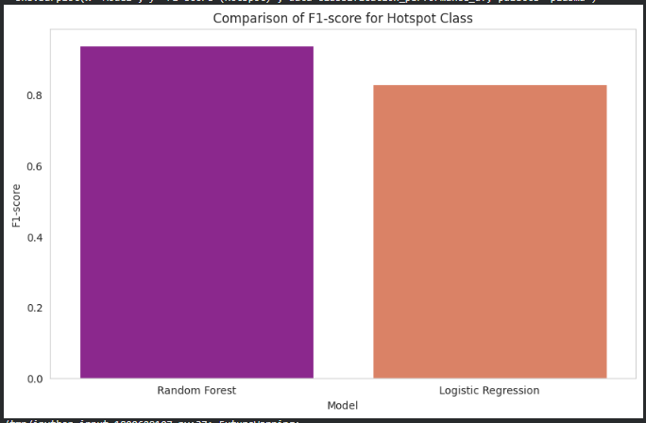
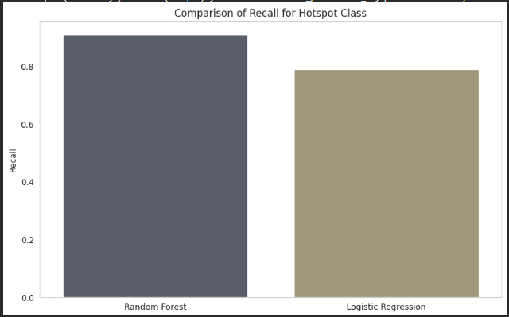
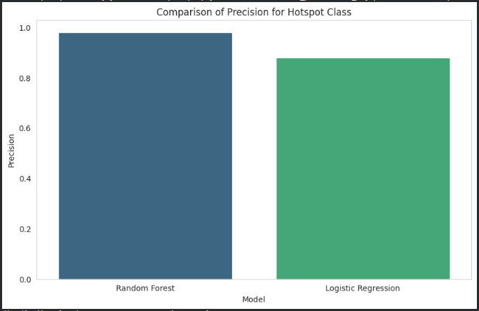

Slide 23
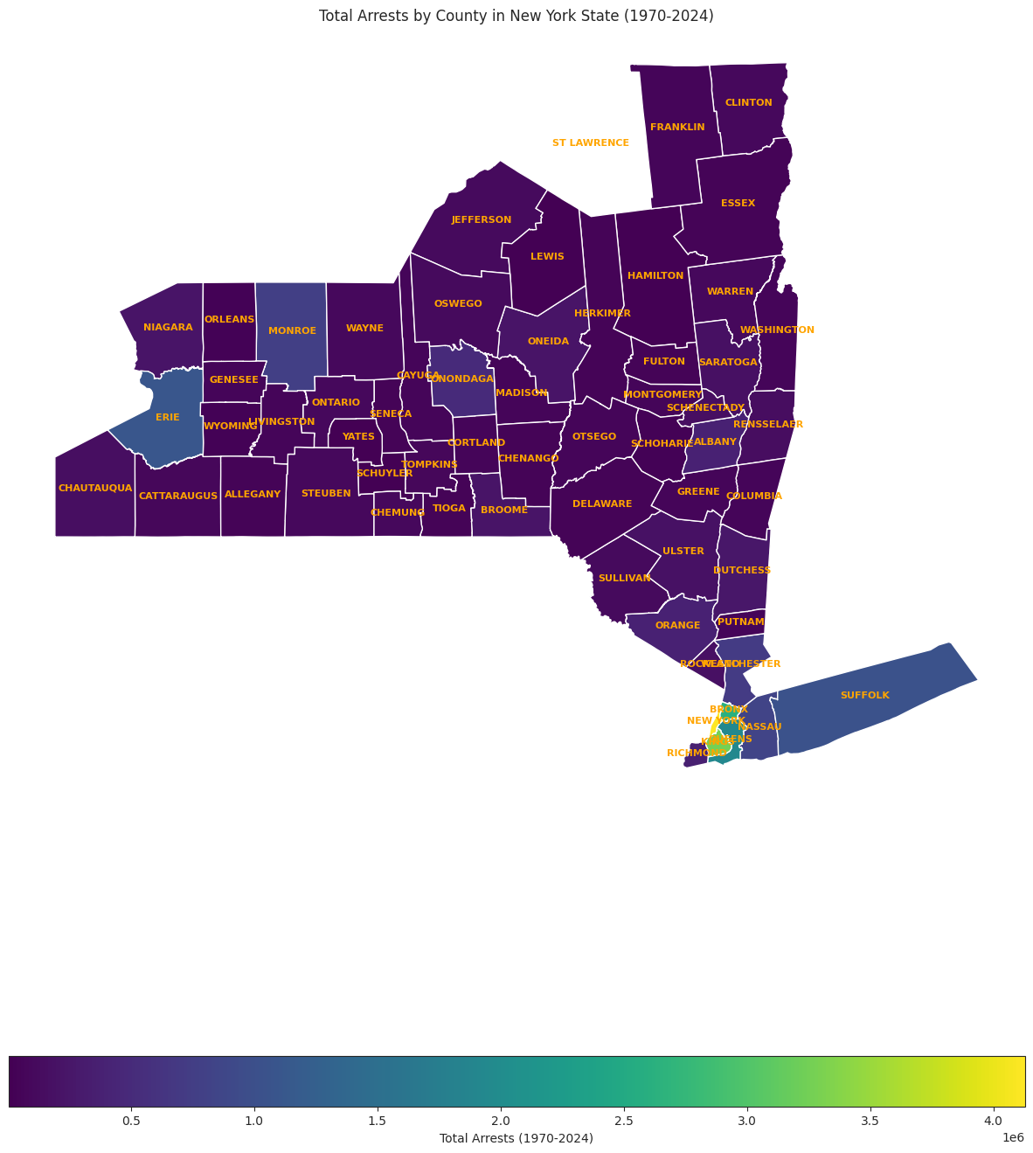
VISUALIZATION OF HOTSPOTS

Slide 24
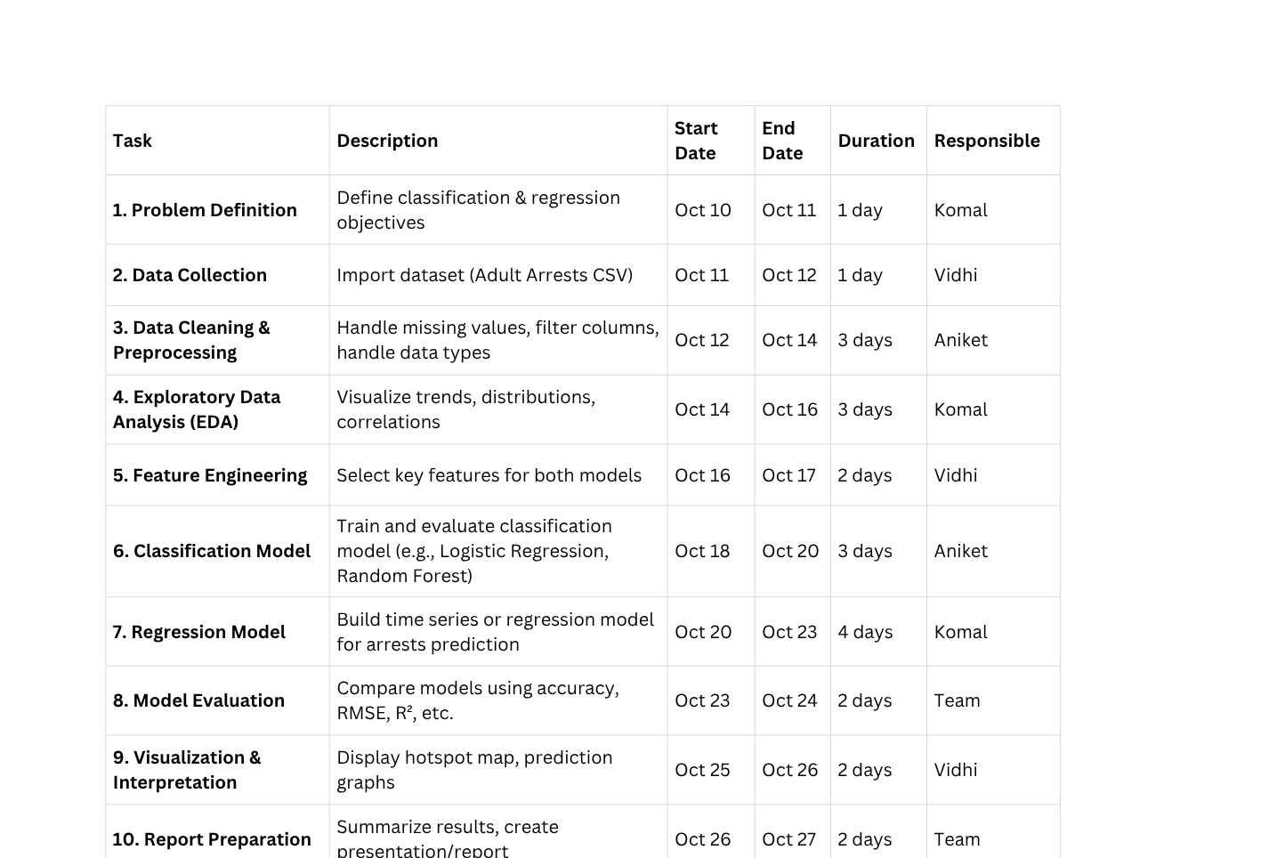
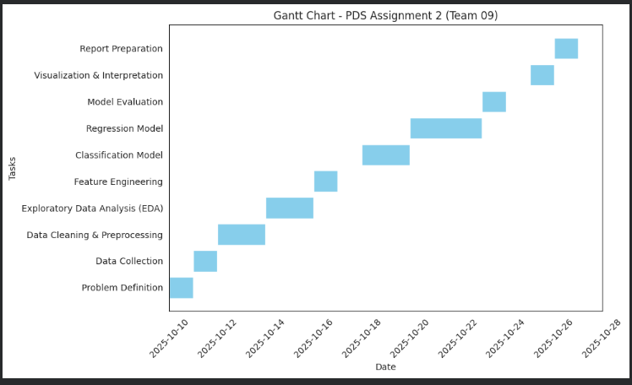
GANTT CHART STRUCTURE

Slide 25
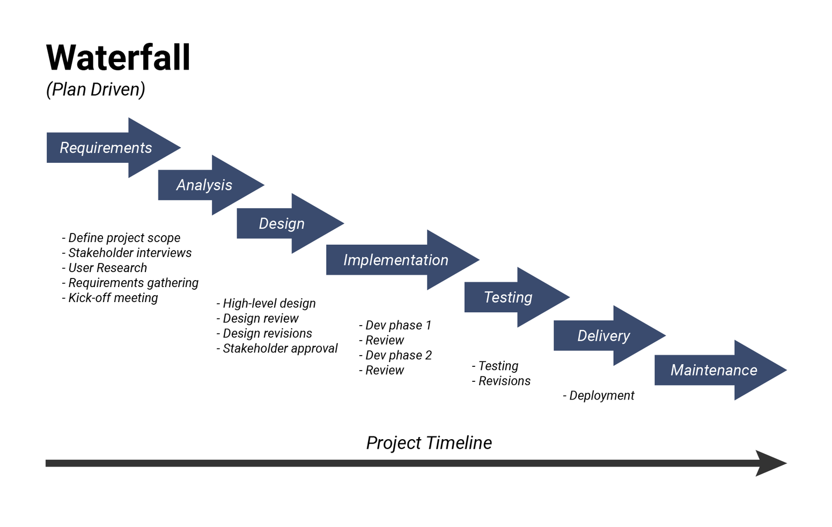
WATERFALL MODEL
YOUR PARAGRAPH TEXT

Slide 26
THANK YOU !

