Slide 1
Email Parser And Summarizer
Guide: Mr. K Ravi Kumar
Komal Soni 18E51A0565
M S Laksh 18E51A0571
Pragya Kumari 18E51A0594
T A Pranav 18E51A05B1
Notes:
1

Slide 2
ABSTRACT
With rapidly expanding technology and digitization, all kinds of information are being communicated via emails.
Emails are massively used for advertisement, meeting schedules, newsletters, banking purposes, and many such reasons.
It becomes difficult to go through each mail and read its content, especially for people who have a busy life and cannot spare time reading emails.
With this project, we propose to create a system that accesses all emails for an email account and summarizes emails and provides a simple view of summarized emails in order to save time and effort.
We have used Natural Language Programming (NLP) for this project in order to summarize emails and also created a web page for the same.
Notes:
2

Slide 3
INTRODUCTION
For parsing and summarization of emails we have used two concept one is NLP(Natural language processing) and other one is SMTP(Simple Mail Transfer Protocol)
SMTP:
SMTP is a set of communication guidelines that allow software to transmit an electronic mail over the internet.
The main purpose of SMTP is used to set up communication rules between servers. The servers have a way of identifying themselves and announcing what kind of communication they are trying to perform. They also have a way of handling the errors such as incorrect email address. For example, if the recipient address is wrong, then receiving server reply with an error message of some kind.
NLP:
Natural language processing (NLP) is the ability of a computer program to understand human language as it is spoken and written -- referred to as natural language. It is a component of artificial intelligence (AI).
Text summarization in NLP is the process of summarizing the information in large texts for quicker consumption.

Slide 4
LITERATURE SURVEY
Email parsing isn't simple, we need to look at an email and pull out the exact bits of data needed. Many email parsing tools exist in the market few of these tools are:
Mailparser for quickly setting up powerful email parsing rules
Email Parser by Zapier for an entry-level parser for Zapier users
Email Parser for a native Windows email parsing tool
Parseur for parsing email attachments
SigParser for scraping email signatures
We plan to provide a email parsing solution along with summarized email body for quick review via a web application.
Notes:
4

Slide 5
HARDWARE REQUIREMENTS
Processor : Any Processor above 500 MHz
RAM : 4 GB
Hard Disk : 500 GB
System : Pentium IV 2.4 GHz
Any system with above or higher configuration is compatible for this project

Slide 6
SOFTWARE REQUIREMENTS
Operating system : Windows 7/8/9/10
Programming language : Python 3
IDE : google collab
Tools : Anaconda

Slide 7
MODULES
1. Hardware Procurement: We have used the appropriate system configuration which is compatible for this project .
2. Software Configuration: Used and also installed streamlit and relevant python libraries
3. Coding:- We have used Python3 in our coding module.
4. Testing & debugging:- Testing and debugging of code until we got the error free output.
5. Deployment :-All the summarized mails are consolidated into a web application.

Slide 8
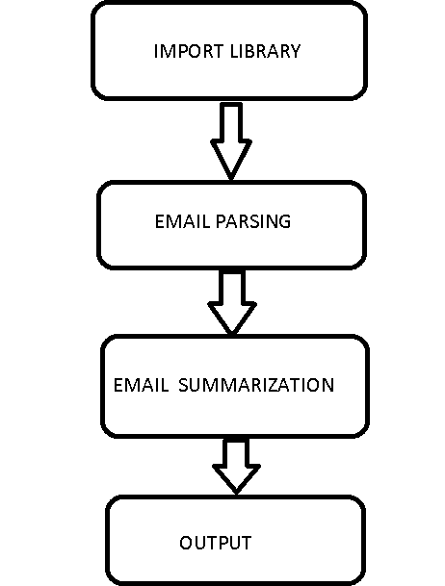
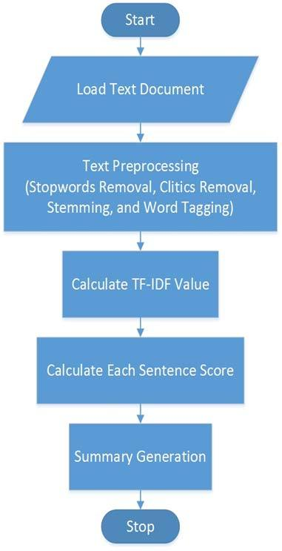
METHODOLOGY
Email Parsing and Summarization
Summarization

Slide 9
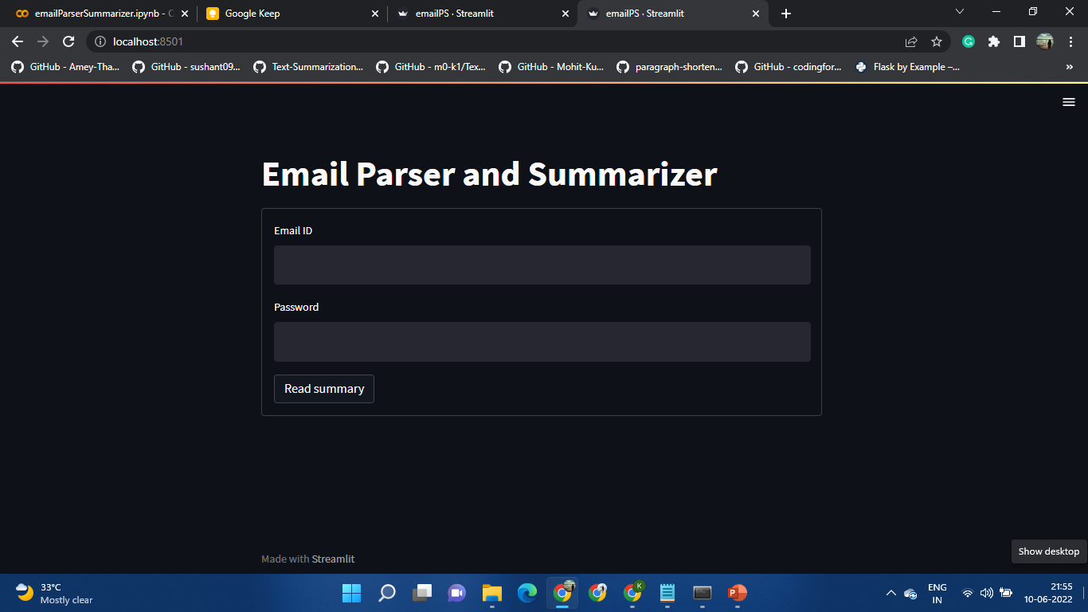
RESULTS

Slide 10
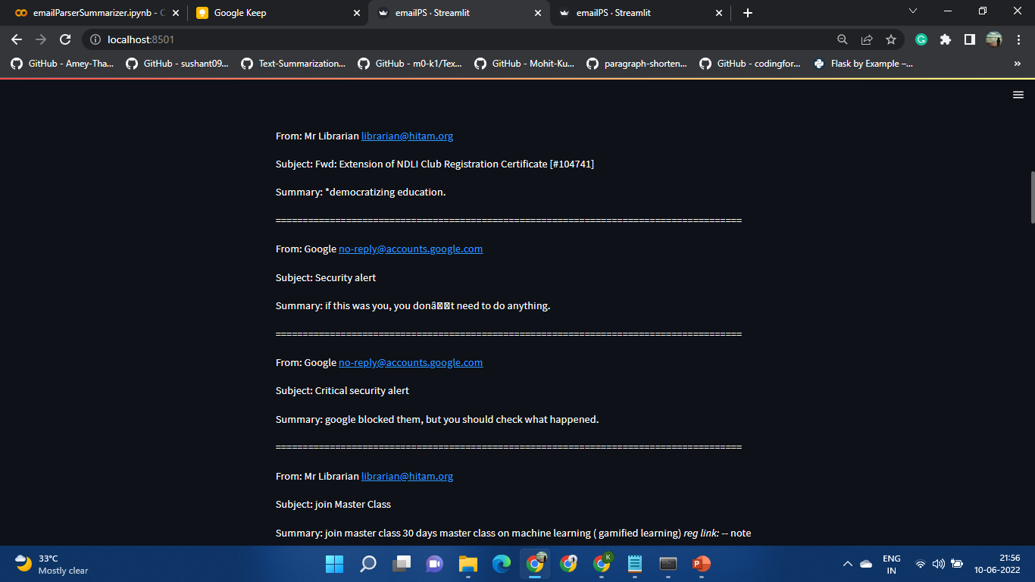
RESULTS

Slide 11
CONCLUSION
In this project we have created an email parser and summarizer. We have used NLP and SMTP implemented in python3 and relevant frameworks. Using NLP email summarization is done .With the help of streamlit python module we have a created a webpage which hosts the emails in its summarized form. It is used and tested by our teammates, we have found it to be very useful and time saving. Hence this email parser and summarizer creates a deep impact on everyday work life.
With this we have created a system that access all emails for an email account and summarizes email with saves time and effort.

Slide 12
FUTURE WORK
The future scope of our project might include:
Fully developed and deployed web application
Functional mobile application
Additional features inclusions such as filters and search options

Slide 13
REFERENCES
https://www.cs.cmu.edu/~wcohen/postscript/email-2004.pdf
https://zapier.com/blog/best-email-parser/
https://www.researchgate.net/publication/221333883_Advances_in_Deep_Parsing_of_Scholarly_Paper_Content/link/02bfe5127cf253bdc1000000/download
https://www.thinkautomation.com/eli5/what-is-an-email-parser-and-why-do-i-need-one/
https://www.researchgate.net/publication/2560392_Exploiting_E-mail_Structure_to_Improve_Summarization
https://www.researchgate.net/publication/221023411_Summarizing_email_conversations_with_clue_words
https://aclanthology.org/2021.acl-long.537.pdf
https://ijcsmc.com/docs/papers/February2014/V3I2201488.pdf
https://arrow.tudublin.ie/cgi/viewcontent.cgi?article=1220&context=scschcomdis
https://www.academia.edu/19833687/Auto_Summarization_of_Email_Document_Using_Statistical_Approach

Slide 14
Queries?

Slide 15
Thank You

