Slide 1
Expressjs

Slide 2
Express is a fast, assertive, essential and moderate web framework of Node.js.
You can assume express as a layer built on the top of the Node.js that helps manage a server and routes.
It provides a robust set of features to develop web and mobile applications.

Slide 3


Installation

Slide 4
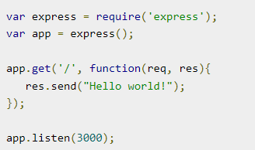

The first line imports Express in our file, we have access to it through the variable Express.
We use it to create an application and assign it to var app.
This function takes an object as input and it sends this to the requesting client.

Slide 5

Express.js Routing
It determines the specific behavior of an application.
It specifies how an application responds to a client request to a particular route, URI or path and a specific HTTP request method (GET, POST, etc.).
It can handle different types of HTTP requests.

Slide 6
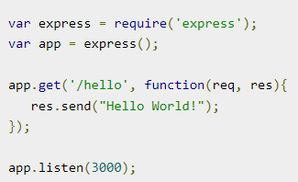
If we run our application and go to localhost:3000/hello, the server receives a get request at route "/hello", our Express app executes the callback function attached to this route and sends "Hello World!" as the response.

Slide 7
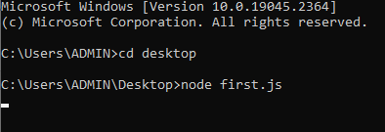
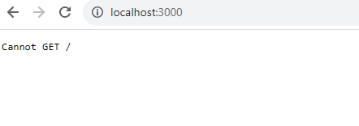
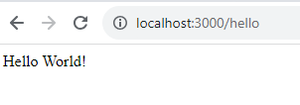
OUTPUT:

Slide 8
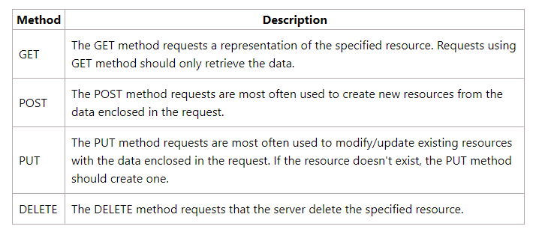
HTTP Methods

Slide 9
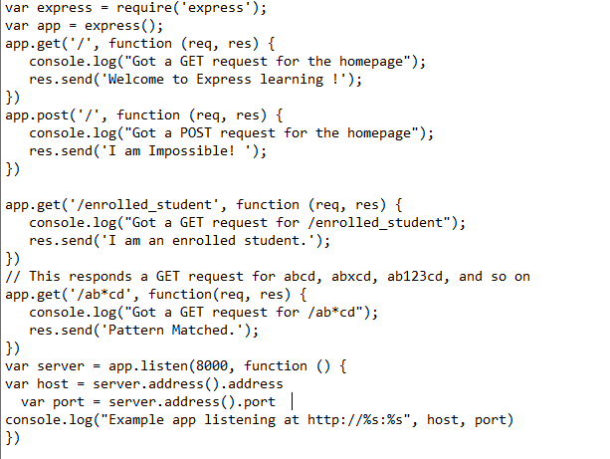
Get

Slide 10

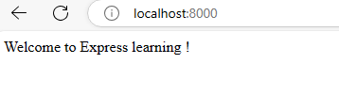



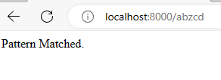


Slide 11
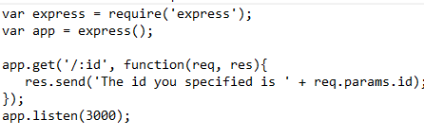

URL binding
We can now define routes, but those are static or fixed.

Slide 12
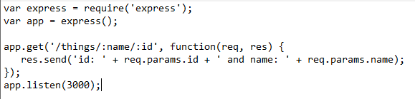


Slide 13
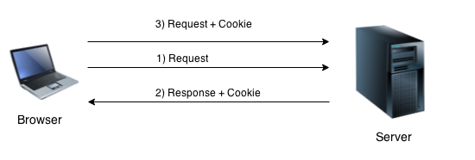
What are cookies??
Cookies are small piece of information i.e. sent from a website and stored in user's web browser when user browses that website.
Every time the user loads that website back, the browser sends that stored data back to website or server, to recognize user.

Slide 14
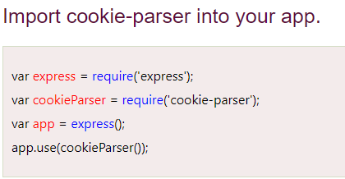
Install cookie To use cookies with Express, we need the cookie-parser middleware. To install it, use the following code −

Slide 15
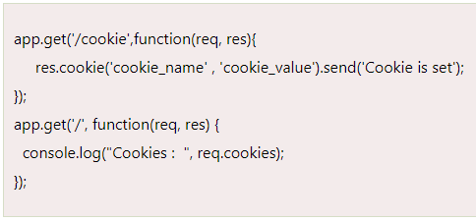
Define a root
Cookie-parser parses Cookie header and populate req.cookies with an object keyed by the cookie names.

Slide 16
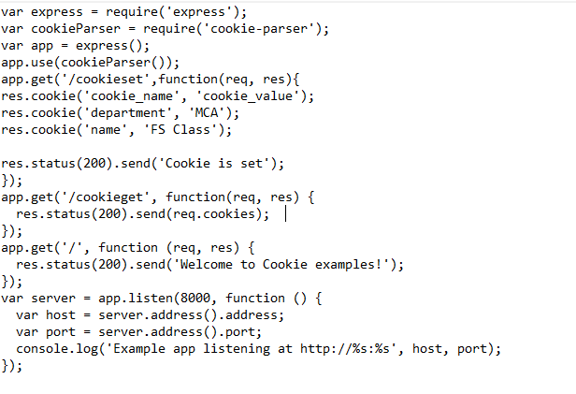

Slide 17

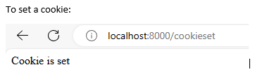
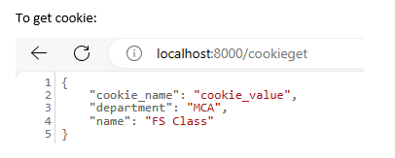

Slide 18
Sessions in Expressjs
Why do we need session?
Before we start, we have to ask why do we need session.
The reason is that HTTP protocol is stateless, which means it cannot keep track of user.
To solve this problem, the server can create a session for tracking the user, including the data in the requests and responses between the client and server.

Slide 19
A session comes into action when a client makes a request to the server, a server then creates a session with a unique ID sent to the user as a response as cookies and stored on their browser and the session server created is stored in the server.
Next time when the same user comes, the session unique ID attached to the user will also come and the server knows that this user is the same user as the previous one.

Slide 20

express-session Module in Node.js

