Slide 1
Working with css in React

Slide 2
4 ways
Inline Styling
CSS Stylesheet
Styled Components

Slide 3
1. Inline Styling
Within the App.jss
Remember styling is written inside two sets of curly braces {{}}.
programs\inline css.txt
programs\css with class component.txt

Slide 4
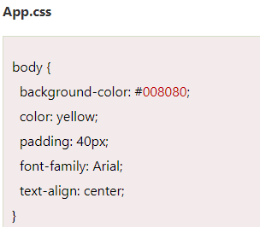

2. CSS Stylesheet
Write a styling part as a separate file with .css extension
Import it in your application

Slide 5
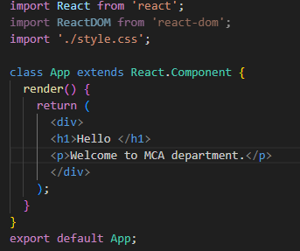

Slide 6
3. Styled Components
Styled-components is a library for React. It uses enhance CSS for styling React component systems in your application, which is written with a mixture of JavaScript and CSS.
The styled-components provides:
Automatic critical CSS
No class name bugs
Easier deletion of CSS
Simple dynamic styling
Painless maintenance

Slide 7

we create a variable by selecting a particular HTML element such as <div>, <Title>, and <paragraph> where we store our style attributes.
Now we can use the name of our variable as a wrapper <Div></Div> kind of React component.

Slide 8

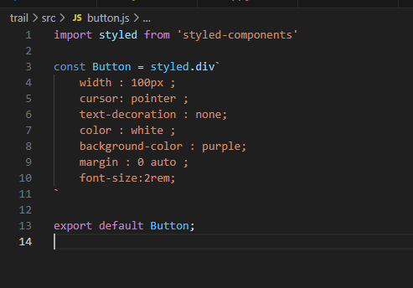

Slide 9
