Slide 1
React Components

Slide 2
Definition
Components are the core building block of react application.
Basically react component is a small and reusable piece of code that represents the user interface.
It is similar to a JavaScript function which returns HTML.
We can define components by two approaches first is called a class component and the second is called a functional component.
React team recommends that a new application should be created using the functional component.

Slide 3
Functionals Component
A functional components are simple JavaScript function that returns HTML
HOW to create???????????

Slide 4
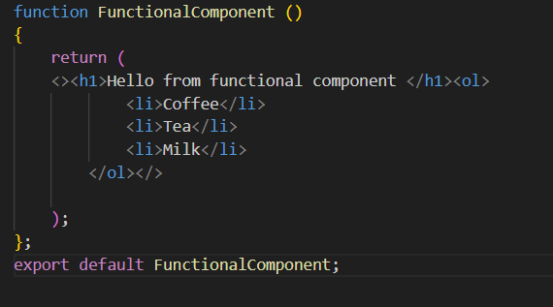
Steps:
create a new js file in the src folder suppose the name is FuncationalComponent.js
Add the code required to create functional component
import React from ‘react’;

Slide 5
Then we have to export the component to use this component where we want that.
The functional component is also known as the stateless component because We can not use state directly in functional components.
Import the functionalcomponent.js file in app.js
Run the program

Slide 6
Class component
A class component is created by using the class keyword and needs to extends the component from react.
We have created a new js file in the src folder let's say the name of the file is ClassComponent.js
We have created a class Class Component and it requires to render method to return HTML.
Then we have to export the component to use where we want that.
We can use state and constructor in the class component so it's also known as a stateful component.

Slide 7
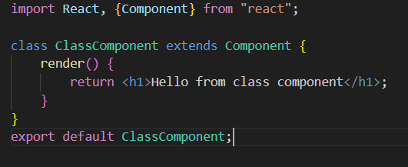
Class.js

Slide 8
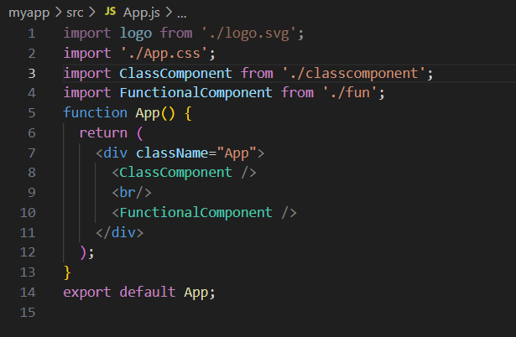
App.js

Slide 9
Props in react
Props-Properties
Props are used to pass data from one component to another component as parameters and by using props we passed data from the parent to the child component(unidirectional flow).
props are read-only (immutable) and they can not change in component.

Slide 10
Function.js
import React from "react";
function FunctionalComponent(prop)
{
return (
<h1>This is {prop.name} (Address- {prop.address} Age- {prop.data.age} Department- {prop.data.dept}) </h1>
);
};
export default FunctionalComponent;

Slide 11
Class.js
import React, {Component} from "react";
class ClassComponent extends Component {
render() {
return <h1>This is {this.props.name} (Address- {this.props.address} Age- {this.props.data.age} Department- {this.props.data.dept}) </h1>;
}
}
export default ClassComponent;

Slide 12
App.js
import FunctionalComponent from './FunctionalComponent'
function App() {
return (
<div className="App">
<ClassComponent name=“Meghana" address="India" data={{age:21,"dept":"IT"}} />
<br/>
<FunctionalComponent name="Pavan" address=“MSRIT" data={{age:22,"dept":“MCA"}} />
</div>
);
}
export default App;

Slide 13
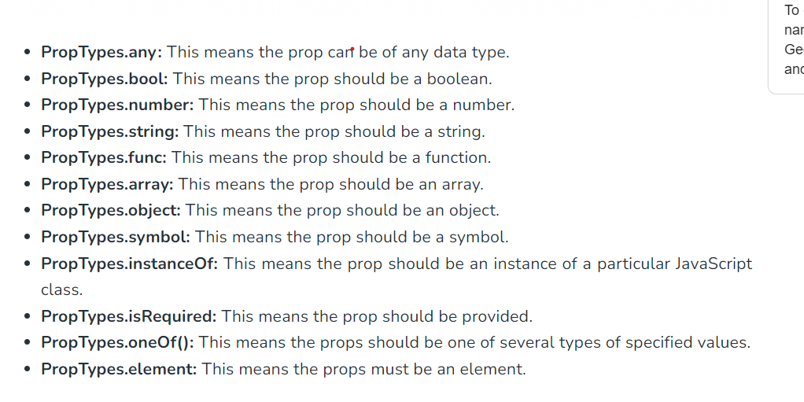
Props validation

