Slide 1


SmartFlow: Prioritize Emergency Vehicle and Traffic Rules Monitoring System
Presented By
Guide
Abhishek K L
1MS22MC016
Komal S Kallanagoudar
Dept MCA
MCA41
Project work
Assistant Professor

Slide 2

Problem Statement
The challenge is to design a SmartFlow System integrating camera technology for traffic monitoring and efficient prioritization of emergency vehicles through traffic lights.

Slide 3
Introduction
Strengthen traffic monitoring efforts with camera technology.
Adaptive traffic signal systems adjust signal timings to minimize waiting times and reduce idling.
The emergency vehicle is detected, which gives ambulances priority to pass through traffic lights
Notes:
For point 2 Reducing congestion and energy consumption at intersection.

Slide 4
Objectives
Reducing congestion and energy consumption at intersection.
Emergency vehicle prioritization.
Traffic rule violation monitoring system

Slide 5

Literature survey
Technology | Description | Advantages | Disadvantages
Manual traffic control management | Manual traffic control management involves the direct intervention of traffic personnel or officers to regulate the flow of vehicles and pedestrians at intersections, road junctions. | 1.Easy to implement 2.Less chances of error due to human involvement | 1.Time Consuming 2.It is possible that accidents happen on the crossings 3.Chances of conflicts are very high Emergency vehicles have only one human to communicate
Infrared Sensor (IR) | Roadside sensors will detect density at a particular lane. Whenever any lane is crowded than other lanes then that busy lane will get more time to pass the vehicle. | 1.By detecting the density at each lane, the system can dynamically adjust traffic signal timings to allocate more green time to congested lanes | 1.Initial setup cost is high 2.An emergency cannot be automated and normally requires human intervention.

Slide 6

Literature survey
Technology | Description | Advantages | Disadvantages
Ultrasonic sensors | Array of ultrasonic sensors equipped at roadside for monitoring traffic levels. Roadside sensors are detecting vehicles and find the traffic level at that lane. The data sensed continuous and send to controller for detecting traffic levels | 1.Based on the traffic levels detected by the sensors, traffic signal timings can be dynamically adjusted to optimize traffic flow and reduce congestion. | 1.The range of ultrasonic sensors is limited, which may require multiple sensors to cover larger area, increasing installation and maintenance costs.
RFID Tag | When the ambulance is detected by the help of RFID tag the green signal is given for the ambulance so it can reach hospital soon. | 1.The system ensures that ambulances can reach their destination quickly, reducing response times and potentially saving lives. | 1.The effectiveness of the system relies heavily on the reliability of technology components such as sensors, communication networks, and traffic control algorithms

Slide 7
Gaps Identified
In the existing system fails to control the traffic congestion.
Fails in reducing congestion and energy consumption
Fails to prioritize emergency vehicles.
Dealing with traffic is common among all the papers mentioned.

Slide 8
Modules
SmartFlow
Congestion Control
Emergency Vehicle Prioritization
Traffic Rules Monitoring

Slide 9
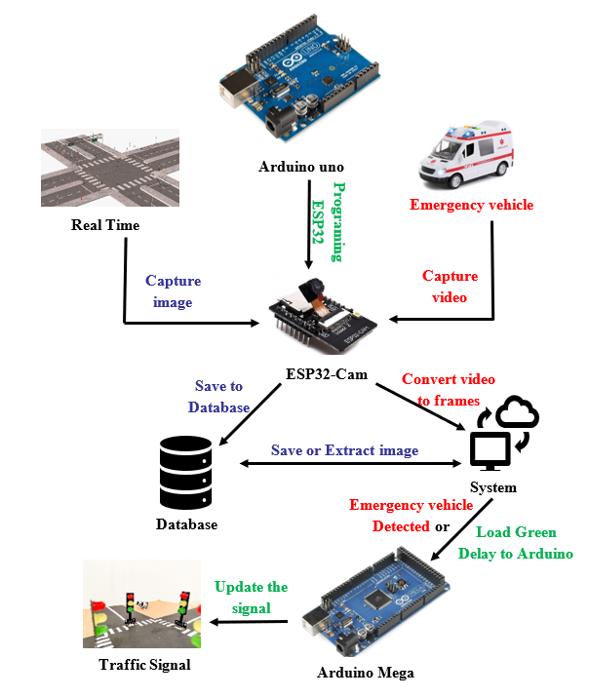
Architecture Diagram
SmartFlow system architecture that integrates various components to optimize traffic management and enhance road safety

Slide 10
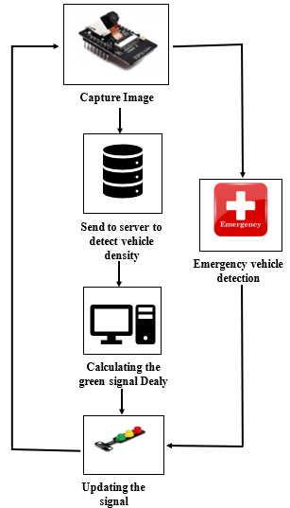
Data Flow Diagram
The camera captures the image and store it in the server
YOLO algorithm processes the image and detect the congestion and calculate the green signal timing
If there is any emergency vehicle is arriving towards the traffic junction it is detected by YOLO algorithm green signal is turned on for the emergency vehicle

Slide 11
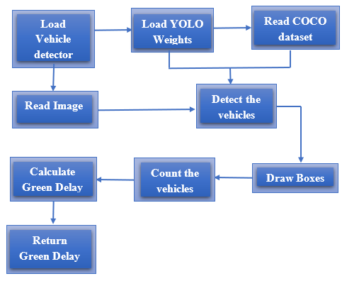
Congestion Control
To implement SmartFlow system using the technologies like, Image Processing and Vehicle Detection. The Image Processing module, utilizing OpenCV, captures traffic scenes.
YOLO algorithm is uses these images and detect the vehicles and count the number of vehicles, so that the green delay can be calculated based on number of vehicles to over come with problem of congestion and reduce the waiting time.
Green_delay = $\frac{(L+\left(vehicle_{count}−1\right)∗(L+G)}{v}$ - - - - -> equation(1)
Green_delay = ((𝑳+(𝒗𝒆𝒉𝒊𝒄𝒍𝒆_𝒄𝒐𝒖𝒏𝒕−𝟏)∗(𝑳+𝑮))/𝒗 - - - - -> equation(1)

Slide 12
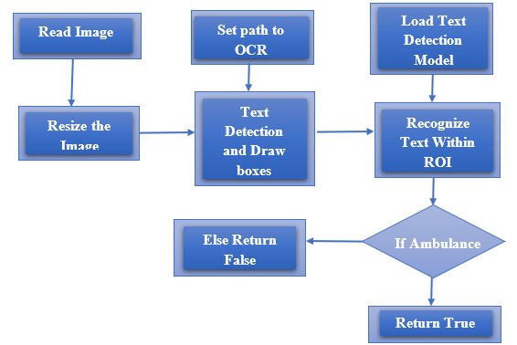
Emergency Vehicle Prioritization
EAST text detection module is used to detect the emergency vehicle by detecting. As soon as the vehicle is detected the green signal is given to the ambulance so that it does not experience any traffic and reach the hospital soon and save the lives.

Slide 13
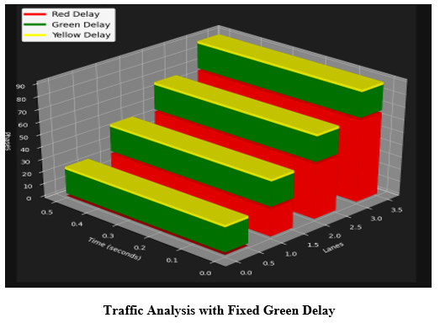
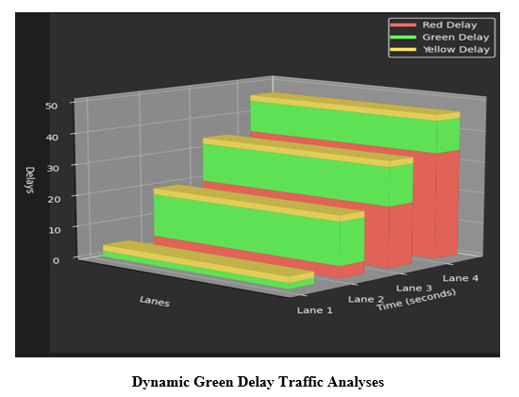
Results and discussion
Green_delay = $\frac{(L+\left(vehicle_{count}−1\right)∗(L+G)}{v}$ - - - - -> equation(1)
The vehicle counts for lanes 1 to 4 are 3, 15, 20, and 18, respectively.
Using the equation (1), the green delays for the lanes are calculated as 1.9, 14.5, 13.8, and 12.4 seconds, respectively.
The total green delay across all lanes sums up to 42.6 seconds. Adding a yellow delay of 2 seconds per lane results in a total time of 50.6 seconds.
In contrast, if a fixed green delay of 20 seconds per lane is used, the total green delay for all lanes is 60 seconds. Including the yellow delay of 8 seconds across all lanes brings the total time to 68 seconds.

Slide 14

Reports
The YOLO algorithm detects the vehicles draws boxes around it and gives the count of vehicles.
The EAST text detection module is used to detect the text Ambulance

Slide 15
Conclusion
The proposed system SmartFlow will control the traffic congestion based on the density
It changes the signal timing intelligently according to traffic density on the particular roadside and regulates traffic flow by capturing the image.
The emergency vehicle is detected from an image taken by camera

Slide 16
Future Scope and Enhancement
Traffic Rule Violation Detection: Enhance the system with high-resolution cameras and license plate recognition to identify and notify drivers of traffic violations.
Accident Detection: Implement sensors and advanced image processing to detect real-time accidents.
Li-Fi Navigation: Introduce Li-Fi technology to guide ambulance drivers with real-time traffic updates for optimal route selection

Slide 17

References
Sunny Hossain and Farzana Shabnam researched on paper A Comparative Study of IoT Based Smart Traffic Management System published paper in IEEE International Women in Engineering (WIE) Conference on Electrical and Computer Engineering (2021) https://ieeexplore.ieee.org/document/9829636
Varsha Sahadev Nagmode and Prof.Dr.S.M.Rajbhoj researched on An IoT Platform for Vehicle Traffic Monitoring System and Controlling System Based on Priority published by IEEE in 2017 https://ieeexplore.ieee.org/document/8463825
Sabeen Javaid, Ali Sufian, Saima Pervaiz and Mehak Tanvee worked on Smart Traffic Management System Using Internet of Things published in International Conference on Advanced Communications Technology (2018) https://www.researchgate.net/publication/324464391_Smart_traffic_management_system_using_Internet_of_Things
Dr. Vikram Bali, Ms. Sonali Mathur, Dr. Vishnu Sharma, Dev Gaur researched on Smart Traffic Management System using IoT Enabled Technology, 2020 2nd International Conference on Advances in Computing, Communication Control and Networking (ICACCCN). https://ieeexplore.ieee.org/document/9362753
Prof. Deepali Ahir, Saurabh Bharade, Pradnya Botre, Sayali Nagane, Mihir Shah worked on Intelligent Traffic Control System for Smart Ambulance paper released in International Research Journal of Engineering and Technology (IRJET) Volume: 05 Issue: 06 June-2018. https://www.irjet.net/archives/V5/i6/IRJET-V5I675.pdf

Slide 18
References
Karthik B,Manoj M,Rohit R Kowshik,Akash Aithal,Dr. S. Kuzhalvai Mozhi worked on Ambulance Detection and Traffic Control System published by International Research Journal of Engineering and Technology (2019) https://www.irjet.net/archives/V6/i4/IRJET-V6I4239.pdf
S. Mahalakshmi a, T. Ragunthar b, N. Veena a, S. Sumukha a, Pranav R. Deshkulkarni a worked on Adaptive ambulance monitoring system using IOT Published by Elsevier Ltd (2022) https://www.sciencedirect.com/science/article/pii/S2665917422001891
Mohammad Moazum Wani, Samiya Khan, Mansaf Alam worked on IoT - Based Traffic Management System for Ambulances published by IEEE in 2005 https://arxiv.org/ftp/arxiv/papers/2005/2005.07596.pdf
Varsha Srinivasan, Yazhini Priyadharshini Rajesh, S Yuvaraj and M Manigandan worked on Smart traffic control with ambulance detection released in 2nd International conference on Advances in Mechanical Engineering (ICAME 2018) https://iopscience.iop.org/article/10.1088/1757-899X/402/1/012015/pdf
Mohammed Fayaz, Pooja K, Pranitha P Reddy, Swathi T worked onvDensity based Traffic Control System with Ambulance Detection released by International Journal of Engineering Research & Technology (2019) https://www.ijert.org/research/Density-based-Traffic-Control-System-with-Ambulance-Detection-IJERTCONV7IS08100.pdf

Slide 19
Thank You

