Slide 1
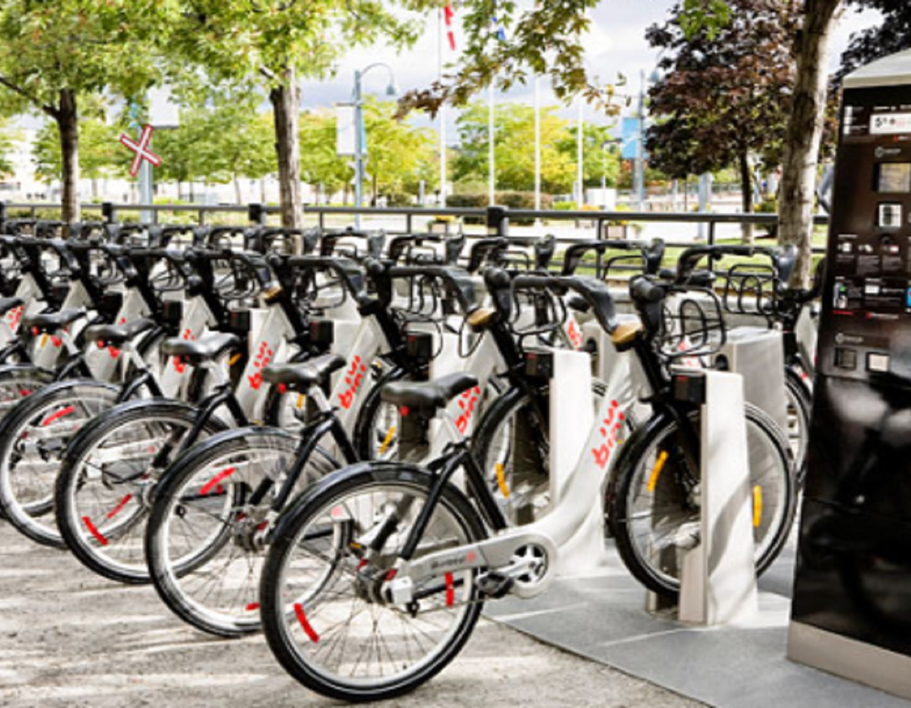
BIKE RENTAL DEMAND PREDICTION AND ANALYSIS
Project Team
Rakhi Jha - 89347
Neeru Jain - 94745
Komal Joshi - 94950

Slide 2

PROJECT DESCRIPTION
The objective is to forecast bike rental demand of Bike sharing program in Washington, DC based on historical usage patterns in relation with Season, Time, Stations and other data.
Using these Bike Sharing systems, people rent a bike from one location and return it to a different or same place on need basis. People can rent a bike through membership (mostly regular users/members) or on demand basis (mostly casual users).
This process is controlled by a network of automated kiosk across the city.

Slide 3
Hypothesis/ Trend Analysis:
Hourly trend There must be high demand during office timings. Early morning and late evening can have different trend (cyclist) and low demand during 10:00 pm to 4:00 am.
Daily Trend: Registered users demand more bike on weekdays as compared to weekend or holiday.
Rain: The demand of bikes will be lower on a rainy day as compared to a sunny day. Similarly, higher humidity will cause to lower the demand and vice versa.
Temperature: The temperature may have the positive correlation with bike rental.
Pollution: If the pollution level in a city starts soaring, people may start using Bike (it may be influenced by government / company policies or increased awareness).
Time: Total demand should have higher contribution of registered user as compared to casual because registered user base would increase over time.
Traffic: It can be positively correlated with Bike demand. Higher traffic may force people to use bike as compared to other road transport medium like car, taxi etc.

Slide 4
Business Understanding:
As a general approach to solve this kind of problem, we identified those variables(Independent Variables and dependent Variables) which can help in solving a business problem and add value to the business.
Accordingly, we research and found out what can be the factors responsible/required to achieve the result.

Slide 5
Data Exploration & Preparation:
We performed the deeper data analysis to identify the patterns & trends. This dataset shows hourly rental data of 12 months.
Our dataset has 12 attributes and 3 million observations. We have 4 separate Quarter files.
We concatenated 4 quarter files to analyze the data.
We have followed the below steps to achieve as part of Data Exploration and Variable Identification:

Slide 6
Independent and Dependent Variables/Target Variables
Independent Variables -
Datetime: Start & End Date & Hour in “mm/dd/yyyy hh:mm” format
Season: Four categories-> 1 = Spring, 2
= Summer, 3= fall, 4 = Winter
Weekday: All the days of the week
Stations: Start & End Stations names & numbers
Bike Numbers: bike number.
Dependent-Variables/Target Variable -
No of Registered User: Member Type - Member
Casual User: Member Type - Casual
No of rentals (registered +casual): Total number of counts of both Member & casual users.

Slide 7
Plotting
Histograms
Scatter Plot
Heat Map
Stack-Bar

Slide 8
Libraries used for Plots -
Matplotlib
Seaborn
Sci-kit learn
Pandas

Slide 9
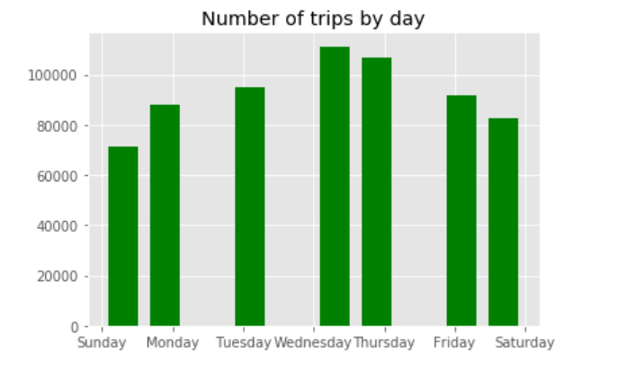
a. Univariate Analysis: Histogram
We have explored variables one by one to understand the distribution of each category.
This histogram shows the distribution of trips in a week.

Slide 10
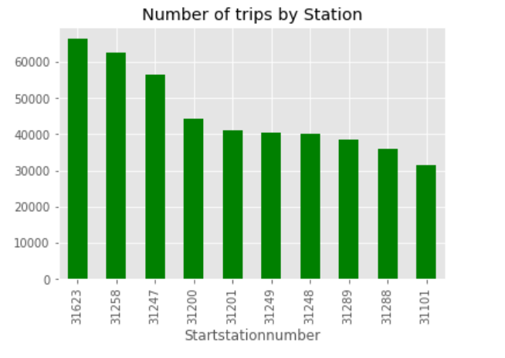
a. Univariate Analysis: Histogram
This histogram shows the station wise distribution of trips.

Slide 11
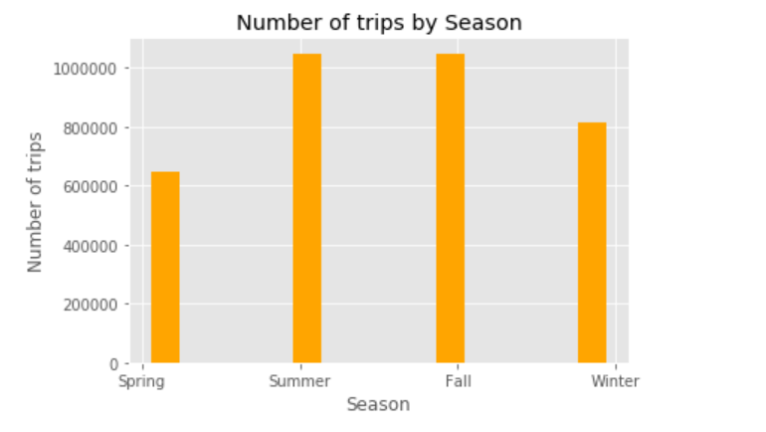
a. Univariate Analysis: Histogram
This plot shows the Season wise distribution of the trips.

Slide 12
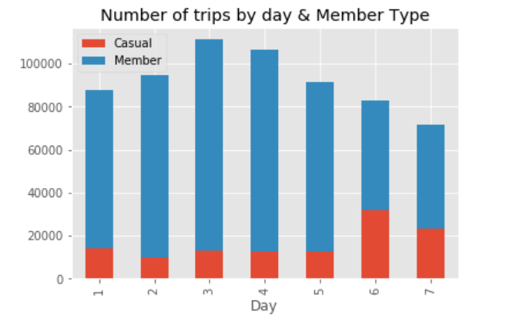
b. Bi-Variate Analysis: Stack-Bar
This box plot shows the distribution of trips between Non-member and member users.

Slide 13
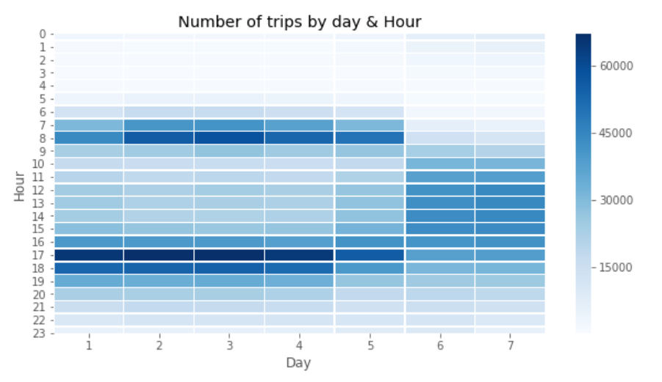
This explains the relationship between two variables.
b. Bi-Variate Analysis: Heat-Map

Slide 14
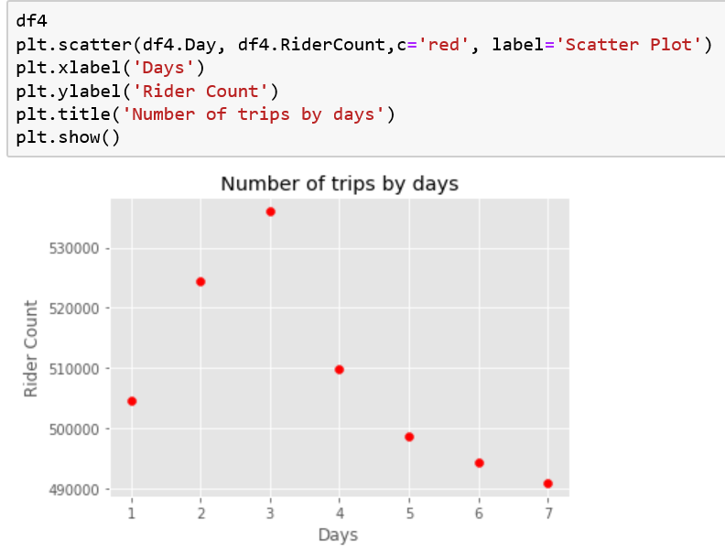
Univariate Analysis
Scatter plot to show the distribution of trip by days.

Slide 15
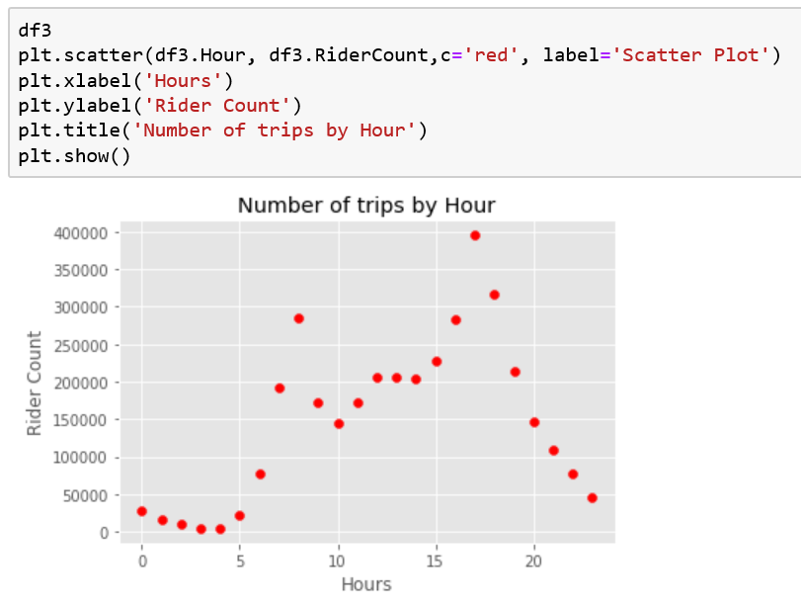
Univariate Analysis: Plotting Based on By hour:
Scatter plot to show the distribution of trip by hours in the day.

Slide 16
Data Analysis, Data Cleaning:
We cleaned the data to identified the missing values.
We also performed the transformation as the data variables given in the dataset were ‘string’ datatype. So, we converted them to Float and Integer Types.

Slide 17
Algorithm Selection and Model Training:
Explored more about data like its dimension, feature relevancy.
Made univariate/multi-variate plots to observe the distribution, scale, relationships (correlation) of attributes in data.
Identified the missing/null values in the dataset.
Data Cleaning :
We looked for data types of attributes (numerical/categorical), data inconsistencies (capitalization errors, spacing and other structural errors), remove unwanted outliers, handling missing data (removing, imputing).
Algorithms used for training and testing the model: Linear Regression and Decision Tree
Model Training –
Test Train split,
Accuracy
Does the model perform well across various metrics? (robustness) - Yes
Does it solve the original business problem? (win) - Yes

Slide 18
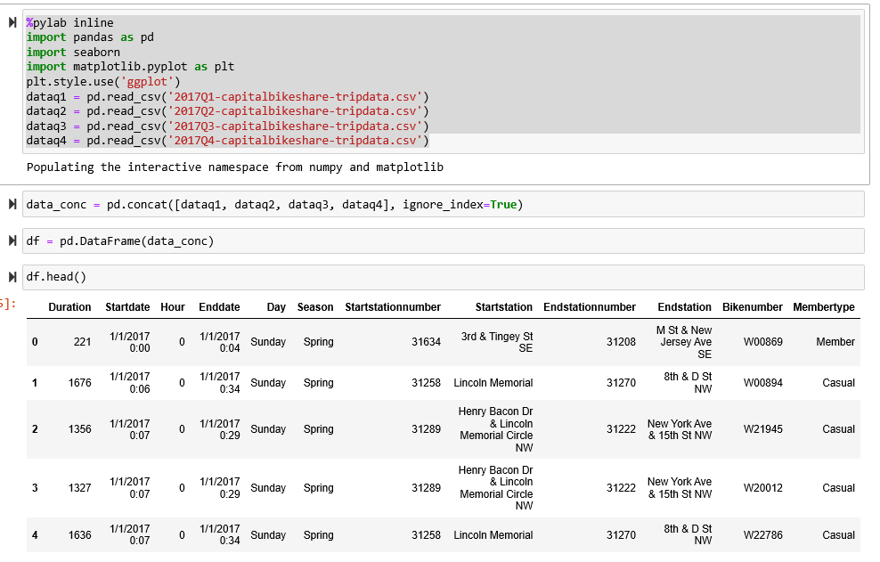
Creating the data frame for Building Training Data:

Slide 19
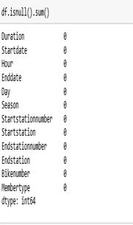
Checking the Null values in Dataset

Slide 20
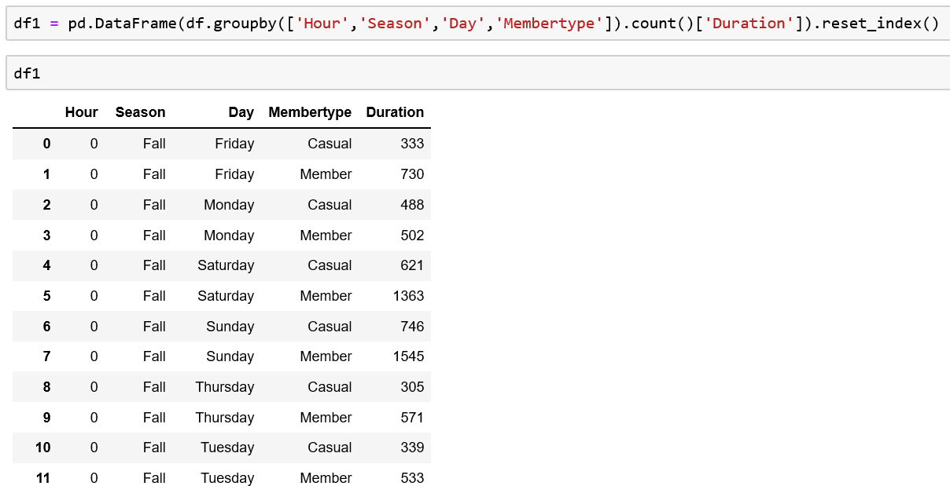
Group-by the Independent Variables:

Slide 21
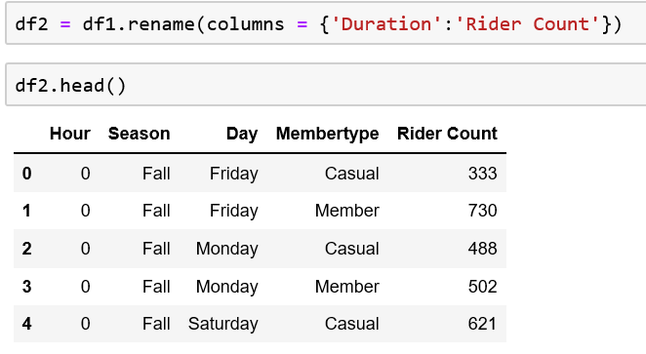
Rename the Target Variable as Rider Count:

Slide 22
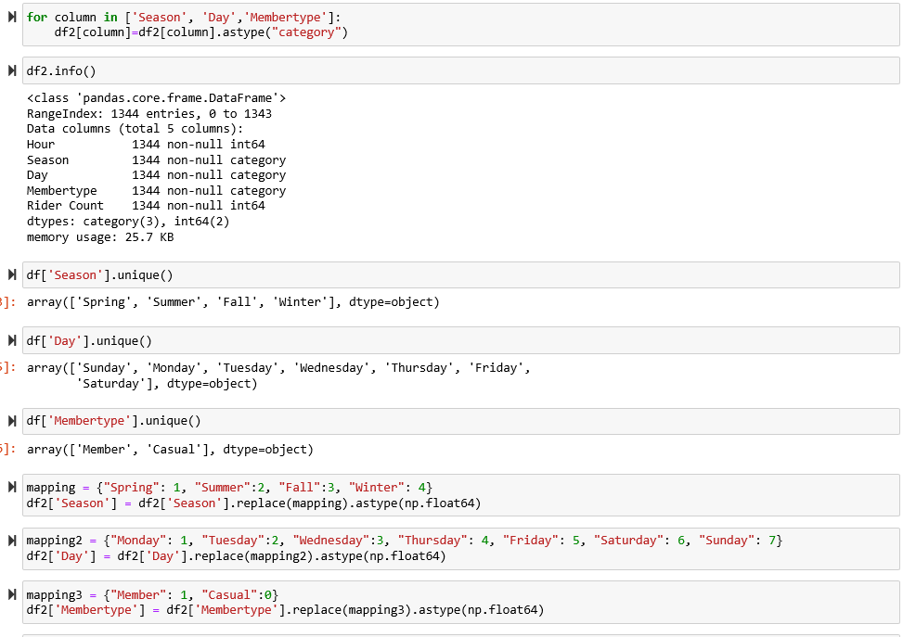
Changing Data Types to fit Training Data attributes for Modelling:

Slide 23
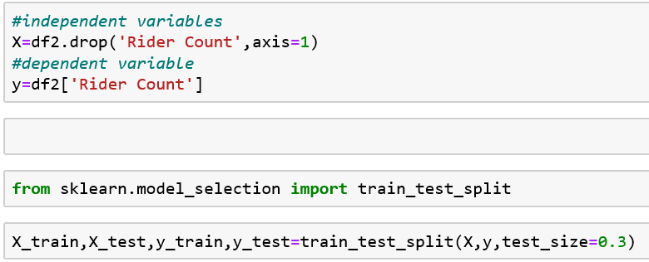
Train and Test data Splitting:

Slide 24
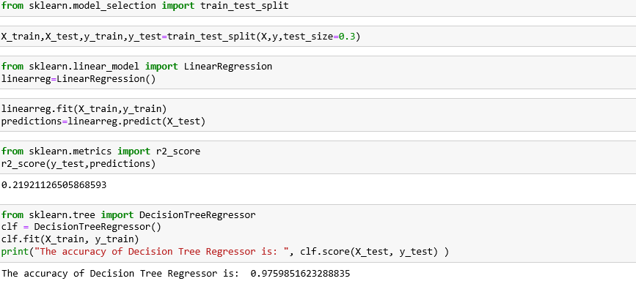
Model Accuracy Check on Testing Data:

Slide 25
References: https://data.world/sya/capital-bikeshare-trip-data https://www.capitalbikeshare.com/system-data

Slide 26
Thank You!

